Slide 1
The HBCU Connection
Shaina V. Destine – Archivist/Librarian
sdestine@iastate.edu
Pronouns: she/her/hers
Special Collections & University Archives, Parks Library

Slide 2
Agenda
Community Agreements / Definitions
Background
Purpose
Findings
Profiles
What’s next?
Questions & Answers

Slide 3
Community Agreements
The use of the words “negro” and “colored”
Questions are welcome
Historical context is important
Definitions:
HBCU = Historically Black College or University
PWI = Predominantly White Institution

Slide 4
Background
What?
  Online exhibit (in progress)
Who?
  ISU Black Alumni 1900-1950
Where?
  Anyone who attended ISU for any degree
Why?
  No or very limited representation in ISU history
How?
  Informal and formal research
Notes:
-The HBCU Connection is an online exhibit meant to aggregate the history of ISU’s black alumni from 1900-1950.
-The only requirement is that they attended ISU and were granted a degree then went on to work at an HBCU

Slide 5
Purpose
Inclusion of students of color into ISU’s history
Template for other POC digital exhibits
Collaboration with HBCUs
Research
Marketing
Notes:
-Inclusion of students of color into ISU’s history
I knew that more than two black people had come to Iowa State but there were no records of them or very little available
-Template for other POC collections
My hope is that we can do similar exhibits for other people left out of the archives
-It allows for a collaboration with HBCUs nationwide which benefits both parties
HBCUs have notoriously limited resources so this gives them more exposure while simultaneously diversifying our own collection
Also it opens communication with folks that we have never been in communication with
-Research
My hope is that it will be an exhibit that can get fuller over time; info can be added as it’s uncovered
Draw more researchers to our online space
-Marketing
Maybe draw more POC to ISU – students, faculty and staff

Slide 6
Findings
Twenty-eight (28) Black alumni went on to have high-ranking and/or high-impact positions at one (1) or more HBCUs during their careers
Most archival records are scattered among a number of institutions – unprocessed or inaccessible
  Creative research is key
There is a willingness among the HBCUs to work with PWIs but also a historic distrust
Notes:
-This project started out with 14 Black Alumni. Over the course of months, I’ve uncovered more people through word of mouth or just by accident
-Many folks have their papers and a number of institutions. Many HBCUs don’t have the resources to process their backlog to even know what they have there
Creative research was key. I looked at old yearbooks, obituaries, magazine articles, commencement notifications, called archivists from all of these schools, historical societies, read dissertations and read blogs – all to piece together people’s lives.
-There was a willingness among HBCUs to work with Iowa State once I explained who I was and what I was doing with their information. They were happy to give me access to their records as well as permission to use it for this exhibit since I was crediting them and with the knowledge that it wouldn’t be coopted and the emphasis would be on the HBCU part of their history.

Slide 7
Featured HBCUs
  Virginia State University
  Tuskegee University
  Florida Agricultural & Mechanical University
  Prairie View Agricultural & Mechanical University
  Kentucky State University
  Tennessee State University
  Alabama State University
  Fisk University
  Howard University
  Langston University
Fort Valley State University
University of Arkansas at Pine Bluff
North Carolina A&T State University
Texas College
Winston Salem State University
North Carolina Central University
Alcorn State University
Huston-Tillotson University
Rust College
Southern University
Okolona College
Notes:
-Here they are listed by their current names. In the profiles that will be featured on the website and the following slides, I have used the name of the institutions as they were known when the individual was there
-21 total – many people worked at more than one

Slide 8
Profiles
Anna Elnora Owens (M.S. Home Economics, 1932)
  Asst. Professor of Home Economics (~1942)
  Supervisor of Directed Teaching in the Division of Home Econ, Virginia State College for Negroes
  Owens building at VSU named after her father (see below)
George Washington Owens
  Worked at ISC’s creamery; excelled so much that he was contacted by Booker T. Washington (founder of Tuskegee) to be head of Agriculture under George Washington Carver
  Moved on to VSU ten years later to establish their agriculture program; ended up establishing vocational agriculture programs all over Virginia
Benjamin L Perry, Jr (M.S. Agricultural Economics, 1942)
  President (1968-1977), Florida A&M
Geneva Crouch (M.S. Home Economics Ed, 1931)
  Instructor of Clothing and Handicraft at Prairie View State Normal & Industrial
Notes:
-These are brief descriptions of the people and their accomplishments
-George Washington Owens is in italics because though he didn’t receive a degree from ISU, he worked at the ISU creamery and excelled so much that Booker T. Washington recruited him to be the Head of Ag at Tuskegee. He then moved to VSU to establish their Ag programs. There is a building at VSU named after him.

Slide 9
Profiles
Cecile Hoover Edwards (Ph.D. Foods & Nutrition, 1950)
  Faculty and Head of Home Economics department (1956-1971), North Carolina A&T
  Professor of Human Nutrition and Continuing Education (1971), Dean of Schools of Ecology, Continuing Education, Pharmacy, Nursing and Allied Health, Established a doctoral program in Nutrition, Howard University
Walker Milan Davis (M.S. Economics & Sociology, 1933)
  Visiting Professor of Sociology, Rust College
  Professor of Social Science, Fisk
  Dean and Registrar(1933-1940), President (1943), Okolona College
Glee J. Willoughby (M.S. Home Economics Ed, 1935)
  Instructor of Home Economics (~1938), Winston Salem State
Grace Mae Sullivan (M.S. Home Economics Ed, 1932)
  Instructor (~1930) and Head (~1935) of Home Economics department, Kentucky State
Notes:
We will talk more about Dr. Edwards at a later slide

Slide 10
Profiles
Addie Lee Ross (M.S. Home Economics Ed, 1932)
  Faculty, Home Economics, Prairie View State Normal & Industrial (~1932)
Mary Evelyn V Edwards Hunter (M.S. Home Economics, 1931)
  Possibly the first woman of African descent to receive a Master’s degree at ISU
  Founded and was the Director of Home Economics program (1931); established a Home Economics graduate program, Virginia State College for Negroes
Rufus B Atwood (B.S. Agricultural Education, 1923)
  Awarded a Bronze Star for bravery while actively under enemy fire
  Director of Agriculture, Acting President, Prairie View N&I
  President (1929-1962), Kentucky State Industrial College for Colored Persons
Walter T Daniels (M.S. Civil Engineering, 1932; Ph.D. Engineering, 1942)
  First African American to receive a PhD in Engineering at Iowa State
  Professor of Mechanic Arts, Prairie View A&M
  Professor of Physics (1934), Negro Agricultural and Technical College of NC
Notes:
Rufus Atwood – He trained with the training camp for black officers in Des Moines

Slide 11
Profiles
Walter H Dabney (M.S. Highways, 1933)
  Professor of Civil Engineering and the Dean of the School of Engineering, Tennessee State
Nathaniel O Calloway (B.S. Chemistry, 1930; Ph.D. Chemistry, 1933)
  Faculty (~1933), Chemistry, Fisk
Frederick D. Patterson (DVM, 1923, M.S. Agriculture, 1927)
  Professor of Veterinary Medicine, Head of Veterinary Division, and Director of Agriculture, Virginia State
Walter G Madison Sr (M.S. Engineering)
  Constructed a significant portion of Ames sewer system; Wrote a part of Iowa Plumbing Code
  Successfully sued an Ames restaurant on Main Street for discrimination and won (1922)
  Professor of Engineering (~1930), Howard
Notes:
-Dr. Patterson will be talked about in a later slide
-Walter G Madison Sr – his son, was possibly the first African American child born in Ames. He also came to ISU for an engineering degree as well and went into the plumbing business with his dad

Slide 12
Profiles
Edward B Evans, Sr. (DVM, 1918)
  Professor of Veterinary Science (1916), Director of Athletics, Acting Registrar, Director of Arts & Sciences, Principal/President and President Emeritus, Prairie View N&I
  Building named after him on PVAMU Campus
Clara Williams Woods (M.S. Home Economics Ed, 1937)
  Professor, Arkansas Agricultural, Mechanical & Normal
Kanata Editha Rodgers (M.S. Home Economics Ed, 1937)
  Faculty of Agriculture and Home Economics (~1937), Southern
Samuel P Massie Jr (Ph.D. Organic Chemistry)
  Associate Professor and Acting Head of Math and Physics department, Arkansas AM&N
  Professor (1947) and Chair of Chemistry department, Fisk
  Professor and Chair of Dept of Chemistry, Langston
  Professor and Chair of Pharmaceutical Chemistry department, Howard
  President (1963), North Carolina Central
Notes:
Dr. Massie will also be discussed in a later slide

Slide 13
Profiles
Harry J Romm (B.S. Zoology, 1930; M.S. Entomology, 1934; Ph.D. Plant Morphology, 1946)
  Head of Dept of Biology at Tuskegee
John L Lockett (B.S. Agronomy, 1923; M.S. Agronomy, 1928)
  Director of School of Agriculture, Professor of Agronomy, Virginia State Colelge for Negroes
  Building named after him at Virginia State
Jesse Jarue Mark (M.S. Agriculture, 1931; Ph.D. Botany, 1935)
  First person of African descent to receive a Ph.D. in Botany (in the United States)
  Instructor (~1931), Kentucky State Industrial College
Willie Lee Campbell Glass (M.S. Home Economics Ed, 1933)
  Head of Home Economics Dept at Texas College
  Helped to desegregate Texas schools
  Inducted into the Texas Hall of Fame
Notes:
Jesse Jarue Mark – Hard to figure out. His name was misspelled and he was mistaken as a female student for decades

Slide 14
Profiles
Irma Handy Dawkins (M.S. Home Economics Ed, 1944)
  Professor of Clothing, Tuskegee
Marion Richards Myles (Ph.D. Botany, 1945)
  Professor at Tennessee State, Fort Valley State and Alcorn State
  First African American faculty member at the University of Mississippi Medical School (Assistant Professor of Pharmacology and Research – 1965)
Ada DeBlanc-Yerwood (M.S. Home Ec Ed & Child Dev, 1936)
  Head of Home Economics Dept at Tillotson
  Co-founder of W.H. Passon Historical Society and George Washington Carver Museum
  Inducted into the Texas Women’s Hall of Fame
Willa J Ewing (B.S. Botany, 1926; M.S. Horticulture, 1935)
  Head of Biology department, Alabama State
Notes:
Dr. Myles was featured in a 1965 edition of Jet magazine- scandal with her hiring

Slide 15
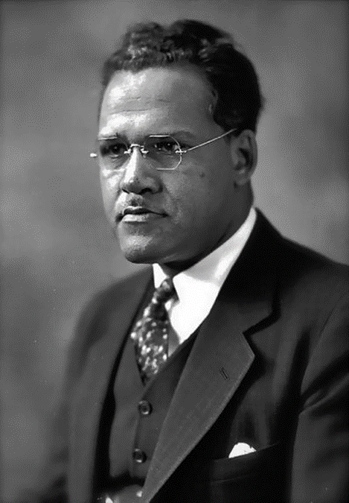

Dr. Frederick D. Patterson (DVM ‘23, MS ‘27)
Taught and was the Director of Agriculture at Virginia State College
Director of Agriculture then President of Tuskegee Institute
  Founded the School of Vet Med at Tuskegee
Founded the UNCF
Notes:
See notes

Slide 16
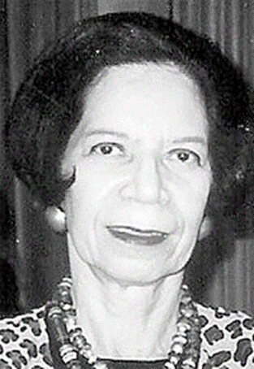
Dr. Cecile Hoover Edwards (Ph.D. ‘50)
Faculty and Head of Foods & Nutrition at Tuskegee
Faculty and Head of Home Economics at Negro A&T College of North Carolina
Career at Howard
  Professor
  Dean, School of Human Ecology
  Dean, School of Continuing Education
  Dean, School of Pharmacy, Nursing and Allied Health Science
  Established the doctoral program in Nutrition
Notes:
See notes

Slide 17
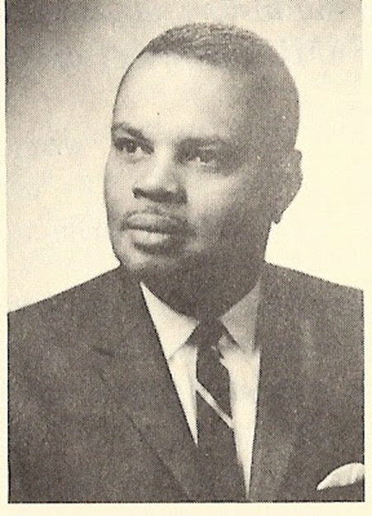
Dr. Benjamin L. Perry Jr. (MS ‘42)
President of FAMU from 1968-1977
Founded the Business and Architectural programs at FAMU
His father, Ben Perry Sr., was the Dean of the School of Agriculture at FAMU
  Street named after him/them in Tallahassee
Notes:
See notes

Slide 18
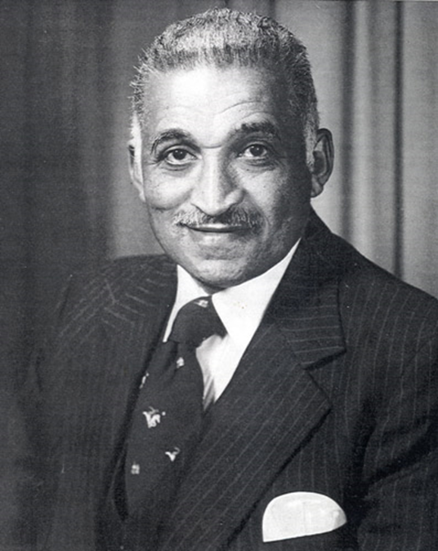
Dr. Samuel Proctor Massie, Jr. (Ph.D. ‘46)
Faculty at Arkansas AM&N, Fisk, Langston and Howard
Lectured at Dilliard, Virginia State, and University of Maryland – Eastern Shore
President of North Carolina College at Durham
Notes:
See notes

Slide 19
What’s next?
A fuller, easy-to-access, sleekly-designed website
The information belongs to the communities it features
Groundwork for similar exhibits featuring other communities
Notes:
-An easy to use, accessible, sleekly-designed website that draws users
-Ensuring that the website is a tribute that belongs to the communities that it features
I envision researchers from HBCUs who want to access the things we do have, not having to pay for it or maybe us having some sort of collaborative processing initiative or archival internships for HBCU students
-Groundwork for other exhibits like one for Latinx folks that can be linked to Hispanic-serving institutions

Slide 20
Questions?
Shaina V. Destine sdestine@iastate.edu

