Slide 1
Who Am I?
U ST 205 Final Narrative
Marcus Herrera

Slide 2
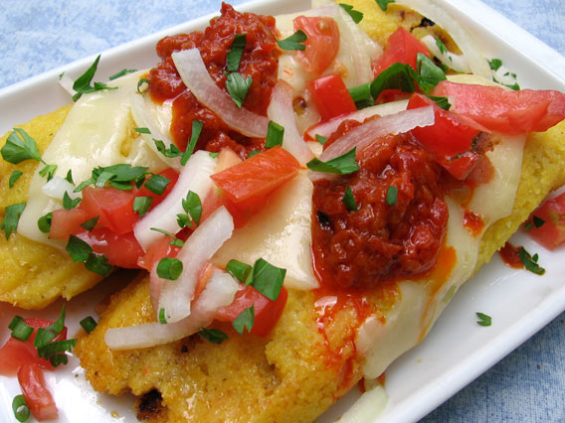

Mexican

Slide 3

Spanish

Slide 4
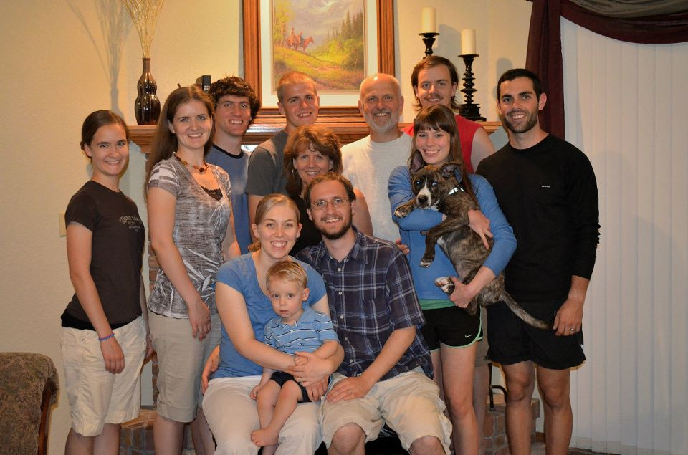
German

Slide 5

Texan

Slide 6

Christian

Slide 7

Student

Slide 8
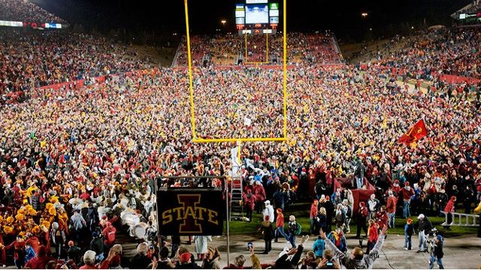
Social

Slide 9

Hard Working

Slide 10

Creative

Slide 11

Engineer

