Slide 1


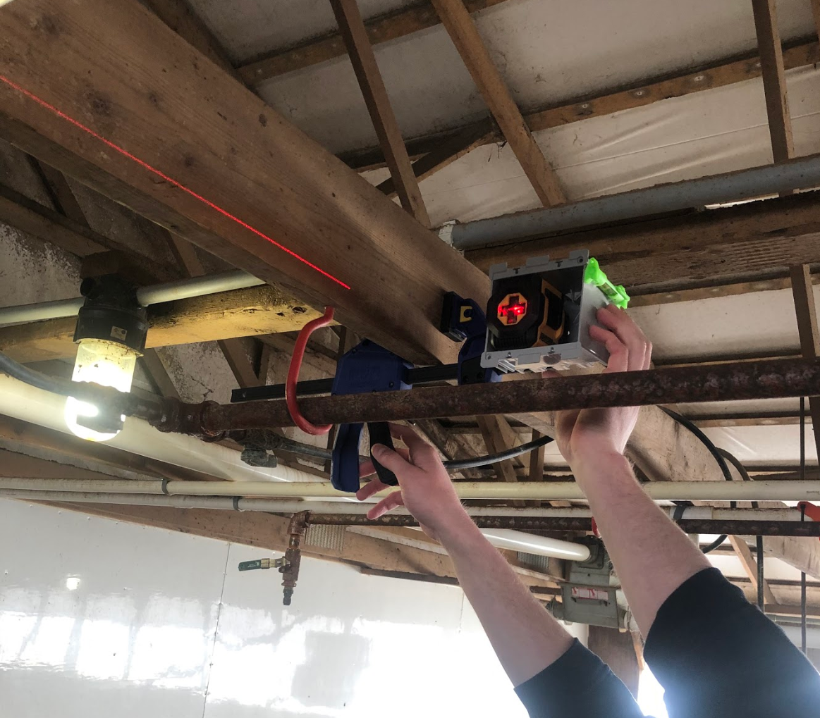
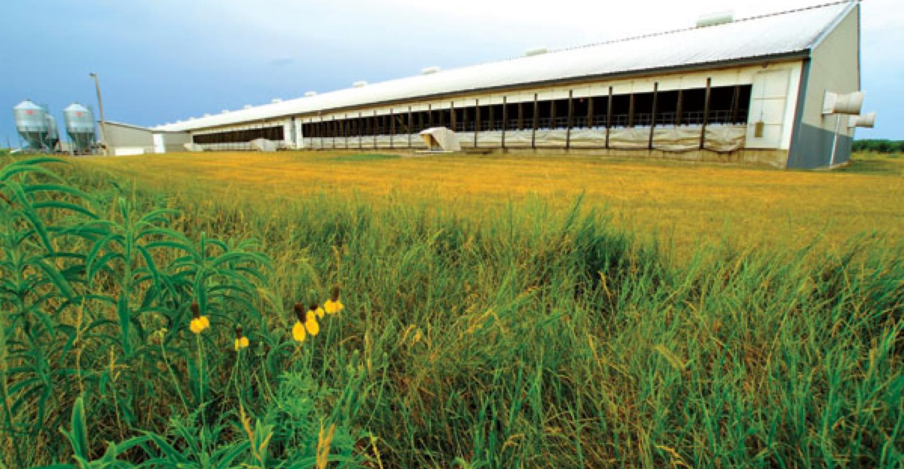
Team Members:
Brady Lindquist - Communications and Development
John Schnack - Team Leader
Smithfield Aging Facility Project

Slide 2
Agenda
Problem Statement & Scope
Products & Deliverables
Inspection Document & Reinforcement Recommendations
Truss Chord Deflection Test Training Video & SOP
Sustainability and Smithfield Moving Forward
Smithfield Aging Facilities

Slide 3
Problem Statement
Predicting natural ventilated facility life expectancy in the NW 1⁄4 of Iowa
Smithfield Aging Facilities

Slide 4
Scope
  Develop timeline for the estimated structural useful life of a Murphy Model 1100 pork production facility for NW Iowa
  Identify structural failure points by type and precedence, include recommendations for alternative reinforcement or repair methods
  Provide time and cost driven maintenance template for Smithfield comparing cost of repair vs. replacement of trusses and other failure components
Smithfield Aging Facilities

Slide 5
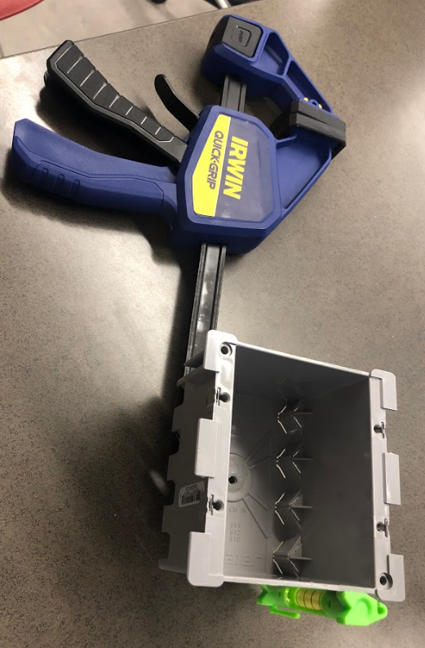
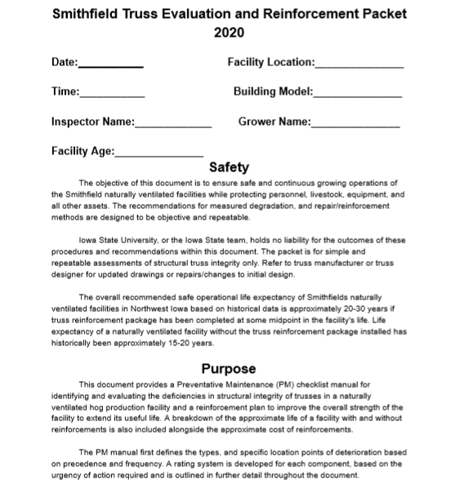
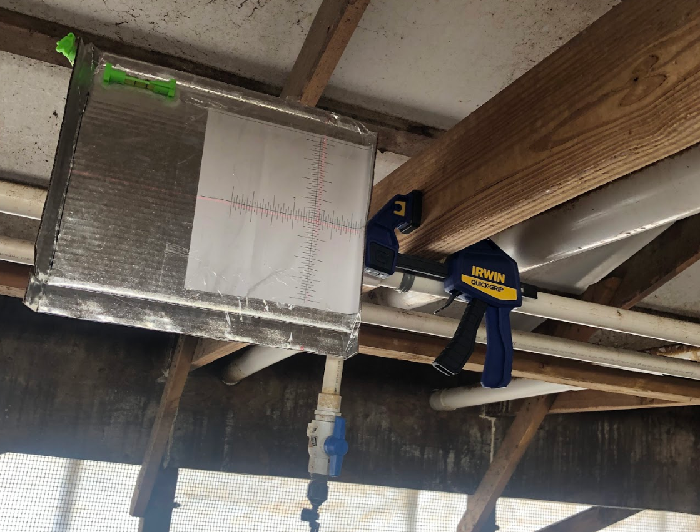
Products & Deliverables
Detailed Final Project Report and Graphical Poster
Video Presentation Summary of Project
All Inclusive Preventative Maintenance Inspection Document
Smithfield Aging Facilities

Slide 6
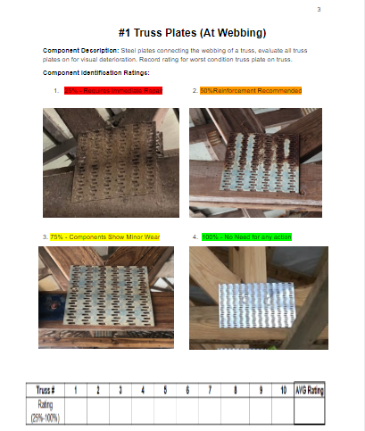
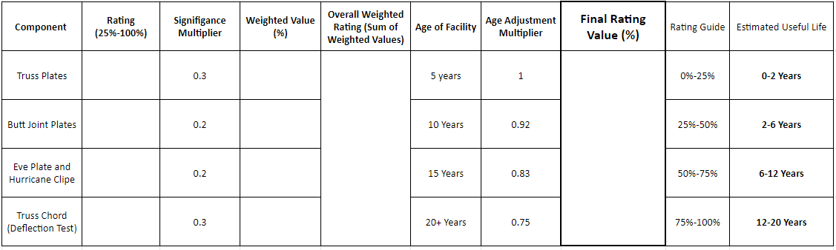
Preventative Maintenance Inspection Document
Link to full PM document
https://docs.google.com/document/d/12PXP_Chn1uQ_Urn0a0eVzOBZVPwhQefiF4exqPCM0Rc/edit?usp=sharing
Overall Truss Structural Rating Table
Smithfield Aging Facilities

Slide 7
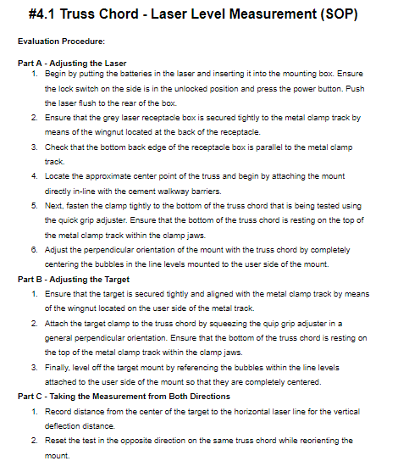
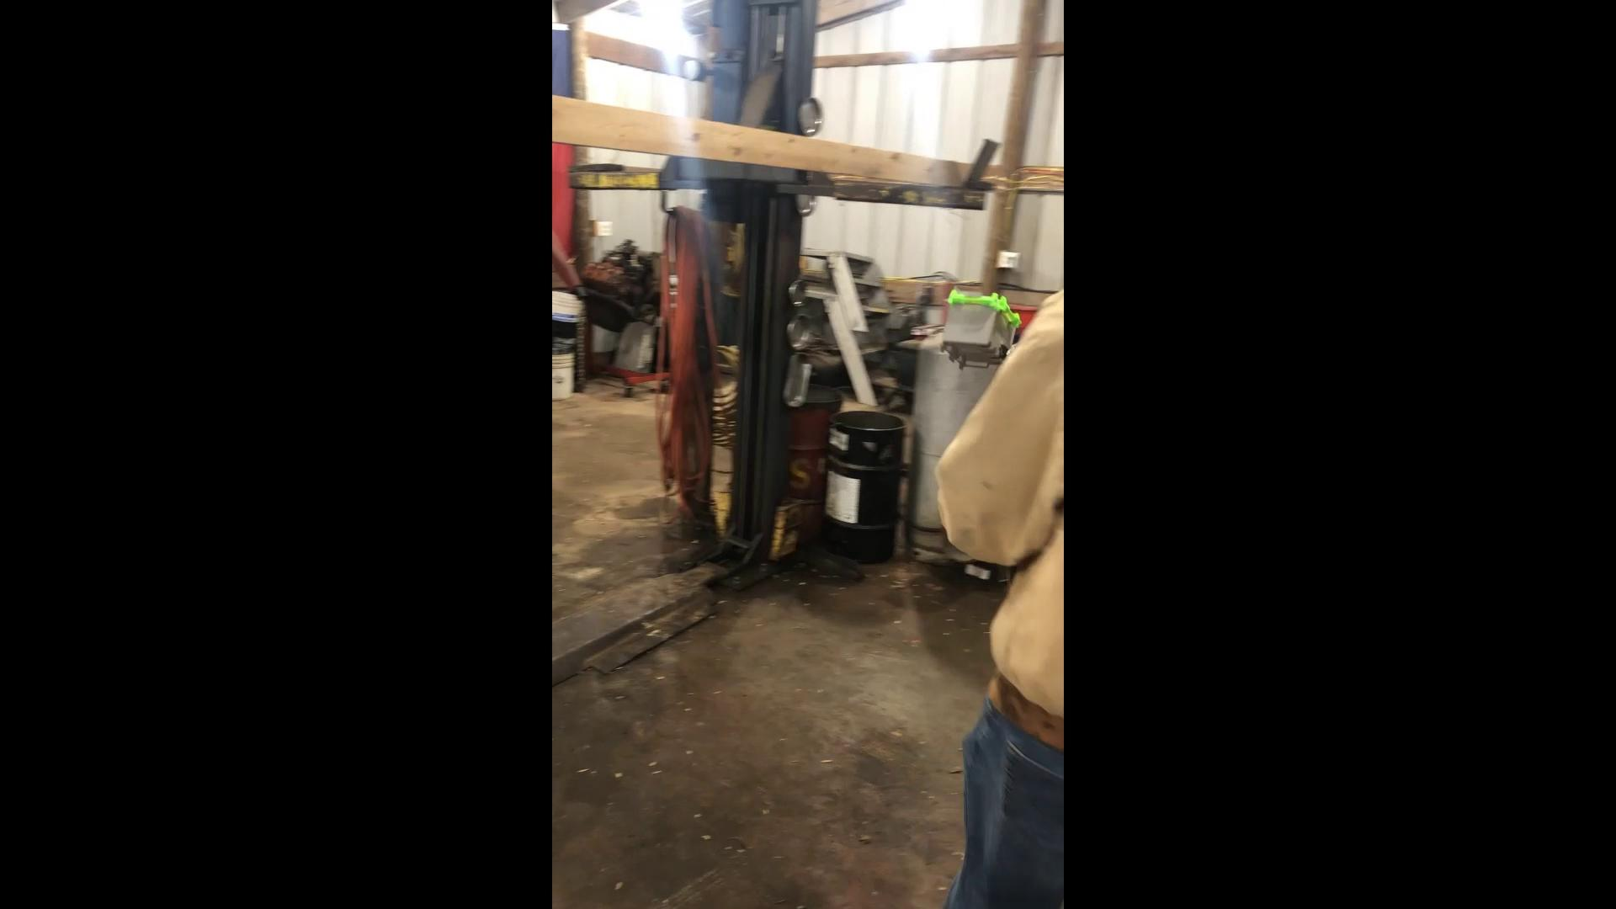
Truss Chord Deflection Test Training Video & SOP
Smithfield Aging Facilities

Slide 8

Sustainability and Smithfield Moving Forward
Objective and repeatable tests that generate estimated useful life of facilities
Provides growers with information to make well informed decisions
Leads to an increase in structural awareness and more sustainable production for Smithfield growers
Smithfield Aging Facilities

Slide 9
Questions For The Team
Please feel free to contact the ISU capstone team with any questions regarding the Smithfield Aging Facilities Project.
Note: References are within the PM document and final report
Brady Lundquist - Communications and Development
Phone: 715-221-7549
Email: Bradyl@iastate.edu
John Schnack - Team Leader
Phone: 402-630-4433
Email: jschnack30@gmail.com
Smithfield Aging Facilities

