Slide 1
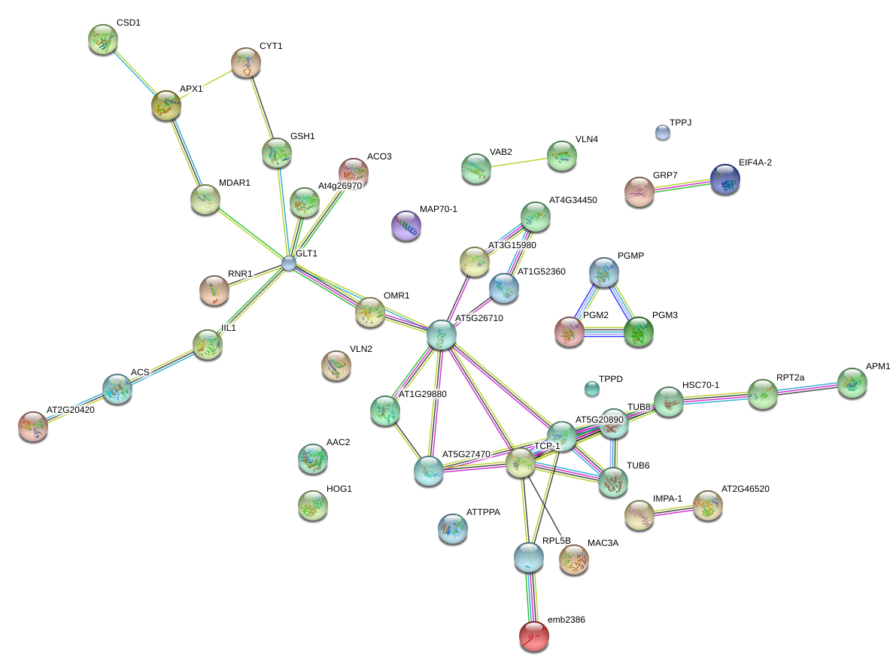
Supplemental File 6.
Notes:
Supplemental File 6. Identification of gene networks unique to herbicide resistance associated with the GO terms gluconeogenesis, cytoskeleton organization and threhalose biosynthesis. we took advantage of the waterhemp annotation platform to identify the best Arabidopsis homologs for 91 unique resistant DETs associated with these GO terms. Forty-five unique Arabidopsis identifiers were then submitted to the String-db website (http://string-db.org) to identify potential gene networks. Thirty eight of the 45 unique Arabidopsis identifiers were present in the database and could be visualized. Line linking proteins indicate connections between proteins. Different colored lines indicate different data sources.

