Slide 1
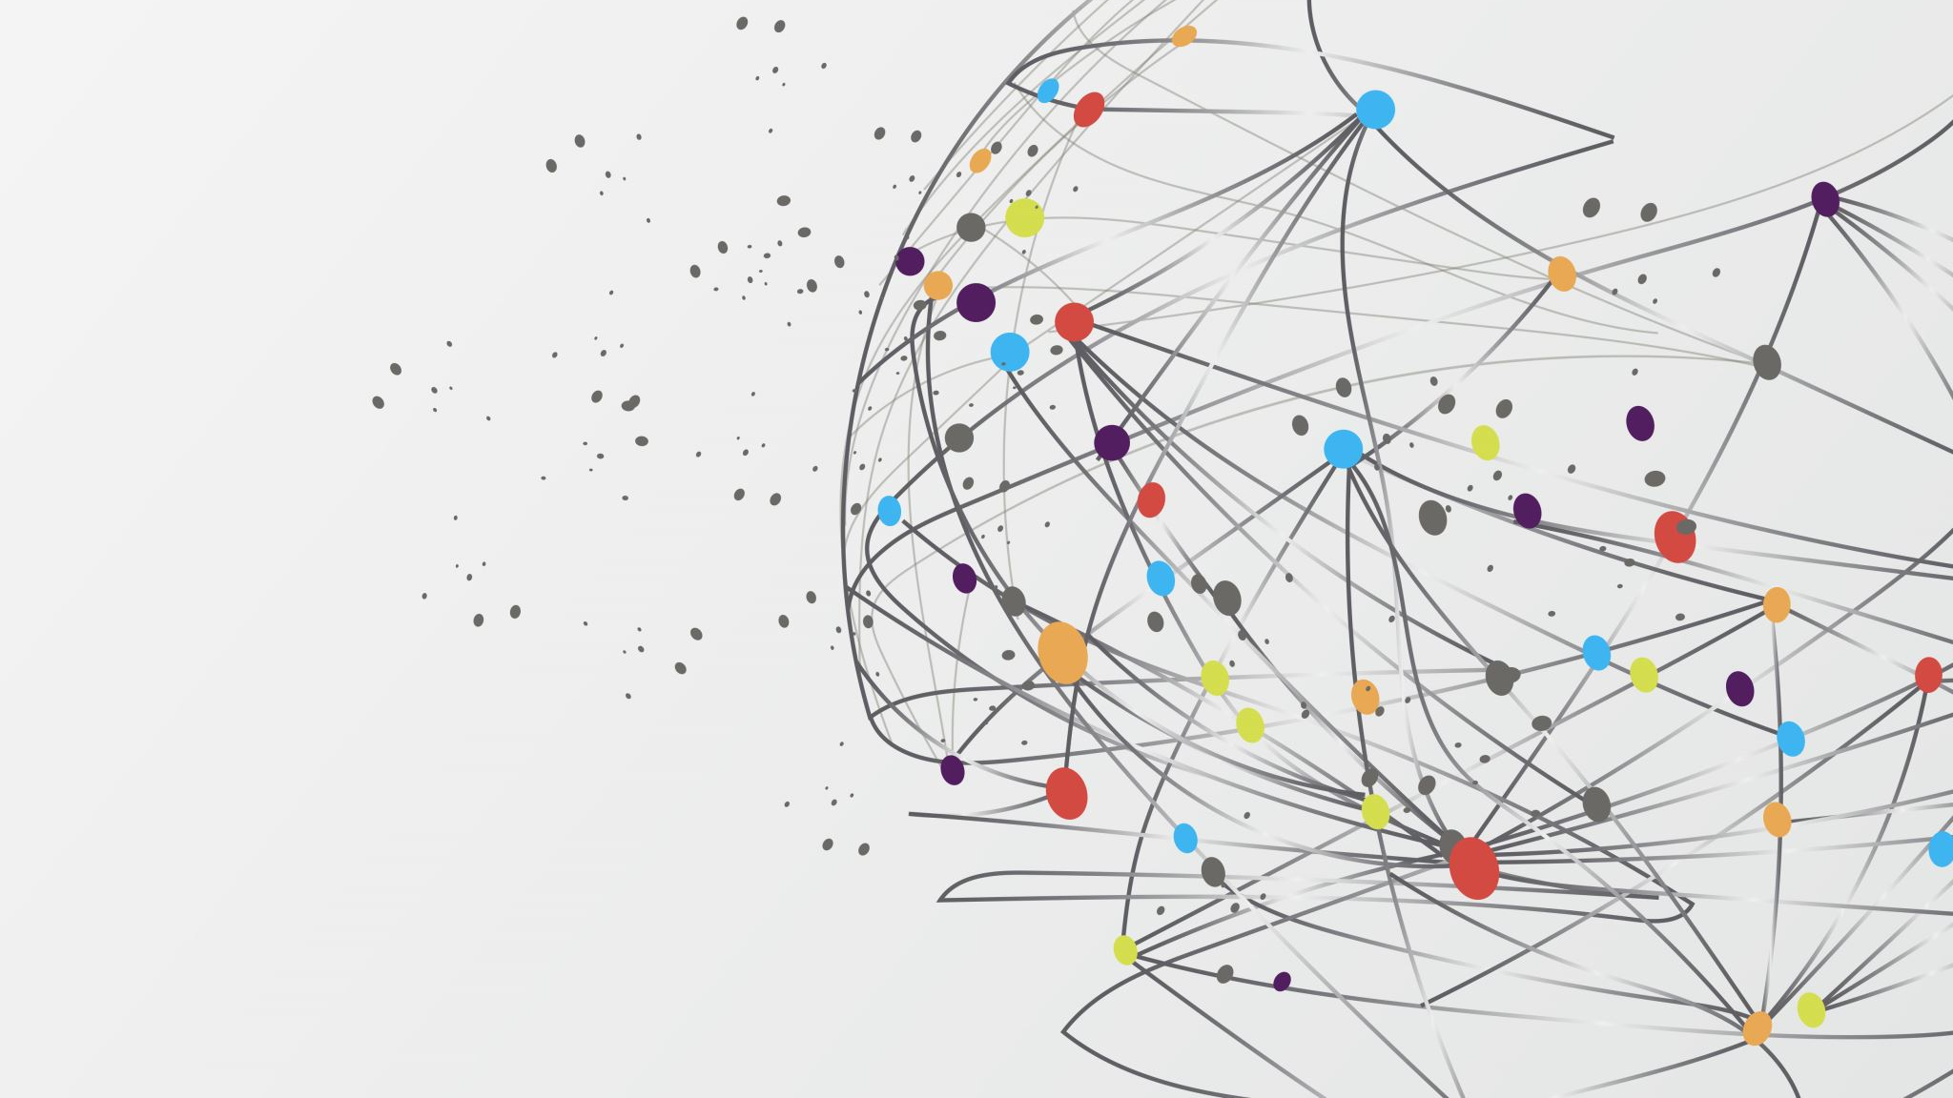
Epilepsy: an uncurable disease?
Assua Phongsavanh

Slide 2
What is epilepsy?
Chronic neurological disorder
  ~ 5.1 million people in the US have a history of epilepsy
  ~ 3.4 million people in the US have active epilepsy
Symptoms vary
  Most common is a seizure
Causes
Treatments

Slide 3
epileptogenesis
The development of epilepsy
Understanding epileptogenesis helps us to find a cure
  Ion-channel targets
  Alternative pathways

Slide 4
Role of glial cells
Supportive function
Types
  Astrocytes
  Microglial cells

Slide 5
methods
Rat model
  Epileptogenesis was induced with chemical agent
Administration of saracatinib
Tissue collection
  Immunohistochemistry
  Imaging
Data collection

Slide 6
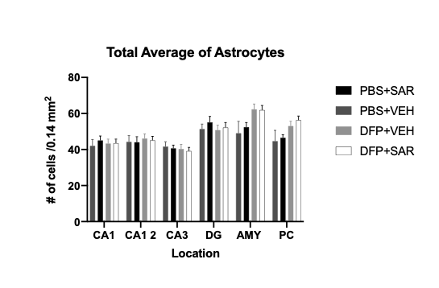
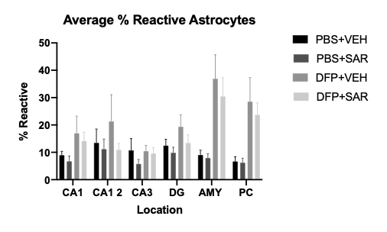
Results

Slide 7
results
Average total astrocytes
  Highest astrocyte count in AMY
  Lowest astrocyte count in CA3
Percent reactive astrocytes
  Largest reactive astrocytes percentage in AMY
  Smallest reactive astrocyte percentage in CA3

Slide 8
discussion
Saracatinib use
Early administration

Slide 9
Other studies
Previous studies
  Fyn-PKC
  1400W
Future studies

Slide 10
citations
Division of Population Health (Ed.). (2020, September 30). Frequently Asked Questions About Epilepsy. Retrieved January 5, 2021, from https://www.cdc.gov/epilepsy/about/faq.htm#What%20is%20epilepsy?%20What%20is%20a%20seizure?
Purves D, Augustine GJ, Fitzpatrick D, et al., editors. Neuroscience. 2nd edition. Sunderland (MA): Sinauer Associates; 2001. Neuroglial Cells. Available from: https://www.ncbi.nlm.nih.gov/books/NBK10869/
Purves D, Augustine GJ, Fitzpatrick D, et al., editors. Neuroscience. 2nd edition. Sunderland (MA): Sinauer Associates; 2001. Neuroglial Cells. Available from: https://www.ncbi.nlm.nih.gov/books/NBK10869/
Putra M, Sharma S, Gage M, et al. Inducible nitric oxide synthase inhibitor, 1400W, mitigates DFP-induced long-term neurotoxicity in the rat model. Neurobiol Dis. 2020;133:104443. doi:10.1016/j.nbd.2019.03.031
Schachter, A. (2014, March 19). What is a Seizure? Retrieved January 5, 2021, from https://www.epilepsy.com/learn/about-epilepsy-basics/what-seizure
Sharma S, Carlson S, Puttachary S, et al. Role of the Fyn-PKCδ signaling in SE-induced neuroinflammation and epileptogenesis in experimental models of temporal lobe epilepsy. Neurobiol Dis. 2018;110:102-121. doi:10.1016/j.nbd.2017.11.008

