Slide 1
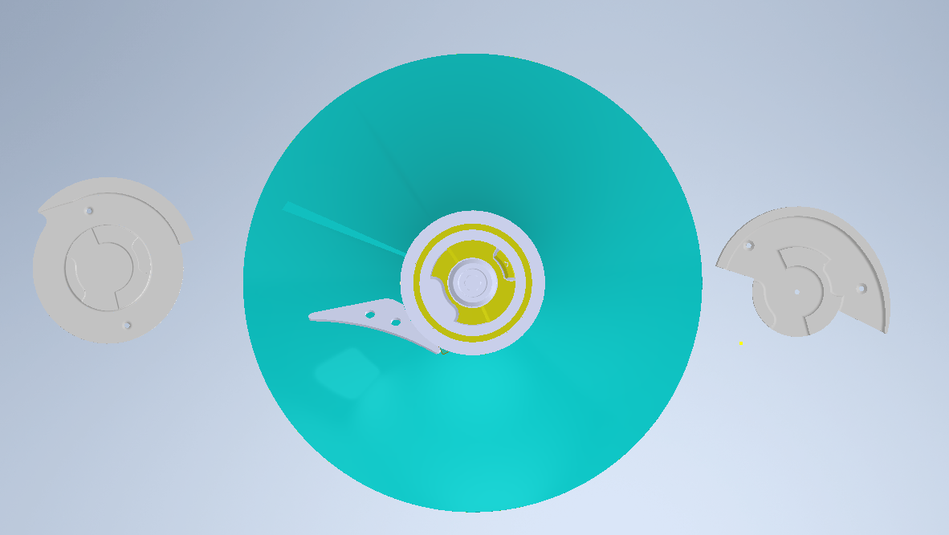
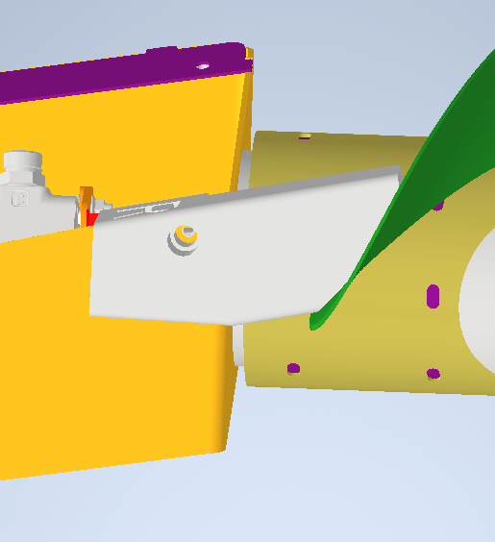
    TSM Technology Capstone
    *Instructors: mea1@iastate.edu; koziel@iastate.edu
Department of Agricultural and Biosystems Engineering
Aaron Drummer, Scott Hoy, Brayden Jacobs, Cooper Tracy, Michael E. Anderson*, Jacek A. Koziel*
John Deere Harvester Works Manufacturing Process Improvement
Client: John Deere Harvester Works, East Moline, Illinois
Problem Statement
Auger installation for folding combine heads can be done incorrectly
When done incorrectly, costs John Deere and customer via down time and labor costs
Auger Alignment Tools
Methods/Approach
Major activities:
  Understand current manufacturing process (virtually and in-person)
  Develop a tool or additional step in the process that will eliminate the possibility of installing the auger incorrectly
Analyses: Failures per Machine, Defect per Machine, No Fault Forward data
Software: 3D printer for prototyping, Autodesk Inventor for designing
Coupler Alignment Go Gauge
Corn Head
Sockets onto coupler and acts as a go-no-go gauge for correct alignment for the auger splines
Objective
Error proof auger installation by making it nearly impossible for auger to be installed in incorrect orientation
Design and implement a useful and reliable solution to avoid the problem
Major Deliverables
Client Contract, Project Agreements, Statement of Work, Project Poster, Initial Tool Design, Final Tool Design, Final Report, and Delivery of Solution
Measures of success (100% improvement in FPM, DPM, and NFF)
Constraints
Budget: Estimated $300 in travel costs covered by ISU students
Timeline: Visits limited due to strike; project needed within 4 months
Materials: 3D printer and filament, possibly Delrin
Requirements: Needs to be robust, tool needs to be useful, solution should preserve TAKT time
Criteria to be met: Tool must make installing the auger in the incorrect orientation impossible
Coupler Alignment Go Gauge
Hinged Draper
Recommendations
Cornhead Product Line: We recommend printing our prototype, testing it, and making changes to it as needed
Hinged Draper Product Line: We recommend inscribing text on the tool, including its use in the OMS, and adding a torque step to JDAAT for the tool
References
“Ria Factory, John Deere Explore Additive Manufacturing Collaboration.” DVIDS, https://www.dvidshub.net/image/6213372/ria-factory-john-deere-explore-additive-manufacturing-collaboration
“Additive Manufacturing for Rapid Tooling.” Rapid PSI, 10 Feb. 2022, https://rapidpsi.com/rapid-tooling/
“Key Design Considerations for 3D Printing.” Hubs, https://www.hubs.com/knowledge-base/key-design-considerations-3d-printing/
Scope
Error proof the auger installation process for the Corn Head and HD draper is in scope
Redesigns are out of scope
Bolts onto mount, and allows for proper spline direction
Acknowledgements: Authors are grateful to Sean Robinson, Nicholis Fitzpatrick, Tim Scholle, and David Korczak for the opportunity to work on this project. Project was co-funded by the differential tuition.

