Slide 1
If you’d like to participate in
Kahoot (a free online quiz game),
take out your phone and visit:
kahoot.it
Game Code: 2850951

Slide 2
Is Anyone Listening?
Starting a Conversation About African American Males’ Success in Higher Education
Group Members: Ben Dralle, Nayely Hurtado, Emily Leaverton, Lisa Saenthavy
Team Leader: Dr. Lequetia Ancar
Notes:
Lisa’s slide
(2 minutes)
Everyone shares name/major
Overview of ISCORE scholar program

Slide 3
Mission Statement
To bring awareness to current research on African American males’ success in higher education and highlight the application of this research to our campus
Notes:
Emily

Slide 4
Outline
Kahoot!
Review of Iowa State University Demographic Data
  Undergraduate Enrollment Statistics
  Graduation Rates of Pertinent Identities
Literature Review - Factors Affecting African American Males in Higher Ed
  Four Factors - Supportive Relationships, Ecological Perspective, Identity Development and Involvement, Academic Self-Efficacy
Survey Information
  Overview and Results
Solutions and Suggestions
Questions and Discussion
Notes:
Ben

Slide 5

Kahoot Instructions
Take out an internet-enabled device and connect to the internet
Visit kahoot.it on your web browser and enter our game code
Create a username
Answer questions - scores are based on accuracy and speed!
Notes:
Ben

Slide 6
Review of Iowa State University Demographic Data
Notes:
Ben

Slide 7
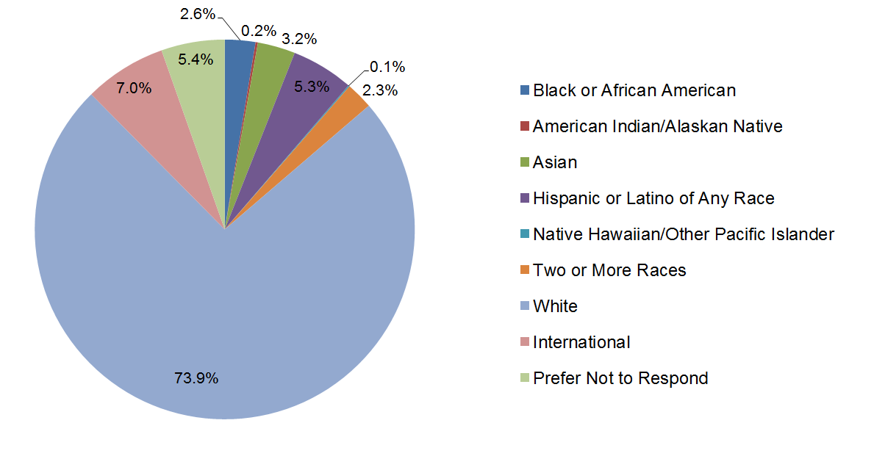
Undergraduate Enrollment by Race/Ethnicity
African American students make up approximately 2.6%
(801 students) of the undergraduate student body at Iowa State.
Notes:
Nayely
Undergraduate enrollment by race/ethnicity
African American students account for 2.6% (or 801 students) of the undergraduate body at Iowa State.
This is compared to the highest representation which is white students at 73.9%

Slide 8
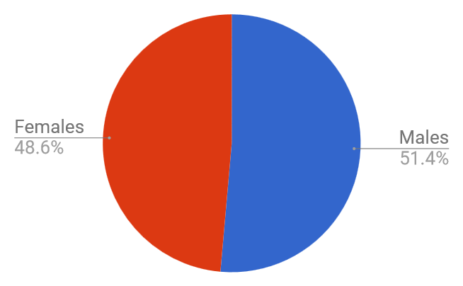
African American Undergraduate Enrollment by Gender
Male students make up 51.4% of the African American undergraduate student body at
Iowa State.
Notes:
Nayely
African American Male students make up 51.4% of the African American undergraduate student body at Iowa State.

Slide 9
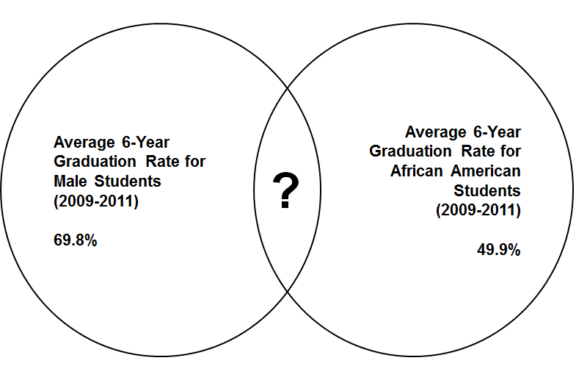
6-Year Graduation Rates of Pertinent Identities
How do these identities interact and impact students’ ability to be successful?
Notes:
Nayely
Graduation rates for majority peers...
We do not have stats that cover the 6-year graduation rates for African American Males.
We are only able to compare two of their identity groups:
Male Students and African Americans overall
6 year graduation rate for males is 69.8 %
6 year graduation rate for African American students 49.9%
How do these identities interact?
Lower:
American Indian/Alaskan Natives - 43.5%
Hawaiian/Pacific Islander - 44.4%
Higher:
Total Minority - 62.6%
Two or More Races - 64.1%
Hispanic - 67.5%
Asian - 69.4%
White - 74.8%

Slide 10
6-Year Graduation Rates (cont.)
6-Year Graduation Rate for African American Male Students at ISU (2010-2011):
48.0%
Notes:
Nayely
Average 6-year graduation rate for cohorts (groups of students) starting in 2010 and 2011 - 48.0%
Average 6-year graduation rate for African American females over the same time - 54.3%
Average 6-year graduation rate for all minority students - hovers between 55% and 65%
Average 6-year graduation rate for White students - almost always over 70%

Slide 11
Literature Review -
Factors Affecting African American Males in Higher Ed
Notes:
Emily

Slide 12

Building Supportive Relationships
“...educational outcomes of African Americans are not on par with those of their White or Asian counterparts” (Strayhorn T.L. 2008)
Largely stems from a young age
  Advanced Placement classes
  College prep courses
What we need to do to help with support?
  Work on creating these positive relationships, with both themselves and others
Notes:
Emily

Slide 13

Building Supportive Relationships (cont.)
Showing empathy to students’ experiences (Palmer, Robert T., and Young, Estelle M. 2009)
  “...enabled the professor to cultivate a trusting and supportive bond… transcended the formal role of a professor…”
Increasing the numbers of supportive persons will not help (Cuyjet, M.J. 1997)
  Create networks and meaningful relationships
Notes:
Emily

Slide 14
Ecological Perspective
Parental involvement, school climate, teachers expectations, and support systems
Positive School Environment + Positive Social Environment = Achievement
  Association with positive peers
  Parent-child discussion
  Father involvement or Male Role Model
  Church attendance
School Climate
  Harmony between students, educators, and staff
Notes:
Nayely
Ecological factors may include (Hines, 2013):
parental involvement, school climate, teachers expectations, and support systems
Positive School Environment + Positive Social Environment = Achievement
Association with positive peers
Parent-child discussion
Father involvement or Male Role Model
Link to social capital for academic and emotional success
church attendance
School Climate
Harmony between students, educators, and staff is needed for student success

Slide 15
Ecological Perspective: School-to-Prison Pipeline
Educators negative perceptions of black male youth:
  Unteachable
  Uncontrollable
Administrative punishments based off biased perceptions
  Black males= 7% of U.S. student population
  1 out of 6 black students suspended at least once in 2009-2010 compared to 1 in 20 white students (Dancy, 2014)
Underrepresentation vs. overrepresentation
  54% of black males graduate from high school in four years compared to 78% of white males.
What does this mean for black male success?
Notes:
Nayely
Role of Educational Institutions:
Educators negative perceptions of black male youth:
Unteachable
Uncontrollable
Administrative punishments are harsher based off biased perceptions
Black males= 7% of U.S. student population
1 out of 6 black students were suspended at least once in 2009-2010 compared to 1 in 20 white students (Dancy, 2014)
Underrepresented in gifted programs but overrepresented in special education and later overrepresented in prison and unemployment.
54% of black males graduate from high school in four years compared to 78% of white males.
School and Society :“Black males are naturally violent and must be contained”
“Schools attempt to prepare black boys to this reality”

Slide 16
Identity Development and Involvement
African American Identity Development - 5 Stage Process (Cross, 1991)
  Process of moving from negative or external determination to positive or internal determination
Internalization - Commitment
Afrocentric awareness
Belief - action of empowerment
Internalization
Distinguish the difference between African American and White values and behaviors
Immersion - Emersion
Declare African American values and beliefs
Encounter
Anti-Black to pro-Black belief system
Pre-encounter
Influenced by Euro-American values and ideas about ethnicity
Notes:
Lisa’s slide

Slide 17
Identity Development and Involvement
Astin Student Involvement Theory - 5 Postulates (Astin, 1984)
  Degree of cognitive and physical energy that students dedicate to their academic and extracurricular experiences
Educational policy and practice equals increase of student involvement
Personal development equals quality and quantity of student involvement
Both quantitative and qualitative feature
Occurs on a continuum
Physical and psychological energy in activities
Notes:
Lisa’s slide

Slide 18
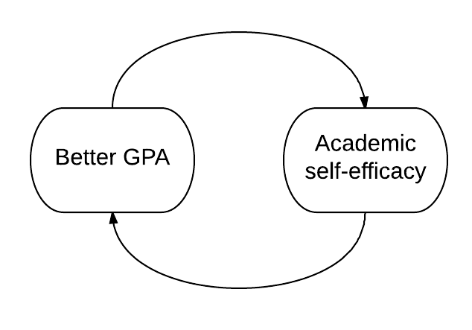
Academic Self-Efficacy
Bandura defined the general topic of self-efficacy in 1997
Acquired from four main sources:
  Progressive accomplishments (ex: academic success)
  Vicarious experiences (role models)
  Verbal messages and social persuasion leading to affirmation
  Physiological states (ex: anxiety, stress, etc.)
Reid (2013) demonstrated that:
  Academic self-efficacy significantly correlated with collegiate GPA
  Suggests improving self-efficacy is the best way to improve academic outcomes for African American males in higher education
Notes:
Ben
Note that academic self-efficacy was positively and significantly correlated with academic integration

Slide 19
Think, Pair, & Share
Notes:
Lisa
To summarize our literature review, we are going to do two “Think, Pair, and Share” activities. For each slide, you can read the content, pair up with a partner when you are ready, and then share with your partner either a question that you have or something that you found interesting from the material. Lastly, we’ll open it up to the whole group for questions and discussion. Remember - we’ll be doing this twice - once for each slide. Let’s begin with a review of our first two topics.

Slide 20
Literature Review Summary
Supportive Relationships | Ecological Perspective
The supportive relationships for African American males in higher education needs to be focused on being quality over quantity. | The environment surrounding students can play a significant role in academic success.
 | “Refers to the disturbing national trend in which children are funneled out of public schools and into juvenile and criminal justice systems (Dancy, 2014).”
Notes:
Lisa

Slide 21
Literature Review Summary (cont.)
Identity Development/Involvement | Academic Self-Efficacy
African American males enter college at varying racial identity levels; it’s necessary to determine this level early to help maximize their involvement on campus and produce a more positive outcome. | Academic self-efficacy can be acquired from a number of sources, and it has a strong effect on academic outcomes for African American males.
Notes:
Lisa

Slide 22
Survey Information -
Overview and Results
Notes:
Emily

Slide 23
Survey Limitations
Only a sample size of the students on campus
  23 responses = 4.84% response rate
  Does not represent the entire undergrad African American male population - don’t generalize the results!
Those who participated are students who tend to be more engaged
  Resulting in skewed results
Miscommunication of what the survey is about and its intentions
  Received a couple questions in response to the survey email link
Notes:
Emily

Slide 24
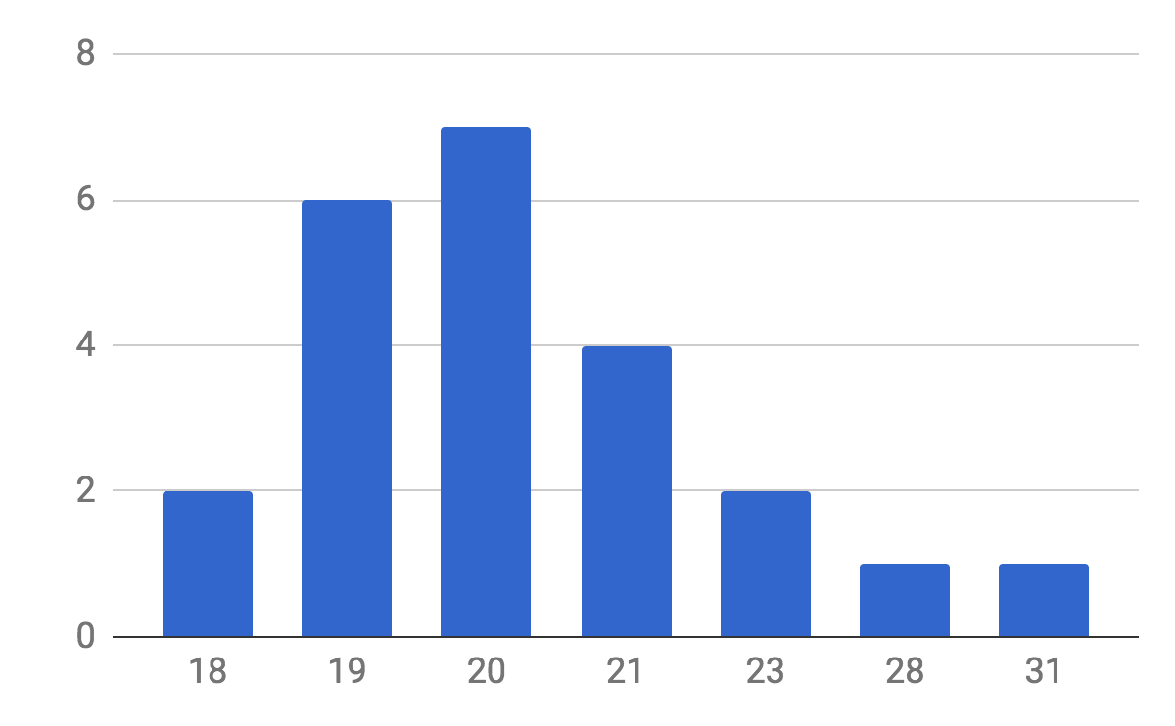
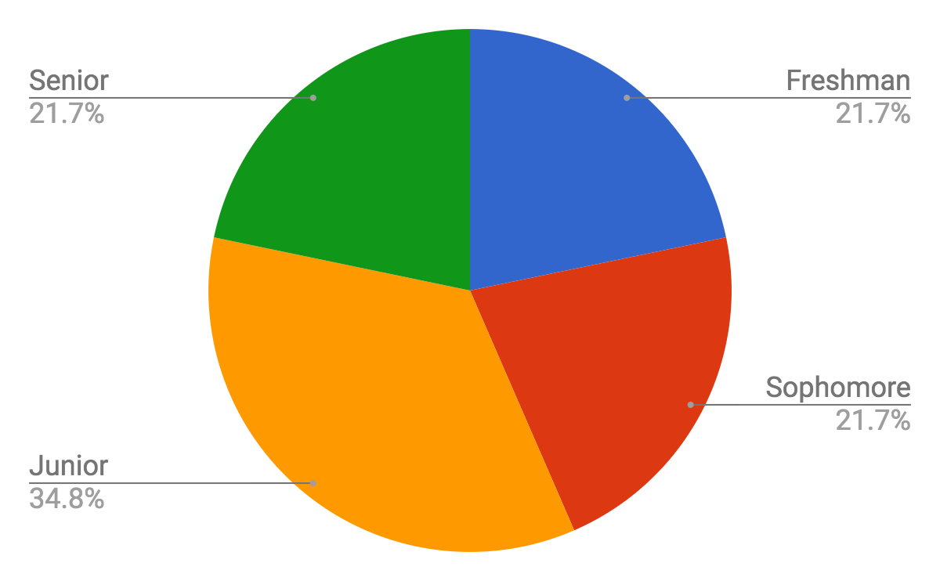
Survey Overview
Age Year in School
Notes:
Emily

Slide 25
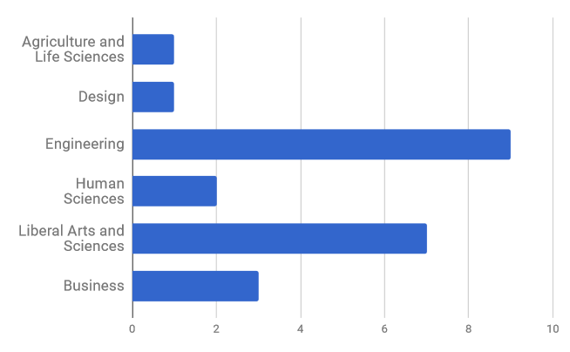
Survey Overview (cont.)
College representation
Notes:
Emily

Slide 26
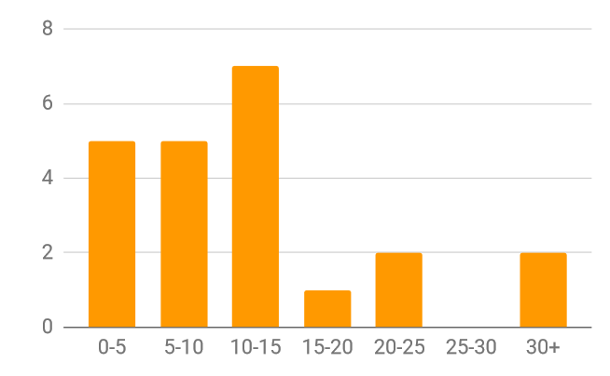
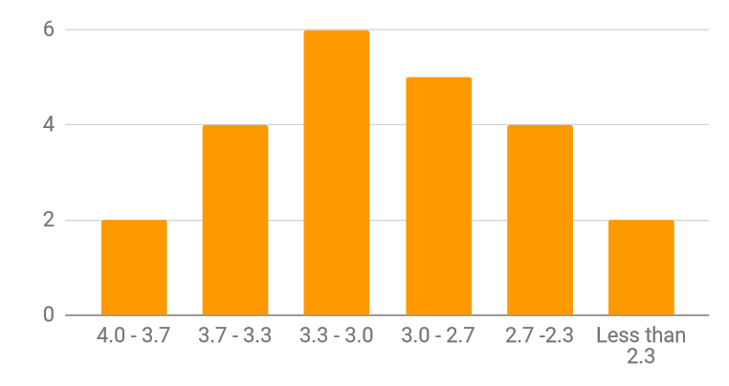
Survey Overview - Academic Background
Hours per Week Spent Studying
Cumulative GPA
Notes:
Lisa
We just want to show that we had a wide range of students who answered our survey through their answers of how many hours per week they spent studying and their self reported cumulative GPA.

Slide 27
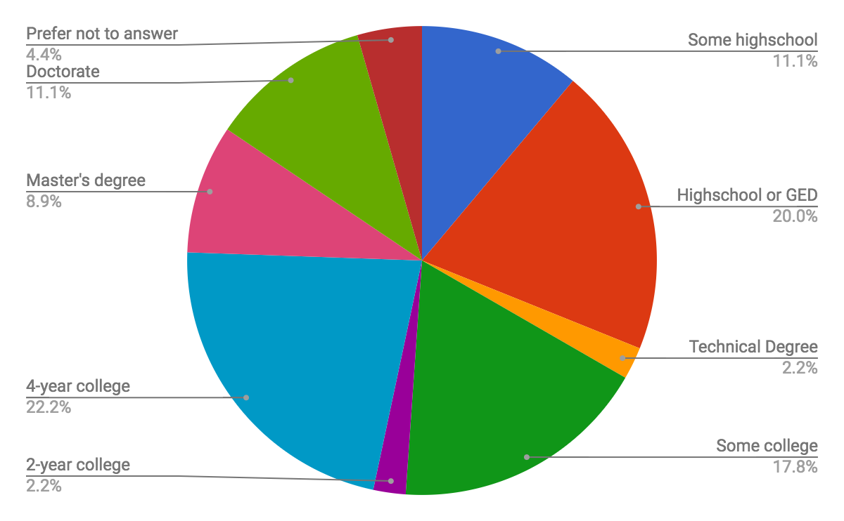
Survey Overview - Academic Background (cont.)
Responses to questions
about parent or
guardian’s academic background:
Responses - primary levels include high school and 4-year college (both ~20% of total)
Notes:
Nayely
Responses to question about parent
/guardian’s academic background:
Originally asked as two questions - grouped for analysis
Wide range of responses - primary levels include high school and 4-year college (both ~20% of total)
Minimal representation from 2-year colleges and technical degree programs (less than 5% of total)

Slide 28

Survey Results - Supportive Relationships
Do you feel like you belong on campus?
“I do feel like I belong on campus, because I have found life long friends and faculty members who have helped me stay in school and stay focused.”
Do you feel like relationships with staff members on campus support you academically?
“Yeah, when you can build positive relationships with staff members, you feel comfortable with them and are more likely to ask for help when you need it and so on.”
Notes:
Emily

Slide 29

Survey Results - Supportive Relationships (cont.)
Do you feel like relationships with faculty on campus support you academically?
“Yes. I have 3 faculty members that I talk to regularly that assist me in my academics and financial standings at Iowa State. They are always eager to help.”
“All my professors, hall directors, academic advisor, and CA’s are great. I can always have a great conversation with them and they are always willing to help me with anything I need.”
Notes:
Emily

Slide 30
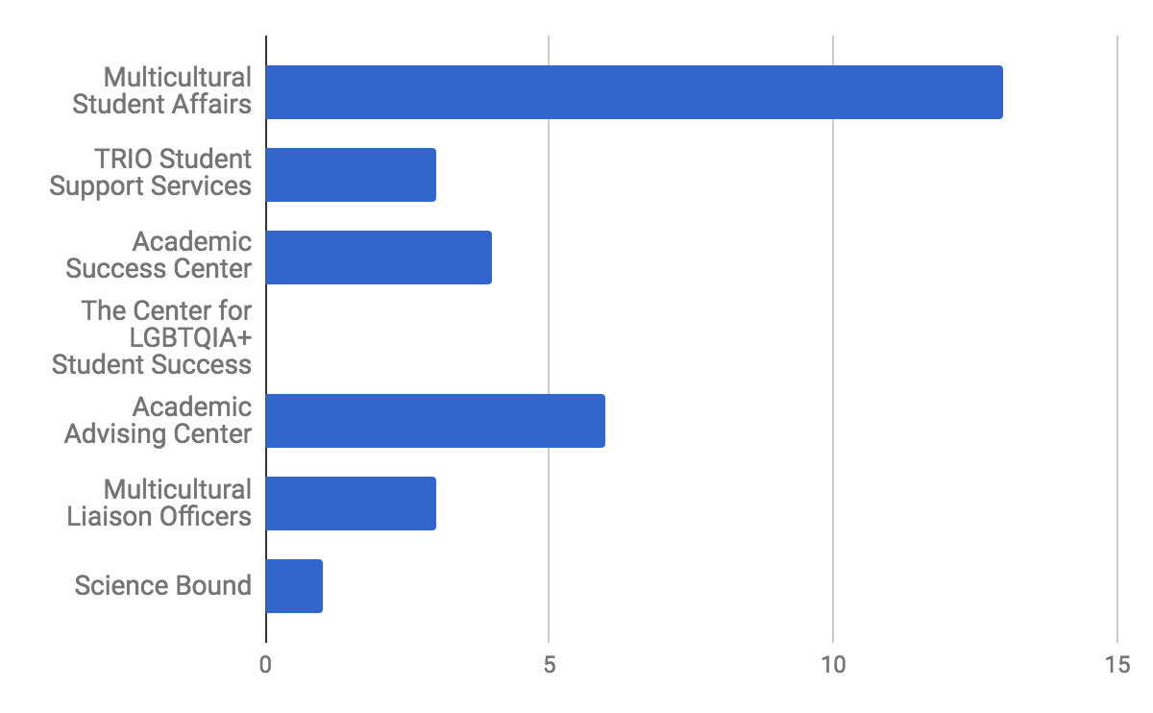
Survey Results - Supportive Relationships (cont.)
“Multicultural administration has been huge in allowing me to feel like I belong somewhere.”
Notes:
Emily

Slide 31
Survey Results - Ecological Perspective
Ecological Barriers?
  race-based, lack of self worth, lack of motivation
Professors and Staff/Faculty Relationships
  Comfortable in asking for academic or personal help
Feeling of Belonging on Campus Influenced by:
  Lack of representation
    Expressed feeling like the “only black kid in it [class],” “a minority,” “I stand out”
  Stereotypes
Positive relationships
Notes:
Nayely
Ecological Barriers?
race-based, lack of self worth, lack of motivation
Professors and Staff/Faculty Relationships
Largely positive
Comfortable in asking for academic or personal help
Feeling of Belonging on Campus Influenced by:
Lack of representation
Expressed feeling like the “only black kid in it [class],” “a minority,” “I stand out”
Stereotypes
Lisa will be covering next
Friendships and Faculty
Positive relationships

Slide 32
Survey Results - Identity Development and Involvement
Are there stereotypes that you feel have the ability to impact your academic success?
“I don't get taken seriously until I prove that I should be. Others take that for granted; I have to fight for it.”
“... I feel like as a Black student, I already have the pressure of just becoming another statistic of a Black student dropping out, and I don't want to be that statistic.”
Notes:
Lisa - are the quotes showing that the students are possibly moving forward or backward

Slide 33
Are there stereotypes that you feel have the ability to impact your academic success?
“...some people feel that because I am Black, I am not good enough or shouldn't be as smart as I am.”
“This is a hard question. On the surface, I don't experience any negative stereotypes against anything about me that impact my academic success, but I like to think about why I'm in college: sure, to get a degree and set myself up for a better future, but I often find myself thinking about all the other African Americans who either didn't want to attend college, or couldn't for whatever reason, and that in and of itself does a lot to motivate me to keep going, for everyone who couldn't make it that far.”
Notes:
Lisa
Put question text on this slide!

Slide 34
Survey Results - Academic Self-Efficacy
Progressive accomplishments:
  “... passing some of my first classes in the first semester showed me I can do this.”
  “Having a 3.85 GPA this last semester - it helped me realize that I can do better than what the society stereotypes me to be.”
Vicarious experiences:
  Student-to-student - “I think it helps because I see all the other students just as involved and doing well, so it motivates me to do better.”
  Faculty/staff - students discussed how their consistent interactions with supportive faculty/staff members helped them at various times
Notes:
Ben - focus on quotes and spread out text!
Students consistently mentioned their prior academic successes as a source of motivation

Slide 35
Survey Results - Academic Self-Efficacy (cont.)
Verbal and social affirmation:
  “In my job on campus, I’m surrounded with other positive influences that push me to want to achieve more.”
Physiological states:
  “... my constant state of anxiety/depression and fears that I’m not good enough.”
Suggestions and items to consider:
  How do we get students to their “first” academic accomplishments?
  Vicarious experiences based on race/ethnicity of faculty members
  Physiological impacts - especially mental health resources for students of color
Notes:
Ben
Students mentioned struggles with mental health and handling depression/anxiety

Slide 36
Solutions and Suggestions
Notes:
Ben

Slide 37
Solutions - A Case Study of Georgia State
Intentional advising and faculty mentoring efforts
  “GPS Advising” computer algorithms track students’ progress
  Connects with topics discussed - relationships, building self-efficacy, etc.
Scholarships and financial assistance
  Direct scholarships and retention grants
  Programs to help students maintain eligibility for scholarships already received - Ex: HOPE Scholarship in Georgia
Infrastructure to hire and support African American administrators, advisors, and faculty members
  Consider interactions with other identities - gender, first generation, etc.
Notes:
Ben
Chiles (2016) analyzed Georgia State’s success with African American students

Slide 38
Solutions - Current ISU Programs
Scholarships and financial programs:
  Hixson Opportunity Awards
  George Washington Carver (GWC) scholarships
  Multicultural Vision Program scholarships
Academic affairs initiatives:
  Learning communities - BOLD and LEAD
  College-level efforts - LEAD IT Collective, G.W. Carver Summer Research Internship, Hometown Design, etc.
  Multicultural Liaison Officers (MLOs)
Notes:
Ben - add notes!

Slide 39
Solutions - Current ISU Programs (cont.)
University Innovation Alliance (UIA) initiatives:
  Education Advisory Board (EAB) Student Success Collaborative
    Predictive analytics advising platform
  MAAPS/First in the World Grant
    $710,000 received in 2015 to increase the university’s advising capacity
  Completion Grants
    Designed to alleviate financial pressure during the final semesters
More information on UIA initiatives: http://www.uia.iastate.edu/
Notes:
Ben - look more here: http://www.uia.iastate.edu/uia-projects-at-iowa-state/

Slide 40
Additional Suggestions
Survey African American males during freshman year on cultural comfort level
  African American Identity Development Theory
Fraternity and/or extracurricular involvement
  Identity confidence
Support - Mentorship
  Higher level of Astin Student Involvement Theory
    Pair low ASIT score with high ASIT score
Notes:
Lisa

Slide 41
Mission Statement - Revisited
To bring awareness to current research on African American males’ success in higher education and highlight the application of this research to our campus
Notes:
Lisa
Thank you all for sitting through this session and listening to us today. To bring our presentation to a close, we wanted to return to our mission - to bring awareness to current research on African American males’ success in higher education and highlight the application of this research to our campus.

Slide 42
References
Astin, A. W. (1984). Student involvement: A developmental theory for higher education. Journal of College Student Personnel, 26, 297-308.
Bandura, A. (1997). Self-efficacy: The exercise of control. New York: Freeman.
Chiles, N. (2016, November 28). Georgia state students close education gap. The Atlanta Journal-Constitution. Retrieved from http://www.myajc.com/news/local-education/georgia-state-students-close-education-gap/urme5HeUWAQjVNTeDAIGgM/
Cross, W. E. (1991). Shades of Black. Philadelphia, PA: Temple University Press.
Cuyjet, M.J. (1997). African American men on college campuses: Their needs and their perceptions. In M.J. Cuyjet (Ed.), Helping African American Men Succeed in College (pp. 5-16). New Directions for Student Services, 80. San Francisco: Jossey-Bass.
Dancy, T.E. (2014). (Un)Doing Hegemony in Education: Disrupting School-to-Prison Pipelines for Black Males. Equity and Excellence in Education, vol. 47, p. 476-493
.
Notes:
Emily

Slide 43
References (cont.)
Dancy, T.E. (2014). (Un)Doing Hegemony in Education: Disrupting School-to-Prison Pipelines for Black Males. Equity and Excellence in Education, vol. 47, p. 476-493.
Hines, E.M. (2013) Parental Characteristics, Ecological Factors, and the Academic Achievement of African American Males. Journal of Counseling and Development vol. 91, no. 1, 2013, p. 68+.
Palmer, Robert T., and Estelle M. Young. Determined to Succeed: Salient Factors That Foster Academic Success for Academically Unprepared Black Males at a Black College. Journal of College Student Retention: Research, Theory & Practice, Vol. 10, no. 4, 2009 pp. 465-482., doi:10.2190/cs.10.4.d.
Reid, K.W. (2013). Understanding the Relationships among Racial Identity, Self-Efficacy, Institutional Integration, and Academic Achievement of Black Males Attending Research Universities. Journal of Negro Education, 82:1, 75-93.
Strayhorn T.L. (2008). The Role of Supportive Relationships in Facilitating African American Males' Success in College. NASPA Journal, 45:1, 26-48.
Taylor, Colette & F. Howard-Hamilton, Mary. (1995). Student Involvement and Racial Identity Attitudes Among African American Males. Journal of College Student Development. 36. 330-336.
Notes:
Emily

Slide 44

Contact Information
Share your thoughts and
questions on Twitter!
Ben Dralle
Email: btdralle@iastate.edu
Twitter: @ben_dralle
Nayely Hurtado
Email: nhurtado@iastate.edu
Emily Leaverton
Email: emilylea@iastate.edu
Twitter: @emily_leaverton
Lisa Saenthavy
E-mail: bsaent@iastate.edu
Notes:
Emily

