Slide 1
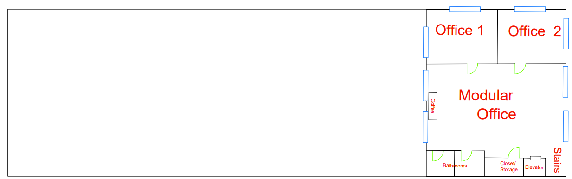
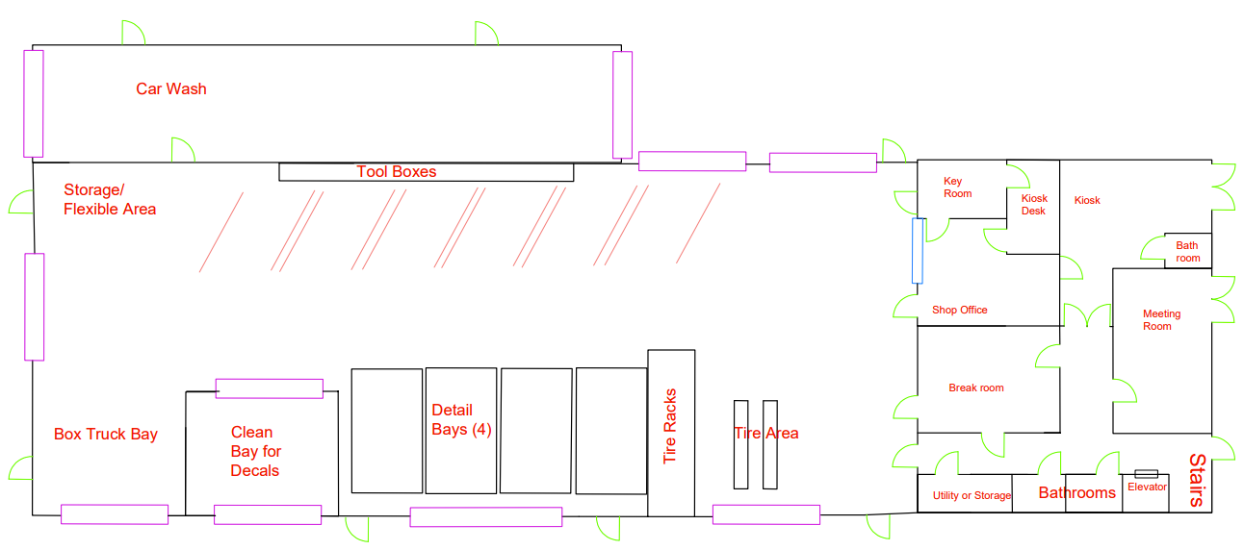
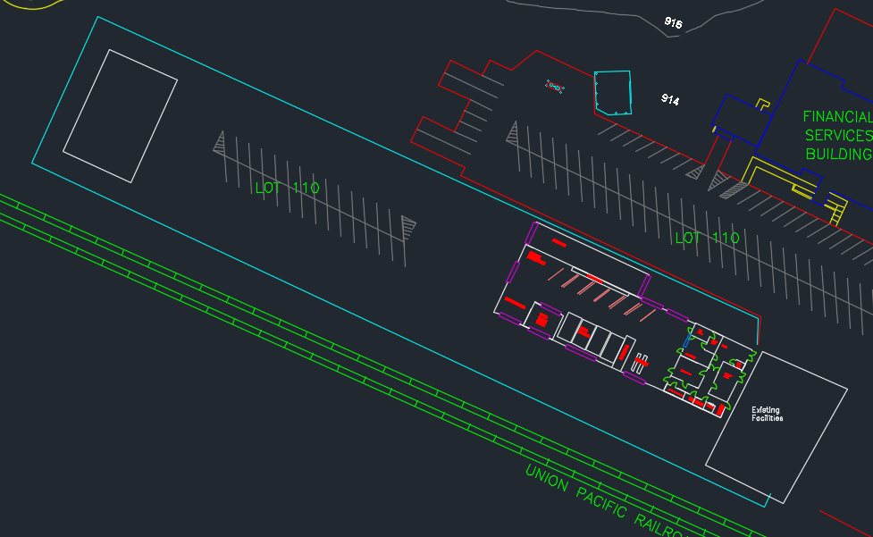
TSM 416 Technology Capstone
*Instructors: mea1@iastate.edu; koziel@iastate.edu
Department of Agricultural and Biosystems Engineering
Chee Hin Hang, Collin Gingerich, Kade Tix, Sophia Anderson, Michael E. Anderson*, Jacek A. Koziel*
ISU Transportation Services Facility Design
Client: ISU Transportation Services, Ames, Iowa
Facility Design
Top Floor
Problem Statement
ISU Transportation Services requires a new facility to better suit our client's needs
There current building is becoming more outdated and does not have space for all their current employees
This is becoming a problem for our client making them more inefficient than they would like
Scope
Design new shop and office spaces
Addition of clean bay, decal bay, Tire alignment bay and electric vehicle equipment
Shop Floor
Methods/Approach
Using AutoCAD for the layout
Meeting with clients and discussing ideas
Looking at current problems and propose a solution
Bottom Floor
Objectives
Provide enough space for employees to work under one roof to improve efficiency
Increase bay height to accommodate larger vehicles
Provide space and resources for electric vehicles to be maintained on site
Major Deliverables
CAD drawings of proposed building layout
Proposed facility plan is complete and meets client’s needs and expectations
Parking Lot Overview
Recommendations
Move gas pump to the back of the lot to improve fuel pumping and delivery ease
Plan to reserve space around the building and on the lot for additional expansion of the facilities
Constraints
Available land to build on
Must maintain large parking lot for vehicle storage
Existing facility needs to function during construction
Moderate budget constraints
2-story building
Needs large bay for food trucks
ADA requirements must be met
References
CAD drawing from architect
Shop equipment list from clients
Visit of car dealership's facilities
TSM 116, 201, 214, 310, 444
Acknowledgements: Authors are grateful to Kathleen Wellik and Butch Hansen for the opportunity to work on this project. Project was co-funded by the differential tuition.

