Slide 1
Assessing the ability of various plant essential oils and sesquiterpenoids to repel bed bugs
Kylie Crystal, Edmund J. Norris, and Dr. Joel R. Coats
Pesticide Toxicology Laboratory, Department of Entomology, Iowa State University, Ames, IA, USA

Slide 2
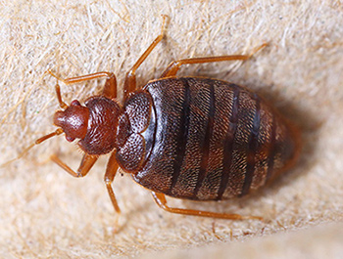
Bed Bugs (Cimex lectularius)
<1mm-3/16”, oval, reddish-brown, flat
Hide easily
What do they bite?
When bitten: different reactions
Health concerns
  Can’t vector diseases
  Psychological health
Treatments
  Insecticide resistance
  Very few options
Notes:
Possible expansion: <1mm up to 3/16” size range (ex: period on page to pencil eraser)
Bites: possible extra slide of showing bed bug bites
No “direct” health concerns (can’t vector diseases) but can affect peoples psychological health – prevention of sleep, paranoia/delusions of insects being everywhere
Sub bullet: resistant to insecticides, very few treatment options
Possibly make a point about their comeback
Make this slide a duplicate to go after a possible bed bug bite picture slide

Slide 3
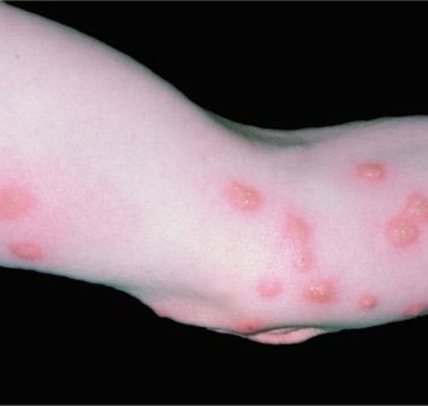
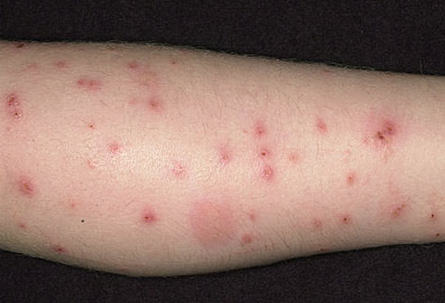
Bed Bug Bites

Slide 4
Bed Bugs (Cimex lectularius)
<1mm-3/16”, oval, reddish-brown, flat
Hide easily
What do they bite?
When bitten: different reactions
Health concerns
  Can’t vector diseases
  Psychological health
Treatments
  Insecticide resistance
  Very few options
Notes:
Possible expansion: <1mm up to 3/16” size range (ex: period on page to pencil eraser)
Bites: possible extra slide of showing bed bug bites
No “direct” health concerns (can’t vector diseases) but can affect peoples psychological health – prevention of sleep, paranoia/delusions of insects being everywhere
Sub bullet: resistant to insecticides, very few treatment options
Possibly make a point about their comeback
Make this slide a duplicate to go after a possible bed bug bite picture slide

Slide 5
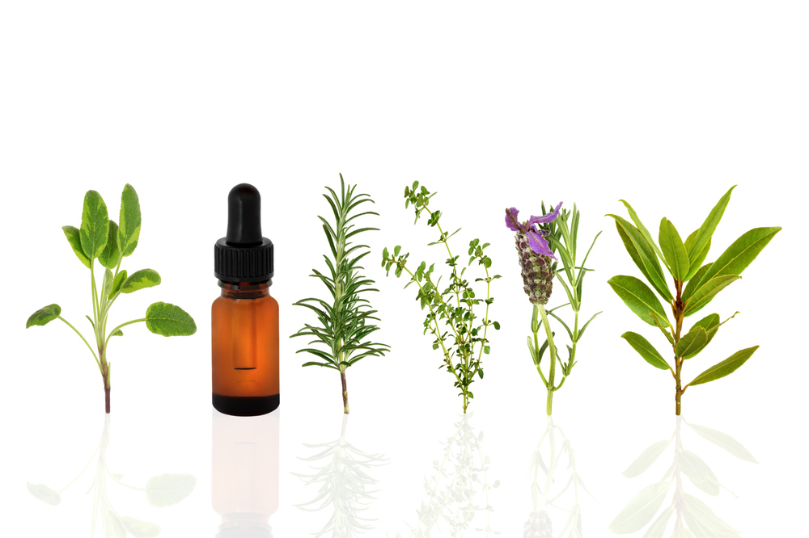
Plant Essential Oils
Limited research done
Repellents and insecticides
Lots of possibilities
Notes:
Clip art

Slide 6
Research Question
What plant essential oils are the most effective repellents against bed bugs, and what components of those plant essential oils cause the repellency?

Slide 7
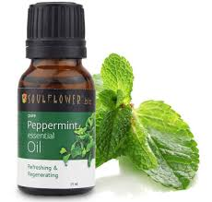
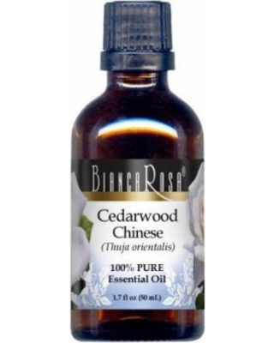
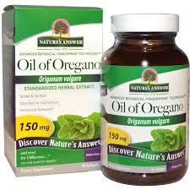
Plant Essential Oils Tested
Various Oils
  Control (no oil)
  Peppermint
  Origanum
  Cedarwood Chinese
Notes:
After identifying the most effective plant essential oil fractionate it and talk about why cedrol important (bc main component)
Move components and figure to new slide in front of plant essential oil component slide
Change the pic for the Chinese cedarwood

Slide 8
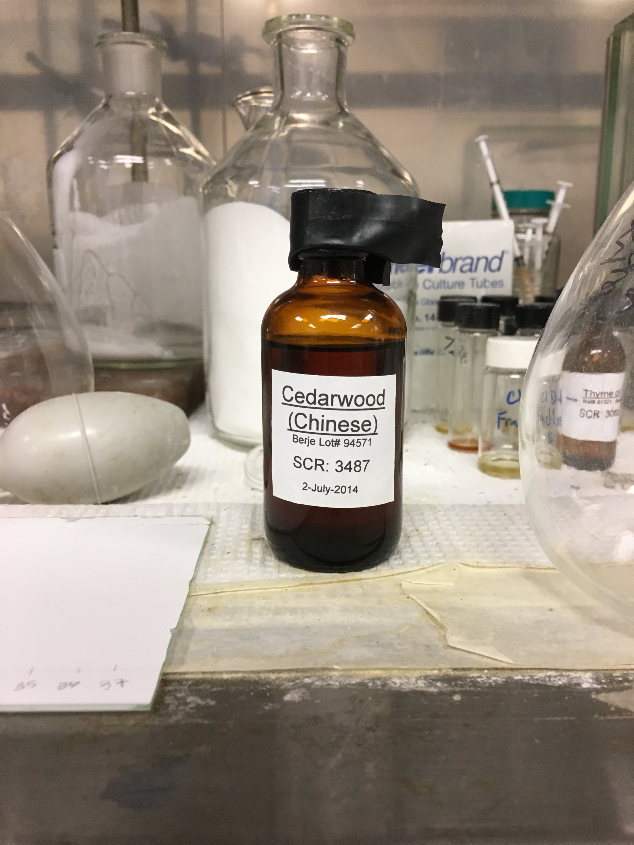
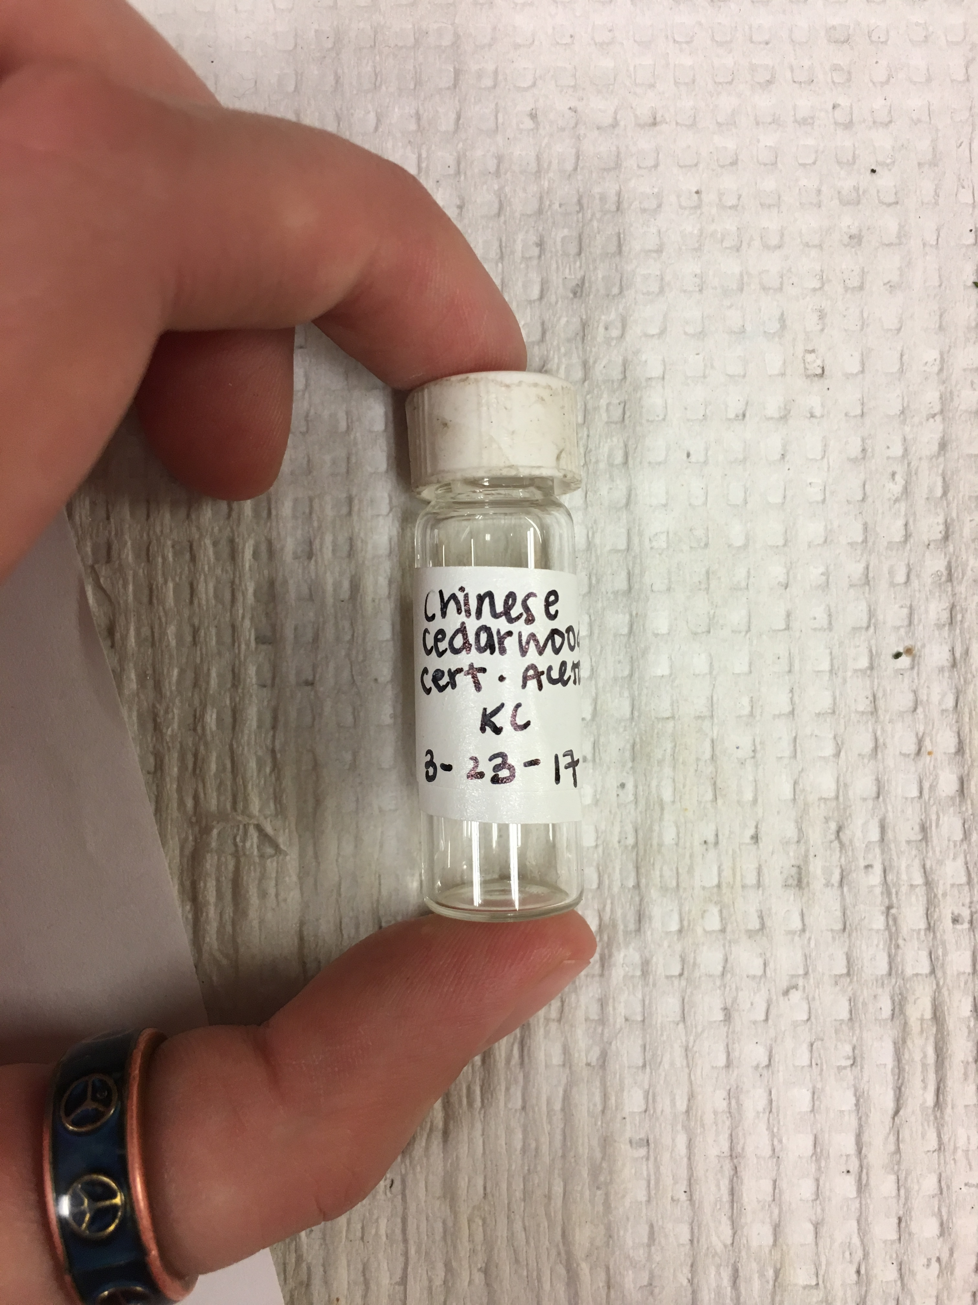
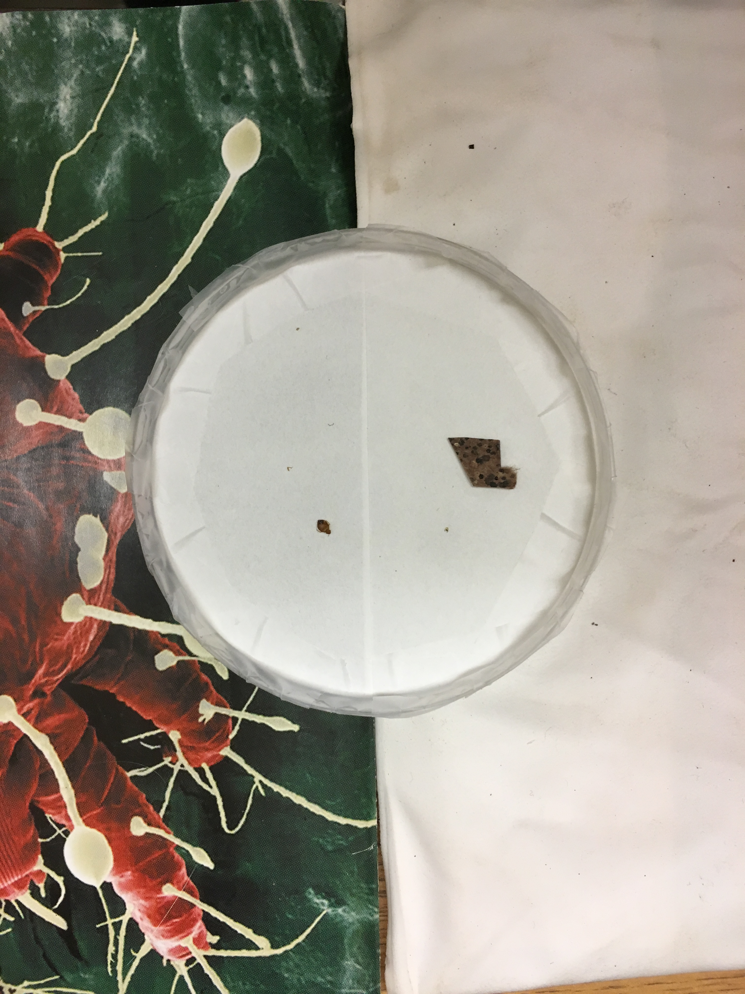
Plant Essential Oil
1% solution in acetone
Treat 90mm filter papers
Contact irritancy dish
Half side treated, other half untreated
15 mins. spent in dish
Notes:
Add “a 1% solution in acetone” – possibly mention that we use acetone bc it evaporates easily: either before or after explaining the filter papers
-applied 1 mL of solution to filter paper
Try to describe why we are using ex: tape, heat pad, fecal pad (do tape and tape, heat and heat…etc)
Bed bugs use their feces to find their harborage after their meal
Cryptic feeders: come out at night, feed, and leave – possibly use when describing why we use the fecal pad

Slide 9
Results
Notes:
Describe how the control works: why the time spent on the treated side is greater than the untreated side
Describe the colors/what each bar is – percentage time spent on treated vs untreated side

Slide 10
Results
T-test results:
  Control vs. peppermint: p=.6605
    Not statistically significant on α value .05
  Control vs. Origanum: p=.0086
    Statistically significant on α value .05
  Control vs. Chinese cedarwood: p=4.732E-7
    Statistically significant on α value .05
Notes:
Don’t need to mention alpha value of .05 after the first time
When really low p value can say its highly significant

Slide 11
Separation of the most effective plant essential oil: Chinese cedarwood

Slide 12
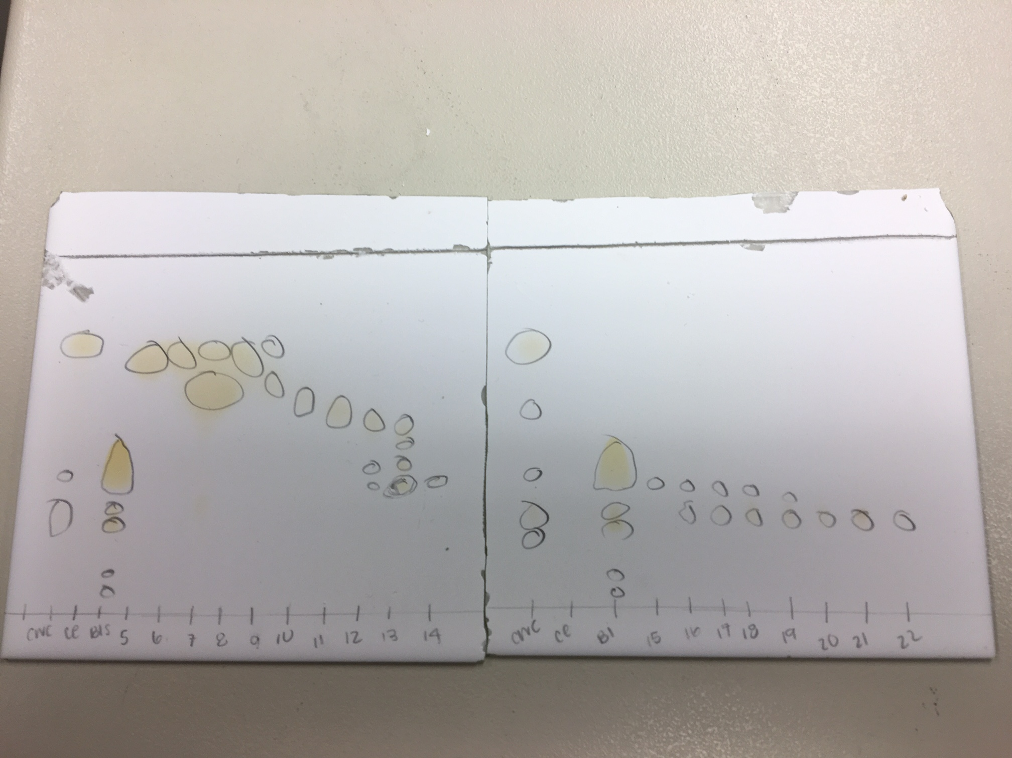
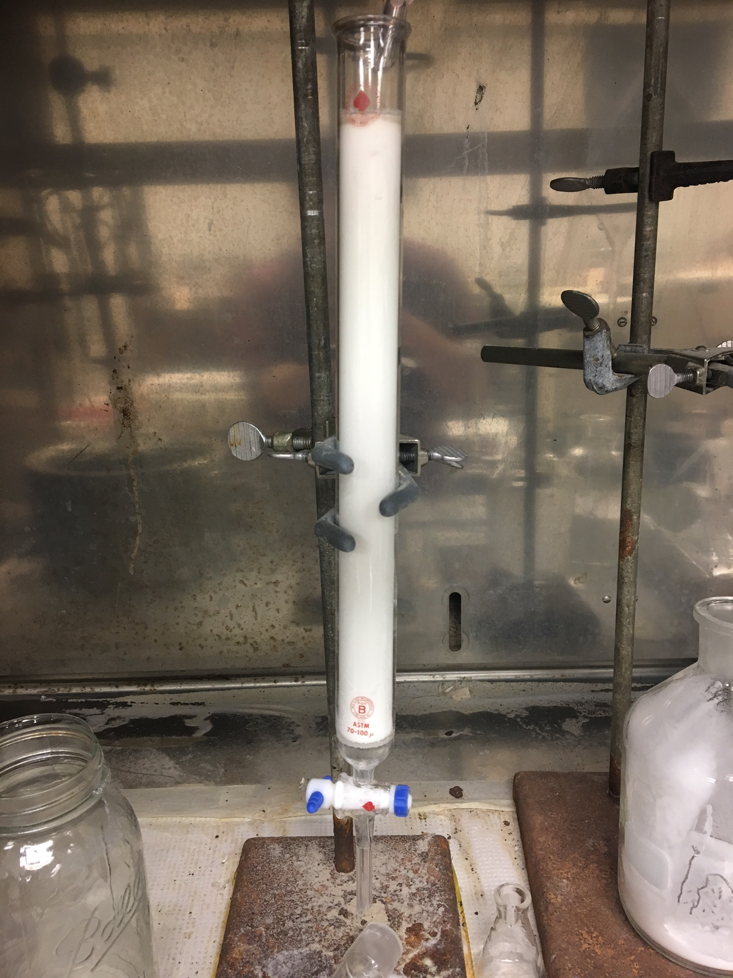
Plant Essential Oil Component
Gravity column chromatography
Thin layer chromatography
1% solution in acetone
Treat 90 mm filter papers
Contact irritancy dish
Half side treated, other half untreated
15 mins. spent in dish
Notes:
Add the components of chincedar here
Why did we choose fractions: these three fractions had a single dot that can indicate a pure compound that was not cedrol (we do not know what the fractions are)

Slide 13
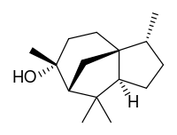
Plant Essential Oil Compounds Tested
Compounds | Peak Area | %
a-Cedrene | 157055 | 22.77
b-caryophyliene | 12792 | 1.85
b-cedrene | 27559 | 4
thujopsene | 223807 | 32.45
a-alaskene | 42453 | 6.16
d-cadinene | 19482 | 2.82
Cedrol | 170082 | 24.66
Total: | 689730 | 100
Components of Cedarwood Chinese
  Control (no oil)
  Cedrol
  Fractions 13-15

Slide 14
Results

Slide 15
Results
T-test results:
  Control vs. cedrol: p=.0623
    Not statistically significant on α value .05
  Control vs. Fraction 13-15: p=6.042E-5
    Statistically significant on α value .05

Slide 16
Conclusions
For plant essential oils:
  Peppermint is not an effective repellent
  Origanum is an effective repellent
  Chinese cedarwood is an effective repellent
For components of Chinese cedarwood:
  Cedrol is not an effective repellent
  Fraction 13-15 is an effective repellent
More research needs to be done on plant essential oils
  Ex: fractions 13-15
Notes:
Talk about future figuring out what the fractions are

Slide 17
Acknowledgements
I would like to thank Edmund Norris for providing me with help and information as I learned to navigate the lab. I would like to thank Dr. Joel Coats for providing me with the opportunity to experience undergraduate research. I would also like to thank the honors program and the undergraduate research program for providing me with the opportunity to participate in a research project. Lastly, I would like to acknowledge the other members of the lab working hard in the background of the project to make sure that I had all of the materials that I needed.

