Slide 1
Effect of Cellulosic Hydrolysate Compounds and Biofuels in E. coli.
Presenter: Patrick Hertzel
Mentor: Miguel Chavez
Faculty Head: Dr. Laura Jarboe

Slide 2
Appendix
Background
Goal
Experimental Method
Data
  Concentrations
  Pacti Strains
Conclusion
Future Work
Acknowledgement

Slide 3
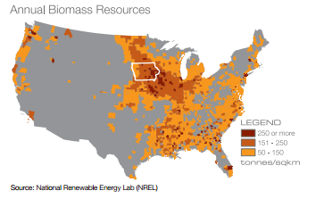
Background
Why Biofuels?
  One of the several major alternative energy sources to fossil fuels with over a 100 billion dollar industry worldwide.
  Iowa ranks 1 and 2 in Ethanol Production and Biodiesel Production.
The Problem?
  Product toxicity hampers the production of biorenewables, preventing larger and more financially feasible gains from occurring.

Slide 4
Goal
Overall: To increase membrane tolerance of E. coli towards inhibitory compounds to allow greater yields of biofuels.
Current: Testing selected strains of E.coli in calculated amounts of inhibitors to determine growth rate.

Slide 5
Experimental Method
Step One: Create a basis concentration for each condition in a known strain.
  Basis was created by inoculating a MG1655 Strain of E. coli into 2% MOPS solution for 19 hours.
  After inoculation period, placed into specific conditions (Right) and measured growth over a 8 to 12 hour using plate reader.
CONDITIONS
Isobutanol
Butanol
Ethanol
Phenol
Hexanol
Octanoic Acid
Acetate
Furfural
Styrene
pH 5
42 Degrees C

Slide 6
Experimental Method
Step Two: Test selected concentrations of conditions with different strains of E. coli.
  Concentration amount of condition was determined by a 50% decrease in growth rate.
  Strains were treated with a 4 hour cultivation in LB to normalize growth curve.
  After the 19 hour incubation period, strains were washed with the condition once then placed into the plate reader with determined concentrations.
CONDITIONS
Isobutanol
Butanol
Ethanol
Phenol
Hexanol
Octanoic Acid
Acetate
Furfural
Styrene
pH 5
42 Degrees C

Slide 7
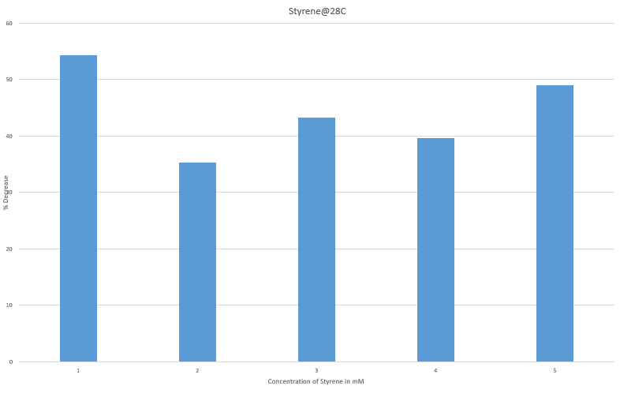
Data Analysis & Concentrations
Selected Inhibitors
7 mM Octanoic acid (pH 7)
1 % v/v Butanol
0.2% v/v Hexanol
17 mM Phenol
1% v/v Isobutanol
2.8% v/v Ethanol
100 mM Acetate (pH 7)
8 mM Furfural
1 mM Styrene (28C)
50
% Decrease growth rate
30
10
Selected Conditions
pH 5
42 degrees C
1
2
3
4
5
Styrene concentration (mM)
Styrene is a special case

Slide 8
Pacti Strains, The What and Why?
What are Pacti strains?
Genetically engineered E. coli strains.
What are we changing?
Different promoters( M1-12, M1-37, M1-93)
Change in signal peptide (PelB)
Cis to trans isomer for fatty acid.
Why are we using different strains?
Measure tolerance towards an inhibitor given by CTI enzyme, strength of promoter, and integration of trans-fatty acids.
Characterize membrane changes to genetic changes.
  Engineered Strains
  M1-12 Pacti
  M1-37 Pacti
  M1-93 Pacti
  M1-12_PelB Pacti
  M1-37_PelB Pacti
  M1-93_PelB Pacti

Slide 9

Data
Growth Rate(%)

Slide 10
Data
Growth Rate(%)

Slide 11
Conclusion
Concentration for 2.8% v/v Ethanol, 1% v/v Butanol, 1%v/v Isobutanol, and 7mM Octanoic acid have shown a positive growth.
  Ethanol had a positive growth in given condition with all strains.
  Isobutanol and Octanoic acid have shown positive growth in all strains but M1-37 PelB.
  Butanol has shown positive growth in all but M1-12 PelB and 12-93 PelB.
  Ethanol, Octanoic, and Butanol showed the best growth rate in M1-12, while Isobutanol showed the best growth rate in M1-37.
  Highest growth rate was shown for Ethanol, which is good since it’s the most common biofuel.
100 mM Acetate, 8 mM Furfural, 0.2% Hexanol, and 17 mM Phenol showed a decrease in growth.

Slide 12
Future Work
Styrene is a special case and requires different conditions then the rest (28 °C).
Determining what to change for the conditions which responded with a negative growth.
Finish up with sampling the rest of the conditions.

Slide 13
Acknowledgement
Miguel Chavez, PhD Student
Laura Jarboe, PhD

