Slide 1

Organization of vocabulary in L2 Spanish textbooks: Semantic relationships within and between vocabulary lists
Department of English
Brody Dingel
Iowa State University
Notes:
Say it slowly

Slide 2
Background
Learning a foreign language (L2) is hard
Learning L2 vocabulary is hard
We need textbooks that teach new L2 vocabulary effectively

Slide 3
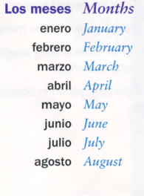
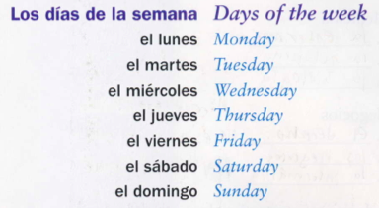
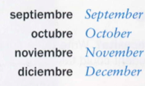
Background
Some common lists
Semantically related (?)
from Pura Vida
Notes:
Don’t know if they’re related; we’ll see from the measure

Slide 4
Background
Unrelated list example:
-paint
-funeral
-recipe
-market
-uncle
-ice
Related list example:
-melon
-apple
-strawberry
-grape
-peach
-orange
Semantically unrelated lists better for
learning than semantically related lists
Unrelated = “good”
Related = “bad”
What do Spanish textbooks use?
Notes:
Mention that I will use these interchangeably throughout

Slide 5
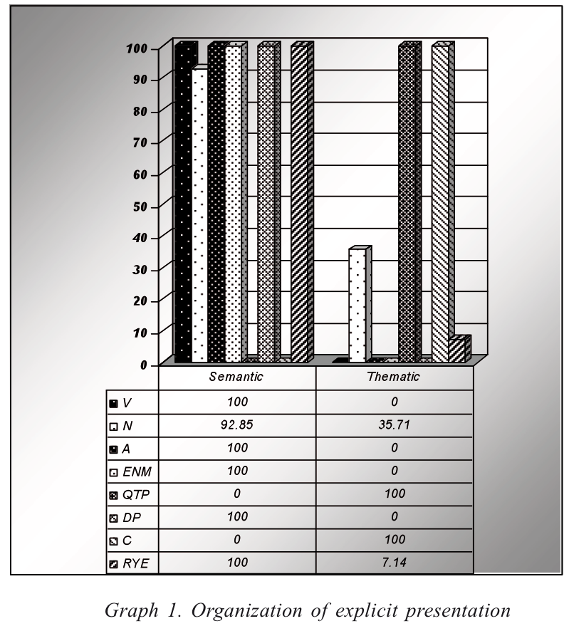
Background
López-Jiménez (2012): semantic
organization in half of
Spanish textbooks (N=12)
“As for the organization of the explicit presentation of the new
vocabulary, most TBs resort to semantic sets to the detriment
of thematic groupings (see graph 1). In the description of the
vocabulary methodology only two books, Nexos and
Conexiones, acknowledge the presence of thematically–organized
vocabulary (see Table 1). This description just confirms the
scarcity of thematic clusterings when organizing the new lexicon.
In addition, half of the TBs that present the new vocabulary in an
explicit way organize it through semantic sets and are beginning level TBs.”

Slide 6
Background
López-Jiménez (2012)
Very broad, little discussion on semantic sets in textbooks
Old textbooks (1999-2009)
No mention of what measure used for determining semantic sets (!!!)
Notes:
Takes away from the credibility of the study

Slide 7
Present Study
Textbooks used (N=4) in low/intermediate Spanish courses at Iowa State University
3 published in 2014 (in use)
1 published in 2016 (to be used next year)
Measure new vocab lists (only nouns) for semantic relatedness within each textbook and across the textbooks
Notes:
Taking all nouns from book (including from lists with other POS)

Slide 8
Research Questions
1) What is the threshold measure that distinguishes semantically related lists from semantically unrelated vocabulary lists?
2) What is the chance that a given list from Textbook X
will be semantically related?
3) What is the chance that a given list from the textbook sample will be semantically related?
Notes:
Make clear difference between 2 and 3

Slide 9
Importance
332 students
Need good textbooks to teach them!

Slide 10
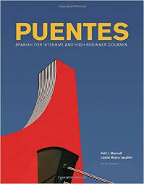
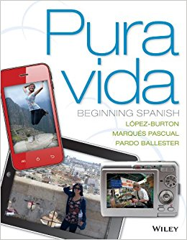
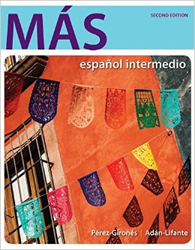
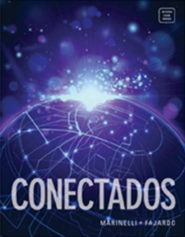
The Data
4 textbooks: Puentes, Pura Vida, Más, Conectados
Extracted all new vocabulary lists (nouns only)
 | Puentes | Pura Vida | Más | Conectados | Total
# Lists | 39 | 31 | 57 | 41 | 168
# Nouns | 504 | 936 | 599 | 827 | 2,866

Slide 11
The Measure
To what extent are the words in a given list related?
Measure semantic distance between words
Least common superconcept (Wu & Palmer, 1994)
Entity
Footwear
Hosiery
Shoe
Sock

Slide 12
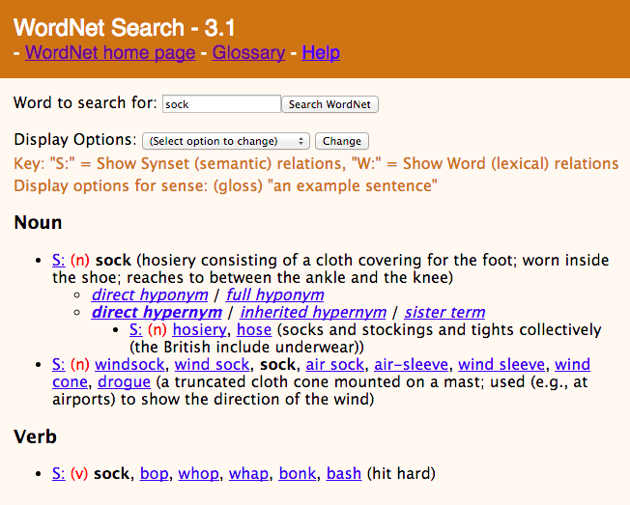

Slide 13
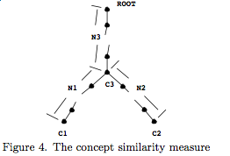
RQ1: The Measure
Wu-Palmer (1994) method:
(2*N3)
(N1+N2+2*N3)
WordNet
Python script
What does this measure mean??
Nothing. We need a threshold!
ConSim(C1,C2) =
(Wu & Palmer, 1994)

Slide 14
RQ1: The Threshold
Identified lists in literature that were deemed “semantically related” and “semantically unrelated”
Wu-Palmer calculation on literature lists
Monte-Carlo method: 10,000 experiments
Chance that the list is “good” or “bad”
96% chance “bad”
WuP 0.75
4% chance “good”
0.75
0
1
Notes:
Explain percentages well, indicate connection with next slide

Slide 15
Threshold: 0.62
Good list
Bad list
Notes:
Say that the x-axis is the exact same as line in previous slide
Don’t re-explain the percentages; you did this in the previous slide

Slide 16
Results: RQ2 & RQ3
2) What is the chance that a given list from Textbook X will be semantically related?
(How “good/bad” is Textbook X?)
3) What is the chance that a given list from the textbook sample will be semantically related?
(How “good/bad” is the sample?)
 | Pura Vida | Puentes | Más | Conectados | Average (Sample)
Chance to be semantically unrelated (GOOD) | 71% | 61% | 86% | 77% | 75%
Chance to be semantically related (BAD) | 29% | 39% | 14% | 23% | 25%
Notes:
Clarify that it’s the chance that a given list will be good/bad versus the threshold, not same as WuP measure
EVGENY: Can I put percentages??

Slide 17
Overall findings
Threshold: 0.62
Related vs. Unrelated lists:
Individual textbooks
Each could obviously use improvement
Sample as a whole
25% chance that a given list is “bad”
Notes:
Clear this slide up, take numbers out

Slide 18
Implications
Establishing threshold IS possible
Need to incorporate in future research
ISU Spanish students may not be receiving adequate vocabulary instruction from textbooks
Some classes may be receiving better instruction from textbooks than others
May need to consider other textbooks

Slide 19
Limitations
Limited to nouns, so great deal of vocabulary omitted
Effectiveness of WordNet
Data extraction difficulties (lack of explicitly defined lists, translation difficulties)
Only statistical probabilities

Slide 20
Special thanks and Works Cited
BIG thank you to Dr. Evgeny Chukharev-Khudilaynen and Dr. Hui-Hsien Feng for their help on this project
López-Jiménez, M. D. (2012). A Critical Analysis of the Vocabulary in L2 Spanish Textbooks. Porta Linguarum, 21, 163-181.
Wu, Z, & Palmer, M. (1994). Verb semantics and lexical selection. In ACL '94 Proceedings of the 32nd annual meeting on Association of Computational Linguistics, 133-138.

Slide 21
(English) (Spanish)
1) Thank you! = ¡Muchas gracias!
2) Questions? = ¿Preguntas?
(Semantic relatedness measure = 0.615,
51% chance of being a good list,
49% chance of being a bad list)

