Slide 1

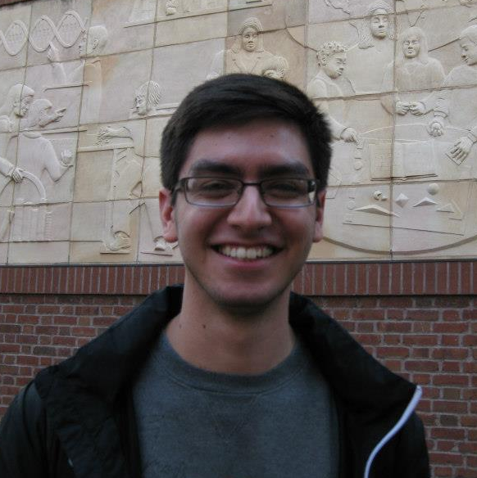

Nick Andrade
University Studies 205 | Fall 2012
Notes:
The colors I chose to use through out my presentation were red and green, because they represent my Mexican heritage.

Slide 2
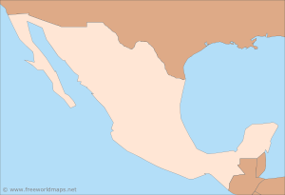
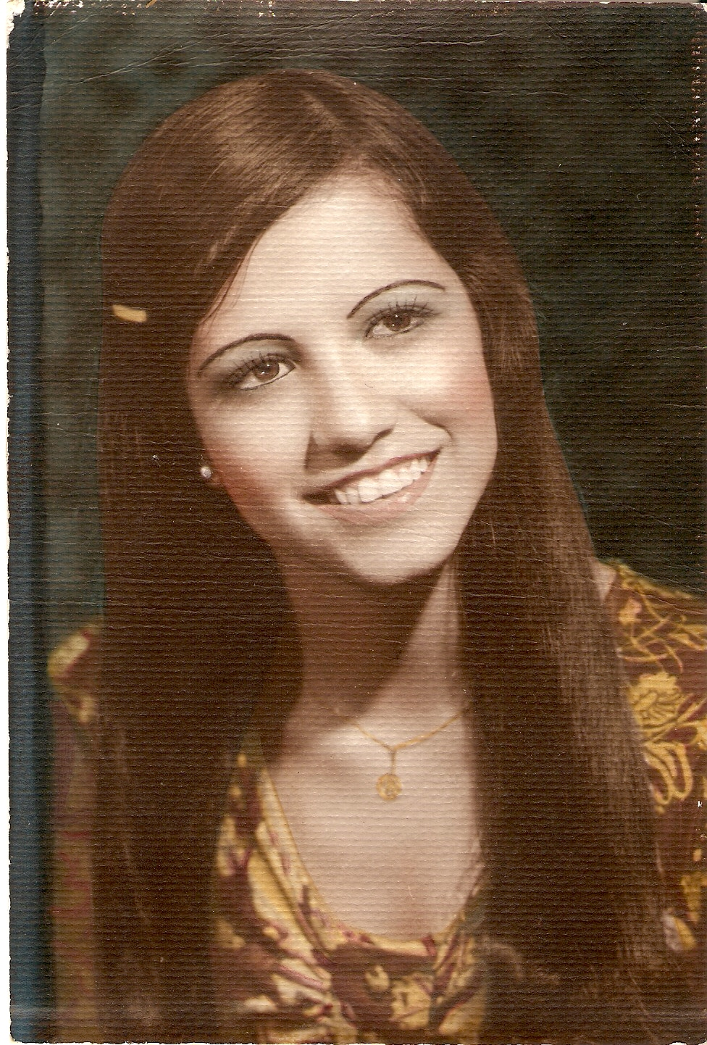
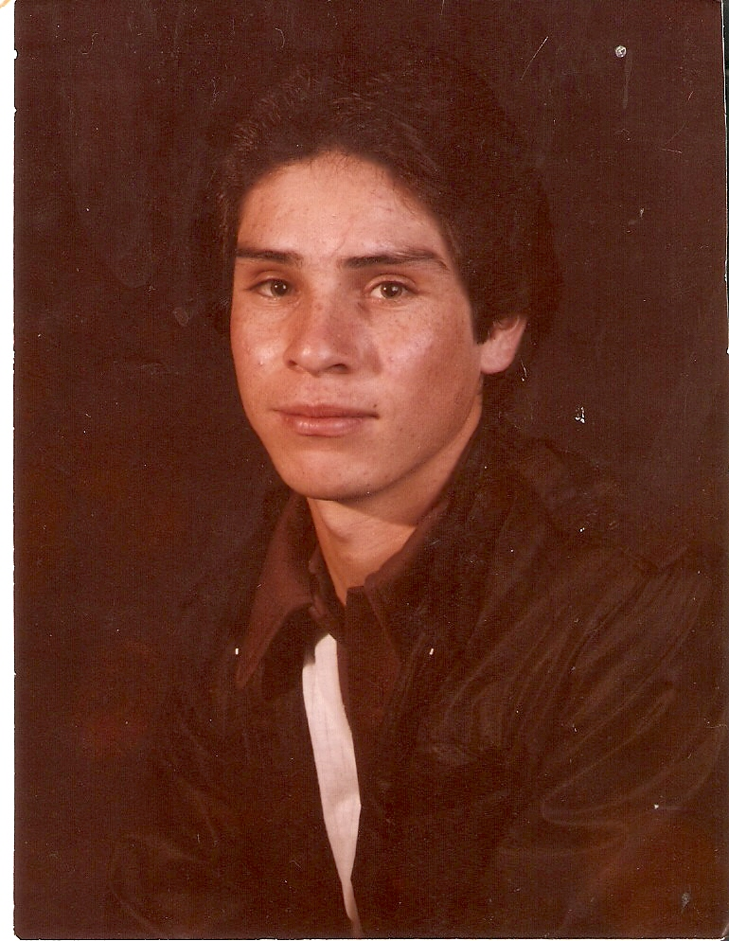
Monterrey
Morelia
Notes:
My parents are originally from Mexico. My dad is from Morelia, and my mom is from Monterrey. Both of them came from poor families. I’m always amazed at how far our family has come within a few generations. This motivates me to become as successful as I can be.

Slide 3
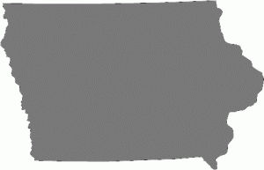
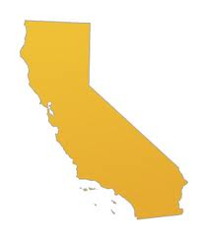

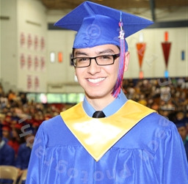
Notes:
In second grade, my family packed up and we moved from Porterville, California, to Marshalltown, Iowa. You’d think it would be a big difference, but it wasn’t that big—location wise. Porterville, California, is located in the San Joaquin Valley where there are lots of farms, so moving to Iowa wasn’t any different. One big difference would be the corn and flat land. I had never moved before, and being the little, shy second grader I was, it was extremely hard for me to adjust to going to a new school. One problem I had was reading. I had really bad reading skills, since I came from a low performing school in California, and so I had to receive special help at my new school in Iowa. I eventually learned to fit in, met new friends, and became a successful student. I graduated from Marshalltown High School in 2011 in the top 10 percent of my class of over 300.

Slide 4

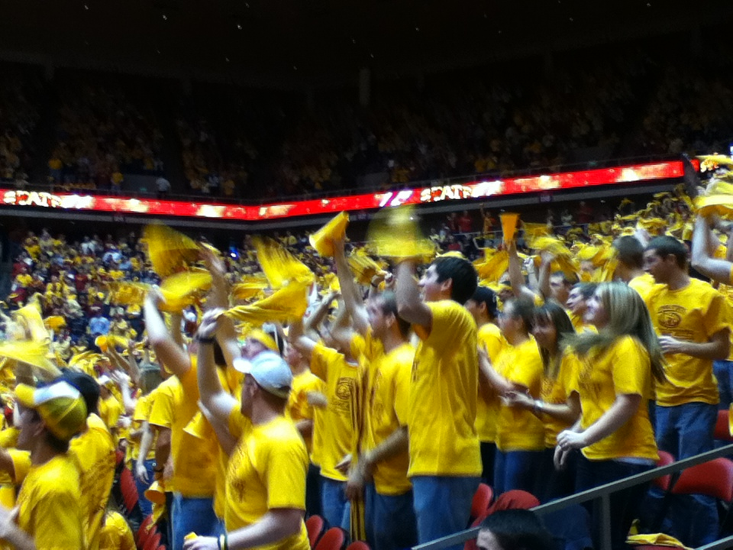
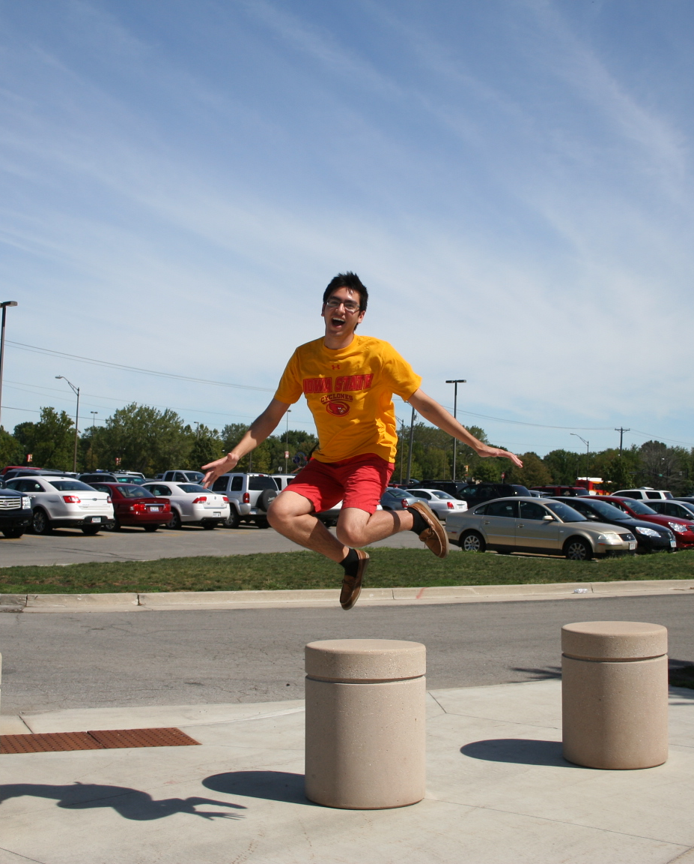
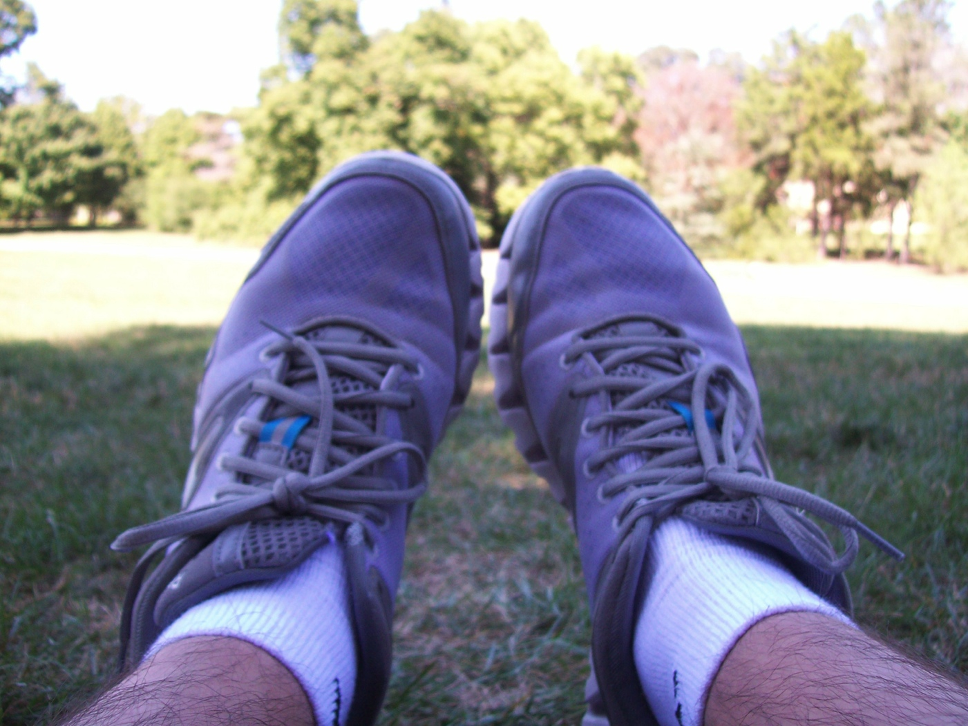
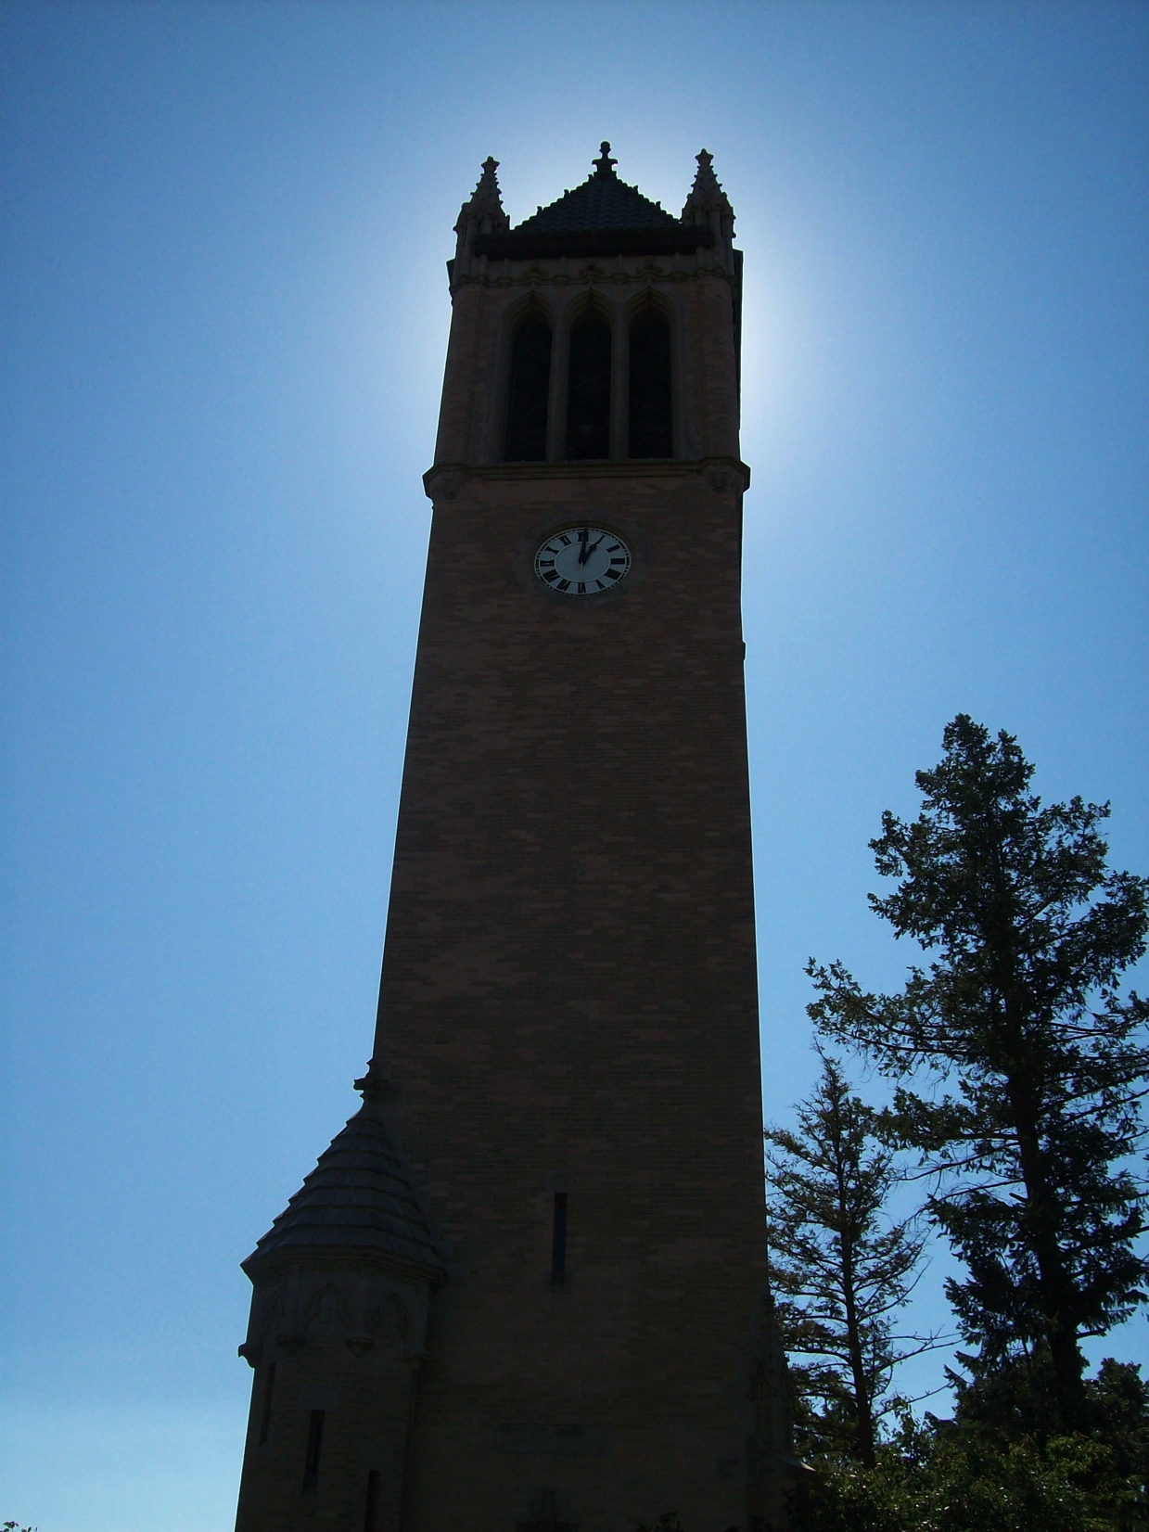
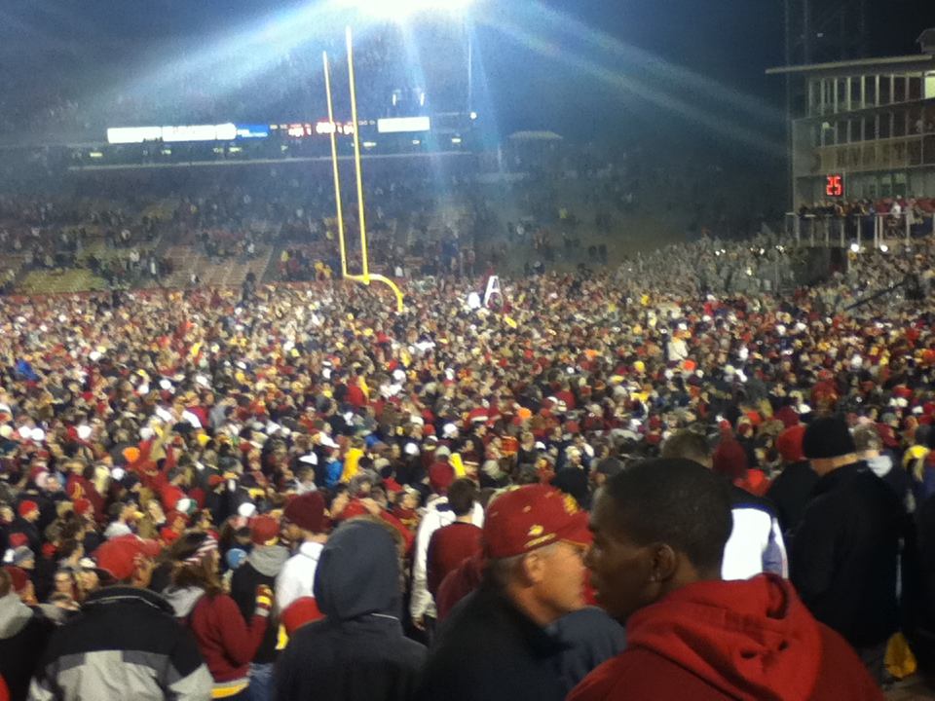
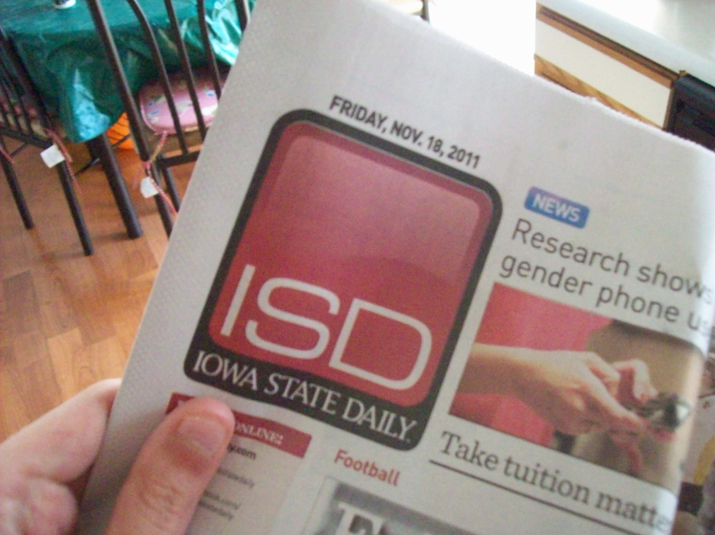
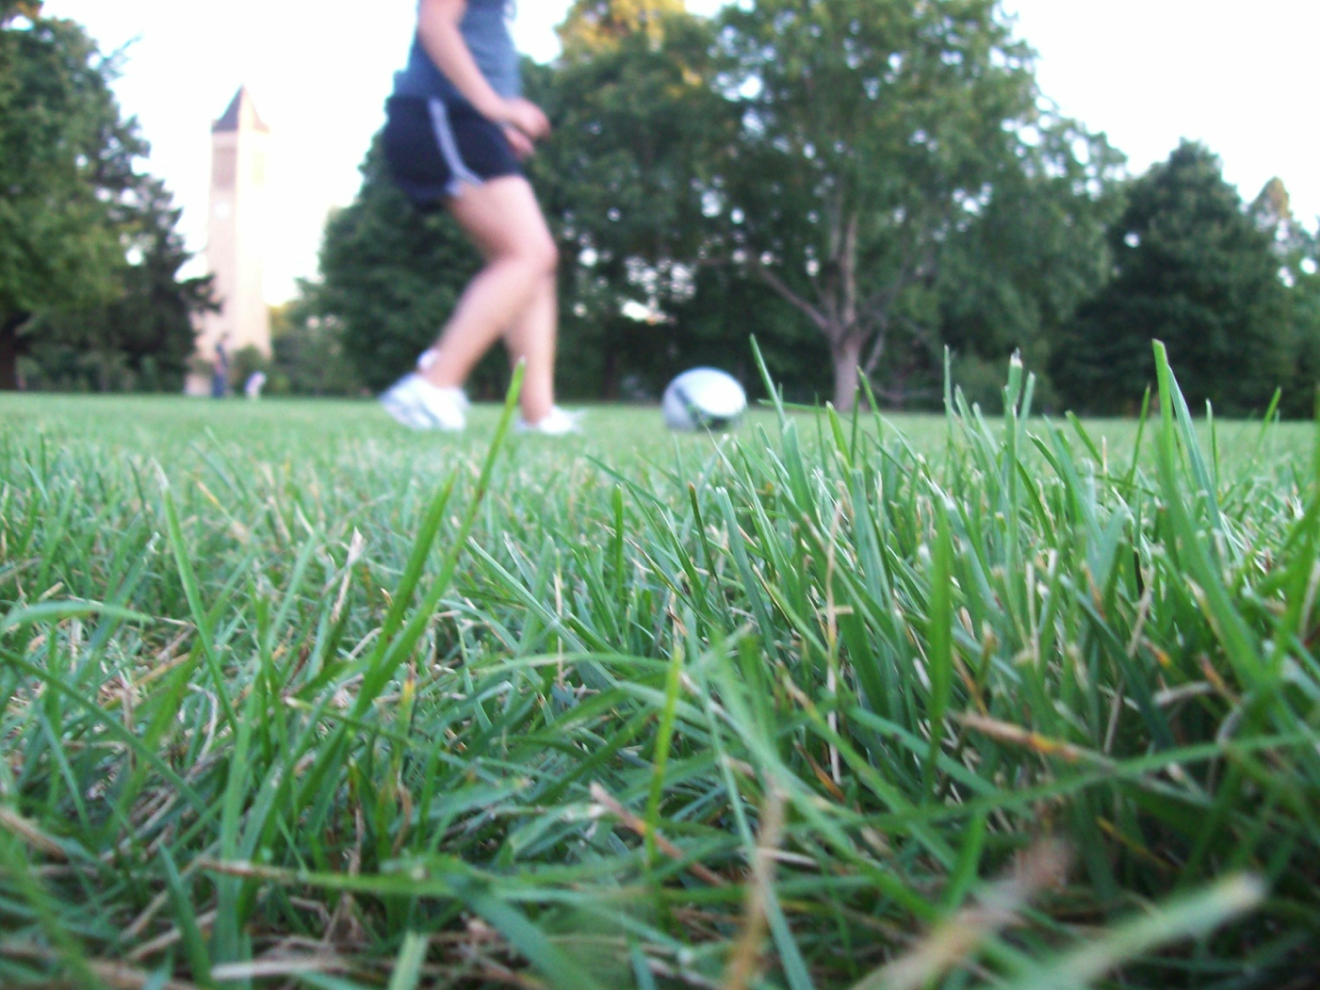
choose you’re ADVENTURE
I o w a S t a t e
Notes:
I came to Iowa State as an advertising major. My first year here I tried to get involved as much as I can. I was part of Student Activities Center’s Fresh Fotos which gave freshman the opportunity to document their first year in photos. I learned a lot of awesome photography skills and met some great people from being a part of Fresh Fotos. I was also involved with the Iowa State Daily. I became a special sections reporter because I wanted to get more experience with Journalism. As a reporter I had to interview people which really put me out of my comfort zone because I am more of an introvert. It was a great experience that will help me build me portfolio for when I apply for an internship or future job. Overall, I had a great first year. I met lots of great people, had interesting classes and even had the opportunity to give back to the community because of GWC.

Slide 5

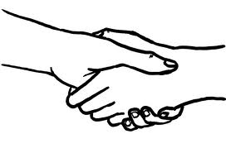





What does the future hold?
Notes:
This semester I sort of took a break. I am in the Journalism writing class which requires lots of writing so I took a break from writing for the Daily. Next semester I want to get involved again with organizations. I want to join PRSSA which is the Public Relations Student Society, because it’ll be a great way to gain experience and make connections. I also want to possibly write for Uhuru which is a student run magazine on campus. Later on, I plan to apply for an internship in something related to Journalism. This will really help me get some great experience that will eventually land me a job. Money will probably be the biggest obstacle I will have to overcome when looking for an internship, and many internships do not pay. I will continue to try my best and challenge myself to become a better student and person.

