Slide 1
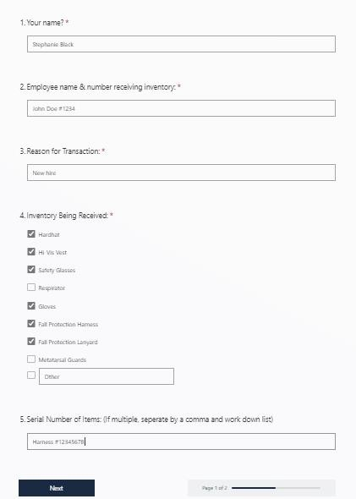
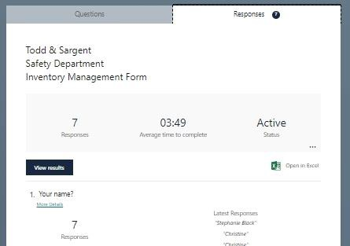
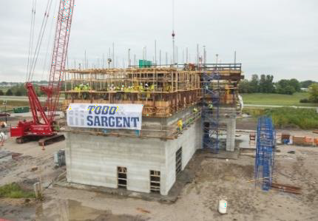

TSM Technology Capstone
*Instructors: mea1@iastate.edu; koziel@iastate.edu
Department of Agricultural and Biosystems Engineering
Stephanie Black, Robert Hodson, Patrick Albers, Jason Park - Michael E. Anderson*, Jacek A. Koziel*
Site Safety Inventory Management System
Client: Todd & Sargent - Christine Gay
Problem Statement
A significant amount of money is being spent on excess PPE and safety inventory, which can be used elsewhere to improve the company. The safety team cannot afford this expenditure over the long term overspending on excess PPE can be avoided by better housekeeping and inventory management.
FEATURES:
Objective
Reduce overspending within the safety department by implementing an inventory management system
The ability to select multiple items in a single form so you don't have to fill out separate forms for each item
Constraints
To find an existing system within the company that can be easily implemented
Management of the company-wide safety inventory
and the history of each employees PPE
Major Deliverables
An end-of-project report including any attachments and deliverables
This form keeps track of all components
using a precise system that allows users to work on it even if they don't have access to the internet.
Suitable for all age groups and includes
the client's desired components.
Results are kept private and do not disappear after completion.
Immersive reading features for those who read or speak other languages
Scope
Conducting preliminary research and brainstorming
Program development
Implementation and testing
An employee training is to be conducted by the Safety Coordinator (client) before the system is sent to job sites
A results page is generated with tables, charts, and excels for easy viewing
Methods/Approach
A software solution for logging inventory data
An online form that logs into an easily understood and accessible database is the preferred solution.
The Microsoft form can be easily incorporated into existing systems
Recommendations
Microsoft Forms automatically logs PPE usage to an Excel spreadsheet. Displays trends and patterns along with employee information.
Scannable paper form for sites without an internet connection.
Phone app for individuals with cellular or hotspot data.
Todd & Sargent is currently working on the ISU feed mill,
which is located just off Highway 30. This was the jobsite
where we tested our form to ensure it covered all of the
necessary components
Acknowledgements: Authors are grateful to Christine Gay for the opportunity to work on this project. Project was co-funded by differential tuition.

