Slide 1
My iowa state experience
By Chris Hildreth

Slide 2
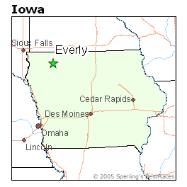
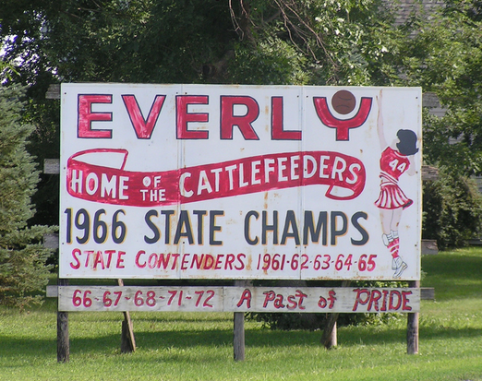
Humble Beginnings
Hometown: Everly, Iowa
Population: 603
Graduating Class: 28

Slide 3
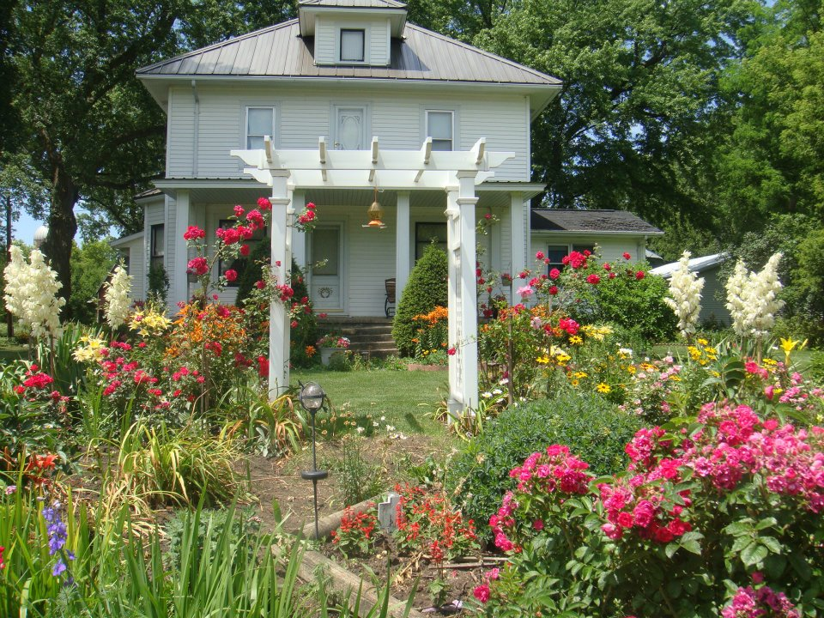
My Home
My mom’s
beautiful flowers

Slide 4
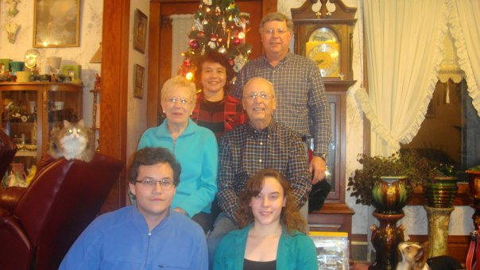
My Family
Jeff & Jellie, Bernard and Margery, then Erika and I!
Mom & Dad, Grandpa & Grandma

Slide 5
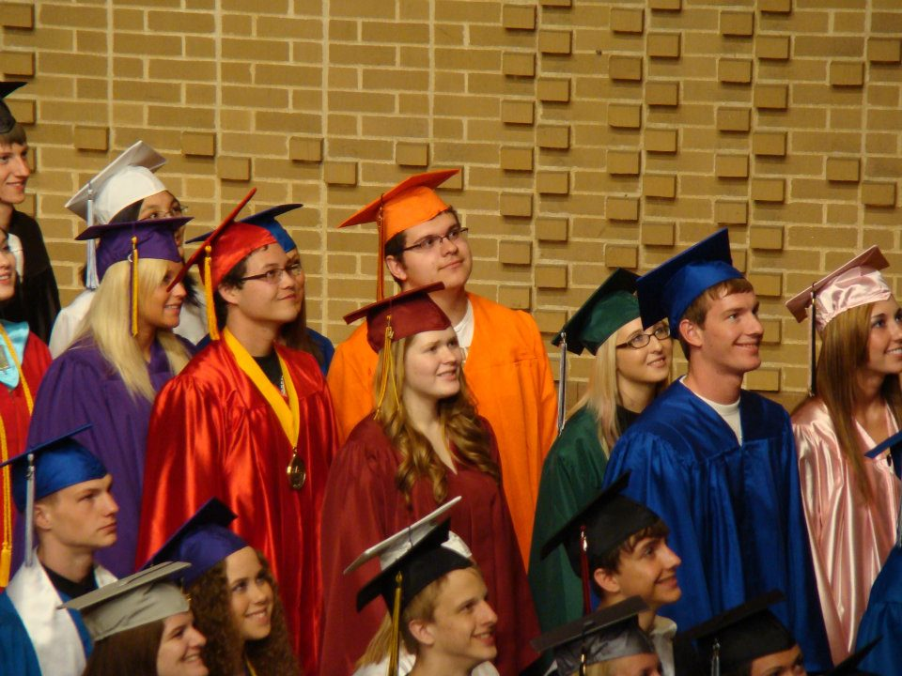
Goodbye, Highschool
Highschool
done already?
With the Valedictorians
of the area
(My higshool’s colors
were also red & gold)

Slide 6
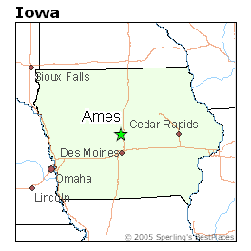
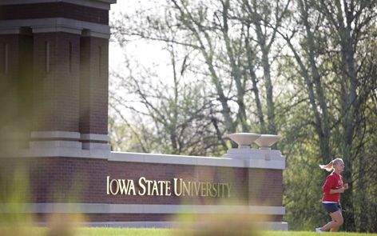
To Iowa State!
Population: ~60,000
Incoming Class: ~29,000
Just a little bigger!

Slide 7
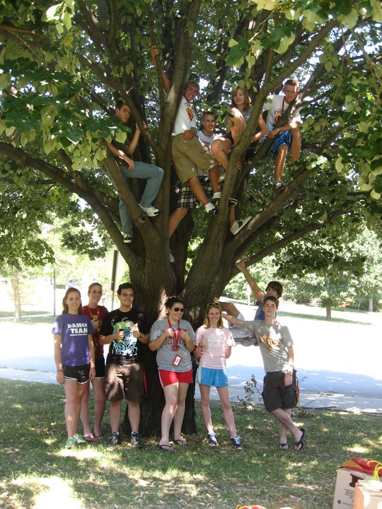
New Friends!
Meeting my floor mates

Slide 8
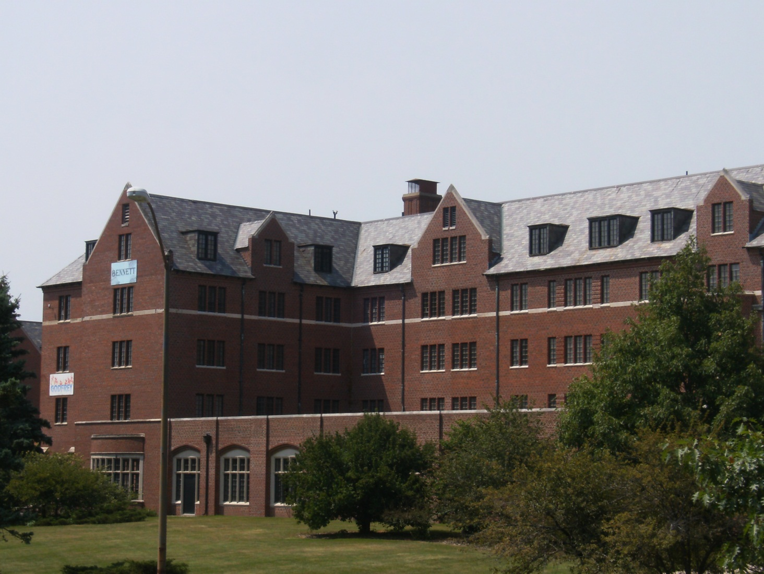
New Home – Friley Hall
My Great-grandmother
lived in Friley in the 20’s

Slide 9
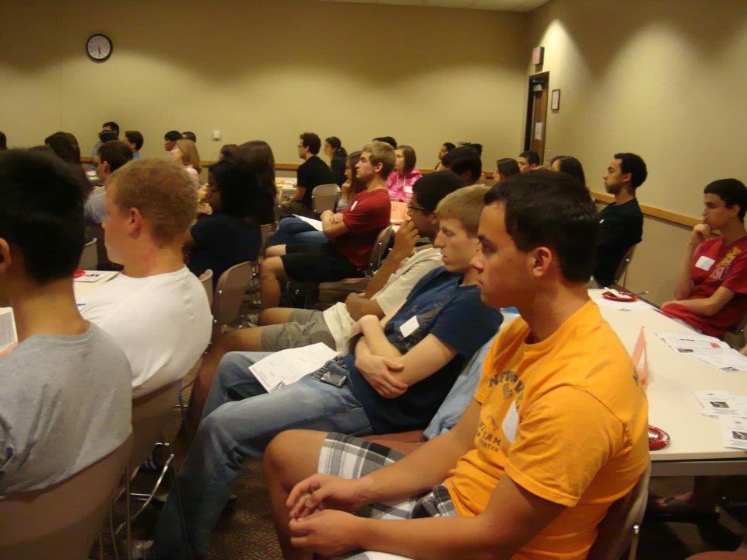
Don’t Forget George Washington Carver!
Meeting the rest
of my Carver class

Slide 10
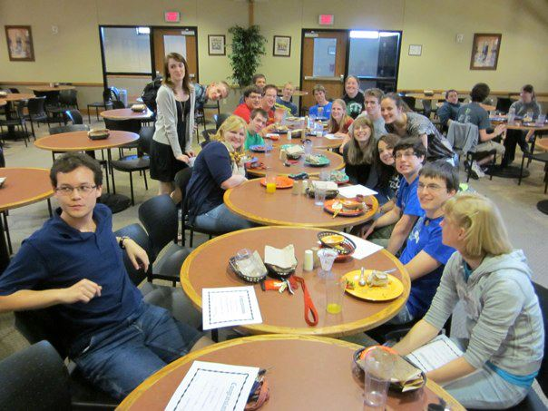
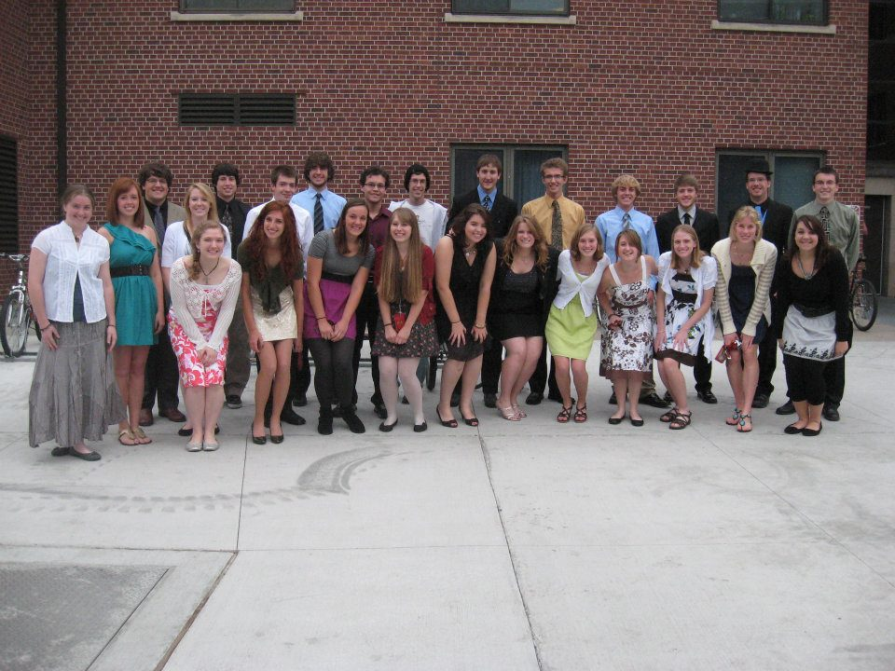
A year already done
Our last floor dinner
It goes too fast!

Slide 11
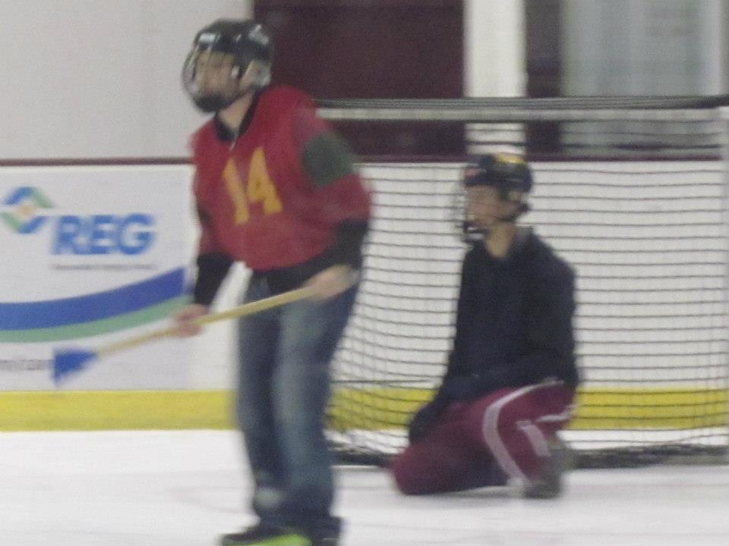
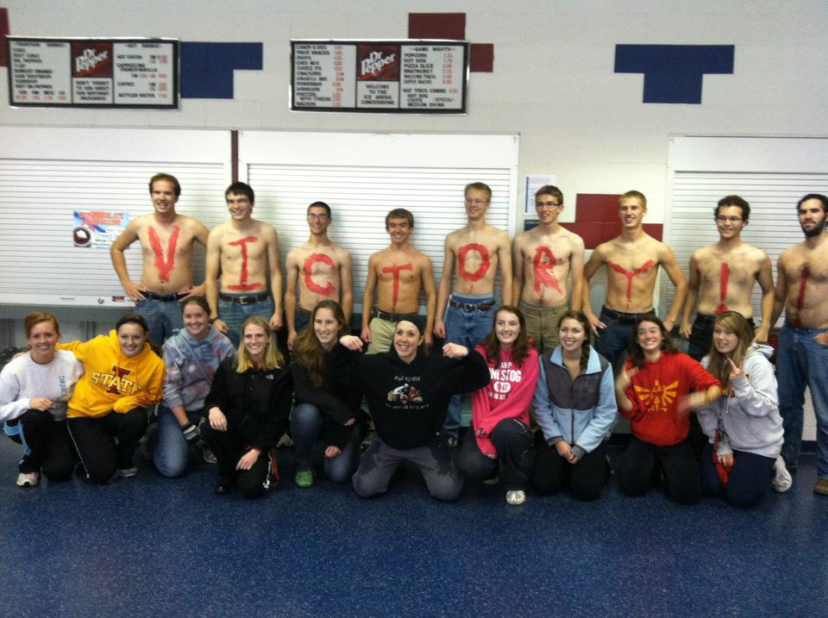
Suddenly a Sophomore
Broomball!

Slide 12
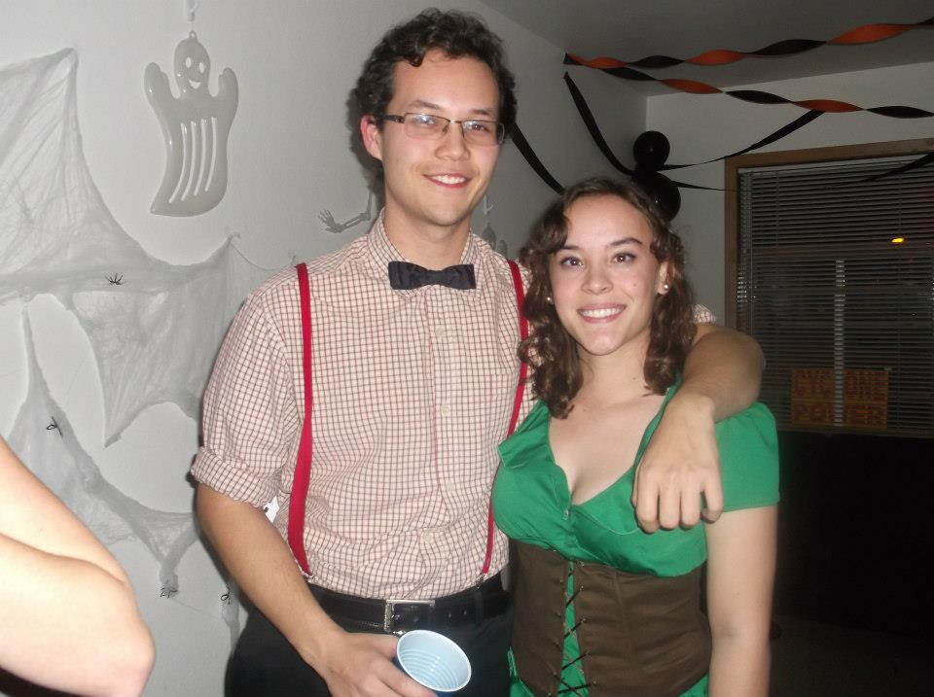
My sister has joined!
Halloween fun

Slide 13
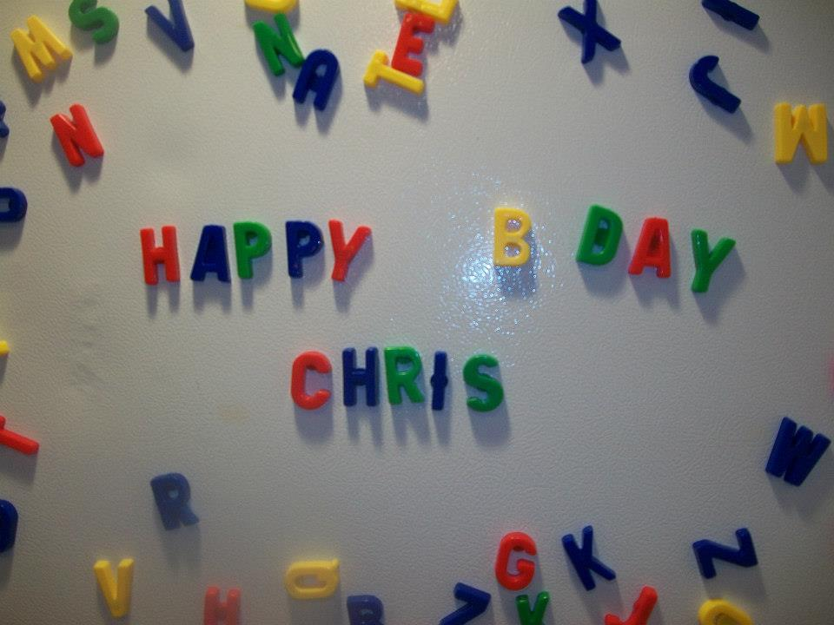
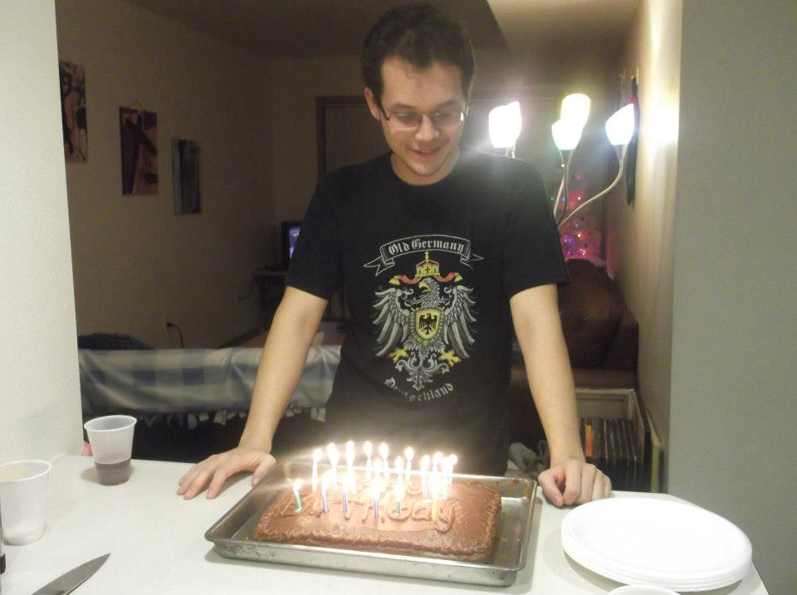
No longer a teenager
Entering my 20’s

Slide 14
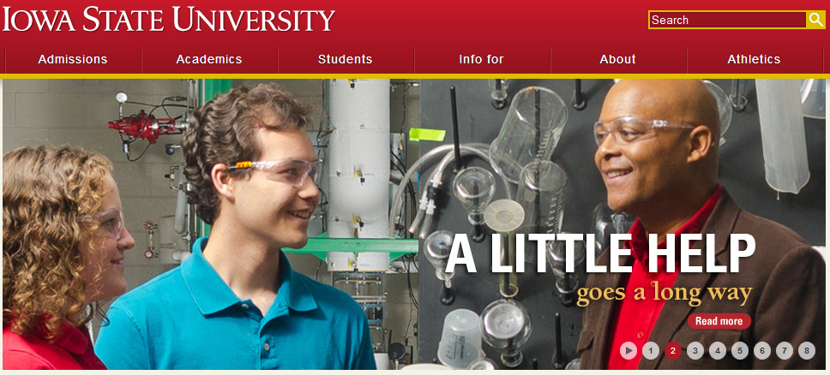
Not to mention I’m famous
With my research professor Dr. Rollins

Slide 15

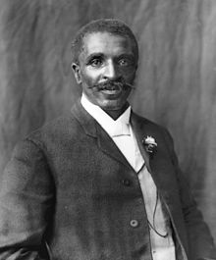
So Many Memories
I’ve met so many people, and have had so much fun. It’s impossible to show it all, so this is just a taste.
Many thanks to the GWC group and Iowa State. I know that I’ll have so much more fun and make many new memories in the years to come.

