Slide 1
The Rise of Mental Health & Effectiveness of Resources Available on College Campuses
By Annika Mikkelson

Slide 2
Purpose
To identify common feelings and behaviors among college students that correlate with mental illnesses
Determine effectiveness of resources available on Iowa State’s campus in treating mental health issues
Notes:
1-1:30 minutes
-research project for capstone course
-mental health is an issue that affects millions of people all across the world, but is particularly important in young adulthood, as that is when the most mental health disorders are first onset
-this is for many reasons, but because young adults are attending college at higher rates than generations past, more colleges are seeing the effects of these mental health issues in students
-looking at the prevalence of mental health on ISU campus based on common feelings and behaviors reported by students
-determine theeffect resources available to students are helping with and/or treating mental health concerns

Slide 3
Literature Review
Stigma of Mental Health
  Students tend not to seek help because of the perceived stigma of mental health
  Believe in handling it privately
  Stigma as a barrier to care
  Low self-esteem as a significant problem
Notes:
1-2 min
-biggest reason students don’t seek help for mental health issues is due to the perceived stigma of mental health
-Oxford Dictionary defines stigma as a mark of disgrace associated with a particular circumstance, quality or person
-young people are embarrassed or even ashamed of mental illness and therefore believe it is something that should be handled privately
-stigma is the main barrier to care for mental health- as many don’t seek out the help they need because of the fear of what others will think
-some people diagnosed with depression reported low self esteem and tasks such as finding a job are significant problems in their lives

Slide 4
Literature Review
Availability of Resources
  More exposure and experience with mental health services
  Greater acceptance of treatment
  Budget shortfalls
  Separate health fees for students
Notes:
-in preliminary research I have found many articles that discuss the relationship between stigma on mental health and help-seeking behaviors
-These previous studies done only shown how stigma influences peoples intentions for seeking help, but doesn’t include actual behavior of seeking help
-It has been noted that prior to coming to college, today’s students have more experience and exposure to mental health services more than previous generations have
- Compared to past generations, we’ve seen a greater acceptance of treatment for those with mental health problems which in turn has caused an increase in demand for these services
-Budget shortfalls have led to an increase in use of medications, shorter forms of psychotherapy and peer counseling programs over one-on-one counseling
-funding for mental health services has increased over time but some universities are finding they need to charge separate health fees to cover the treatment of mental health issues

Slide 5
Methodology
Research survey
  Likert Scale model for feelings and behaviors
  Stigmatized attitudes
  Demographics
Interviews with mental health professionals
  Resources available to students
  Effectiveness of those resources
  Trends in mental health at ISU
Notes:
1-2 min
For my own research, I developed a survey to determine common feelings of students that correlate with mental health issues as well as stigmatized beliefs of mental health
-anonymous survey for college students with 10 questions pertaining to feelings and behaviors experienced within the past two weeks and 8 questions pertaining to perceived personal and public stigma
-certain demographics were also recorded, including gender, ethnicity and geographical location of hometown in terms of rural, suburban or urban
I also conducted interviews with 3 professionals at Iowa State in the mental health field
-I asked 5 questions pertaining to the resources available on this campus, how effective they believe the resources are, and what trends they see In mental health on this campus

Slide 6
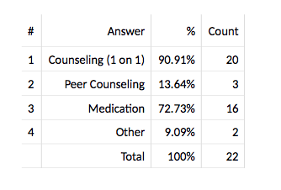
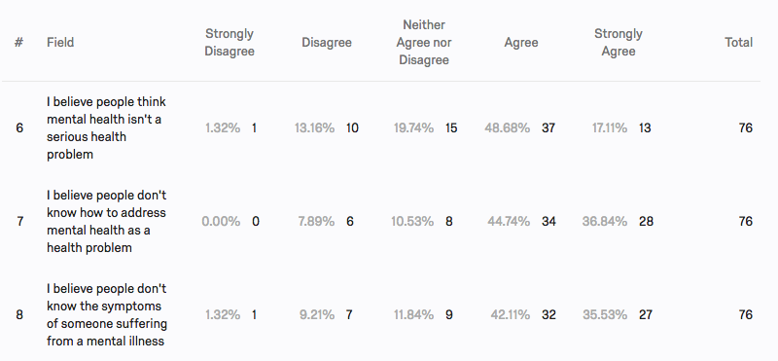
Findings from Survey
Counseling was the most commonly sought out resource by those suffering from a mental illness
Higher public stigma than personal stigma
Notes:
-After analyzing my survey results, I found that among students who reported previously being diagnosed with a mental illness, counseling was the most sought out resource, with 90% saying they had received some form of 1 on 1 counseling. In addition,14% indicated they had received some type of peer counseling as treatment for mental health issues. Other forms of treatment included biofeedback programs and self-teaching
-Something I found interesting was the differences in responses from perceived personal stigma and perceived public stigma, The first questions asked were relating to personal stigma while the last questions included the beliefs of others and related to the public stigma of mental health. Respondents were much more likely to strongly agree and agree with statements beginning with “I believe people think…” rather than the statements beginning with “I believe”
-If I was to conduct this survey again, I would tweak the questions to be exactly the same excpet for the beginning words to analyze more accurately the differences between public and personal stigma.

Slide 7
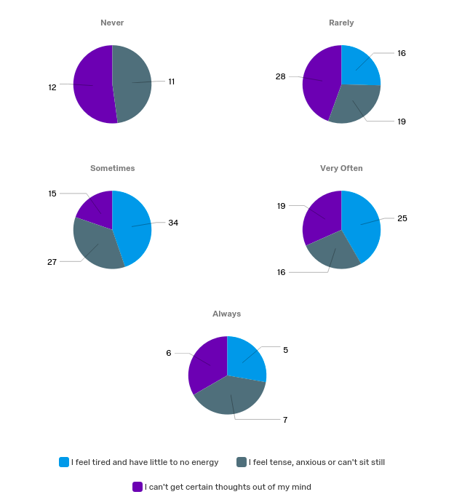
Findings from Survey
¼ of respondents indicated they often or always felt tired or had little energy, were unable to get thoughts out of their mind and felt anxious or tense
Notes:
When analyzing the results from common feelings and behaviors, I found at least ¼ of respondents were often or always tired and had little energy, were unable to get thoughts out of their mind and felt anxious and tense.
-no students responded that they never felt tired or had little energy
-these are common feelings associated with the onset of mental illnesses, and are also very common feelings in college students nationwide

Slide 8
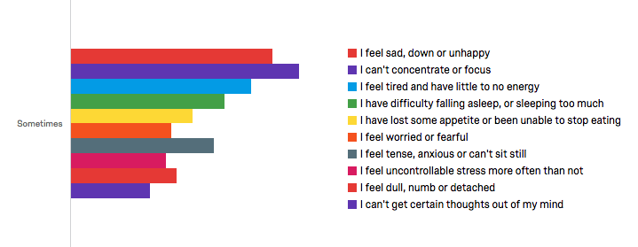
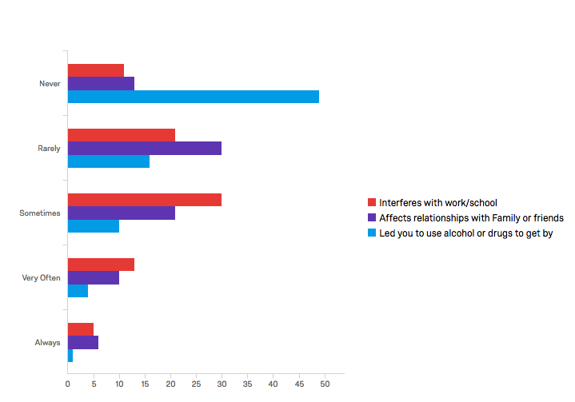
Findings from Survey
Notes:
-Over half of respondents indicated having trouble concentrating or focusing at least some of the time
-48% of students reported feeling sad, down or unhappy at least some of the time, however no one reported they always felt sad, down or unhappy during the two week span
-around 25% of respondents indicated they felt worried or fearful and anxious and tense at least some of the time
-46% of respondents indicated their behaviors affected relationships with friends or family sometimes, very often or always
-61% of respondents indicated that they never turned to drugs or alcohol as a way to get by

Slide 9
Findings from Interview
Counseling is the most sought out resource
Group counseling is very popular and has proven beneficial for students
Students are most likely to confide in peers first
Student Wellness Center as a proactive resource for wellness promotion and connecting students to resources
Notes:
-all three interviewees indicated that counseling with student counseling services was the most sought out resource for students and they believe it was also one of the most effective and beneficial in helping with mental health concerns
-with the multitude of students seeking out counseling services, the need for a waitlist has emerged, because of this group counseling or peer counseling has become very popular and one interviewee suggested it was a way to “help students realize they aren’t alone in their mental health struggles”
-Another interviewee discussed the likelihood of students confiding in peers, such as roommates, friends, significant others and sometimes family, when mental health issues arise
-the new Student Wellness Center’s goal is to be a holistic resource and to have a proactive role in preventing mental health concerns by promotion of health and wellness for students in areas like stress management. Helping to recognize and manage these concerns before they get out of control
-Thielen Student Health Center, Student Counseling Services and Student Wellness as a continuum of care for students

Slide 10
Discussions
Mental health affects all aspects of students lives
  Effects relationships with family and friends and interferes with school and work
  High percentages of respondents feeling stressed, anxious and overwhelmed
Public stigma is still seen as a barrier to discussing mental health concerns
Strong usage of resources after onset and/or diagnosis (i.e. counseling)
Notes:
-As seen in my findings, mental health can affect all aspects of students lives, from performance at school and work to relationships with family and friends.
-feelings of stress, anxiety and being overwhelmed were very common among respondent-these are also some of the most common mental health concerns seen nationwide among college students
-because of the higher perceived public stigma over personal stigma, stigma is still seen as a barrier to both seeking help and discussing mental health concerns with peers, which was also found in my preliminary research
-Those who have previously been diagnosed with mental health illnesses are very likely to use resources, especially counseling, after the diagnosis and onset of these issues

Slide 11
Recommendations
Emotional Intelligence
  Knowing yourself and knowing those around you
Stigma change
  Advocating for a change in stigma
  Open communication with peers
Student Wellness Center
  Mental health awareness
  Promoting healthy behaviors
Having a holistic view of mental health
  Mind and body
Notes:
-Mental health is a topic many people don’t understand and aren’t always comfortable discussing but one leadership theory could help us to better understand what others are going through when they have mental health concerns
-Emotional Intelligence is a leadership theory with four different sectors, self-awareness, social awareness, self-management and relationship management
-Self-awareness involves being aware of your own emotions, understanding why you have those emotions and knowing the implications of those emotions while social awareness relates to knowing and recognizing the emotions of others and being able to empathize with them, regardless of if you know what they are feeling or not
-When addressing mental health concerns in others, empathy is so important, you will not always know exactly what someone else is going through but by listening and showing empathy and concern for them, you are able to help them become more comfortable accepting the issues they have and are helping to eliminate the stigma associated with mental health
-Stigma change is an important step in being able to openly communicate about mental health, and for those suffering from mental health issues to seek the help they need, without fear of being judged or ridiculed
-The Student Wellness center is a wonderful resource, that not many people know about yet, for raising awareness of mental health and to promote healthy behaviors that could potentially prevent the onset of serious mental health concerns, their efforts can help to curve a lot of mental health issues within our campus
-Recognizing that mental health is more than just taking care of your mind is crucial in helping to change the way mental health is viewed. Taking care of your mind is just as important as taking care of your body. If you aren’t eating right, exercising or sleeping right, that can be affecting your mind in ways that you don’t even realize.
- Mental health is such an important topic, especially in college environments because it is when most mental health concerns are first onset. By taking a step back to have a more holistic view of your own mental health, and by being emotionally intelligent about those around you, we could put an end to the stigma behind mental health.

Slide 12
References
Bharadwaj, P., Pai, M. M., & Suziedelyte, A. (2015, June). Mental Health Stigma [Scholarly project]. In NBER Working Paper Series. Retrieved January 25, 2017, from http://www.nber.org/papers/w21240
Eisenberg, D., Downs, M. F., Golberstein, E., & Zivin, K. (2009). Stigma and Help Seeking for Mental Health Among College Students. Medical Care Research and Review, 66(5), 522-541. doi:10.1177/1077558709335173
Kitzrow, M. A. (2003). The Mental Health Needs of Today's College Students: Challenges and Recommendations. NASPA Journal, 41(1), 167-181. Retrieved January 25, 2017.
Kraft, D. P. (2011). One Hundred Years of College Mental Heatlh. Journal Of American College Health, 59(6), 477-481. Retrieved January 29, 2017, from http://www.informaworld.com/openurl?genre=article&doi=10.1080/07448481.2011.569964&magic=crossref||D404A21C5BB053405B1A640AFFD44AE3
Lai, Y. M., Hong, C. P., & Chee, C. I. (2001). Stigma of mental illness. Singapore Medical Journal, 42(3), 111-114. Retrieved January 25, 2017, from https://www.ncbi.nlm.nih.gov/pubmed/11405561
Saxena, S., Thornicroft, G., Knapp, M., & Whiteford, H. (2007). Resources for Mental Health: Scarcity, Inequity, and Inefficiency. Global Health, 370(9590), 878-889. doi:DOI:10.1016/S0140- 6736(07)61239-2
Watkins, D. C., Hunt, J. B., & Eisenberg, D. (2011). Increased Demand for Mental Health Services on College Campuses: Perspective from Administrators. SAGE Journals, 11(3), 319-337. doi:DOI: 10.1177/1473325011401468
Zivin, K., Eisenberg, D., Gollust, S., Golberstein, E. (2009). Persistence of mental health problems and needs in a college student population. Journal of Affective Disorders, 117(3), 180-185.

