Slide 1
Arts Engagement in the College Years:
A Longitudinal Study
What Can We Learn about Students’ Expectations, Preparation, Identity and Transformation?
Alliance for the Arts in Research Universities Annual Meeting
Iowa State University
11/6/14
Presented by Deb Mexicotte
Arts at Michigan, University of Michigan

Slide 2
Arts at Michigan Programs and Services
Arts in Residence
Art Outta Town
Arts Ambassadors
Arts Info Newsletter
Comprehensive Arts Website
  Calendar
  Student Blogs
  Feeds and features
Funding Programs
  Course Connections
  Student Mini-grants
Passport to the Arts
As I See It Photo Competitions
UpstART Festival
Student HUB
Student Arts Organization Roundtable
Reflective E-Portfolios
Arts Engagement Project
Notes:
Arts at Michigan Elevator Speech
Funded through the Provosts Office, and housed in the Office of New Student Programs.
Explanation of Progams and Services
If it is about co-curricular arts engagement, on the University of Michigan main campus, we are it, which led to us considering adding a research component to our work – the Arts Engagement Project. Especially when speaking to my colleagues about students arts engagement needs, I am sometimes met with - Students seem happy with the way things are, where is the data?

Slide 3
Advocacy for Student Arts Organizations
What do student organizations doing the arts need and how do we know?
  Facilities/Equipment
  Funding
  Advertising/Marketing
  Organizational Development
  Technical Expertise
  Ticketing
  Alumni Development
  Community Visibility
  Advising Network
  Why was it important for the University to increase support for student arts organizations?

Slide 4
Impact of Participation in Student Arts Organizations
How do we describe the spaces in which students engage and learn outside the classroom.
  Peer-to-Peer Learning
  “Expert” Sharing
  Advising/Mentoring
How do we measure the impact/value of that learning?
How does this engagement in co-curricular arts create value for the individual and the campus environment.

Slide 5
The Arts Engagement Project
UM Context
  University of Michigan
    Arts at Michigan Mission
    Perception/Reality of Arts Rich Campus Experience
    Growth, Demand and Competition for Arts Programming/Student Organizations
      ~1500 Student Organizations/~ 200 Directly Engaged in the Arts
    Climate for Student Development through Arts Engagement
    Interested in Interactions between Curricular and Co-Curricular experiences
      Liberal Arts Education/Student Expectations
    Data Driven Policy/Resource Recommendations
      Student Focus Groups 2010-2012
        88 Student Leaders
        33 Arts Organizations
        Importance to UM Education and Beyond

Slide 6
The Arts Engagement Project
National Context
  Alliance for the Arts in Research Universities(A2RU)
    Creativity versus the Arts
    Role of art-making in the college experience
    Skill building through arts engagement
      Arts Ambassador Reflective E-Portfolio Program
  Arts as catalyst for economic development
Funding Context
  Sr. Vice Provost for the Arts/Office of New Student Programs
    Graduate Student Support
    Professional Development
  Exploring Learning Analytics Grant
    2 Year Funding
    Database Formatting and Analysis
    Research Context
      IRB Reviewed/Exempt Study
      Literature Review

Slide 7
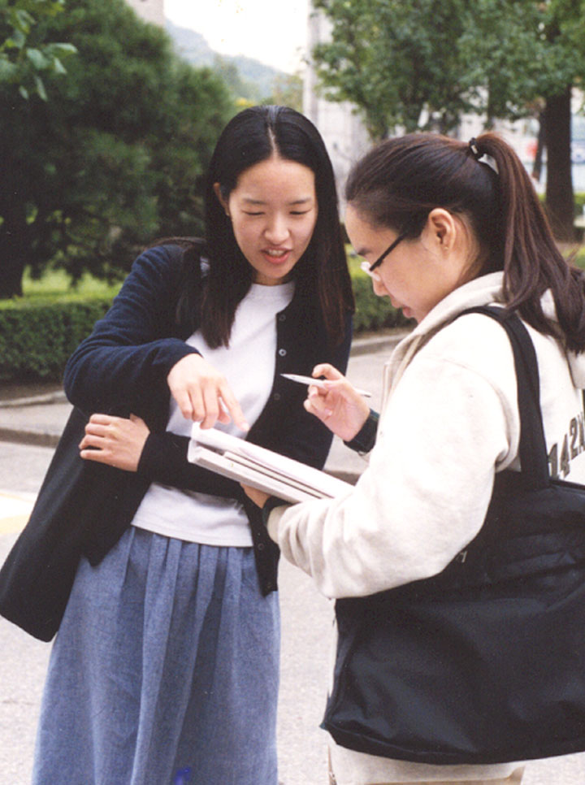
Research, Surveys and Literature
Existing Research Primarily K-12
  Almost no research currently published on effects of arts engagement on college age students
Programmatic Surveys and Assessments
  More typical of Student Engagement programs
  Quantity versus Quality
The (“Out of Our Minds” by Ken Robinson)
Discussion Starter
NSSE /CIRP
  2006 Supplemental Arts Test
Creativity Testing
Curricular vs. Co-Curricular Engagement
  Multi-Disciplinary Discussion
  Academic and Co-Curricular Transcripts
  Portfolio Learning and Research

Slide 8
Survey Goals
  Describe UM Students and their Engagement in the Arts to the University
Database Creation
    Longitudinal survey data
    Demographic data
    Academic Data
    Major
    GPA
  Expansion to/Comparisons with other Universities

Slide 9
Survey Goals
Describing Our Students
  Are students engaging in the arts, and if so, which arts, how, where and how often?
  What characteristics differentiate students engaging in the arts from those not engaging?
  How do students feel about their arts engagement and what do they get out of it?
  What skills or knowledge do students gain at college through co-curricular arts engagement?
  What do students expect of their arts experiences at college?
  Do students engage with the arts to a greater or lesser degree at college vs. high school?

Slide 10
Survey Goals
Describing Our Students
  How does engagement in the arts at college translate into careers in the arts?
  How does engagement in the arts influence career choices or arts participation after college?
  What factors make a student more likely to engage in the arts in college? Less likely?
  What levels of arts participation have what kinds of outcomes (audience vs. art-making, type of arts interest?)
  Do students identify themselves as artists?
  How does participation in the arts contribute to student learning and development outcomes?

Slide 11
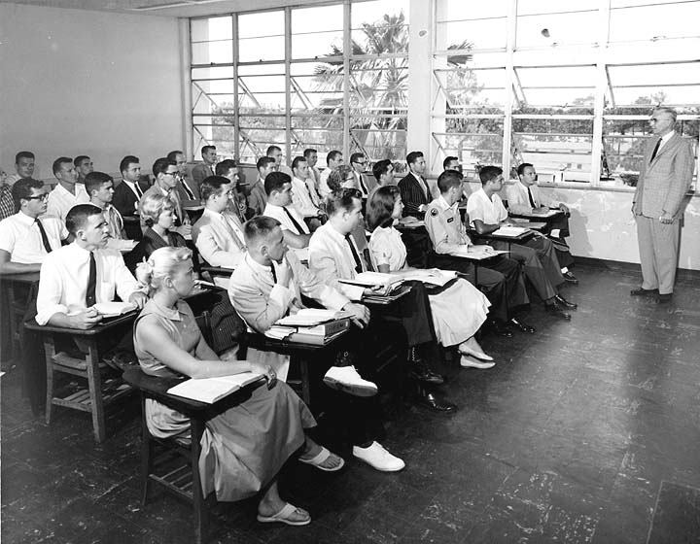
Survey Goals
Database Creation
  The Arts Engagement Assessment project has created a robust database that could be used to answer questions about student arts engagement at UM and the environmental and transitional factors that support that engagement.
    ~3000 invitations for each cohort (25% initial return)
    ~ 4000 individual students have participated at least once in information gathering surveys
    4 year cohort is ~200 students with 5 longitudinal data sets (about 3.5% of the cohort)

Slide 12
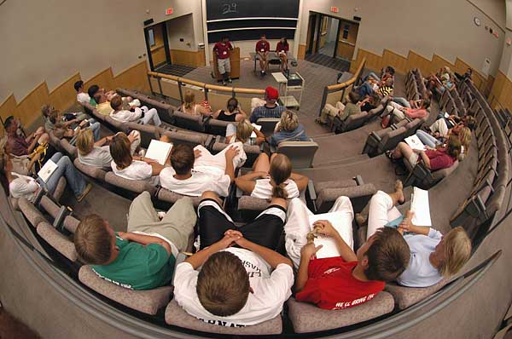

Survey Goals
Expansion to/Comparisons with other Universities
Similar studies (or modules) might be done at other institutions to compare different campus experiences and student demographic groups, and that new arts engagement best practices and recommendations would emerge both locally and nationally.

Slide 13
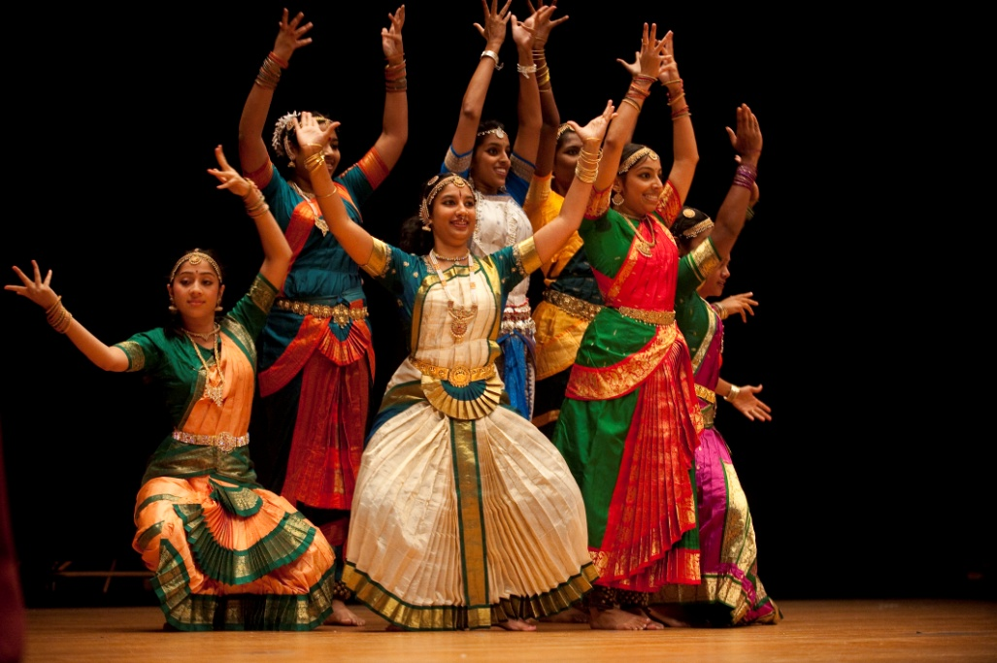
Learning Outcomes
Appreciating Diversity
Appreciates diverse perspectives and experiences
Understands one’s own culture
Understands the role of arts and culture in a diverse and global society
Shakti, JHU
Survey Questions:
I find art a good way to explore other cultures.
I think art is a good way for me to learn more about my culture
and identity.
I think art has an important role in promoting diversity in society.

Slide 14
Learning Outcomes
Creativity
Expresses ideas in new ways
Creates artistic work
Demonstrates ability to generate and examine multiple solutions and approaches
Chemistry Lab, UM
Survey Questions:
I find it easy to come up with new ideas and figure out which are
the best.
I am often the one that comes up with an unusual or unique way of doing something.

Slide 15
Survey Modules
Freshman 1 - October
Questions | Frosh 1
1 and 2 | SES
3 thru 5 | HS Classification
6 | How do you define arts
7 thru 15 | HS Experiences
16 | HS Expectation of College Involvement
17 and 18 | I Test
19 | Focus Group
Notes:
Given to incoming class in the fall
Some demographics, around high school and family characteristics
High School Arts Experiences
I Test

Slide 16
Survey Modules
Freshman 2 - March
Questions | Frosh 2
1 thru 18 | College Experiences/Impressions
19 thru 20 | Anticipated Future Involvement
21 | Personal Characteristics
22 thru 23 | I Test
24 | Focus Group
Notes:
First of the annual college experience tests

Slide 17
Survey Modules
Sophomore- March
Questions | Sophomore
1 thru 18 | College Experiences/Impressions
19 and 20 | Anticipated Future Involvement
21 | Personal Characteristics
22 thru 30 | Childhood
26 and 27 | I Test
28 | Focus Group
Notes:
Childhood arts engagement experience

Slide 18
Survey Modules
Junior- March
Questions | Junior
1 thru 18 | College Experiences/Impressions
19 and 20 | Anticipated Future Involvement
21 | Personal Characteristics
22 thru 25 | College Reflection
26 and 27 | I Test
28 | Focus Group

Slide 19
Survey Modules
Senior- March
Questions | Senior
1 thru 18 | College Experiences/Impressions
19 and 20 | Anticipated Future Involvement
21 | Personal Characteristics
22 thru 31 | College Reflection/Future
32 and 33 | I Test
34 | Focus Group
Notes:
College Reflection
The turn to a reflection back and a look forward

Slide 20
Demonstrating the Power of the Arts Engagement Database
Initial Findings
  Full Database/The “200”
  Descriptive Data
    Demographics
    I-Test
      Correlation to personal attributes
      Probability of Identity Maintenance
    Expectations of College Involvement

Slide 21
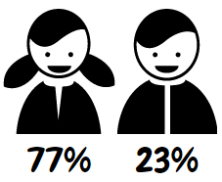
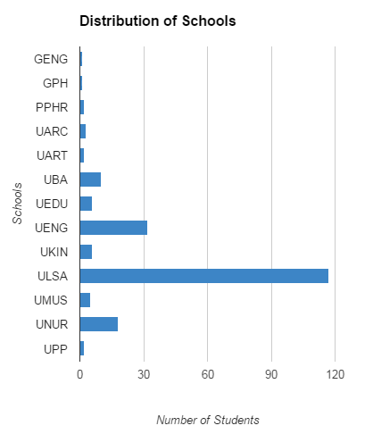
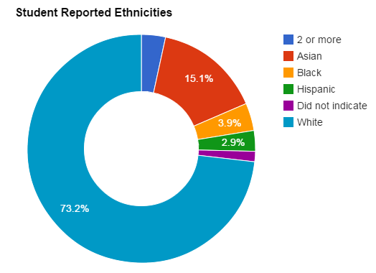
“The 200” Demographics

Slide 22
Initial Findings
High School Involvement
Student Expectation of Being Involved in the Arts during College Prior to Beginning College
Notes:
A very similar looking graph –
Who are the first bar – those engaged frequently?
Move back to other slide?

Slide 23
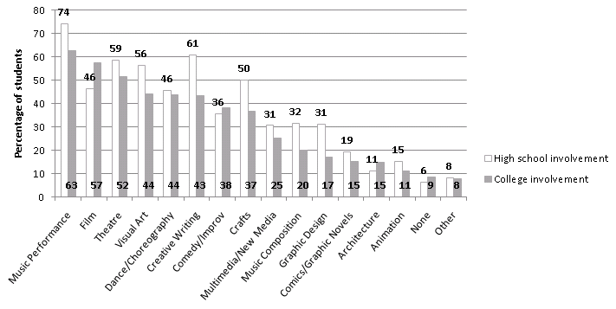
Initial Analysis
Comparison of High School and College Involvement
Are there enough opportunities for those who want them ?
Notes:
Comparison between Frosh 1 and Frosh 2
Decrease in almost every category (except architecture and improv comedy)
What do we think about this trend?

Slide 24
Percent Participation of the 200
Freshmen Participation | No Identity | Some Artistic Identity
Weekly | 3.70 | 19.6
Monthly | 14.81 | 53.76
Yearly | 81.48 | 95.7
Sophomore Participation | No Identity | Some Artistic Identity
Weekly | 4.26 | 20.0
Monthly | 14.89 | 45.24
Yearly | 68.09 | 95.24
Junior Participation | No Identity | Some Artistic Identity
Weekly | 3.77 | 19.01
Monthly | 22.64 | 50.0
Yearly | 67.92 | 96.72
Senior Participation | No Identity | Some Artistic Identity
Weekly | 2.08 | 17.39
Monthly | 14.58 | 43.10
Yearly | 70.83 | 95.69

Slide 25
Implications
Since students expect to be involved in the arts in college – we need to prepare them to take advantage of their opportunities
We need to identify students for whom the arts are very important (half of them!) and market the University accordingly during recruitment.
We need to understand if students expectations are being met, and whether we are delivering on their vocational and avocational aspirations.
We need to understand why 46% of our incoming students do not expect to be involved in the arts in college.

Slide 26
Initial Analysis
Artist as Identity
A self-identification section was asked on the questionnaire to describe whether students thought of themselves as artists.
Hypothesis: The self reported artist identities will decrease at the end of the 4 year college experience.
If true, is this loss of artist identity acceptable or expected at a liberal arts institution?
Notes:
76.8 % describe themselves as artists – a huge percentage.
What will that number be at the end of 4 years?

Slide 27
Initial Findings
Artists Upon Leaving High School
Arts-Related Identification by Artist Type
Notes:
Almost 50 % musicians
33% Creative Writers
28% Visual Artists
These numbers are not reflective of those percentages majoring in these areas, so are avocational in nature.

Slide 28
The 200: Identity Percentages, Losses, and Gains
These are the percentages of students in the 200 that belong to each artistic identity
Identity | Percent Freshman Year | Percent Senior Year
Musician | 52.17 | 40.17
Visual Artist | 37.07 | 31.03
Dancer | 17.24 | 16.38
Creative Writer | 32.76 | 27.59
Filmmaker | 8.7 | 8.7
Graphic Designer | 15.25 | 15.25
Architect | 6.09 | 6.09
Designer | 14.53 | 18.80
Actor | 15.38 | 6.84

Slide 29
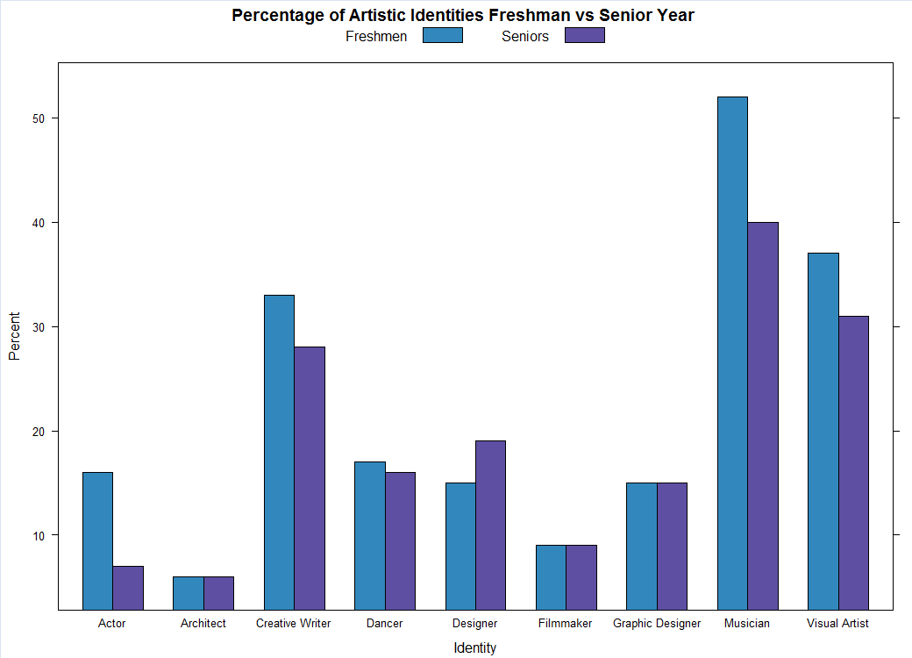
Change in Reported Identities

Slide 30
Change in Reported Identities
Losses
These are the probabilities that a freshman will lose their artistic identity by senior year
Identity | Probability of Loss
Musician | 0.256
Visual Artist | 0.349
Dancer | 0.4
Creative Writer | 0.289
Filmmaker | 0.4
Graphic Designer | 0.556
Architect | 0.571
Designer | 0.471
Actor | 0.72
For example: A freshman with a musician identity has a 25% chance of losing their musician identity by senior year.

Slide 31
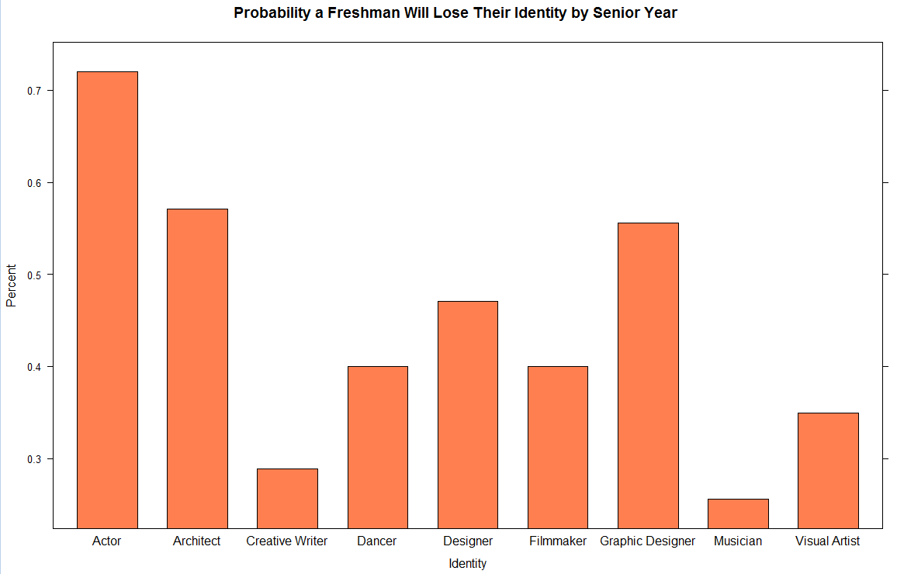
Changes in Reported Identities

Slide 32
Gains in Reported Identities
Gains
These are the probabilities that a freshman will gain each identity by senior year
Identity | Probability of Gain
Musician | 0.179
Visual Artist | 0.1096
Dancer | 0.0727
Creative Writer | 0.0641
Filmmaker | 0.0095
Graphic Designer | 0.10
Architect | 0.037
Designer | 0.130
Actor | 0.030
For example: A freshman with no musician identity has a 17.9% chance of gaining a musician identity by senior year.

Slide 33
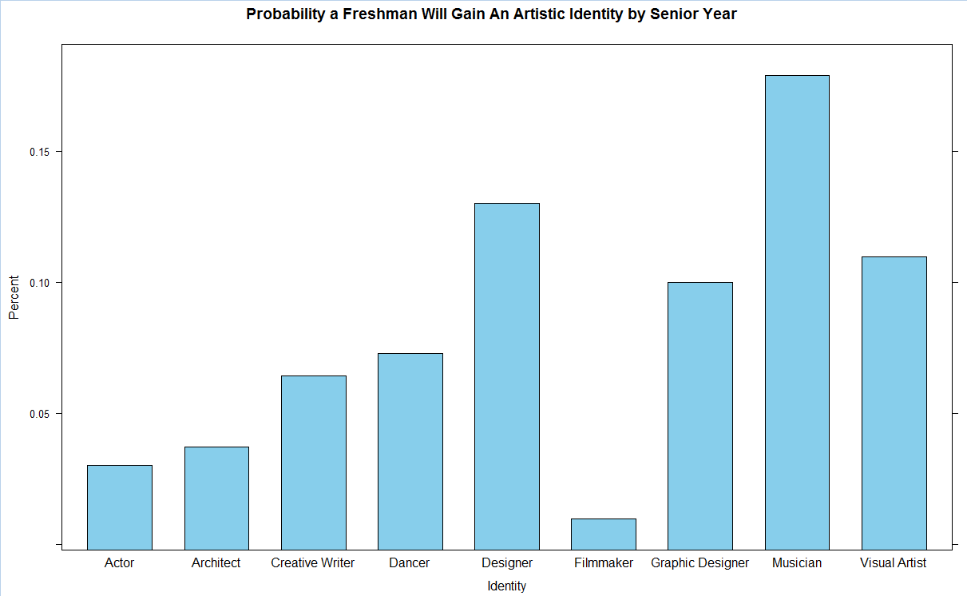
Gains in Reported Identities

Slide 34
Identity Maintenance/Acquisition
Musician
  Strong Maintenance Over Time
  Highest Likelihood for Identity Acquisition
  What does this tell us about support for this identity at Michigan?
  What does this tell us about the relationship between preparation and identity maintenance?
Actor
  Weak Maintenance Over time
  Low Likelihood for Identity Acquisition
  What is different about the maintenance of this identity versus Musician (Student Organization Tally - Music 47/Theatre 23)?

Slide 35
Personal Characteristics Findings FR1
Musician
Statement | Mann-Whitney U | Wilcoxon W | Z | Asymp. Sig. (2-tailed) | Identity | Survey | Adjustment | Adjusted p-value
Statement: I communicate effectively through art. | 553513.000 | 1417468.000 | -12.670 | .000 | a. Grouping Variable: Identity: I am a musician. | FR1 | 233 | 2.01E-34
Statement: I find it easy to use information and skills gotten from my interest in art in other areas of my life. | 569685.000 | 1433640.000 | -11.958 | .000 | a. Grouping Variable: Identity: I am a musician. | FR1 | 232 | 1.36E-30
Statement: I am able to do complicated things in intentional ways. | 624394.500 | 1488349.500 | -8.966 | .000 | a. Grouping Variable: Identity: I am a musician. | FR1 | 225 | 6.9E-17
Statement: I communicate effectively through writing. | 694765.500 | 1558720.500 | -4.330 | .000 | a. Grouping Variable: Identity: I am a musician. | FR1 | 169 | 0.002519
Statement: I communicate effectively in other ways. | 710289.000 | 1574244.000 | -3.684 | .000 | a. Grouping Variable: Identity: I am a musician. | FR1 | 156 | 0.035772

Slide 36
Personal Characteristics Findings FR2
Musician
Statement | Mann-Whitney U | Wilcoxon W | Z | Asymp. Sig. (2-tailed) | Identity | Survey | Adjustment | Adjusted p-value
F2 Statement: I communicate effectively through art. | 131922.500 | 348733.500 | -8.210 | .000 | a. Grouping Variable: F2 Identity: I am a musician. | FR2 | 218 | 4.83E-14
F2 Statement: I find it easy to use information and skills gotten from my interest in art in other areas of my life. | 150579.000 | 367390.000 | -5.132 | .000 | a. Grouping Variable: F2 Identity: I am a musician. | FR2 | 188 | 5.39E-05
F2 Statement: I communicate effectively in other ways. | 156173.500 | 371669.500 | -4.150 | .000 | a. Grouping Variable: F2 Identity: I am a musician. | FR2 | 167 | 0.005542
F2 Statement: I am able to do complicated things in intentional ways. | 158754.000 | 376884.000 | -3.987 | .000 | a. Grouping Variable: F2 Identity: I am a musician. | FR2 | 163 | 0.010923

Slide 37
Personal Characteristics Findings SO
Musician
Statement | Mann-Whitney U | Wilcoxon W | Z | Asymp. Sig. (2-tailed) | Identity | Survey | Adjustment | Adjusted p-value
SO Statement: I communicate effectively through art. | 138717.500 | 370938.500 | -7.182 | .000 | a. Grouping Variable: SO Identity: I am a musician. | SO | 211 | 1.45006E-10
SO Statement: I find it easy to use information and skills gotten from my interest in art in other areas of my life. | 140830.500 | 372370.500 | -6.998 | .000 | a. Grouping Variable: SO Identity: I am a musician. | SO | 209 | 5.43524E-10
SO Statement: I am able to do complicated things in intentional ways. | 157362.500 | 388222.500 | -4.178 | .000 | a. Grouping Variable: SO Identity: I am a musician. | SO | 168 | 0.004931609

Slide 38
Personal Characteristics Findings JR
Musician
JR Statement: I communicate effectively through art. | 109212.000 | 331323.000 | -8.573 | .000 | a. Grouping Variable: JR Identity: I am a musician. | JR | 221 | 2.23E-15
JR Statement: I find it easy to use information and skills gotten from my interest in art in other areas of my life. | 129237.500 | 353352.500 | -4.829 | .000 | a. Grouping Variable: JR Identity: I am a musician. | JR | 181 | 0.000249

Slide 39
Personal Characteristics Findings SR
Musician
SR Statement: I communicate effectively through art. | 126504.000 | 411139.000 | -7.731 | .000 | a. Grouping Variable: SR Identity: I am a musician. | SR | 214 | 2.27E-12
SR Statement: I find it easy to use information and skills gotten from my interest in art in other areas of my life. | 131941.500 | 415822.500 | -6.912 | .000 | a. Grouping Variable: SR Identity: I am a musician. | SR | 207 | 9.87E-10
SR Statement: I am able to do complicated things in intentional ways. | 145510.500 | 430145.500 | -4.598 | .000 | a. Grouping Variable: SR Identity: I am a musician. | SR | 176 | 0.000751

Slide 40
Personal Characteristics Findings F1
Actor/Actress
Statement: I find it easy to use information and skills gotten from my interest in art in other areas of my life. | 295528.000 | 2436943.000 | -9.608 | .000 | a. Grouping Variable: Identity: I am an actor/actress. | FR1 | 228 | 1.68E-19
Statement: I communicate effectively through art. | 295864.000 | 2437279.000 | -9.379 | .000 | a. Grouping Variable: Identity: I am an actor/actress. | FR1 | 227 | 1.51E-18
Statement: I communicate effectively through speaking. | 331621.500 | 2473036.500 | -6.715 | .000 | a. Grouping Variable: Identity: I am an actor/actress. | FR1 | 206 | 3.87E-09
Statement: I am able to do complicated things in intentional ways. | 337734.500 | 2479149.500 | -6.327 | .000 | a. Grouping Variable: Identity: I am an actor/actress. | FR1 | 203 | 5.07E-08
Statement: I communicate effectively in other ways. | 359029.000 | 2500444.000 | -4.680 | .000 | a. Grouping Variable: Identity: I am an actor/actress. | FR1 | 178 | 0.000511
Statement: I communicate effectively through writing. | 358143.500 | 2499558.500 | -4.372 | .000 | a. Grouping Variable: Identity: I am an actor/actress. | FR1 | 171 | 0.002101
Statement: I am comfortable explaining complicated and abstract ideas. | 363504.000 | 2504919.000 | -4.009 | .000 | a. Grouping Variable: Identity: I am an actor/actress. | FR1 | 164 | 0.009992
Statement: I have good problem-solving skills. | 368735.000 | 2510150.000 | -3.701 | .000 | a. Grouping Variable: Identity: I am an actor/actress. | FR1 | 157 | 0.033759
Statement: I can effectively manage complicated projects. | 370142.500 | 2511557.500 | -3.652 | .000 | a. Grouping Variable: Identity: I am an actor/actress. | FR1 | 155 | 0.040312

Slide 41
Personal Characteristics Findings F2
Actor/Actress
F2 Statement: I communicate effectively through art. | 65038.000 | 586769.000 | -5.943 | .000 | a. Grouping Variable: F2 Identity: I am an actor/actress. | FR2 | 200 | 5.6E-07
F2 Statement: I find it easy to use information and skills gotten from my interest in art in other areas of my life. | 64605.500 | 592483.500 | -5.882 | .000 | a. Grouping Variable: F2 Identity: I am an actor/actress. | FR2 | 198 | 8.05E-07
F2 Statement: I communicate effectively in other ways. | 68323.500 | 586994.500 | -5.484 | .000 | a. Grouping Variable: F2 Identity: I am an actor/actress. | FR2 | 194 | 8.05E-06
F2 Statement: I communicate effectively through speaking. | 67467.000 | 588177.000 | -5.484 | .000 | a. Grouping Variable: F2 Identity: I am an actor/actress. | FR2 | 195 | 8.09E-06
F2 Statement: I communicate effectively through writing. | 69960.000 | 592713.000 | -4.881 | .000 | a. Grouping Variable: F2 Identity: I am an actor/actress. | FR2 | 182 | 0.000193

Slide 42
Personal Characteristics Findings SR
Actor/Actress
SR Statement: I communicate effectively through art. | 36971.000 | 617474.000 | -8.471 | .000 | a. Grouping Variable: SR Identity: I am an actor/actress. | SR | 220 | 5.36E-15
SR Statement: I find it easy to use information and skills gotten from my interest in art in other areas of my life. | 44293.500 | 624796.500 | -6.535 | .000 | a. Grouping Variable: SR Identity: I am an actor/actress. | SR | 205 | 1.31E-08
SR Statement: I communicate effectively in other ways. | 54644.500 | 634070.500 | -3.611 | .000 | a. Grouping Variable: SR Identity: I am an actor/actress. | SR | 154 | 0.047001

Slide 43
Personal Characteristics Findings F1
Performer
Statement: I communicate effectively through art. | 461652.000 | 1634398.000 | -15.826 | .000 | a. Grouping Variable: Identity: I perform. | FR1 | 239 | 4.92E-54
Statement: I find it easy to use information and skills gotten from my interest in art in other areas of my life. | 493057.500 | 1665803.500 | -14.191 | .000 | a. Grouping Variable: Identity: I perform. | FR1 | 238 | 2.49E-43
Statement: I am able to do complicated things in intentional ways. | 578278.000 | 1751024.000 | -9.167 | .000 | a. Grouping Variable: Identity: I perform. | FR1 | 226 | 1.1E-17
Statement: I communicate effectively in other ways. | 614393.500 | 1787139.500 | -7.100 | .000 | a. Grouping Variable: Identity: I perform. | FR1 | 210 | 2.62E-10
Statement: I can effectively manage complicated projects. | 639375.000 | 1812121.000 | -5.358 | .000 | a. Grouping Variable: Identity: I perform. | FR1 | 193 | 1.63E-05
Statement: I communicate effectively through writing. | 635415.000 | 1808161.000 | -5.197 | .000 | a. Grouping Variable: Identity: I perform. | FR1 | 189 | 3.83E-05
Statement: I communicate effectively through speaking. | 638658.500 | 1811404.500 | -5.099 | .000 | a. Grouping Variable: Identity: I perform. | FR1 | 187 | 6.4E-05
Statement: I am able to realistically assess my strengths and weaknesses. | 644486.000 | 1817232.000 | -4.995 | .000 | a. Grouping Variable: Identity: I perform. | FR1 | 184 | 0.000109
Statement: I work well in groups. | 644866.500 | 1817612.500 | -4.945 | .000 | a. Grouping Variable: Identity: I perform. | FR1 | 183 | 0.00014
Statement: I have good problem-solving skills. | 650116.000 | 1822862.000 | -4.527 | .000 | a. Grouping Variable: Identity: I perform. | FR1 | 175 | 0.001046
Statement: I am comfortable explaining complicated and abstract ideas. | 649199.000 | 1821945.000 | -4.422 | .000 | a. Grouping Variable: Identity: I perform. | FR1 | 172 | 0.001679

Slide 44
Personal Characteristics Findings F2
Performer
F2 Statement: I communicate effectively through art. | 112829.500 | 388482.500 | -10.133 | .000 | a. Grouping Variable: F2 Identity: I perform. | FR2 | 230 | 9.08E-22
F2 Statement: I find it easy to use information and skills gotten from my interest in art in other areas of my life. | 121086.500 | 396739.500 | -8.958 | .000 | a. Grouping Variable: F2 Identity: I perform. | FR2 | 224 | 7.44E-17
F2 Statement: I communicate effectively in other ways. | 135394.000 | 408824.000 | -6.502 | .000 | a. Grouping Variable: F2 Identity: I perform. | FR2 | 204 | 1.62E-08
F2 Statement: I am able to do complicated things in intentional ways. | 139357.000 | 417242.000 | -5.921 | .000 | a. Grouping Variable: F2 Identity: I perform. | FR2 | 199 | 6.36E-07
F2 Statement: I communicate effectively through speaking. | 141387.500 | 414817.500 | -5.240 | .000 | a. Grouping Variable: F2 Identity: I perform. | FR2 | 191 | 3.07E-05
F2 Statement: I am comfortable explaining complicated and abstract ideas. | 148391.500 | 425531.500 | -4.094 | .000 | a. Grouping Variable: F2 Identity: I perform. | FR2 | 166 | 0.007029

Slide 45
Personal Characteristics Findings SR
Performer
SR Statement: I communicate effectively through art. | 103171.000 | 425174.000 | -10.148 | .000 | a. Grouping Variable: SR Identity: I perform. | SR | 231 | 7.84E-22
SR Statement: I find it easy to use information and skills gotten from my interest in art in other areas of my life. | 112505.500 | 433706.500 | -8.636 | .000 | a. Grouping Variable: SR Identity: I perform. | SR | 222 | 1.3E-15
SR Statement: I am able to do complicated things in intentional ways. | 134967.000 | 457773.000 | -4.503 | .000 | a. Grouping Variable: SR Identity: I perform. | SR | 174 | 0.001164

Slide 46
Personal Characteristics Findings FR1
Visual Artist
Statement: I communicate effectively through art. | 322061.000 | 1923216.000 | -19.400 | .000 | a. Grouping Variable: Identity: I am a visual artist. | FR1 | 240 | 1.84E-81
Statement: I find it easy to use information and skills gotten from my interest in art in other areas of my life. | 466652.500 | 2067807.500 | -9.957 | .000 | a. Grouping Variable: Identity: I am a visual artist. | FR1 | 229 | 5.38E-21
Statement: I am able to do complicated things in intentional ways. | 494639.000 | 2095794.000 | -8.369 | .000 | a. Grouping Variable: Identity: I am a visual artist. | FR1 | 219 | 1.28E-14
Statement: I communicate effectively through writing. | 535951.500 | 2137106.500 | -5.221 | .000 | a. Grouping Variable: Identity: I am a visual artist. | FR1 | 190 | 3.39E-05
Statement: I am comfortable explaining complicated and abstract ideas. | 543848.000 | 2145003.000 | -4.781 | .000 | a. Grouping Variable: Identity: I am a visual artist. | FR1 | 179 | 0.000312
Statement: I communicate effectively in other ways. | 560268.000 | 2161423.000 | -3.883 | .000 | a. Grouping Variable: Identity: I am a visual artist. | FR1 | 160 | 0.016536

Slide 47
Personal Characteristics Findings FR2
Visual Artist
F2 Statement: I communicate effectively through art. | 78279.500 | 455425.500 | -12.939 | .000 | a. Grouping Variable: F2 Identity: I am a visual artist. | FR2 | 236 | 6.43E-36
F2 Statement: I find it easy to use information and skills gotten from my interest in art in other areas of my life. | 113315.500 | 492200.500 | -6.260 | .000 | a. Grouping Variable: F2 Identity: I am a visual artist. | FR2 | 202 | 7.8E-08
F2 Statement: I am able to do complicated things in intentional ways. | 120993.000 | 503368.000 | -4.998 | .000 | a. Grouping Variable: F2 Identity: I am a visual artist. | FR2 | 185 | 0.000107
F2 Statement: I am comfortable explaining complicated and abstract ideas. | 125925.000 | 505681.000 | -3.912 | .000 | a. Grouping Variable: F2 Identity: I am a visual artist. | FR2 | 161 | 0.014739
F2 Statement: I work well in groups. | 128369.500 | 184649.500 | -3.728 | .000 | a. Grouping Variable: F2 Identity: I am a visual artist. | FR2 | 158 | 0.030551

Slide 48
Personal Characteristics Findings SR
Visual Artist
SR Statement: I communicate effectively through art. | 65380.500 | 496436.500 | -12.796 | .000 | a. Grouping Variable: SR Identity: I am a visual artist. | SR | 234 | 4.01E-35
SR Statement: I find it easy to use information and skills gotten from my interest in art in other areas of my life. | 90437.000 | 520565.000 | -7.693 | .000 | a. Grouping Variable: SR Identity: I am a visual artist. | SR | 213 | 3.07E-12
SR Statement: I am able to do complicated things in intentional ways. | 102832.500 | 532960.500 | -5.292 | .000 | a. Grouping Variable: SR Identity: I am a visual artist. | SR | 192 | 2.32E-05
SR Statement: I communicate effectively in other ways. | 109634.500 | 538835.500 | -3.764 | .000 | a. Grouping Variable: SR Identity: I am a visual artist. | SR | 159 | 0.026578

Slide 49
Kind Of Questions we can answer
With relatively simple modeling, we can look at how people with certain identities differ in GPA, self rated problem solving abilities, and many other areas.
For example, do students who identified as musicians as freshmen differ in GPA, after adjusting for race and gender? What about students who identified as musicians as seniors?

Slide 50
Some Results
Parameter | Estimate | Standard Error | t Value | Pr > |t|
Intercept | 3.458998467 | 0.07091936 | 48.77 | <.0001
Sex_Descrshort Female | 0.069181547 | 0.07566871 | 0.91 | 0.3623
Ethnic_Group_Descrsh 2 or | -0.100710638 | 0.16618520 | -0.61 | 0.5456
Ethnic_Group_Descrsh Asian | -0.037742480 | 0.08654853 | -0.44 | 0.6635
Ethnic_Group_Descrsh Black | -0.422817774 | 0.15284205 | -2.77 | 0.0065
Ethnic_Group_Descrsh Hispa | 0.138906705 | 0.18598747 | 0.75 | 0.4565
Ethnic_Group_Descrsh Not I | -0.087786165 | 0.21283751 | -0.41 | 0.6807
f1_identity_musician 0 | 0.067413280 | 0.06474394 | 1.04 | 0.2997
Among the 200, those who identified as musicians as freshmen did not have significantly different GPAs that those who did not, after adjusting for sex and ethnicity.

Slide 51


Future Work
Analysis
  Current Research Questions
  Senior Exit Interviews (~100)
  Reports/Publishing
  Small Study Follow-ups
Future Cross University Database Inquiries
    Retention/Recruitment
    Expanded Curricular
    Options/ Additional
    Co- Curricular
    Resources
    Development
    Opportunities

Slide 52
Arts Engagement in the College Years:
A Longitudinal Study
What Can We Learn about Student’s Expectations, Preparation, Identity and Transformation?
Graduate Student Contributors
Marco Benedetti
Lauren Ziemba
Sarah Abraham
Tom McGuinness
Justin Meyer
Danielle Kohl
Madeleine DeBot
Undergraduate/UROP Contributors
Nicole Antin
Laura Hines
Meredith
Jillian Neill
Karli Johnson
Thank You!
Discussion

