Slide 1
L1 Spanish speakers perception of English vowels produced by both L1 and L2 English speakers
Richard A. Ambert Torres
Dr. Charles Nagle – Faculty Mentor
Department of World Languages and Cultures
Iowa State University

Slide 2
What is language?
The system of spoken or written communication used by a particular country, people, community, etc., typically consisting of words used within a regular grammatical and syntactic structure. (Oxford English Dictionary)
There’s more about language than just speaking it!
Notes:
Everybody uses it; not many see its complexity!

Slide 3
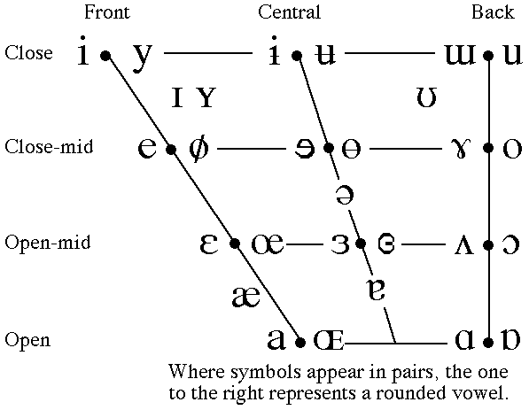
Review your linguistics knowledge
L1 = first (native) language(s)
L2 = non-native language(s)
IPA = International Phonetic Alphabet
Minimal pair = words that vary by only one phonological element
IPA Vowel Chart

Slide 4
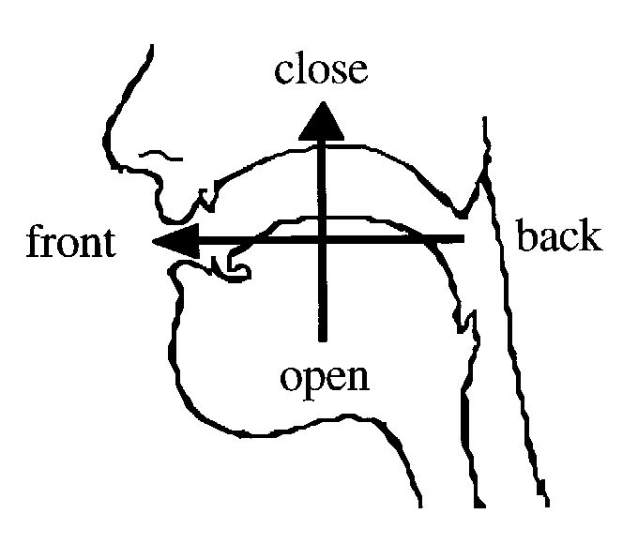
Review your linguistics knowledge
L1 = first (native) language(s)
L2 = non-native language(s)
IPA = International Phonetic Alphabet
Minimal pair = words that vary by only one phonological element
IPA Vowel Chart

Slide 5
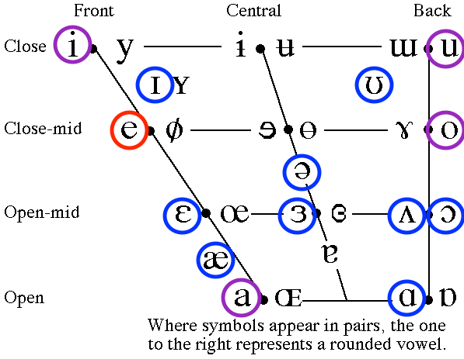
Review your linguistics knowledge
L1 = first (native) language(s)
L2 = non-native language(s)
IPA = International Phonetic Alphabet
Minimal pair = words that vary by only one phonological element
IPA Vowel Chart
Red = Spanish
Blue = English
Purple = Both

Slide 6
Research purpose
L2 English – L2 English interaction
Advantages of sharing an L1 while speaking an L2
Vowels selection
  <bus> vs. <boss> → personal struggle
  Other vowels → proximity to Spanish vowels, yet not the same

Slide 7
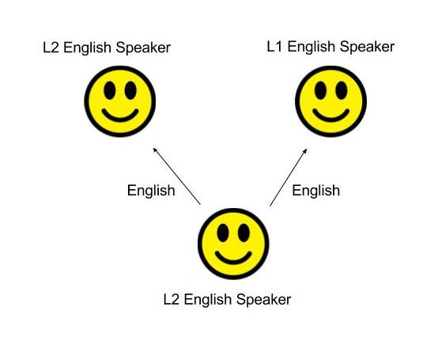
Question and participants
Speakers: 5 L1 English and 5 L2 English
Listeners: 10 L1 English and 10 L2 English
Notes:
Is English speech perception between two non native speakers better than the speech perception between a native speaker and a non native speaker?

Slide 8
Participants
Speakers read a list of words that included the target words and distractor words
Listeners were given only the target words arranged in minimal pairs
    Bet – Bat (/ɛ/ vs. /æ/)
    Bed – Bad (/ɛ/ vs. /æ/)
    Bus – Boss (/ʌ/ vs. /ɑ/)
    Cut – Caught (/ʌ/ vs. /ɑ/)

Slide 9
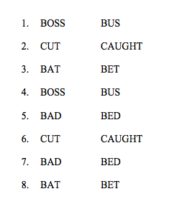
Data collection
2 audios – one only-L1-English-speakers; one only-L2-English-speakers
Listeners listened to one word and had to choose between two options

Slide 10
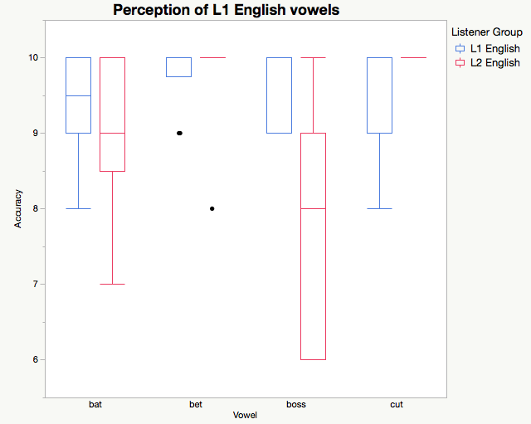
Results – L1 & L2 English participants listening to L1 English speakers
L2 English speakers had a higher recognition score with vowels /ɛ/ and /ʌ/
L2 English speakers had a higher difficulty with <bus> and <boss>
/æ/ /ɛ/ /ɑ/ /ʌ/
as in:
bat bet boss cut

Slide 11
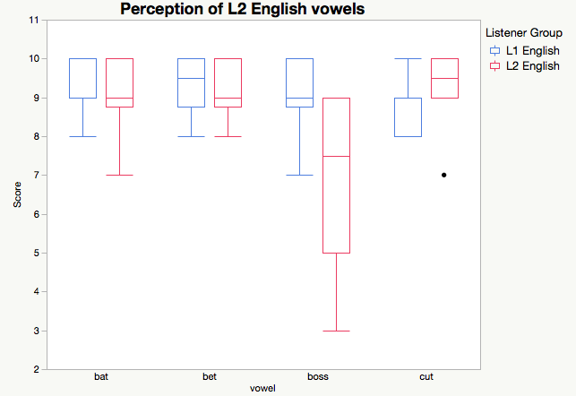
Results – L1 & L2 English participants listening to L2 English speakers
Both L1 and L2 speakers had similar scores
Again, L2 English speakers had a greater difficulty with <bus> and <boss>
/æ/ /ɛ/ /ɑ/ /ʌ/
as in:
bat bet boss cut

Slide 12
Conclusion
Control group (L1 English speakers listening to L1 English speakers) performed as expected (high scores)
L2 English speakers did not show any improvement when listening to other L2 English speakers.

Slide 13
Conclusion
Control group (L1 English speakers listening to L1 English speakers) performed as expected (high scores)
L2 English speakers did not show any improvement when listening to other L2 English speakers.

Slide 14
Future investigation
Looking at the acoustic differences between L1 and L2 English vowels
Is there a pattern in L2 speech that helps L2 English speakers identify non-native sounds?

Slide 15
Acknowledgments
Dr. Charles Nagle – Faculty Mentor
  Assistant Professor of Spanish Linguistics – Department of World Languages and Cultures
Giselle Narváez – Mentor
  Anthropology M.A. Student – Department of World Languages and Cultures
  ISU McNair Program Alumni
Iowa State University McNair Program
  Ms. Thelma Harding
  Dr. Ashley Garrin
Notes:
Giselle: helped with the data collection design

Slide 16
[θæŋk.ju]!

