Slide 1
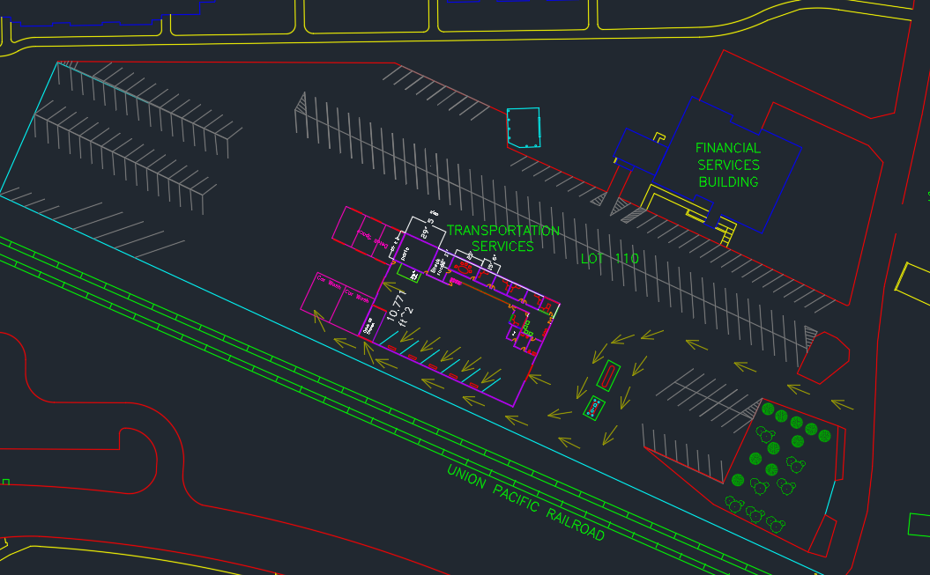
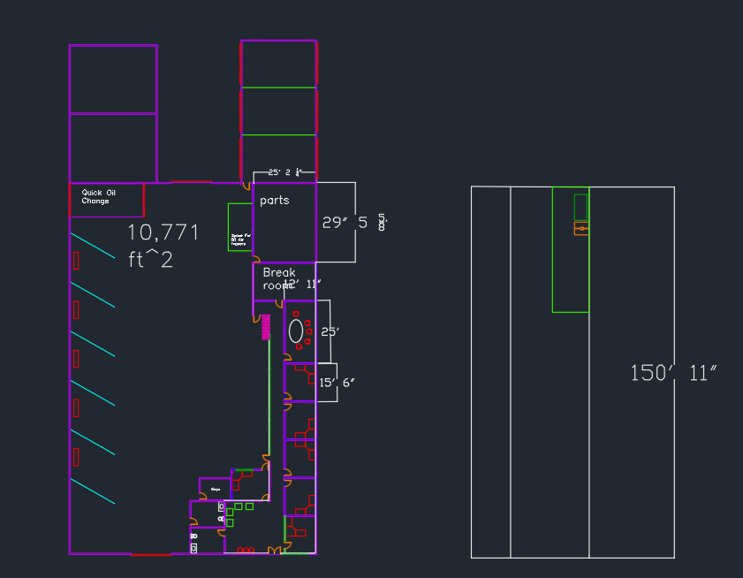
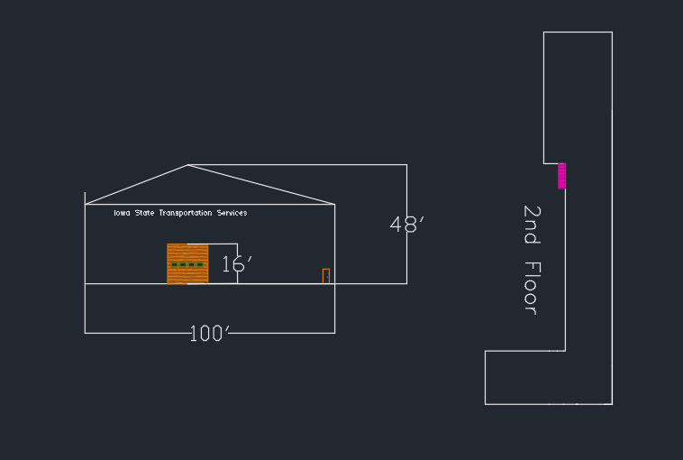
    TSM Technology Capstone
    *Instructors: mea1@iastate.edu; koziel@iastate.edu
Department of Agricultural and Biosystems Engineering
Jeremy Cox, Sean Hosch, Patrick Pogwizd, Nicholas Stanley, Michael E. Anderson*, Jacek A. Koziel*
ISU Transportation Modernization
Client: Iowa State Transportation Facilities, Ames, IA
Problem Statement
Transportation Services shop is becoming outdated with both the building's structure and the technology available. There is not enough space available for the current employees to work comfortably and this is decreasing efficiency around the shop. The lack of space leaves some employees working across the parking lot in a different facility which creates communication issues
The current shop does not have the space to accommodate the tools and technology required to service newer electric vehicles. The garages are also not tall enough for box trucks which limits the vehicles they can service
Proposed Facility Layout
Methods/Approach
Tours of the facilities, Interviews with staff, Design/Construction
Measurements for design of facility
Interviews for satisfaction and
efficiency
AutoCAD: Design of new facility with a flow diagram implemented to help explain our design process.
Major Deliverables
Prioritized
  More space for the workers
  Bigger garage for box trucks
  Blender Pump
Measures of success
  Satisfaction of workers,
  Ability to fit larger vehicles
  Increased efficiency due to new workflow
Objectives
Add a blender pump and relocate the current above ground E-85 tank to the front of the parking lot
Add a second floor above the garages that can be used as an office space and conference room in order to keep all employees under the same roof
Add new garages to the back portion of the lot that will have higher doors to accommodate larger vehicles and add additional storage
Location of the new facility on the existing parking lot . Additional parking was added for storage and vehicles waiting to be serviced. The gas pumps were relocated with the plans of adding a blender pump.
Scope
Our group helped design a new and modern facility for the ISU transportation services. The new facility will have all staff under one roof and there will be plenty more workspace for everyone The extra space will help us provide more storage for the mechanics for their additional tools, parts, and fluids that they need.
Constraints
The new design must allow for all employees to work in the same building
Must remain open during construction
Garage doors must be tall enough to fit larger vehicles such as box trucks
Must have a green space on the facility lot
New facility layout with all offices and customer space visible. The mechanics bay will be attached to the offices with two access doors and a long window for a view for office employees and management. There is also a second floor that will be used for storage.
Acknowledgements: Authors are grateful to Kathleen Wellik and Butch Hansen for the opportunity to work on this project. Project was co-funded by the differential tuition.

