Slide 1
Soil Judging in Iowa
Amber Anderson

Slide 2
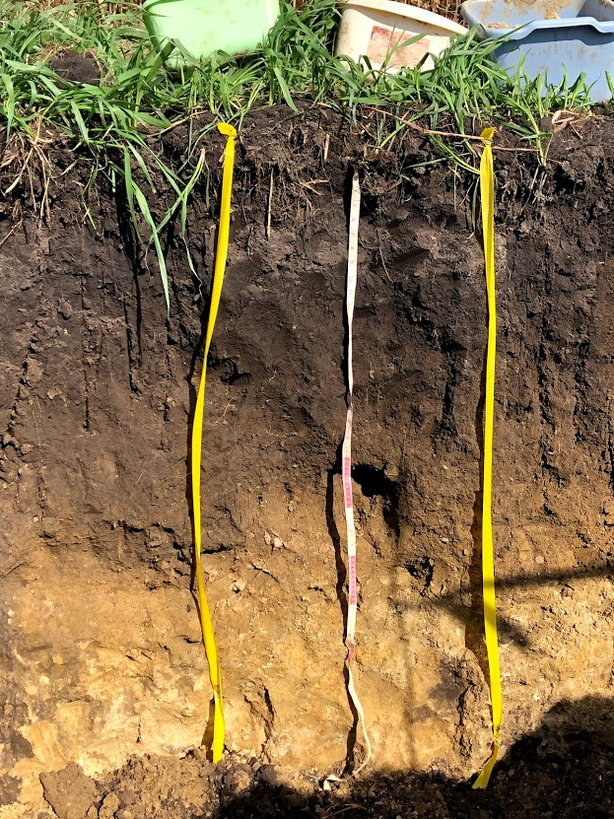
Outline
Major changes in soil judging manual
  Soil orders
  Soil structure
  Soil health
Soil cores
Where to find/request materials
Clarifications?

Slide 3
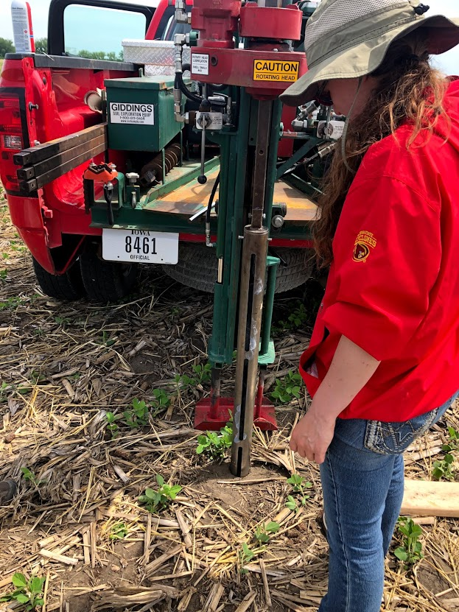
Amber Anderson
Assistant teaching professor
amberand@iastate.edu

Slide 4
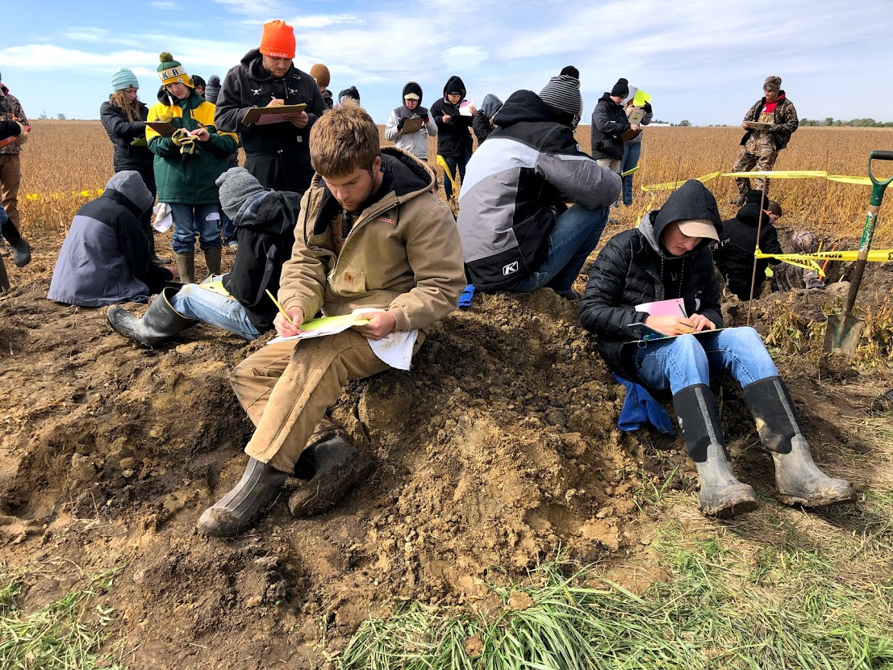
Notes:
What is an FFA soil judging contest?

Slide 5
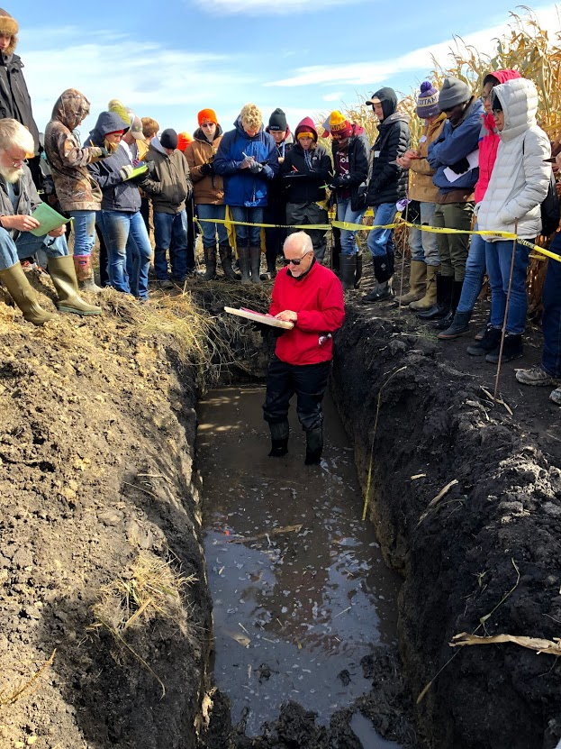
Additions
Why: Changes align with NRCS standard practices and understanding, terms match other references, wording more consistently interpreted between districts
Soil orders
Soil structure
Soil health

Slide 6
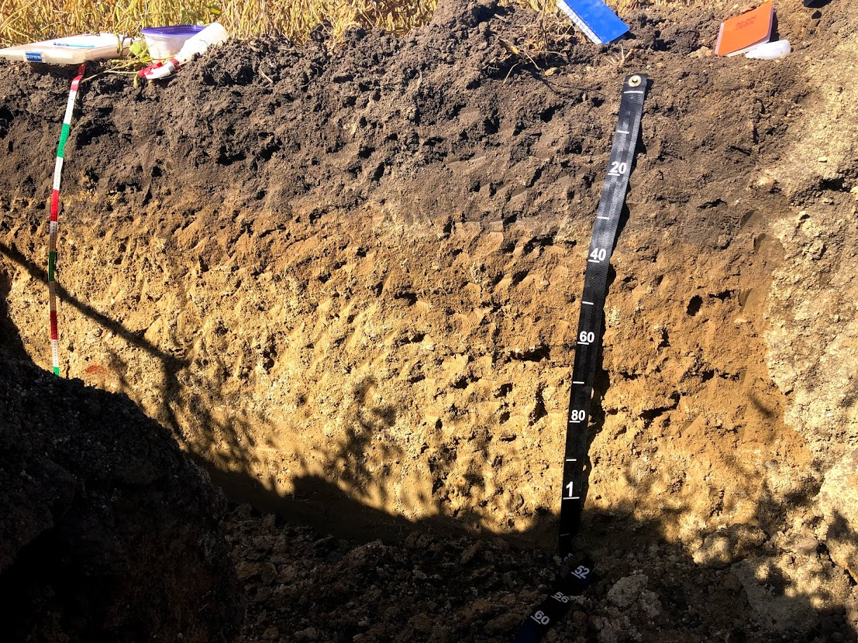

Slide 7
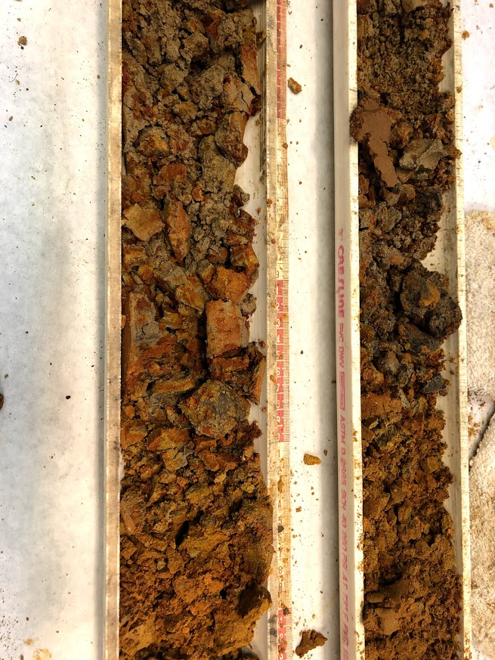
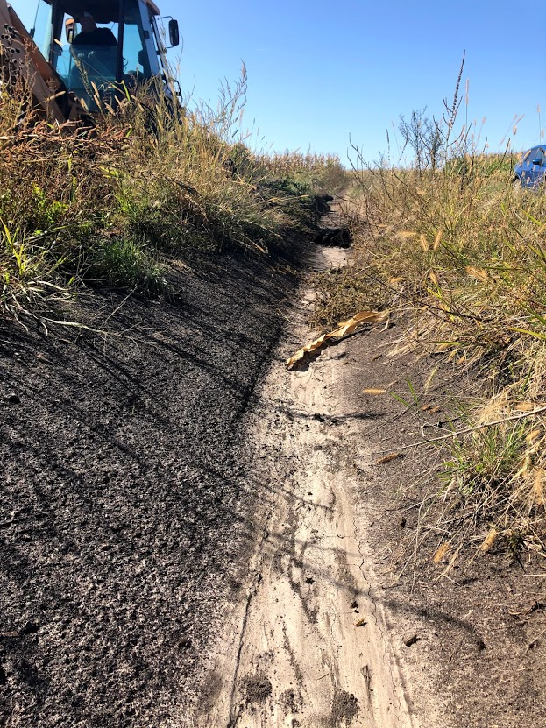
Resources available:
Videos and materials new and historically challenging materials
  Redoximorphic features
  Soil orders
  Soil structure
  Soil health

Slide 8
Soil orders
Most broad categories (12 total, not all present in Iowa)
Students select the FIRST one that fits
Vertisol (high shrink-swell clays)
Mollisol (Dark, thick A horizon)
Alfisol (Clay accumulation in B, likely under trees)
Inceptisol (weak B)
Entisol (no B)

Slide 9
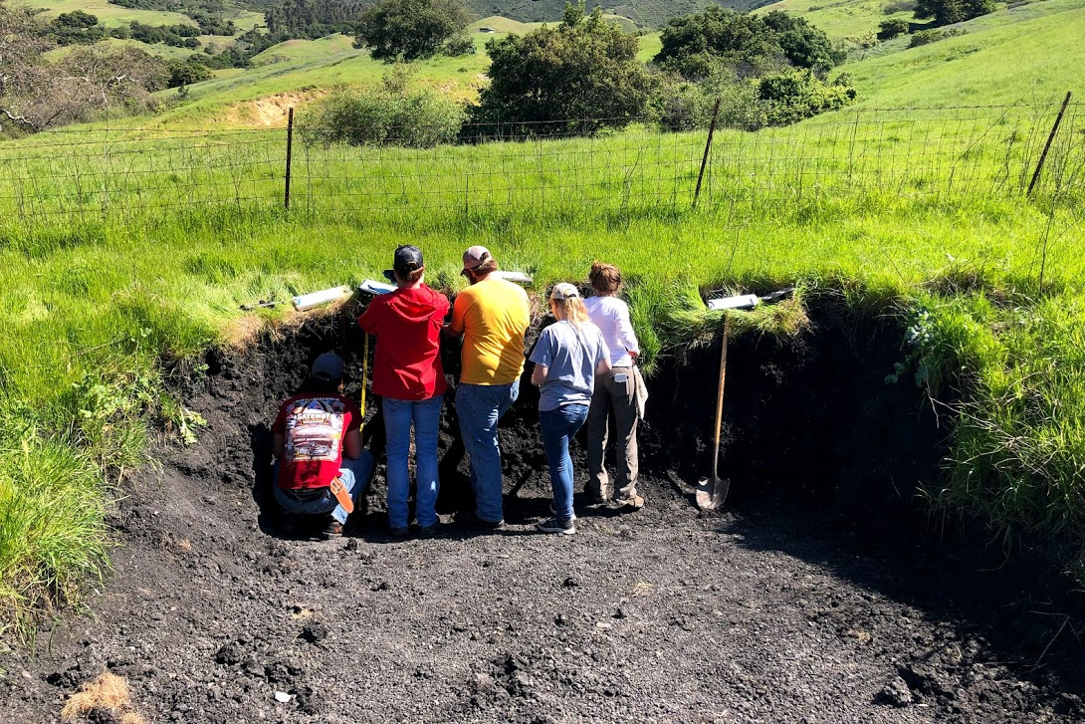
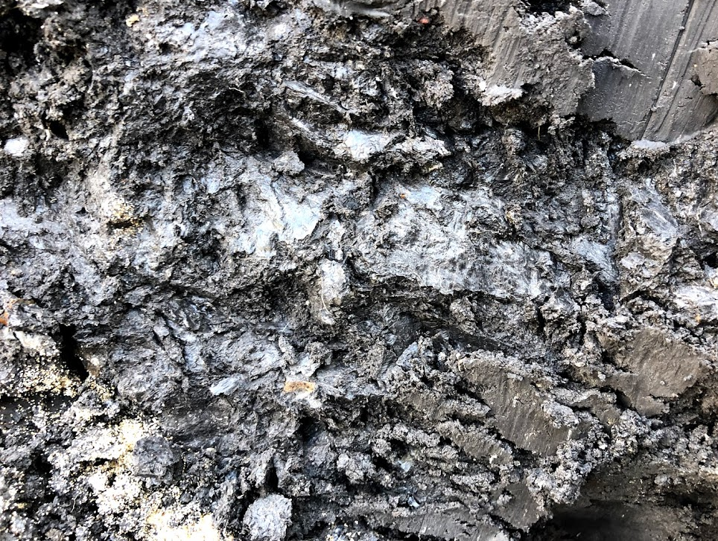
Vertisol
Notes:
Look for cracking, slickensides (shiny surfaces at about 45 degree angles), really really sticky to texture, fence posts going odd directions. Unusual in Iowa except along large river floodplains like the Missouri.

Slide 10
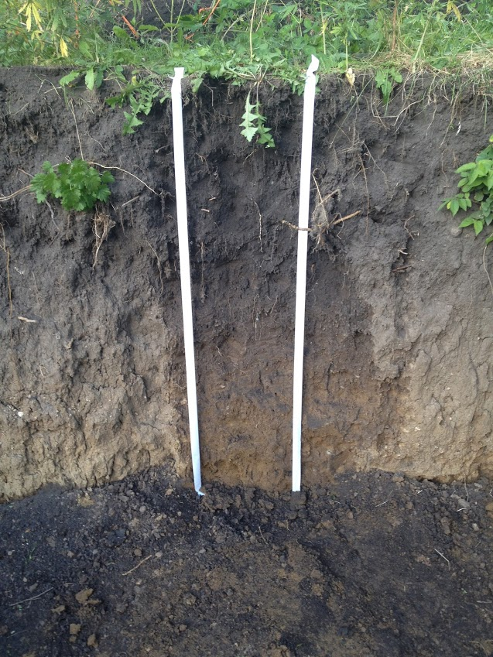
Mollisol
Organic enrichment beyond the surface (usually 25+ cm) as determined by darker color
Most common order in Iowa
Notes:
This order will be most likely in north central/central Iowa and is widespread across the rest of the state. Look for dark or moderately dark to 12 inches of depth.

Slide 11
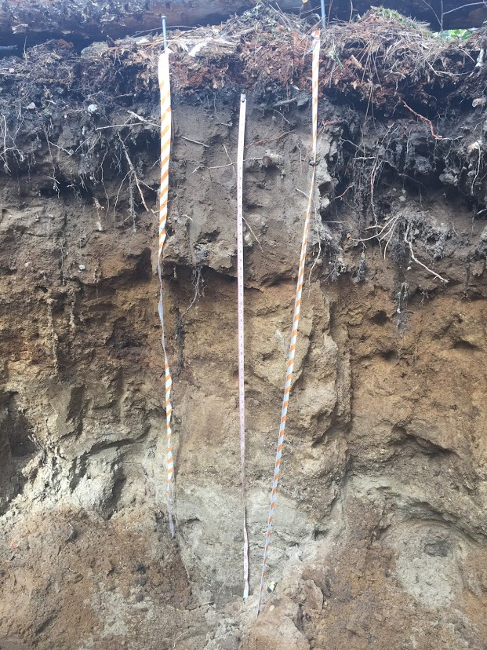
Alfisol
A-Bt-C
A not thick enough organic accumulation to be mollic, b horizon with significant development such as silicate clay accumulations but still has significant minerals
Notes:
This order is most likely found under native vegetation of trees, particularly in Eastern Iowa. Thin A horizon (or not dark enough to be a Mollisol), old/stable enough to have a significant B horizon (look for ‘chocolate glaze’ sort of coatings on the B horizon, change color when you take your nail and scratch them off).

Slide 12
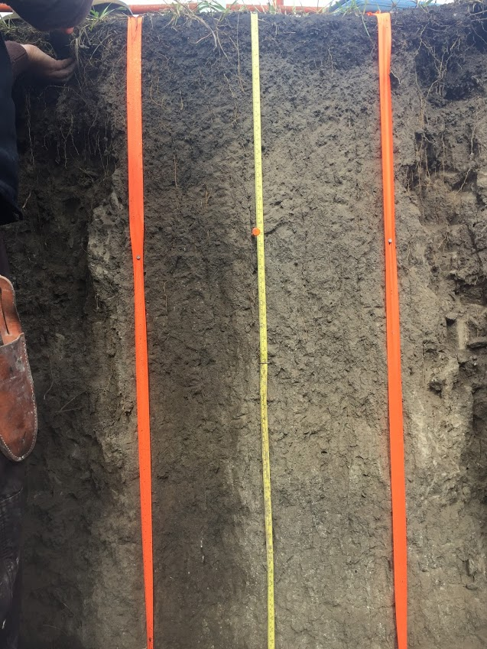
Inceptisol
A-Bw-C
Weak development, indicated by some form of weak B horizon (look for a soil piece that breaks where it wants to instead of the point you put pressure)
Found in areas disturbed in the recent geologic past, but recently stable (stream terraces, some younger glacier deposits like central Iowa)
Notes:
This profile in older flood deposits, see slightly darker layer most of the way down. Inceptisols are found in spots in Western Iowa where the landscape is less stable/less thick dark A, in Central Iowa where the younger landscape hasn’t developed generally in combination with eroded conditions, or steeper slopes in other parts of the state that have lost or not changed much from the initial material

Slide 13
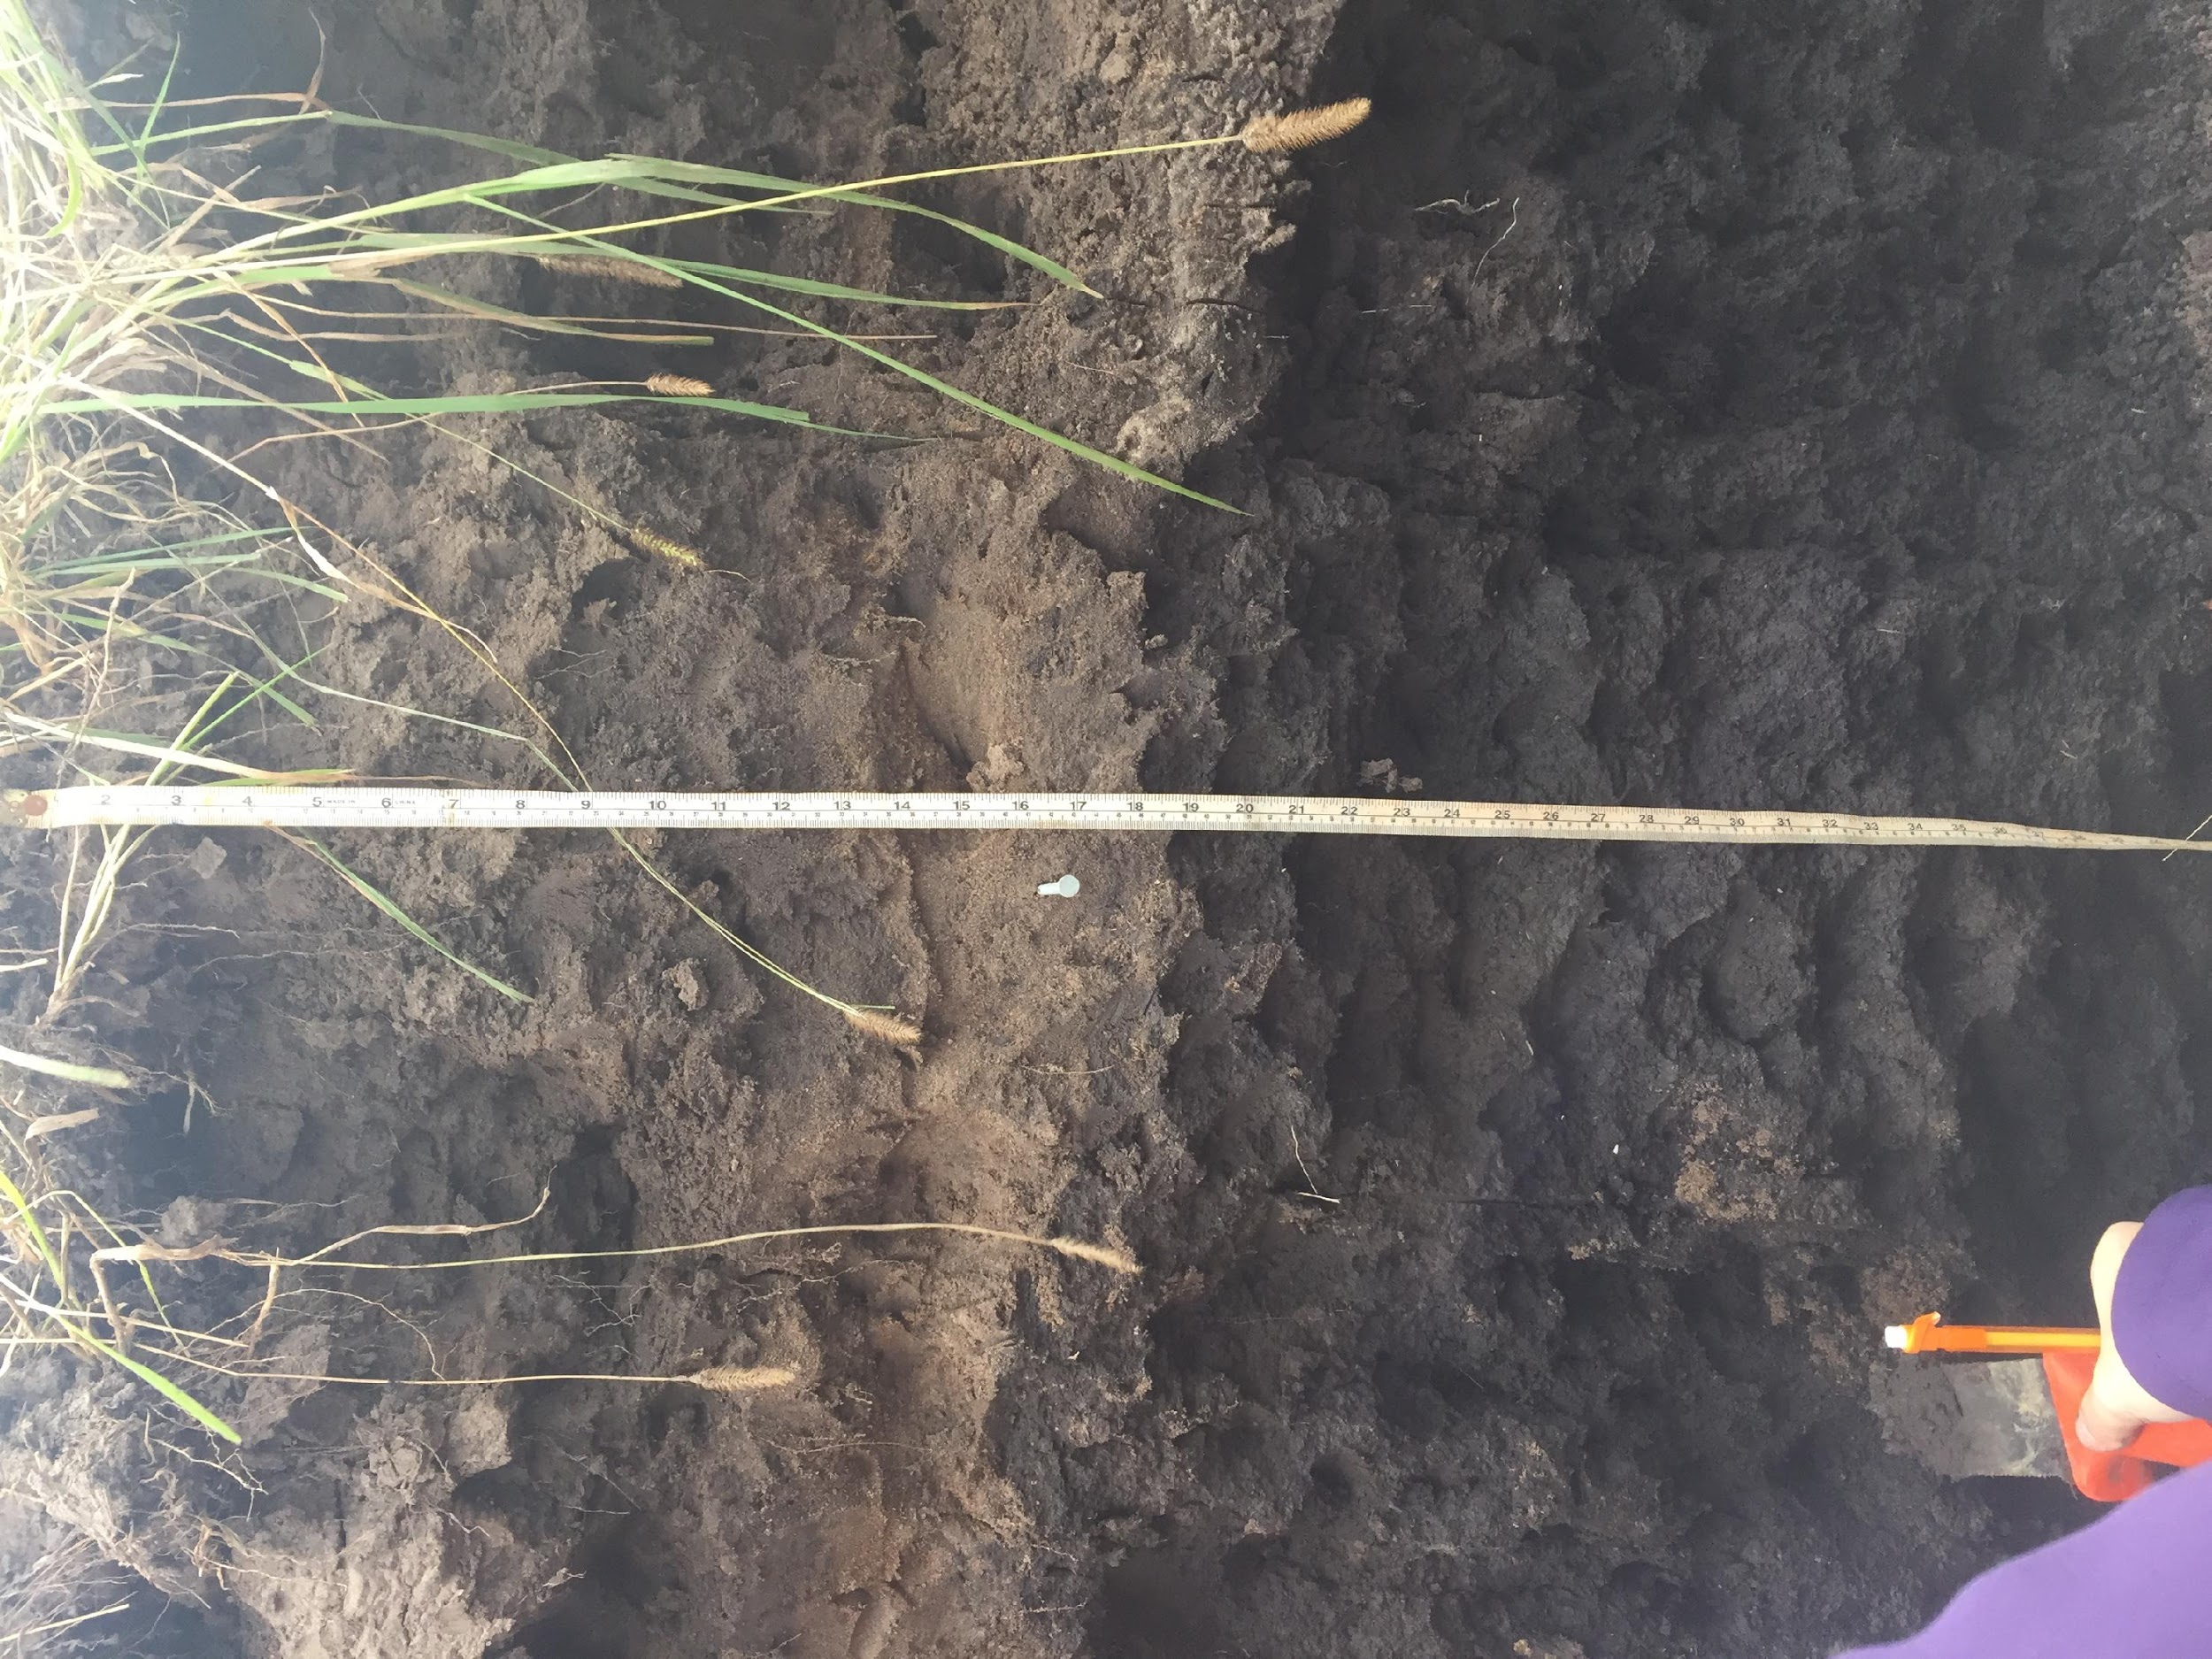
Entisol
Young soil
A-C profile
Commonly found in fresh deposits or recently disturbed materials, like flood plains
In Iowa-could be found on extremely eroded areas as well
Notes:
Found in highly eroded conditions or fresh flood plain deposits that don’t qualify as a Mollisol. Picture is a flood deposit on top of buried A horizon, coarser textured but well sorted material on top, finer textured on the bottom

Slide 14
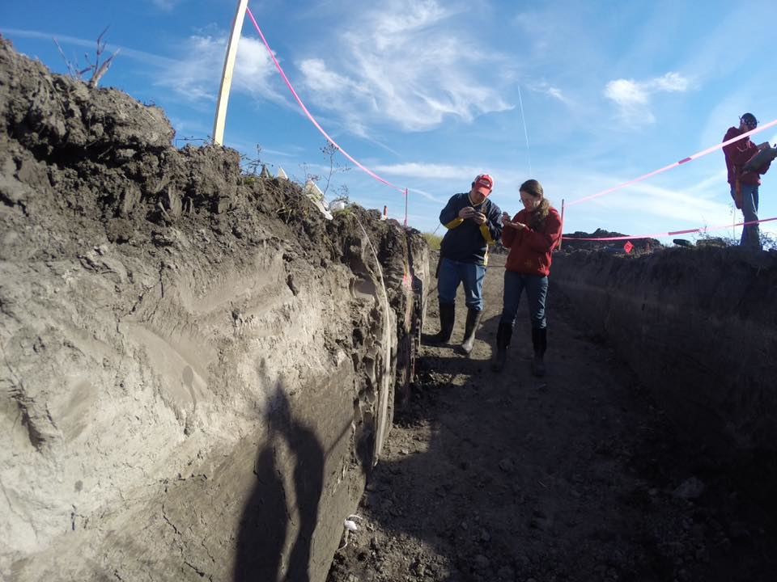
Questions?

Slide 15
Soil core and soil health discussion

