Slide 1
Unmanned Aircraft System-Based Structural Health Monitoring
Samuel Dwyer and Charles Vavrick
Mentor: Dr. Christina Bloebaum
With guidance by: Akash Vidyadharan and Robert Philpott III

Slide 2
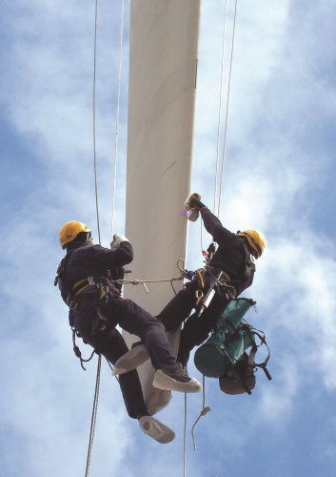
Structural Health Monitoring
Focuses on maintaining the safety and reliability of systems going through fatigue
  Bridges, airplanes, space shuttles, buildings
Requires a large amount of data to be gathered and processed
  Sensor arrays, visual monitoring, predictive simulations
Non-destructive evaluation:
Monitors health of a system without altering function
Valuable in expensive engineered systems that need routine health monitoring, but complicated
Source: The New York Times (http://www.nytimes.com/2009/12/25/business/25climb.html)

Slide 3
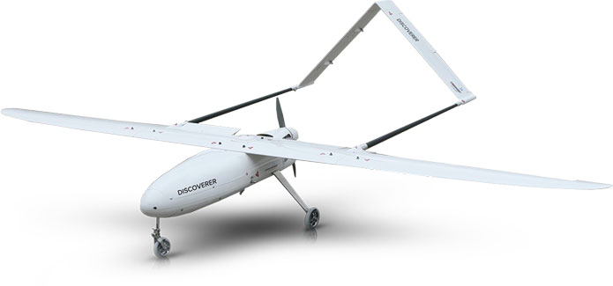
Unmanned Aircraft Systems
Unmanned aerial vehicles
  “Drones,” multicopters, fixed-wing aircraft
  All lack a human pilot on the craft
The system can be heavily autonomized
Major setback is flight lifespan
Recently being pushed in many commercial areas
Must adhere to FAA Part 107 guidelines
Source: Hire a Drone (http://hireadrone.co.nz)

Slide 4
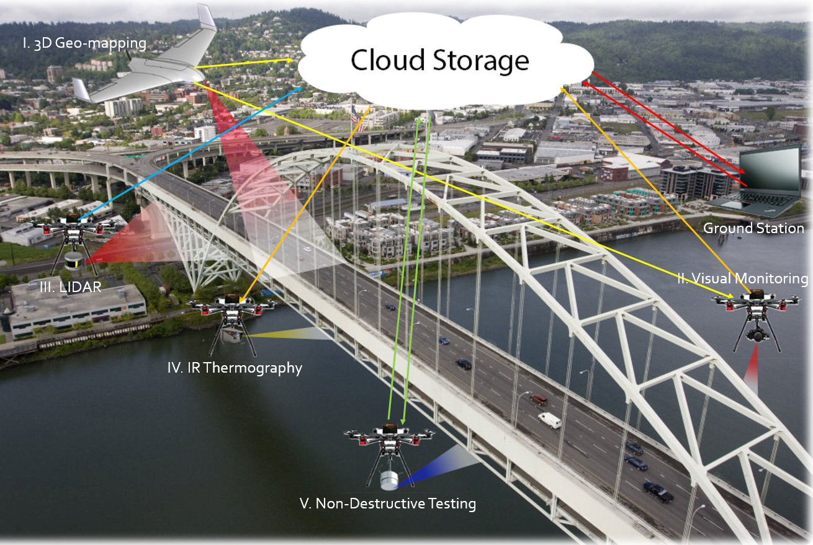
Data Acquisition Model
High-definition photo and video
3D Photogrammetry
3D Geo-mapping
LiDAR
Infrared Thermography
Ultrasonic
All forms communicate with a ground station and/or the cloud

Slide 5
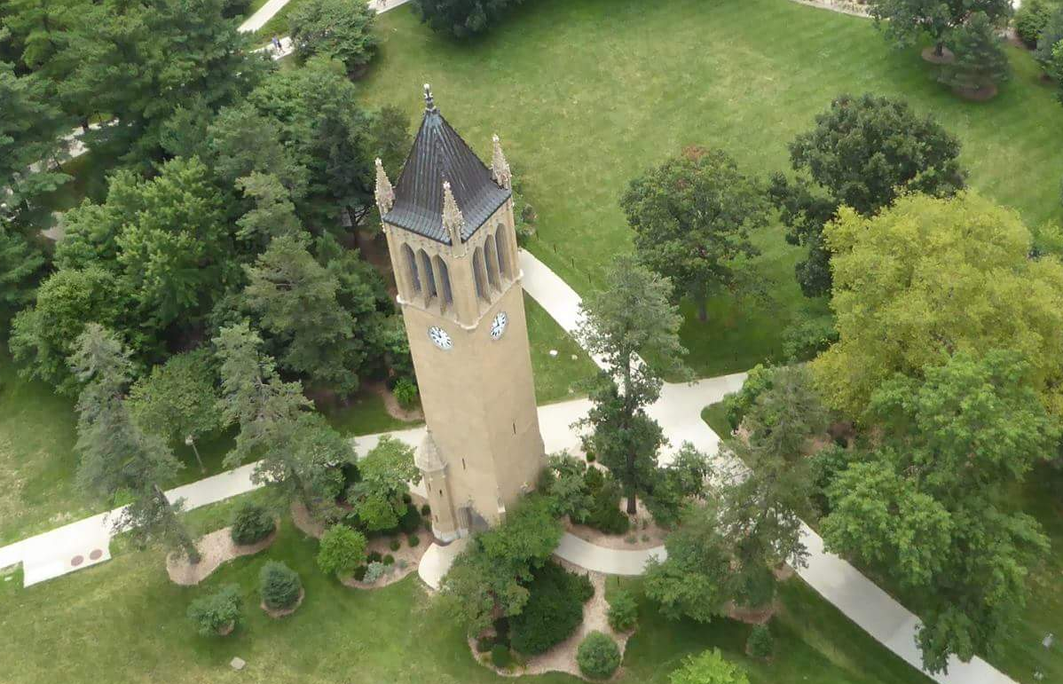
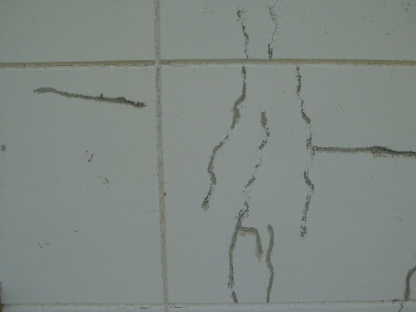
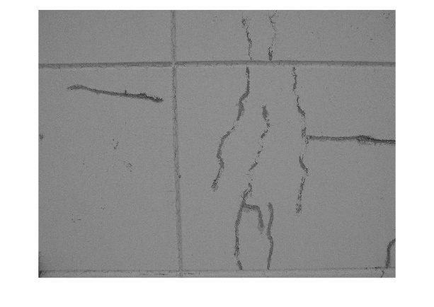
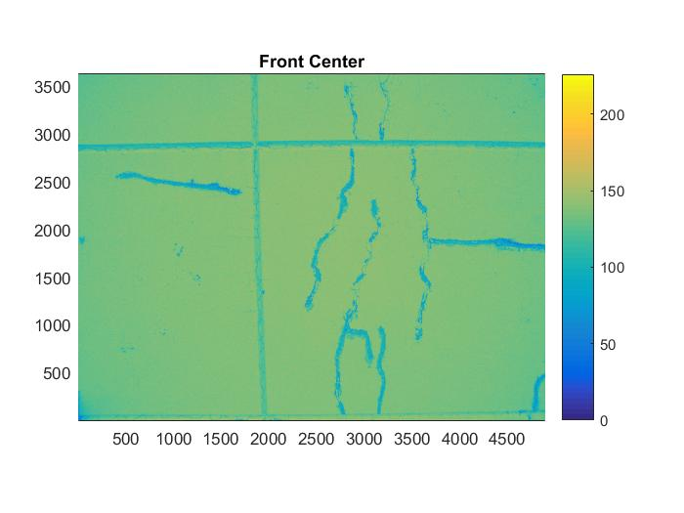
HD Imaging and Mapping
Drones can be flown to autonomously circle infrastructure and take pictures
Combined with geolocation data and point-matching software, an interactive 3D model is obtained
Workers can study the model much quicker and safer than inspecting in person
Faults can also be automatically detected

Slide 6
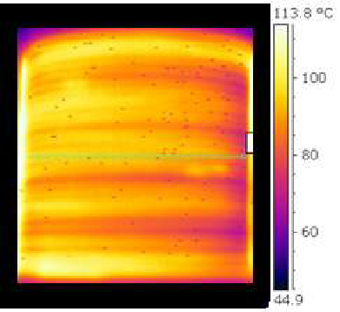
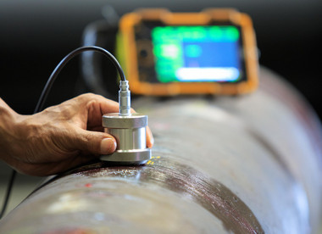
Thermal and Ultrasonic NDE
Thermal images can suggest faults in a structure that would be invisible to normal cameras
Thermography is nondestructive and does not require contact, but can sometimes require a heat source
Ultrasonic testing sends ultrasonic waves through an object to find faults below the surface
Probes require contact with the surface being tested
These methods can be combined with others to gain the clearest final result
Sources: Research Gate and Precision NDT
https://www.researchgate.net
http://www.precisionndtllc.com/service/ultrasonic-testing

Slide 7
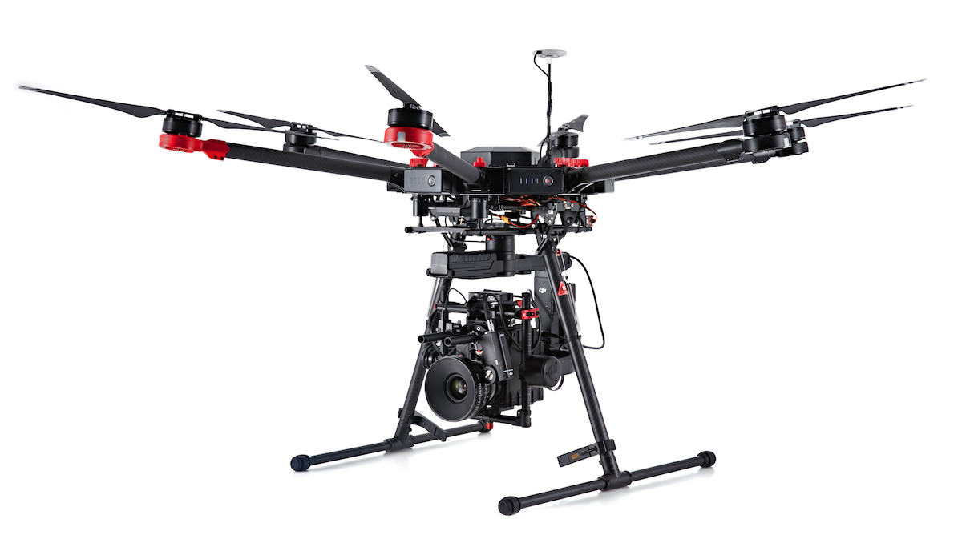
UAV Technology
Hexacopters are more stable and reliable than quadcopters
A camera gimbal is used to stabilize images and ensure quality
  Gimbals and multicopters use gyroscopes, accelerometers, and inertial measurement units
GPS locators set the UAVs on autonomized paths with “return to home” function
Different applications benefit from the use of different UAVs
Source: Advexure Systems
https://www.advexure.com/new-dji-matrice-600-heavy-lift-drone/

Slide 8
Decision Analysis
Understanding the complexity of the environment and task
Knowing the constraints of the type of infrastructure
Adding in the value and risk of the operation
From the data, UAS types and attributes are selected to complete the task
Value:
Preventing major faults
Finding repair sites to increase longevity
Using the least resources
Risks:
Destroying the UAV
Harming People
Damaging the Structure
Affecting Nature

Slide 9
The Future
Expansion of the Decision Model to include risk vs. value of other SHM approaches
Increase UAS technology to serve a larger variety of engineered systems
Analyze ethics within the value model
Autotomize as many operations as possible to increase value

Slide 10
Unmanned Aircraft System-Based Structural Health Monitoring
Samuel Dwyer and Charles Vavrick
Mentor: Dr. Christina Bloebaum
With guidance by: Akash Vidyadharan and Robert Philpott III

