Slide 1
Investigating Retinal Development Through Loss of Function Analysis
Abbie Burney

Slide 2
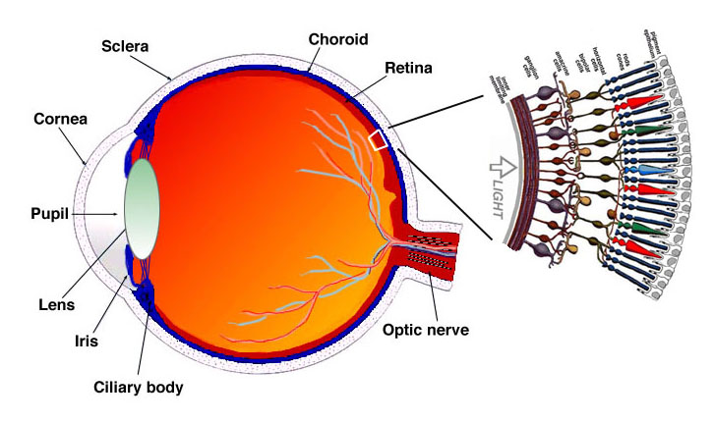
The Retina
Kolb, Fernandez and Nelson 2006

Slide 3
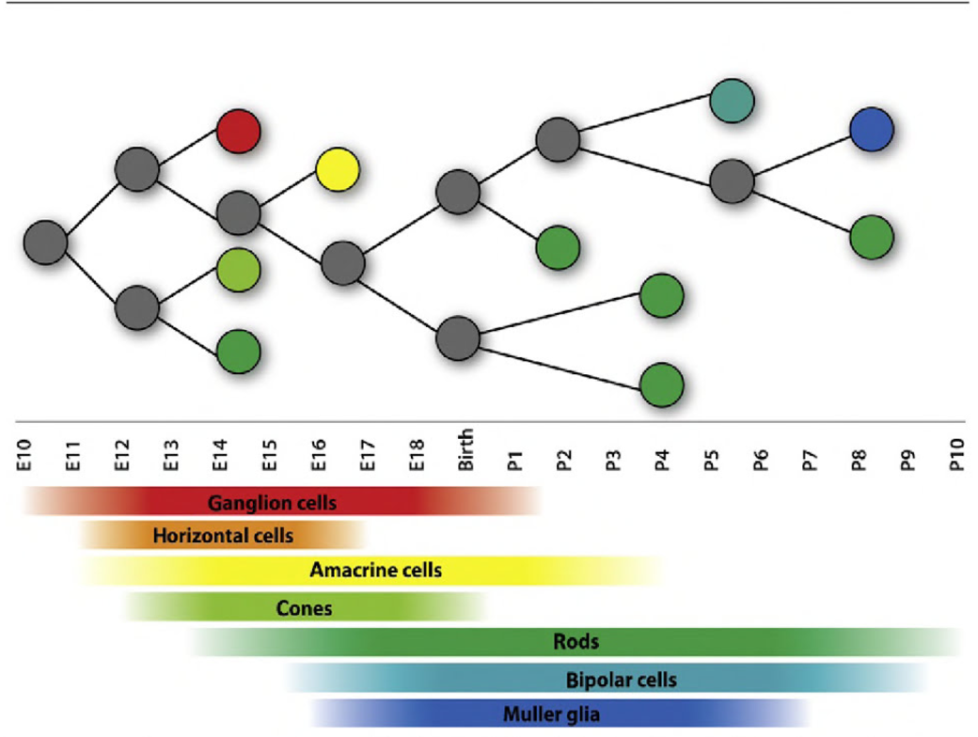
Developing Retina
Goetz et al. 2014

Slide 4
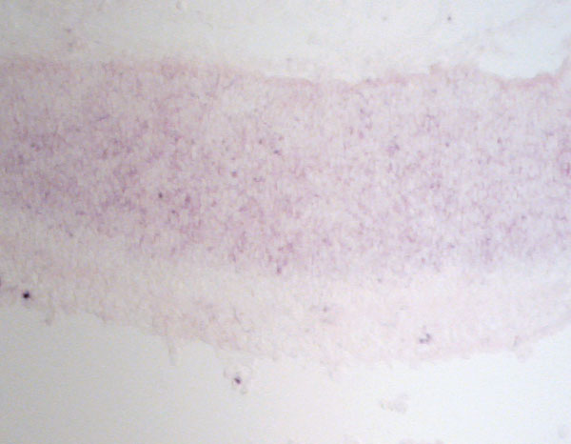
Rationale for Spred1 and Nrarp
Cross section in situ of mouse retina at P0
Spred1 and Nrarp are expressed in cycling progenitor cells
ONBL
INBL
Nrarp
Spred1

Slide 5
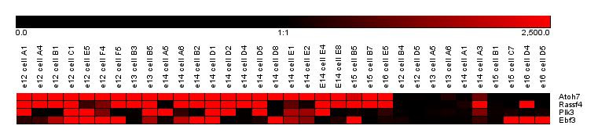
Rationale for Plk3
Math5 is expressed in cells that are about to leave the cell cycle
Plk3 is one gene that we found to be expressed among Math5+ cells
Math5 +
Math5 -
Math5
Rassf4
Plk3
Ebf3

Slide 6
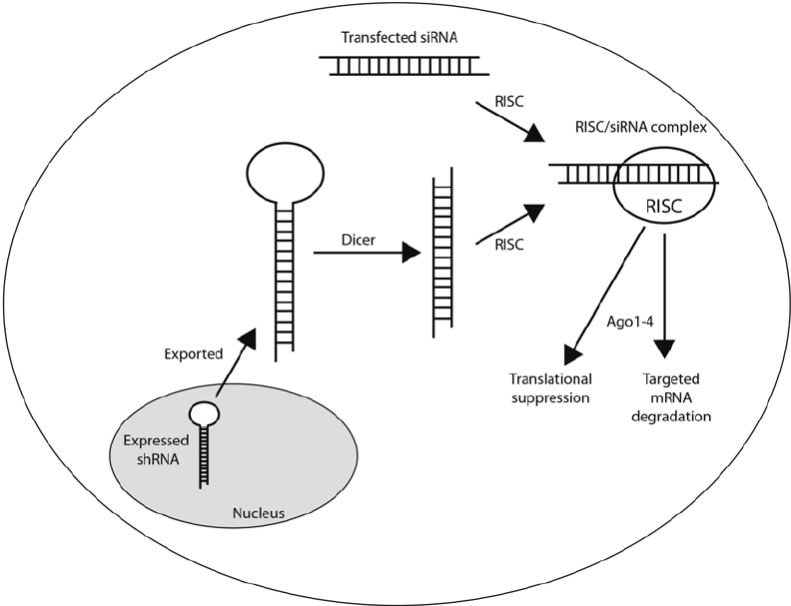
RNA Interference

Slide 7
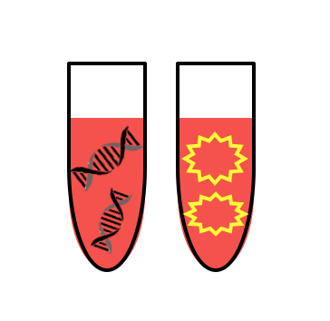
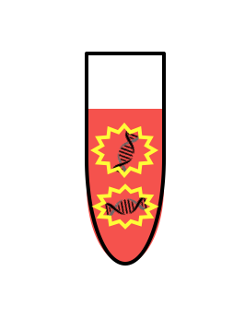

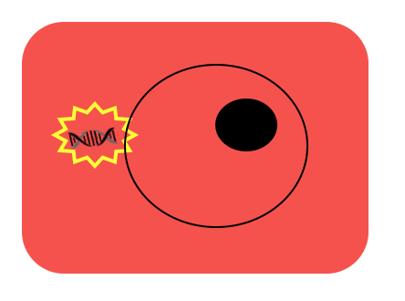
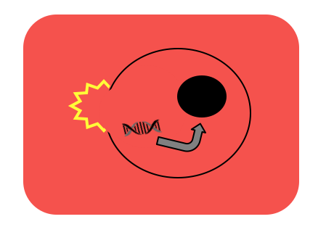

Transfection

Slide 8
Spred1
Control
Spred1 Sensor
RNAi

Slide 9
Nrarp
GFP
RFP
Sensor
RNAi

Slide 10
Plk3
GFP
RFP
Sensor
RNAi

Slide 11
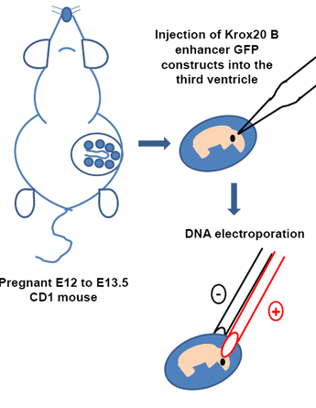
Ex vivo Electroporation

Slide 12
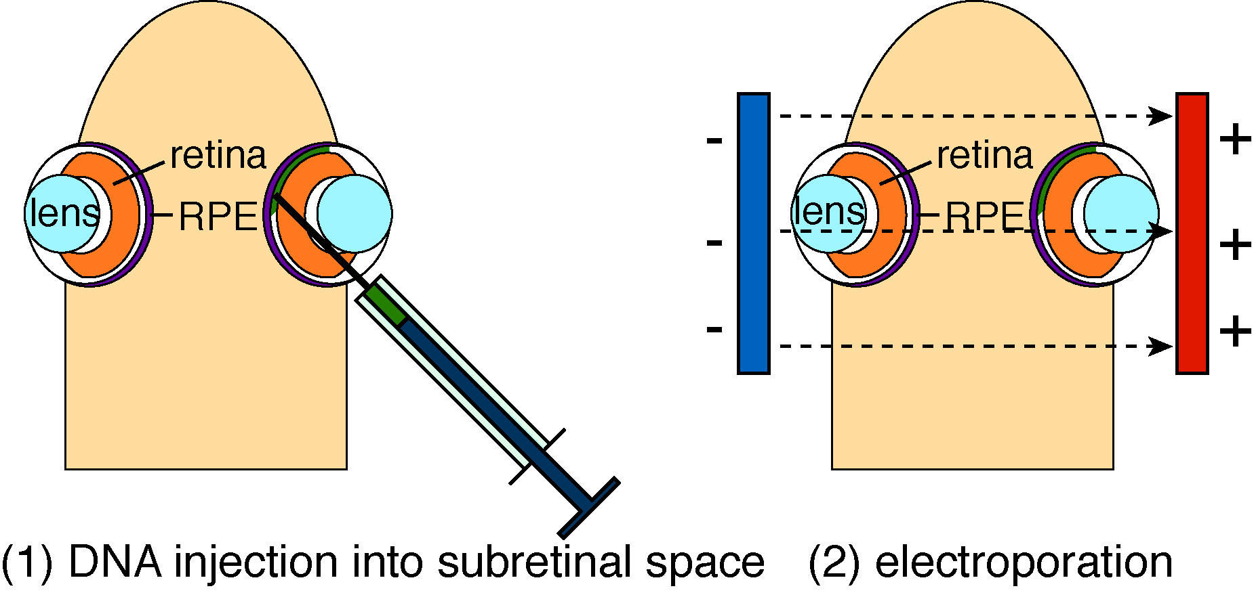
In vivo Electroporation
Matsuda and Cepko, 2004

Slide 13
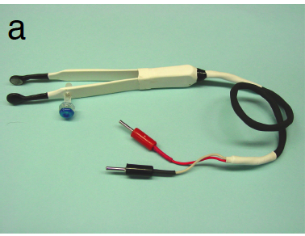
Electroporation Paddles

Slide 14
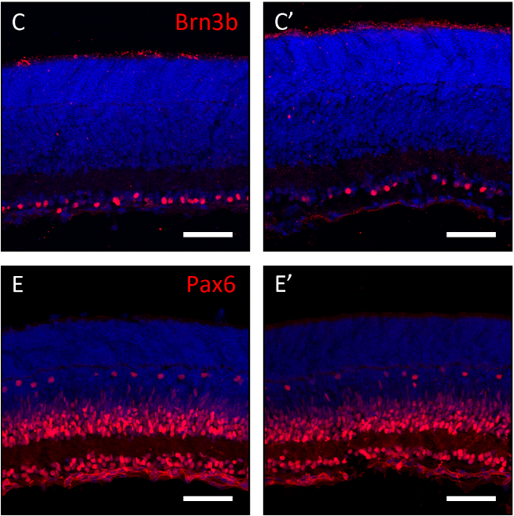
After Successful Electroporations
Immunostaining
qPCR

Slide 15
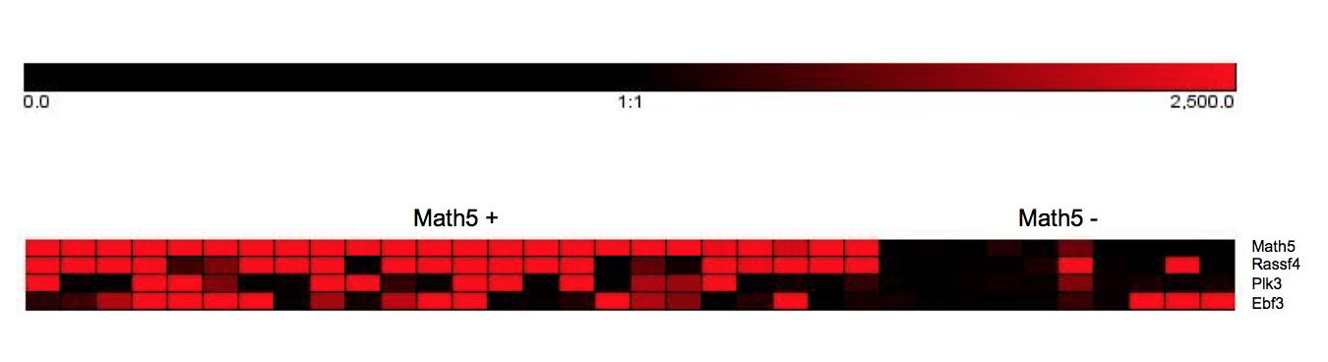
Future directions
Rassf4
Ebf3

Slide 16
Acknowledgments
Dr. Jeffrey Trimarchi Lab
  Rebecca Chowdhury
  Lauren Laboissonniere
  Courtney Smith
  Bailey Mooney
  Lauren Kopetzky
  Hannah Wickham
  Bryn Myers

