Slide 1
Restoration and Respiration:
Soil Respiration Rates and Carbon Isotope Emissions under Differing Herbivory and Plant Diversity Treatments in a Restoration Prairie
Miranda Salsbery
With DR. Haldre Rogers and Dr. Steven Hall

Slide 2
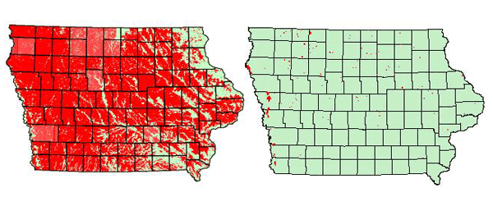
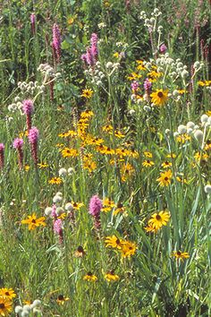
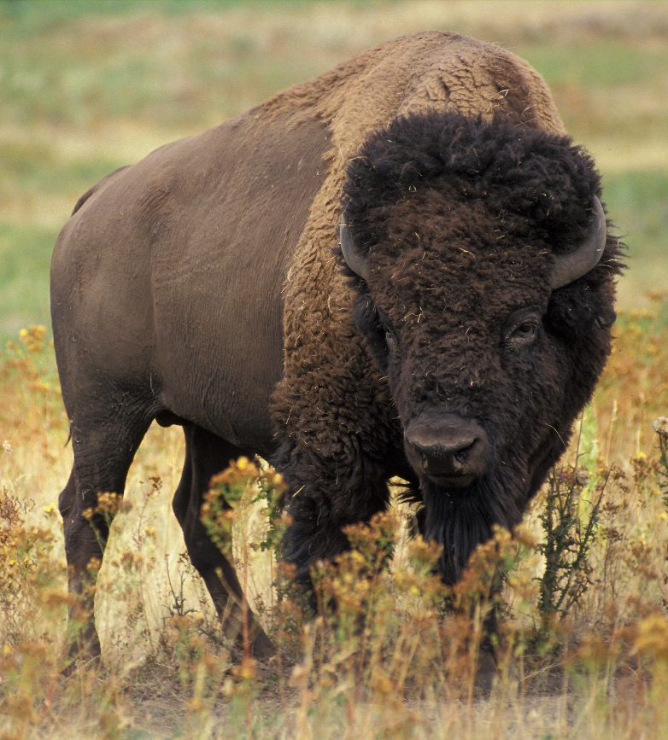

Slide 4
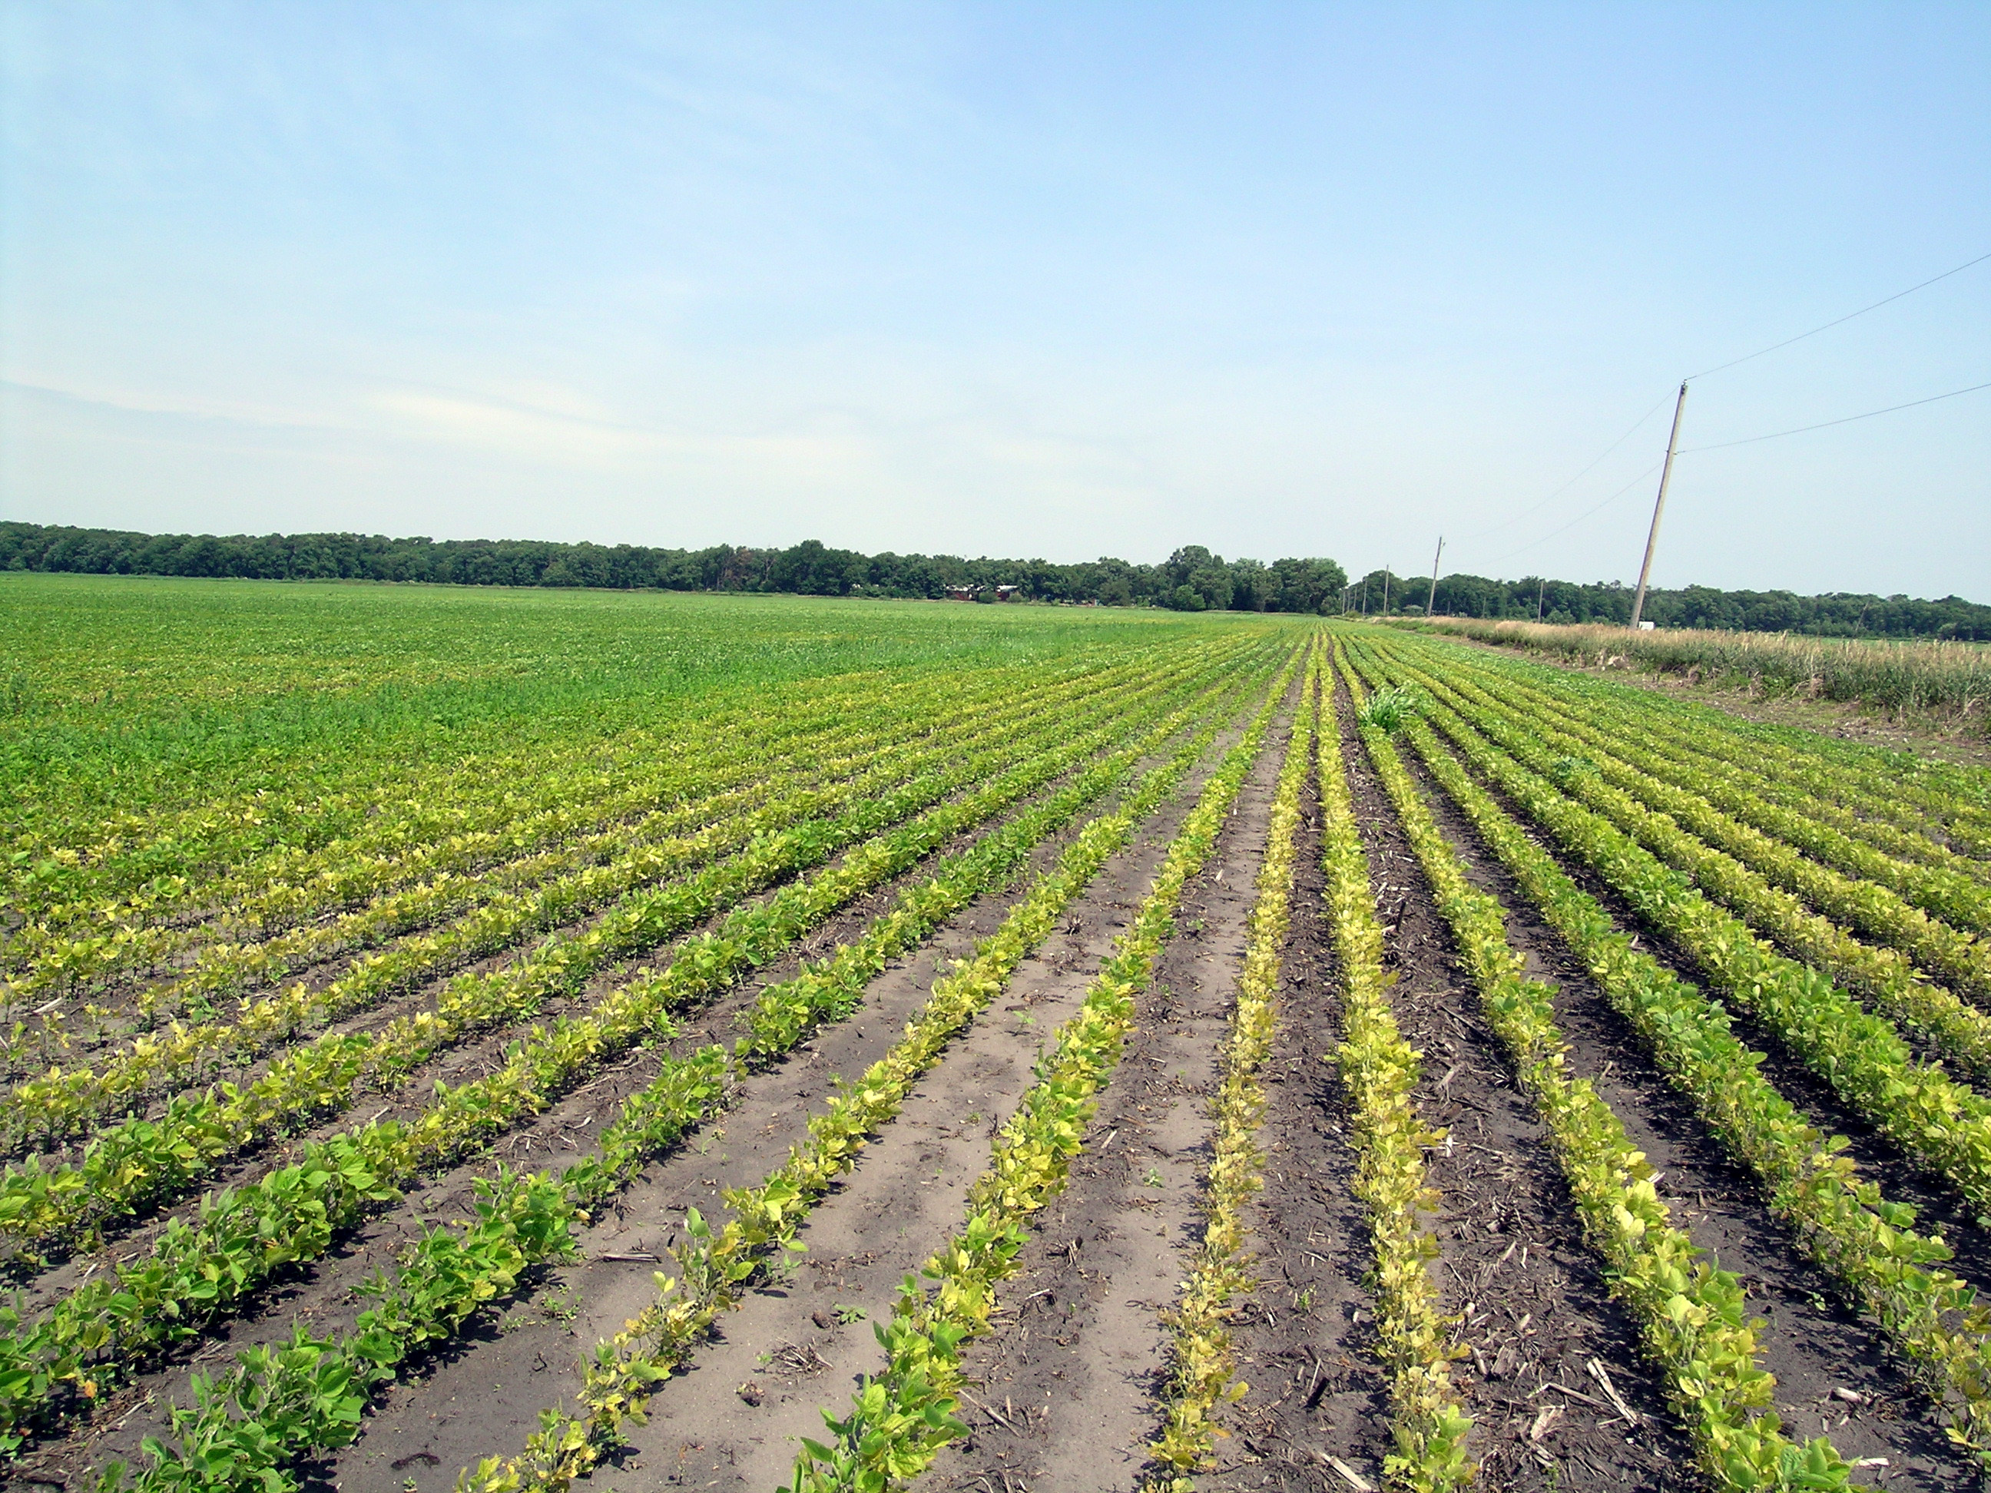

Slide 5
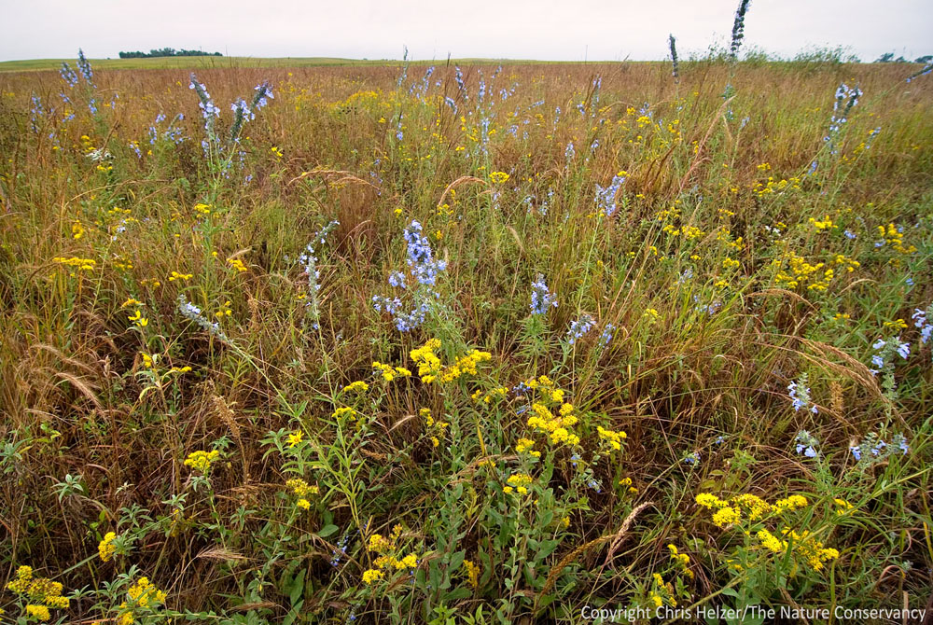

Slide 6
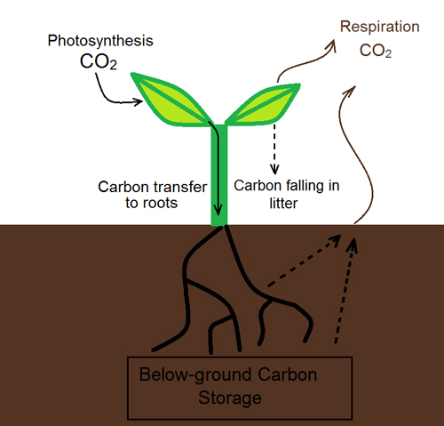

Slide 7
Soil Respiration
:the process of carbon dioxide release from soil by root respiration and microbial decomposition of litter and organic matter
Soil respiration is an important indicator of soil fertility and ecosystem productivity

Slide 8
Carbon turnover
Soil is a major store of carbon
Rates range from 9-120 years

Slide 9

Soil can be affected by components of historical prairies

Slide 10
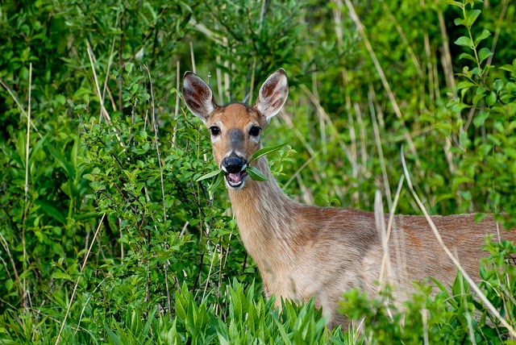
Herbivory
Effects
plant growth overcompensation
nutrient inputs by herbivores through urine and dung
change on plant species competition

Slide 11
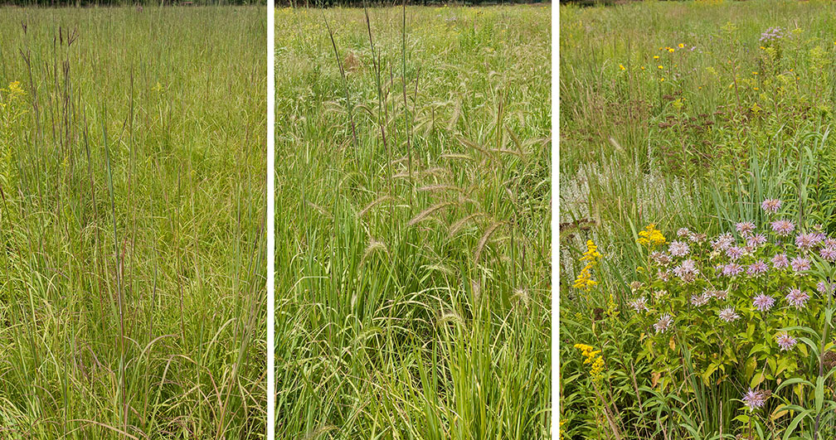
Diversity
plant species diversity increases soil respiration rates via increase productivity
soil carbon related to above ground community

Slide 12
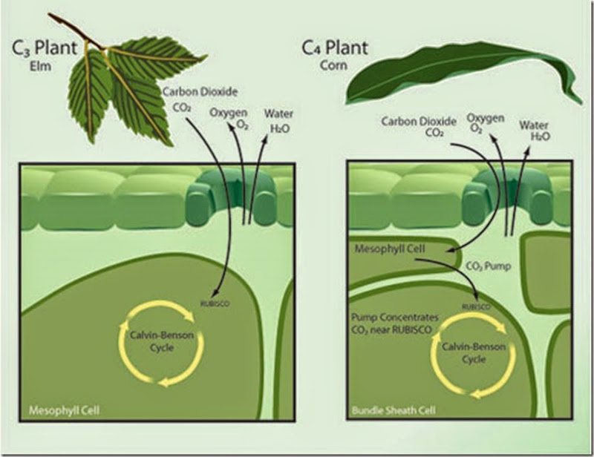

Slide 13
Hypothesis
Herbivory will increase soil respiration rates
High diversity areas will have higher rates of respiration
Herbivory will increase carbon turnover and lead to a higher portion of C3
High diversity will have higher readings of C3

Slide 14
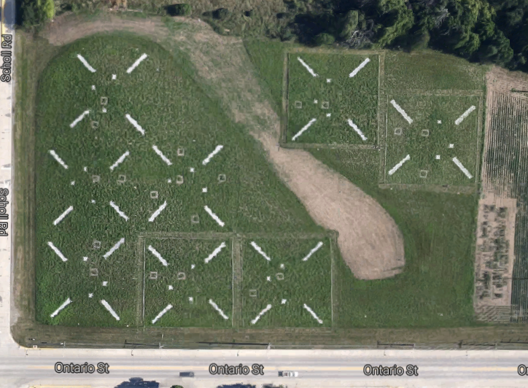

Slide 15



Slide 16



Slide 17
High Diversity Low Diveristy
Total # species planted
                58 14
# C3 species
                52 11
# C4 species
                6 3
Proportion C3/Total
                0.896 0.785

Slide 18
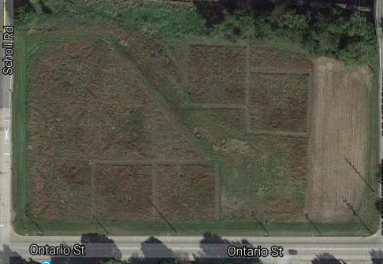

Slide 19
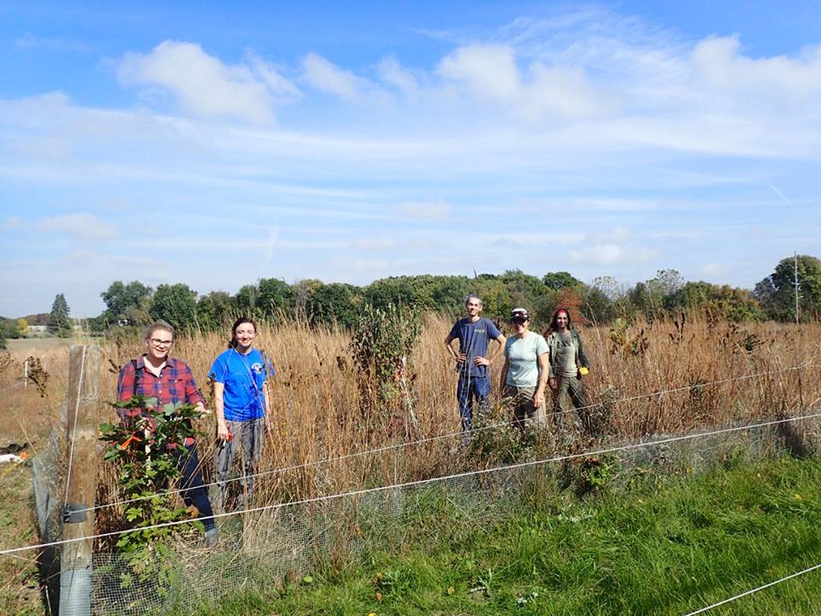

Slide 20
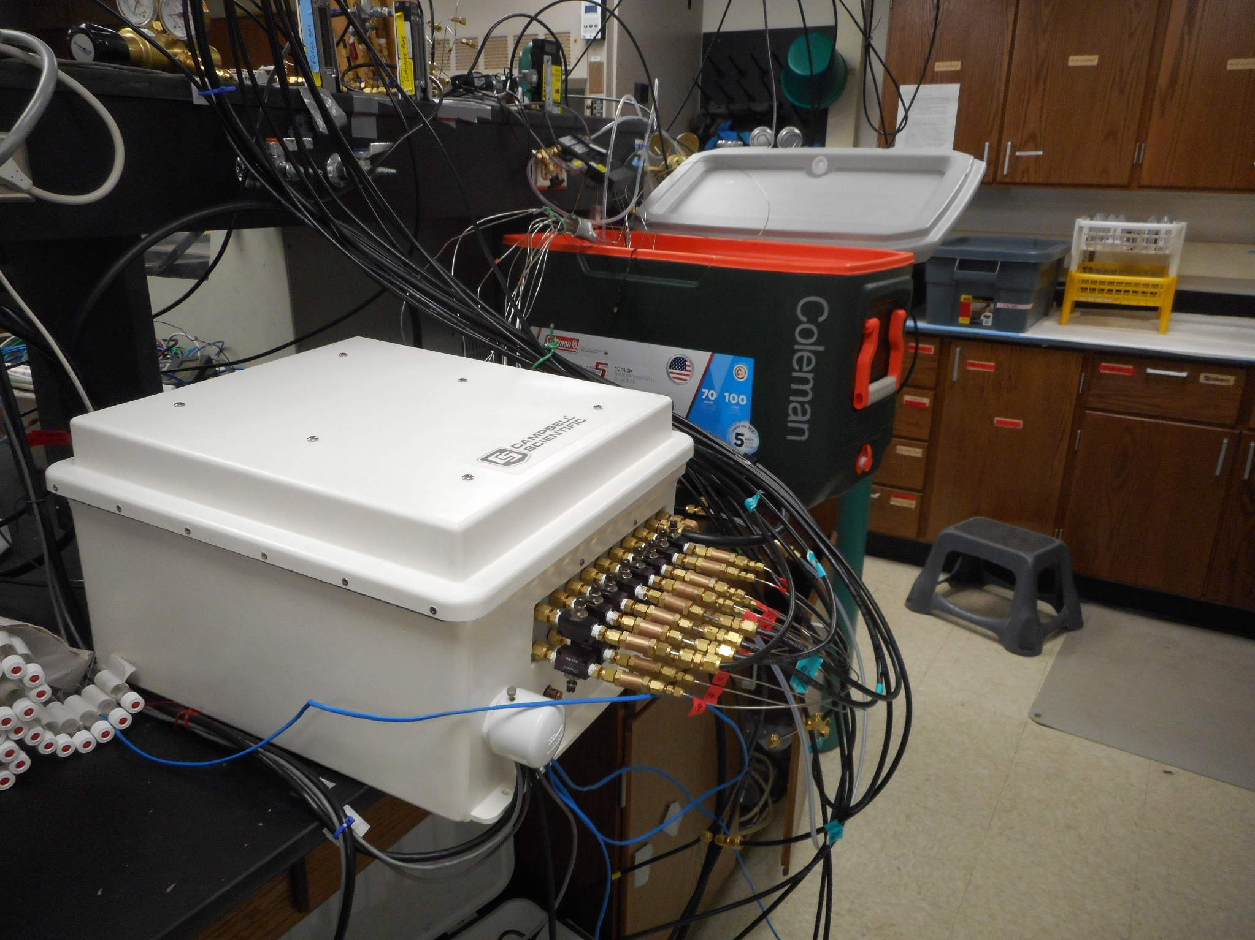

Slide 21
Hypothesis 1:
Herbivory will increase soil respiration rates

Slide 22
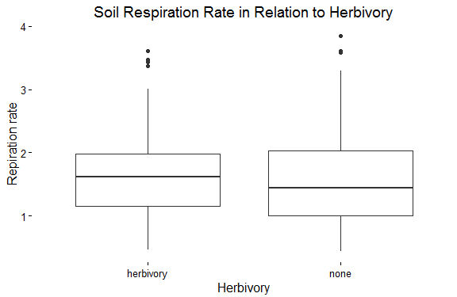

Slide 23
Hypothesis 2
High diversity areas will have higher rates of respiration

Slide 24
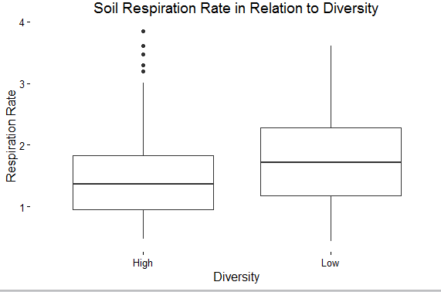

Slide 25
Hypothesis 3
Herbivory will increase carbon turnover and lead to a higher portion of C3

Slide 26
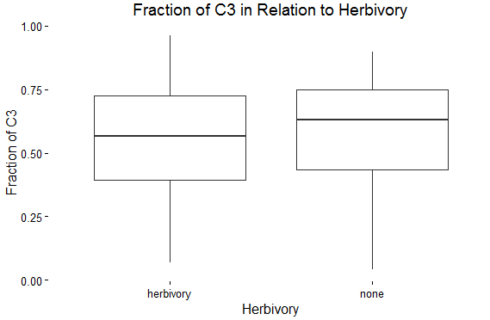

Slide 27
Hypothesis 4
High diversity will have higher readings of C3

Slide 28
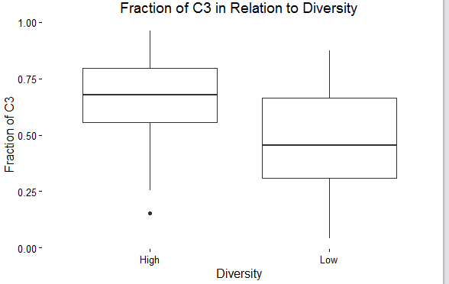
*
*

Slide 29
Summary
-Herbivory did not affect respiration rates or carbon turnover
-Diversity did not affect respiration
-Significant difference in proportion of C3 in high and low diversity implies fast carbon turnover

Slide 30
Images:
http://3.bp.blogspot.com/-jAa2v8fQkz8/T4odOGIGheI/AAAAAAAAABU/48dY0fxfLhY/s1600/prairiemap.gif
https://upload.wikimedia.org/wikipedia/commons/8/8d/American_bison_k5680-1.jpg
https://s-media-cache-ak0.pinimg.com/236x/e0/1b/f5/e01bf5dab2b57a684a2117ad252db972.jpg
http://extension.entm.purdue.edu/pestcrop/2008/issue18/images/popups/DSCN8047.JPG
https://theprairieecologist.files.wordpress.com/2011/11/enpo080912_d049.jpg
https://www.aber.ac.uk/en/media/departmental/ibers/eco2/image015.jpg
http://lh6.ggpht.com/-vPaZWRMMS6U/U0PakHySjaI/AAAAAAAABEs/wrGELdC5vqk/c3andc4plants%25255B1%25255D.jpg?imgmax=800
http://www.brightsideoutdoors.com/wp-content/uploads/2015/06/a8b65-deer-eating1.jpg

Slide 31




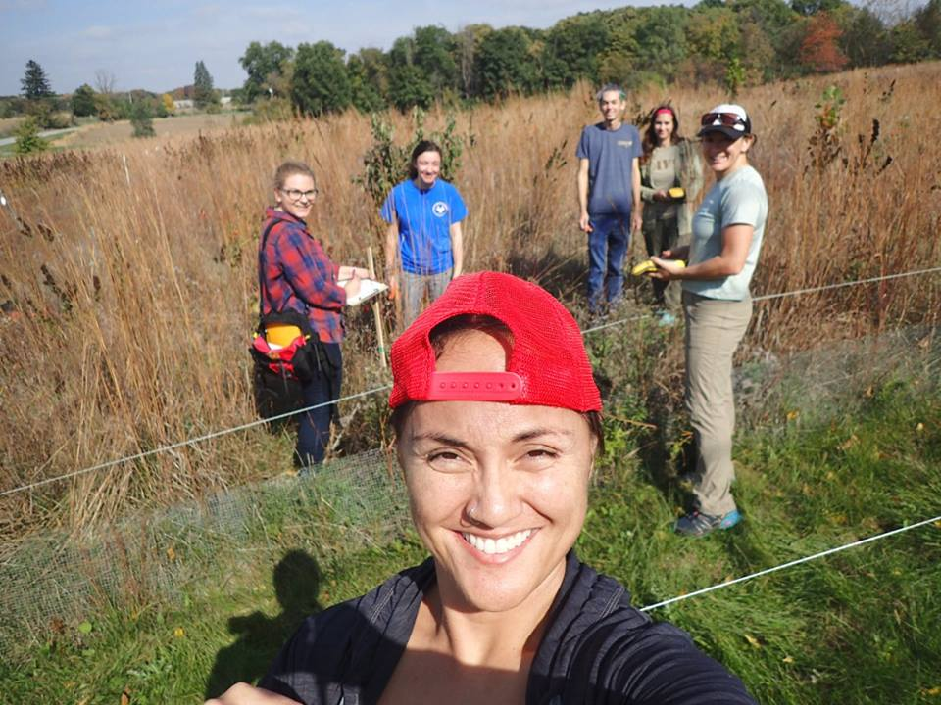
Special thanks to
Dr. Haldre Rogers, Dr. Steven Hall, Brent Mortenson,
Dr. Wenjuan Huang, Dr. Lauren Sullivan,
Alex Karnish, Joe Staudacher, Brittany Cavazos,
Andrea Colton, Cassey Raaz,
Courtenay Ray, Ann Marie Gawel,
Callie Peterson, and Dr. Marshall McDaniel.

Slide 32
Summary
-Herbivory did not effect respiration rates or carbon turnover
-Diversity did not effect respiration
-Significant difference in proportion of C3 in high and low diversity implies fast carbon turnover
-Questions?

