Slide 1

Ames Laboratory
By: James Burke, Jack Hendricks, Caden Woollen

Slide 2


Introduction
Our Goals - Capstone Team
  Find effective solution for client
  Succeed in Capstone class
Client Goals - Ames Laboratory
  Reduction of fire hazard during equipment cleaning process
  General improvement of cleaning process
Joint Goal
  Find effective solution to reduce fire hazards during cleaning
Ames Laboratory

Slide 3
Opportunity
Mitigation of Fire Hazards
  Improvement of Equipment Cleaning Procedures
    Better cleaning tools
    Improved methods
    Appropriate safety precautions
    Proper disposal of pyrophoric waste
Ames Laboratory

Slide 4
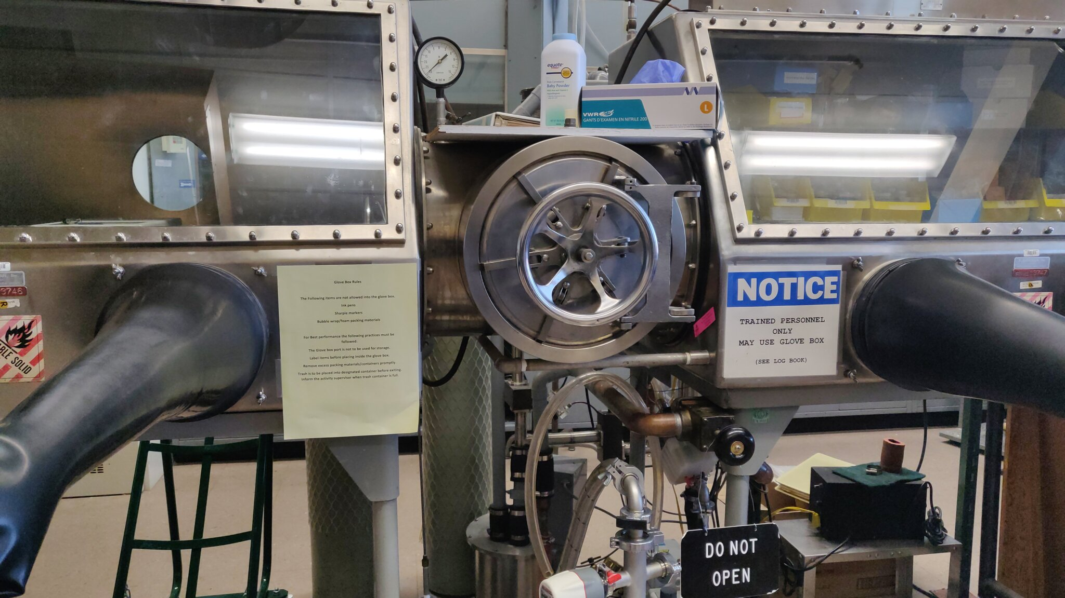
Solution
Best Practices Guide
  Highlights:
    Required PPE
    Cleaning Materials
    Procedures
    Safety Steps
Ames Laboratory

Slide 5
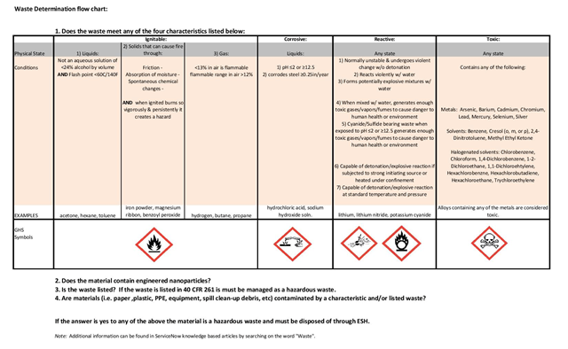
Benefits
Establishes safety within the laboratory
Shortens the cleaning process
Prevents work samples for getting contaminated
Ames Laboratory

Slide 6
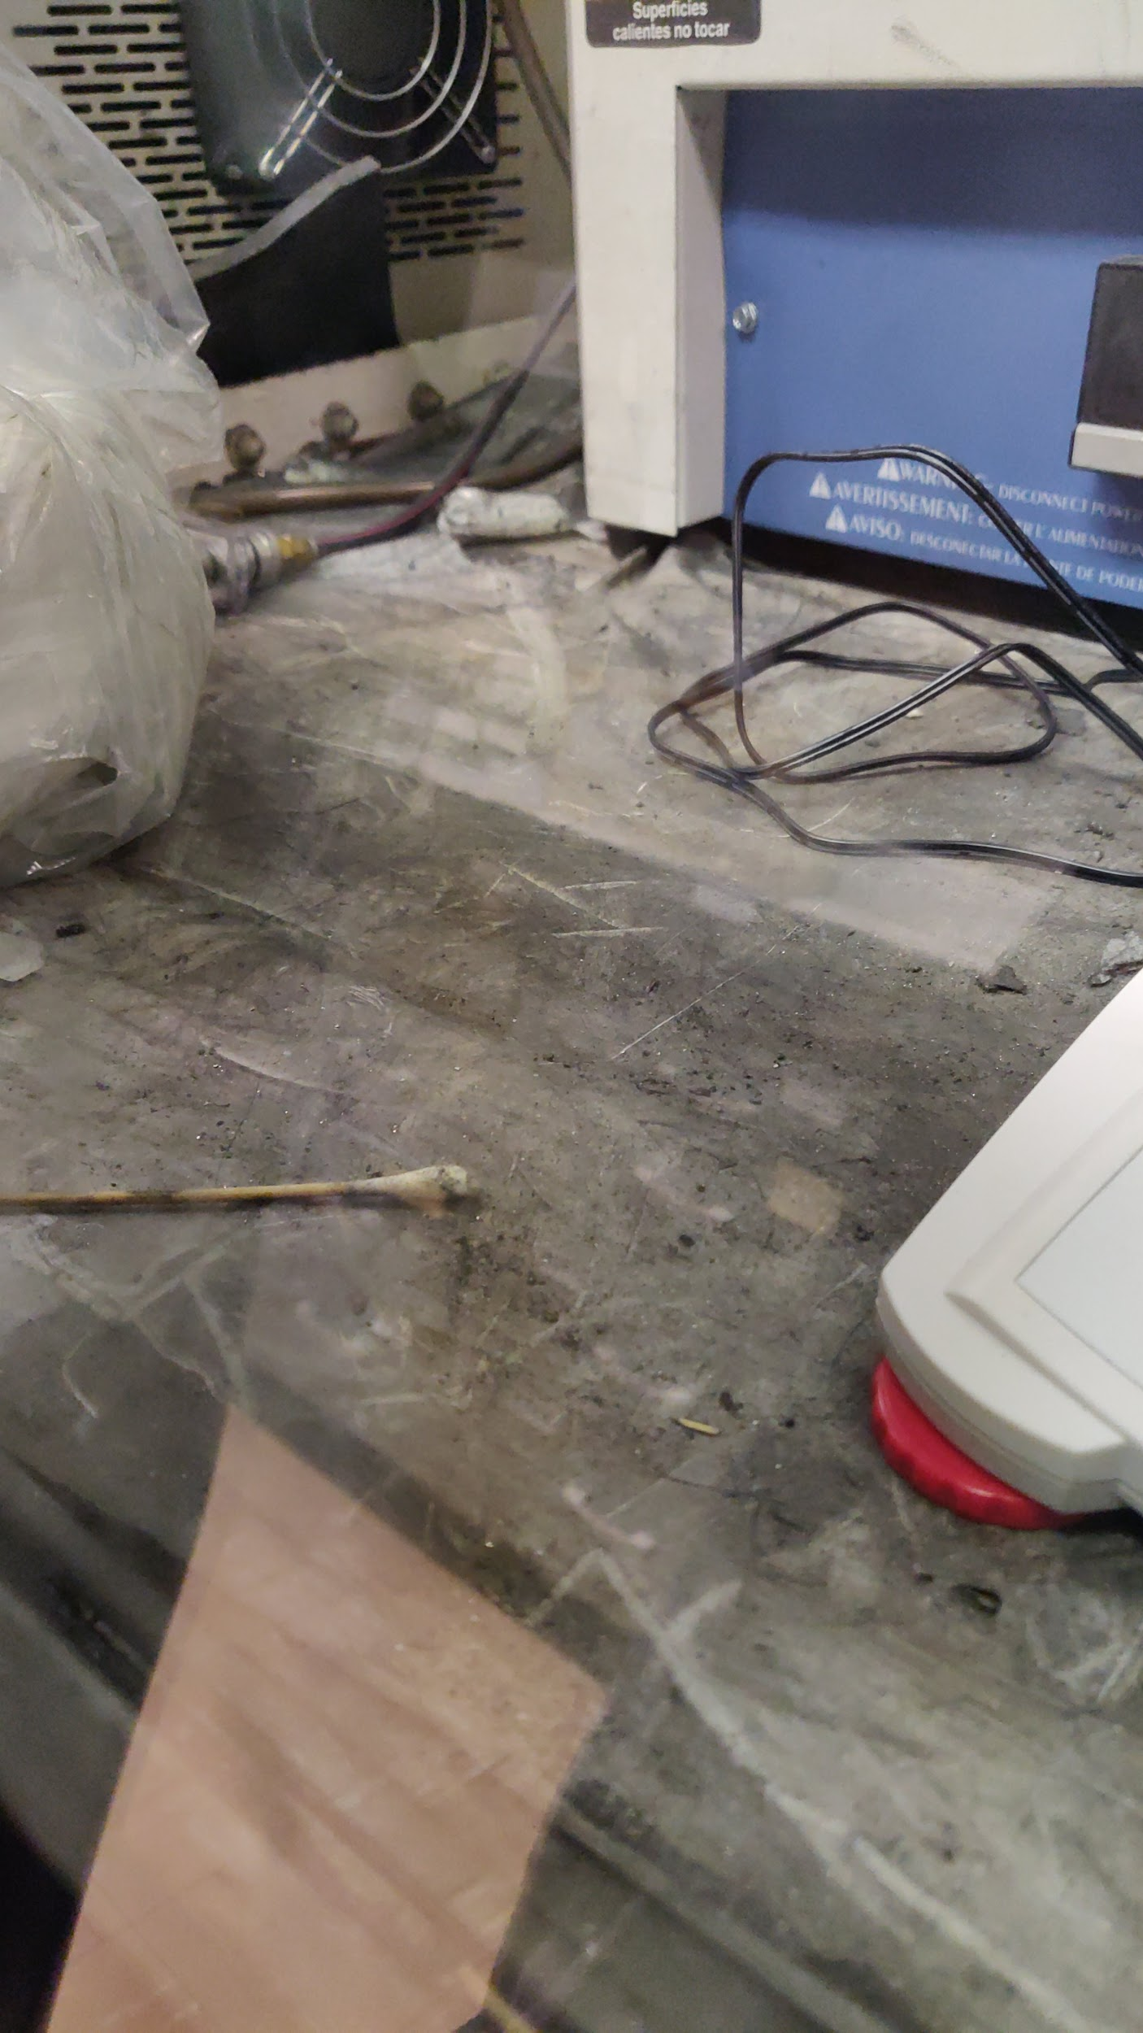
Evidence
Purpose built cleaning tool
  Impractical to build
  Too expensive
  Doesn’t fully address the problem
Best practices guideline
  Mindfulness
  Procedure
  Coordination with ES&H
Ames Laboratory

Slide 7
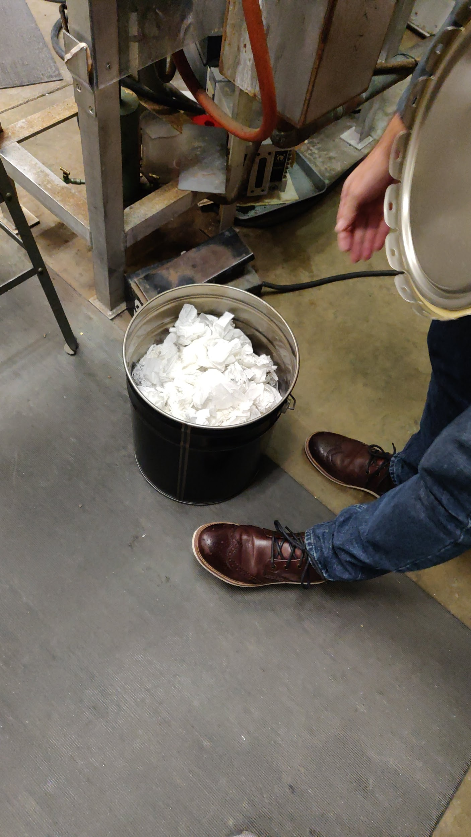
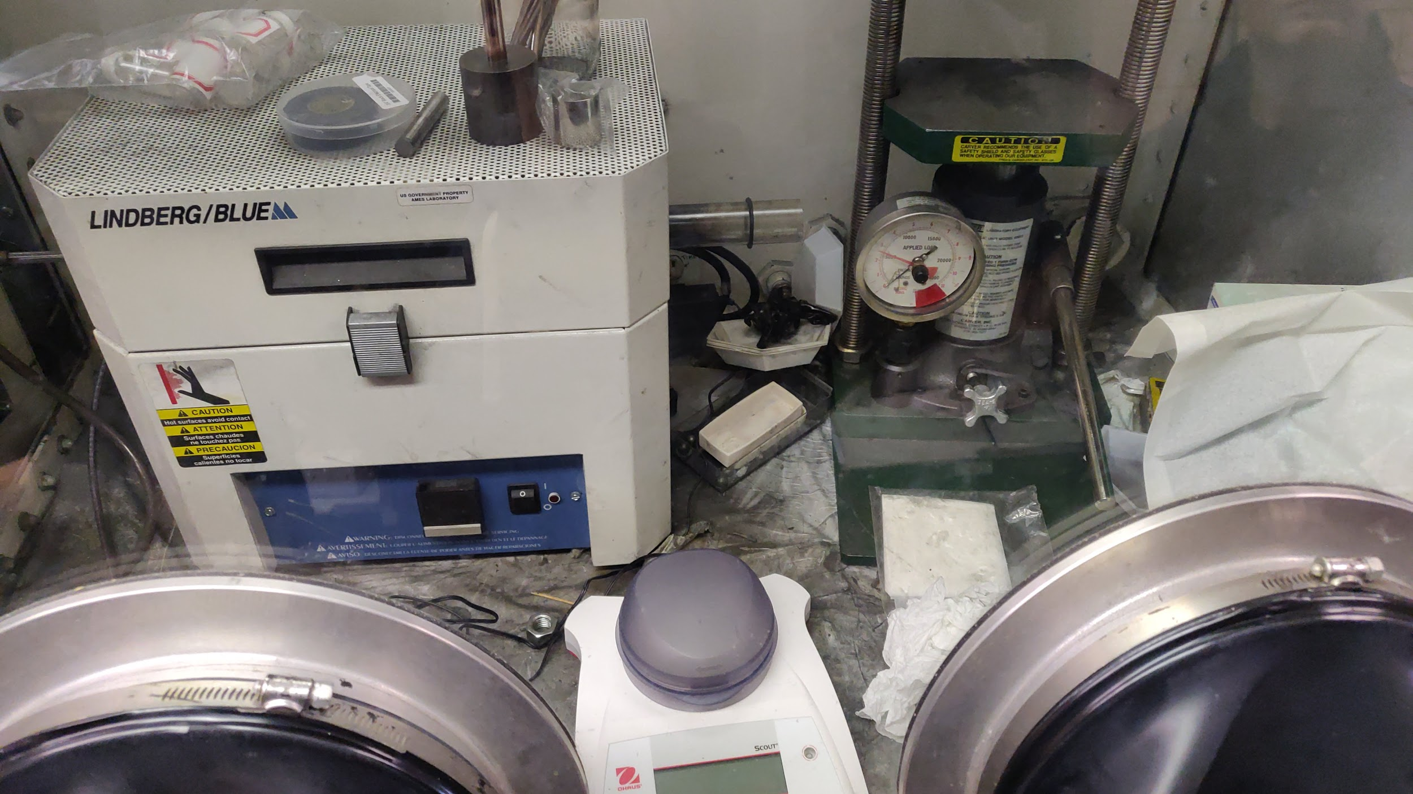
Close/Action Steps
Recommendations for the future
  Specific SOPs
  Generalized training
  Waste determination flow chart
Ames Laboratory

