Slide 1



Forensic Analysis of Joker-Enabled Android Malware Apps
Chen Shi, Chris Cheng, and Yong Guan
Iowa State University, CSAFE & Department of Electrical and Computer Engineering
In collaboration with Barbara Guttman, Rick Ayers, Michael Ogata, and James Lyle (NIST)

Slide 2
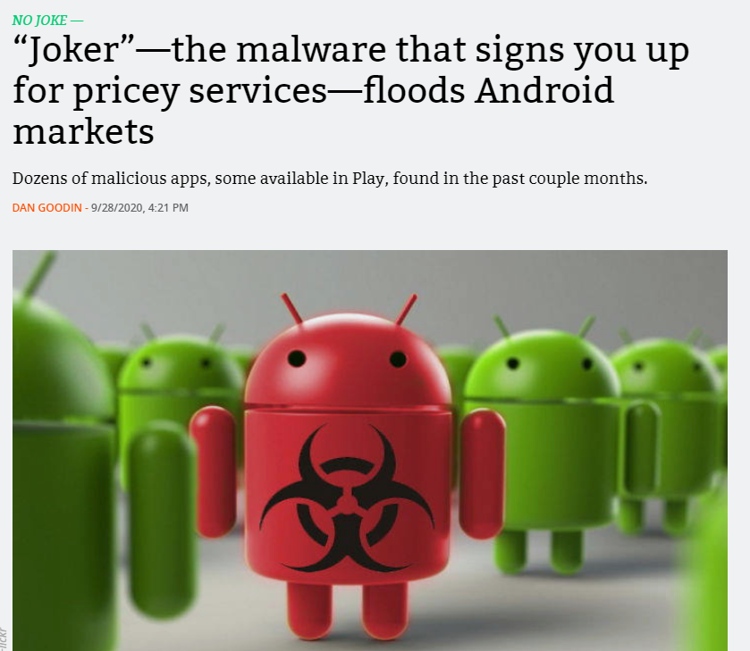
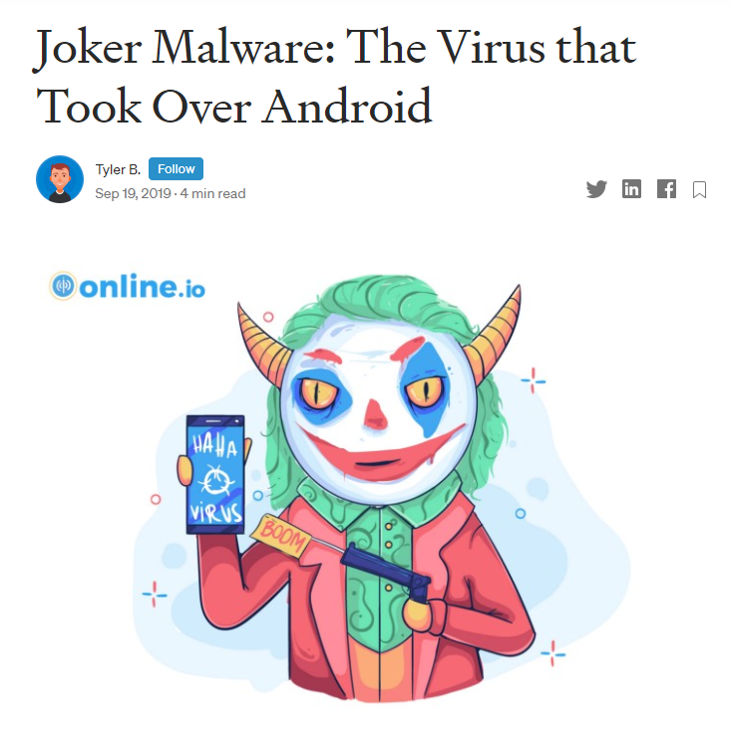
Joker is no joke!
Google removes 17,000 Android apps designed
to deploy Joker malware
The apps included the following:
  All Good PDF Scanner
  Mint Leaf Message-Your Private Message
  Unique Keyboard - Fancy Fonts & Free Emoticons
  Tangram App Lock
  Direct Messenger
  Private SMS
  One Sentence Translator - Multifunctional Translator
  Style Photo Collage
  Meticulous Scanner
  Desire Translate
  Talent Photo Editor - Blur focus
  Care Message
  Part Message
  Paper Doc Scanner
  Blue Scanner
  Hummingbird PDF Converter - Photo to PDF
  All Good PDF Scanner
Screenshot from https://arstechnica.com/ on 9/28/2020
Screenshot from https://medium.com/ on 9/19/2019
Notes:
Chen, please add some more details.

Slide 3
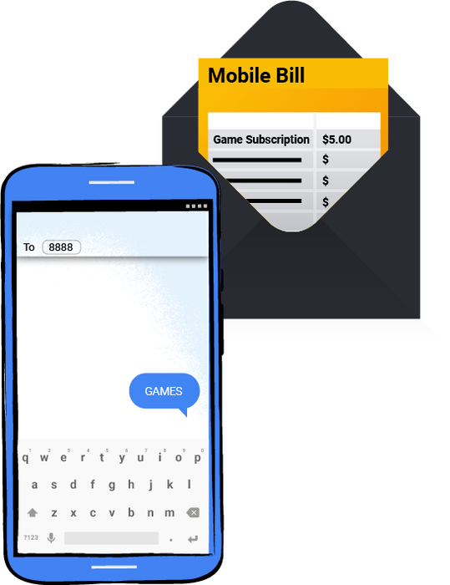
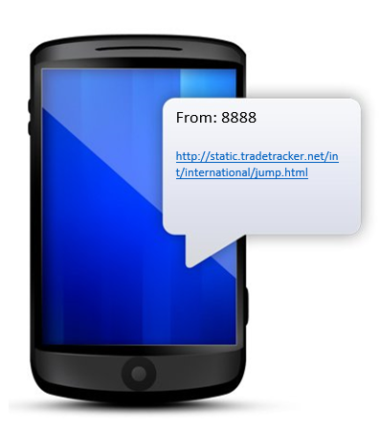



Android Malware - Joker Family
Joker Server
Subscriptions could cost hundreds of dollars per month
SMS Fraud
WAP Fraud
Contact list
IP address
Text message

Slide 4
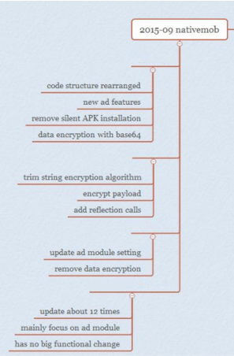
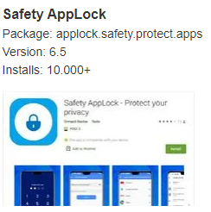
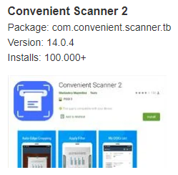
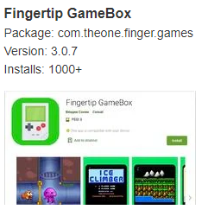
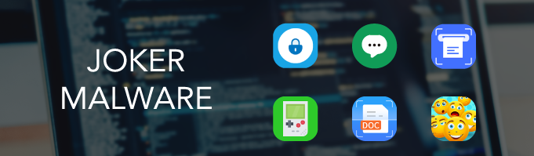
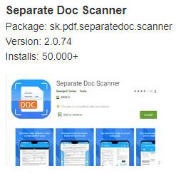
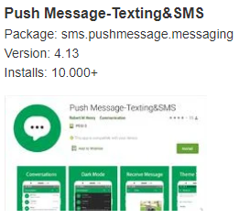
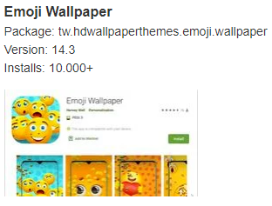
Joker Malware staying active
2017 first discovered
2018 Sep
2019 Jul
2019 Aug
2020 Oct - Dec
Some examples of Joker apps
Development of Joker Malware

Slide 5
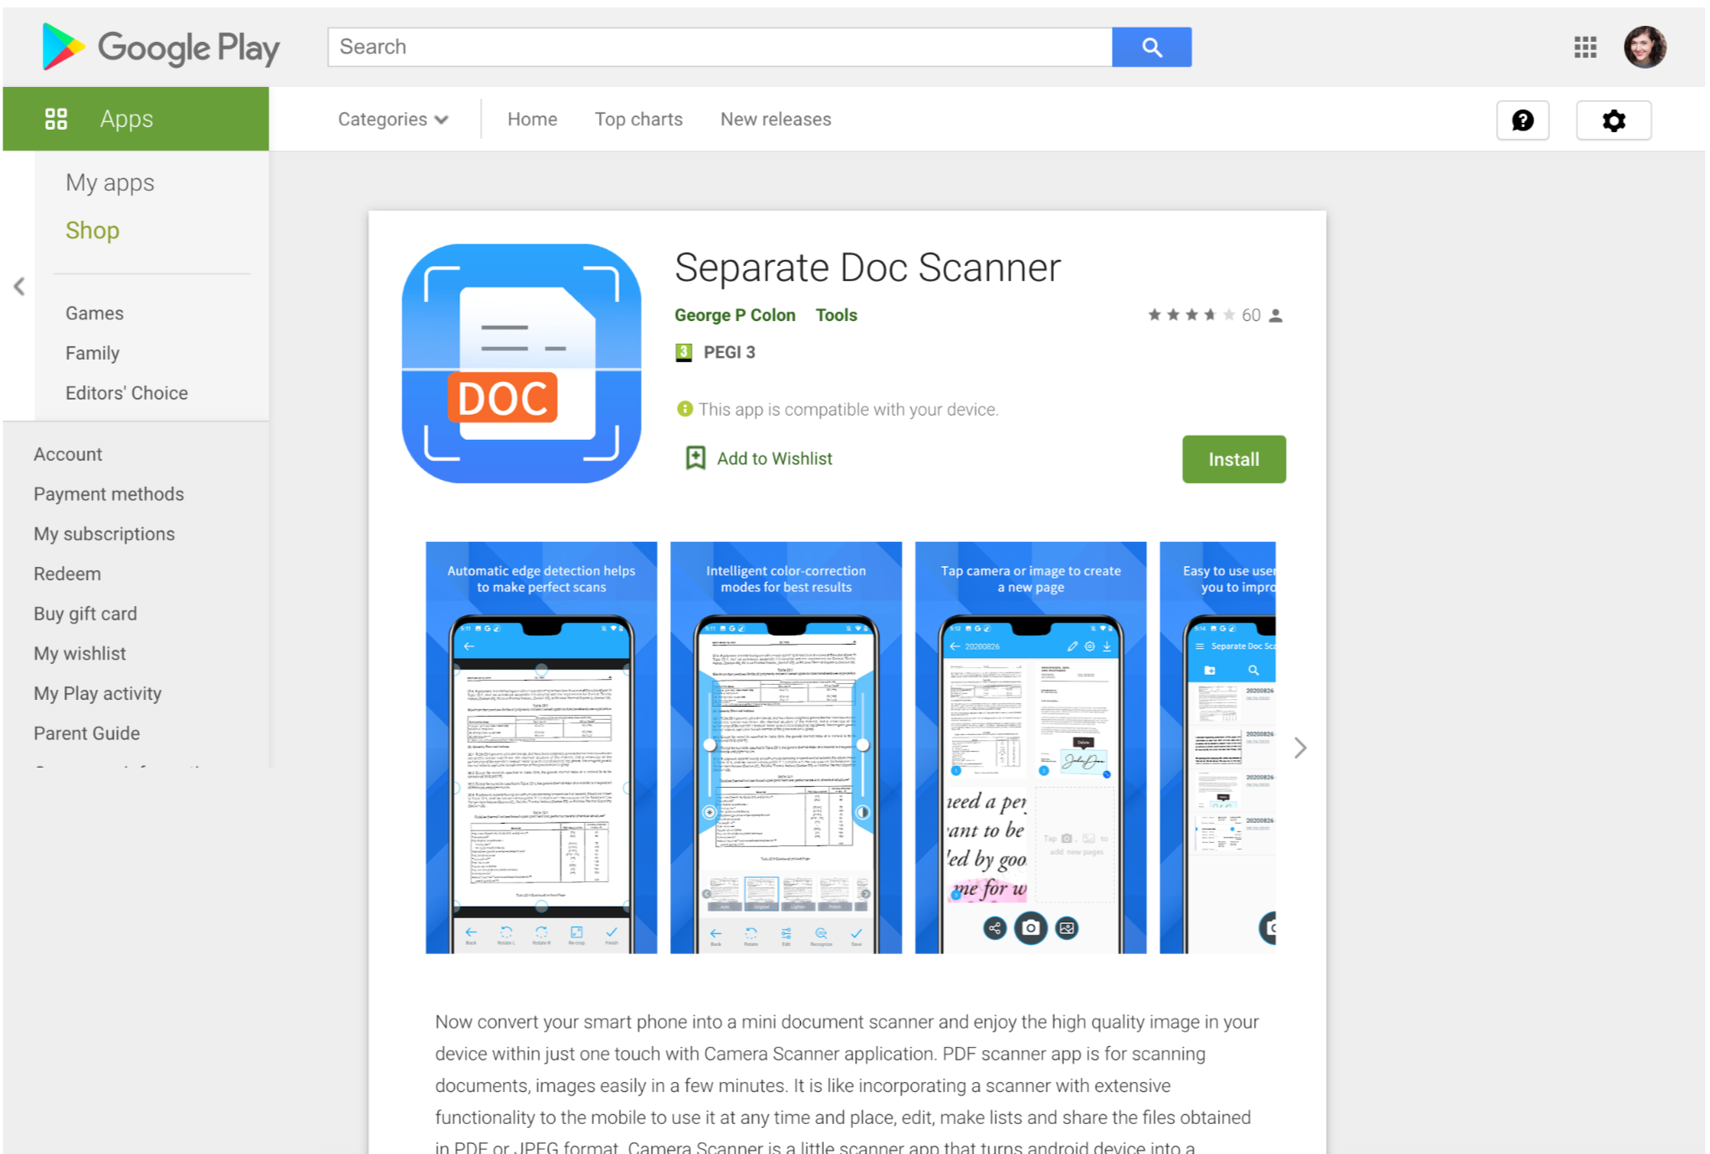


When you are using the Joker apps
Joker
Screen-recording of Joker App

Slide 6
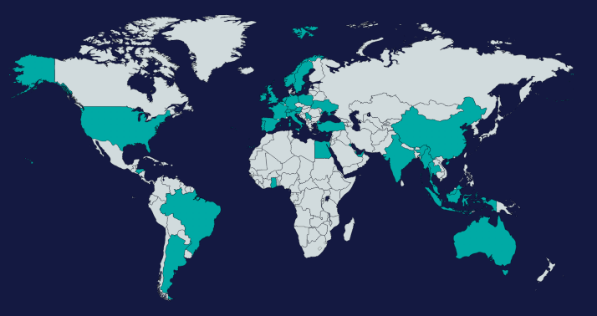
Our Investigation: Collection of Joker Malware
We have collected 12 different variants from 46 infected apps with 472,000+ installs in total
From the Mobile Country Codes, we have discovered the joker apps targeted on 37 countries.
https://medium.com/csis-techblog/analysis-of-joker-a-spy-premium-subscription-bot-on-googleplay-9ad24f04445

Slide 7

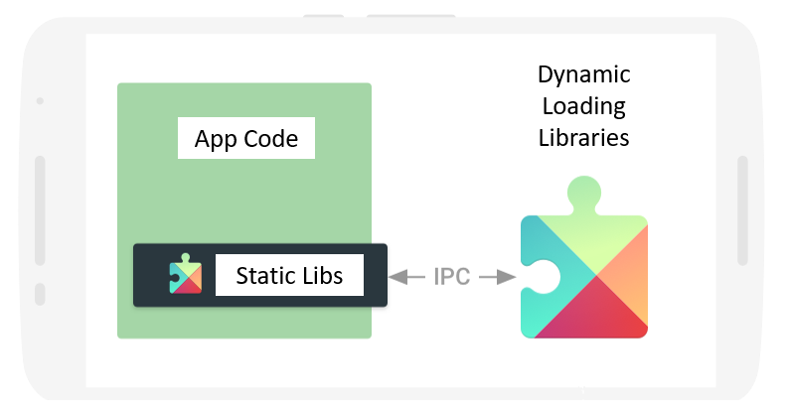



NIST-CSAFE: The Development of Evihunter & Lib Analysis (2016 – present)
Evihunter
Lib Analysis Tool
EviHunter toolset – published in the proceedings of ACM CCS 2018, IEEE SADFE 2018, etc.

Slide 8

Our Findings: How Joker Apps Bypass Google App Vetting
Dynamic Code Loading
Time Checks And Display Durations
Using Open-Source Utility Library
Replacing With Malicious SDKs
Hide malicious code in the app updates
…

Slide 9
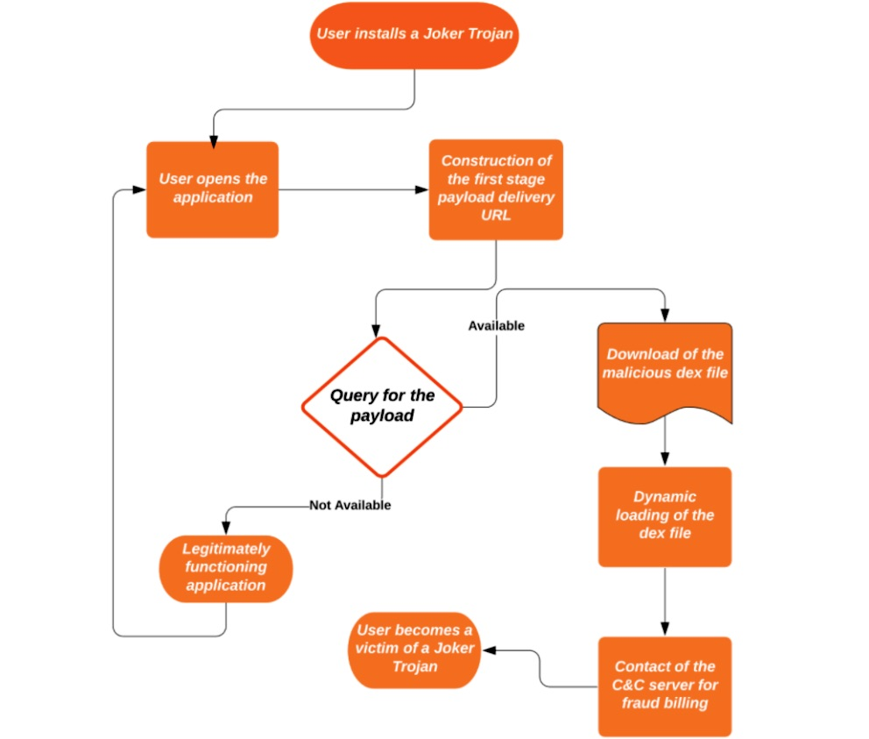
Our Findings: Joker → Advertisement Framework
• Target country checking via MCC
• C&C communication
• DEX decryption & loading
• A notification listener
https://arstechnica.com/information-technology/2020/09/joker-the-malware-that-signs-you-up-for-pricey-services-floods-android-markets/

Slide 10
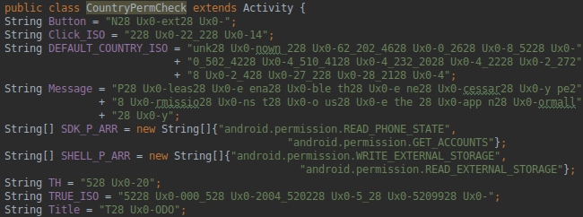
Our Findings: String Obfuscation
The Joker employs custom string obfuscation schemes for all of the configuration/payload/communication parsing procedures. The code listing below displays an example of an obfuscated MCC code list, (DEFAULT_COUNTRY_ISO) separated by the underscore symbol.

Slide 11
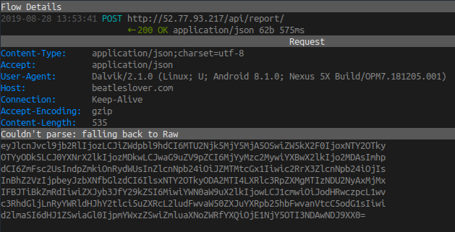
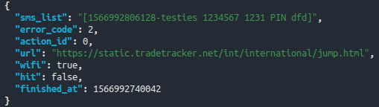
Our Findings: Sends SMS messages to subscribe services
decrypted SMS message
Encrypted SMS data

Slide 12
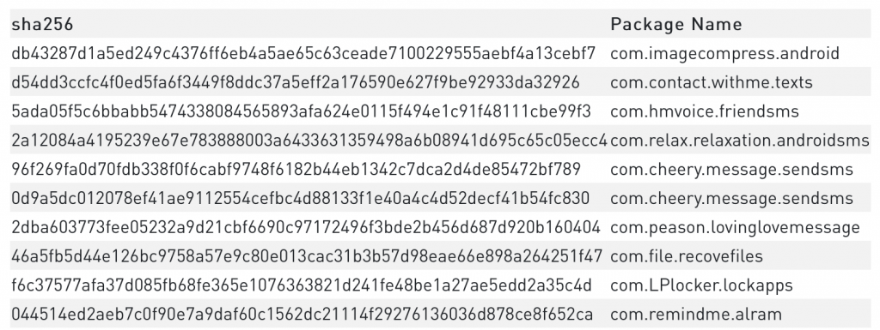
Our Findings: Joker Variants
12 unique builds of Joker Malware were found.
The version names are:
  -s8-release
  -s8–5-release
  -s8–6-release
  -s8-all
  -s9–6-dsp-release
  -s9–6–3
  -s9–3-sendsms
  -s9–5-release
  -Y12-all-no-log
  -Y12-no-log
  -Y13-all
  -Y13-all-no-log
The Server IP address:
IP | 161.117.62.127
IP | 161.117.83.26
IP | 47.74.179.177
The Infected apps(shown partial):

Slide 13
Our Findings: Joker Variants –cont.
The URLs of payload:
  blackdragon.oss-ap-southeast-5.aliyuncs.com/privateSMS_ba.html
  blackdragon03.oss-ap-southeast-5.aliyuncs.com/partMessage_base.css
  blackdragon03.oss-ap-southeast-5.aliyuncs.com/partMessage_config.json
  nineth03.oss-ap-southeast-5.aliyuncs.com/MeticulousScanner_bs.mp3
  sahar.oss-us-east-1.aliyuncs.com/care.asf
  sahar.oss-us-east-1.aliyuncs.com/onesentence.asf
  sahar.oss-us-east-1.aliyuncs.com/onesentence2.asf
  sahar.oss-us-east-1.aliyuncs.com/saiks.asf
  sahar.oss-us-east-1.aliyuncs.com/tangram.asf
  sahar.oss-us-east-1.aliyuncs.com/tangram2.asf
  sahar.oss-us-east-1.aliyuncs.com/twinkle.asf
  2j1i9uqw.oss-eu-central-1.aliyuncs.com/328718737/armeabi-v7a/ihuq.sky
  blackdragon.oss-ap-southeast-5.aliyuncs.com/blackdragon.html
  blackdragon.oss-ap-southeast-5.aliyuncs.com/privateSMS.json
  fgcxweasqw.oss-eu-central-1.aliyuncs.com/fdcxqewsswq/dir.png
  jk8681oy.oss-eu-central-1.aliyuncs.com/fsaxaweqwa/amly.art
  n47n.oss-ap-southeast-5.aliyuncs.com/H20PDF29.txt
  n47n.oss-ap-southeast-5.aliyuncs.com/font106.ttf
  nineth03.oss-ap-southeast-5.aliyuncs.com/blackdragon.html
  proxy48.oss-eu-central-1.aliyuncs.com/m94.dir
  proxy48.oss-eu-central-1.aliyuncs.com/response.js
  laodaoo.oss-ap-southeast-5.aliyuncs.com/allgood2.webp
  laodaoo.oss-ap-southeast-5.aliyuncs.com/flower.webp
  rinimae.oss-ap-southeast-5.aliyuncs.com/powerful.mov
  rinimae.oss-ap-southeast-5.aliyuncs.com/powerful2.mov
  rinimae.oss-ap-southeast-5.aliyuncs.com//intro.mov

Slide 14
Our Findings: Analysis Results(partial) – Joker Malware
<package_name = “com.saying.wallpaper.bb”>
<Source>
<util.setTimezone();>
<helper.getAndroidID();>
<android.getInstalled();>
<android.getPin();>
<Sink>
<httpUtils.setPost(url);>
Normal
Signature
Dangerous
Dangerous
Dangerous

Slide 15
Our Findings: Analysis Results – Detailed Level
< package_name = “com.saying.wallpaper.bb”>
<Method= “change_color_function”>
<source>
<parameter class= “change_color_function”, parameter= 1>
<source category= “ip_address”>
<sink>
<returnValue>
Source

Slide 16
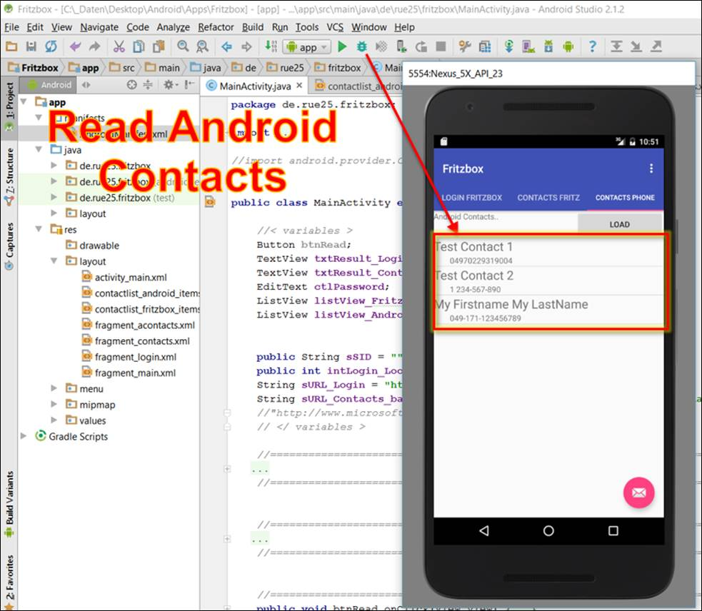
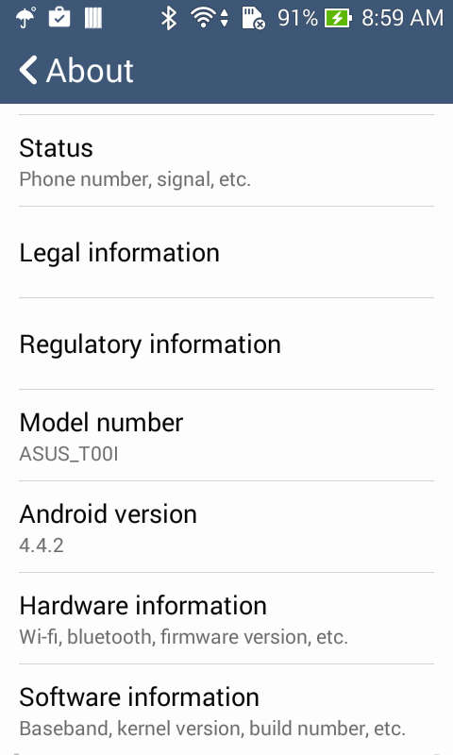
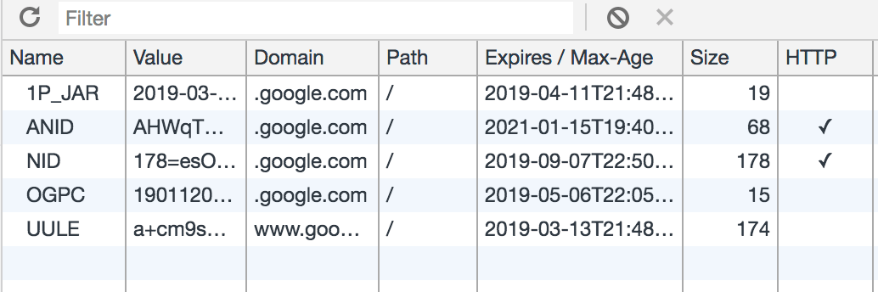
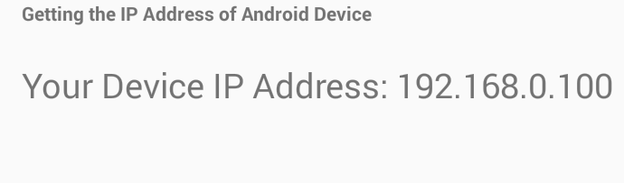
Forensic artifacts being discoverable!
Cookies
IP address
Device information
Contact lists

Slide 17
Evidential data found from Joker apps(samples)
Package_Name | Evidence_Type | Evidence_Path
com.relax.relaxation.androidsms | Timestamp | File_System: | /data/user/0/com.relax.relaxation.androidsms/files/.Fabric/com.crashlytics.sdk.android.crashlytics-core/5E4190DE0072-0001-2DB2-5491063CD578SessionOS.cls_temp
 |  |  | /data/user/0/com.relax.relaxation.androidsms/databases/alertc_data.db
 |  |  | /data/user/0/com.relax.relaxation.androidsms/shared_prefs/nl.flitsmeister_preferences.xml
com.hmvoice.friendsms | SMS | File_System: | /data/user/0/com.hmvoice.friendsms/app_acra-reports/5a2fc273-ac3e-4889-bd89-75f82e2ad89c-0F0-141753097.stacktrace
 |  |  | /data/user/0/com.hmvoice.friendsms/shared_prefs/acra_criticaldata_store.xml
 |  |  | /data/user/0/com.hmvoice.friendsms/shared_prefs/rti.mqtt.mqtt_radio_active_time.xml
com.remindme.alram | Device_ID | File_System: | /data/user/0/com.remindme.alram/files/.Fabric/com.crashlytics.sdk.android.crashlytics-core/5E5D55750213-0001-26F7-C9F567148EB1SessionOS.cls_temp
com.LPlocker.lockapps | Device_ID | File_System: | /data/user/0/com.LPlocker.lockapps/cache/image_manager_disk_cache/3f02e54b32502bb549b6f2aab5ed0f6daa4c8adff3013c59223427ba3cddf5e0.0
com.file.recovefiles | Timestamp |  | /data/data/com.file.recovefiles/shared_prefs/.xml
 |  | Network_System: | url":"https://com.file.recovefiles/0.1/journeys?lang=&from=Business+Schools+In+New+York,+West+23rd+Street,+New+York,+NY/&to=Babylon,+NY&searchType=&dateTime=04/22/20_15:24:16+00:00&sequence=&byTrain=&byBus=&bySubway=&byTram=&byFerry=&interchangeTime=&planWithAccessibility=&before=&after=&realtime=true
 |  |  | url":"https://com.file.recovefiles/0.1/journeys?lang=&from=&to=&searchType=&dateTime=<timestamp>&sequence=&byTrain=&byBus=&bySubway=&byTram=&byFerry=&interchangeTime=&planWithAccessibility=&before=&after=&realtime=true
 | Unclassified |  | url":"https://com.file.recovefiles/0.1/accounts/register?lang=nl-NL
 |  |  | url":"https://com.file.recovefiles/0.1/accounts/login?lang=nl-NL
 |  |  | url":https://maps.googleapis.com/maps/api/directions/json?origin=,&destination=,&key=AIzaSyBa4hEf62cOuu10td_crNhaVHElHgF0M40&sensor=false&mode=walking
 |  |  | url":"https://com.file.recovefiles/0.1/stopinfo//nl-NL
 |  |  | url":"https://com.file.recovefiles/0.1/sessions//used-locations?lang=nl-NL
 |  |  | url":"https://com.file.recovefiles/0.1/status?lang=nl-NL
 |  |  | url":"https://com.file.recovefiles&after=4
 |  |  | url":"https://com.file.recovefiles&before=4
 |  |  | url":"https://com.file.recovefiles/0.1/locations//departure-times?lang=nl-NL

Slide 18
Summary and Future Works
Automated Android Malware vetting tools to discover all the malicious behaviors and retrieve potential forensic artifacts of Android Malwares in the local storage and data sent to server.
Future Works
  Malware collection of Joker family.
  Establish a dictionary-like Android malware database that includes malware themselves (malicious code and variant) with all the detected IP addresses, URLs as well as other types of evidence data.

Slide 19
Thank you!
Acknowledgements
This work was partially funded by the Center for Statistics and Applications in Forensic Evidence (CSAFE) through Cooperative Agreement #70NANB15H176 between NIST and Iowa State University, which includes activities carried out at Carnegie Mellon University, University of California Irvine, University of Virginia, Duke University, and West Virginia University.
Technical Contact: Chen Shi, Ph.D Student, cshi@iastate.edu;
Yong Guan, Professor, Department of Electrical and Computer Engineering, Iowa State University, (515) 294-8378, guan@iastate.edu, http://www.eng.iastate.edu/~guan

