Slide 1
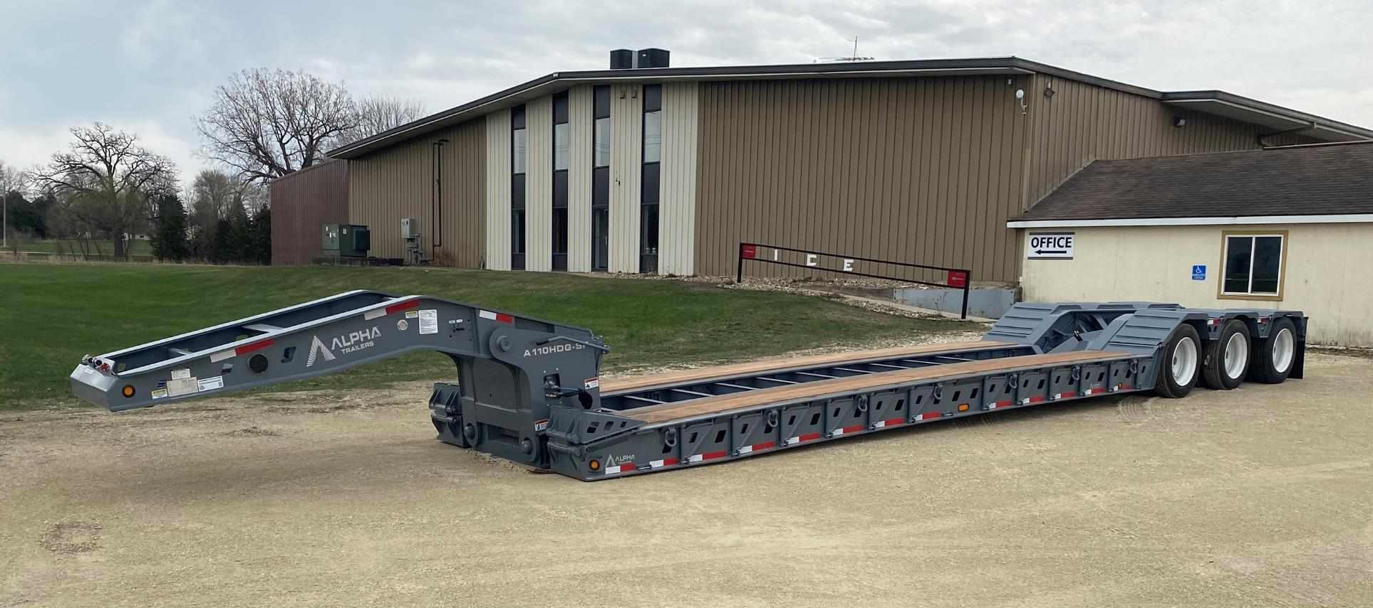
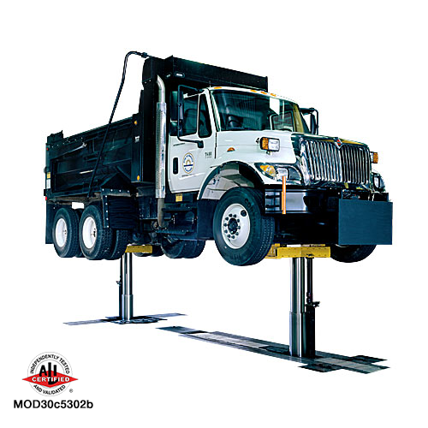
    TSM Technology Capstone Day, April 29, 2022
    *Instructors: Mike Anderson and Jacek Koziel
Department of Agricultural and Biosystems Engineering
Chase Bittle, Burton Hess, Bryce Kleitsch, Mason Mahlow, Michael E. Anderson*, Jacek A. Koziel*
Alpha Trailers Painting Rotisserie
Client: Alpha Trailers, Oelwein, Iowa
Problem Statement
Alpha's current painting process is both cost and ergonomically inefficient. That creates an unsafe and very costly work environment for everyone. The current process involves setting the trailer on stands requiring the painters to crawl on the floor to paint the bottom of the trailer.
Constraints
Must be cost effective
Must be explosion proof
Be able to support up to 20,000 lbs
Rotate trailers 30-45 degrees in both directions
Must be able to accommodate different trailers lengths
Must not mount to axles
Project completion by 3/11/2022
Objective
Decrease ergonomic hazards on employees
Decrease time required to paint a trailer
Present commercial product to client to implement
Alpha HD Trailers "Low-Boy" Trailer
Methods/Approach
Find a product to decrease paint time and improve paint quality
Analysis on the product will be performed on Inventor and through on-site testing
Proposed Lift Concept
Flex MOD335 Lift
Major Deliverables
Graphical design and drawing
Estimated cost with bill of materials
Report
Measures of success
Measuring cycle time
Quality of paint on the trailers
Scope
Formulate Ideas/Complete research to develop a plan for the project
Find a product that conforms to constraints.
Complete analysis on the product
Propose product to Alpha Trailers
References
NFPA Standards Directory 2021
OSHA 1915.35
British EN Standard Strength of Steel
Recommendations
Implement design
Buy available product
Acknowledgements: Authors are grateful to Jeff Ingels for the opportunity to work on this project. Project was co-funded by the differential tuition.

