Slide 1
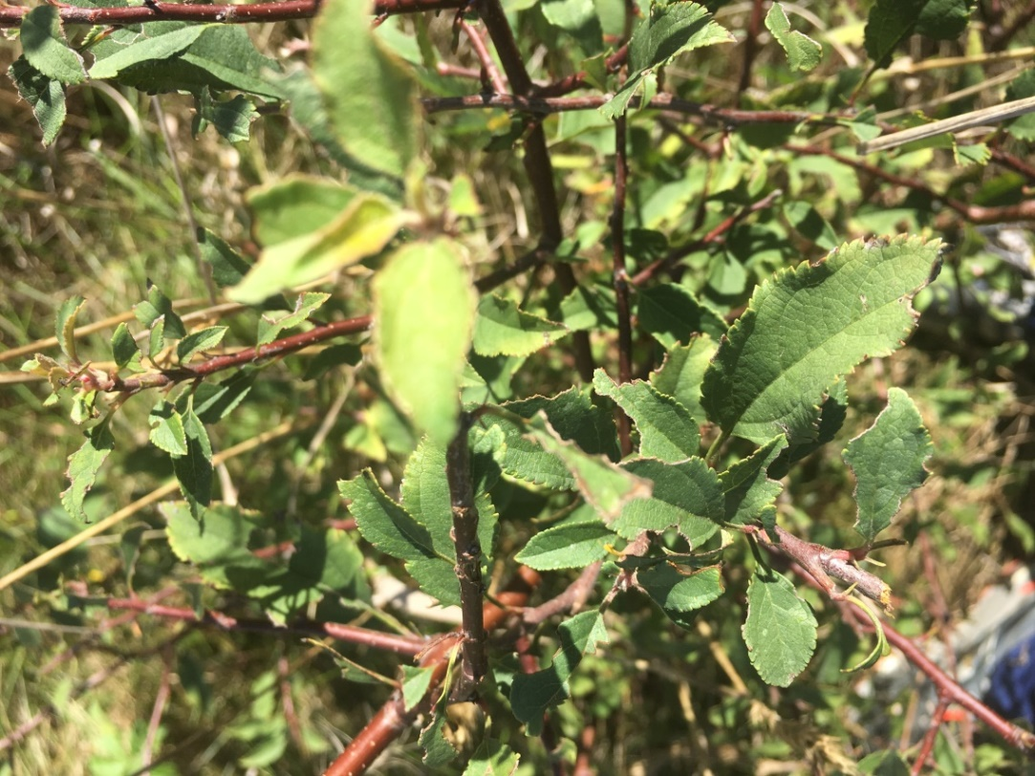
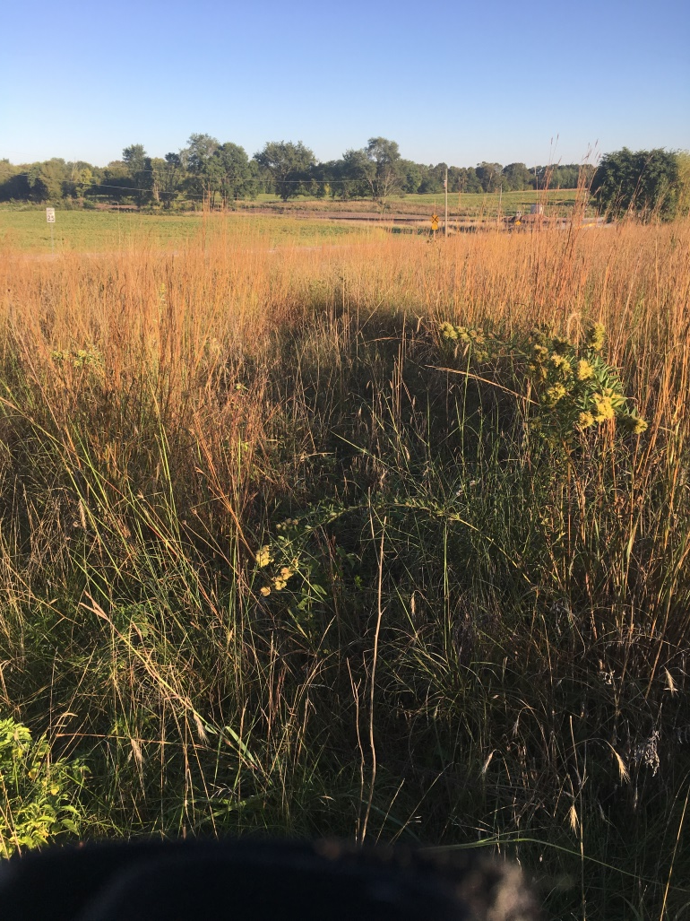
Patterns of Woody Encroachment Establishment in a Restored Prairie
Andrea Colton, Dr. Haldre Rogers

Slide 2
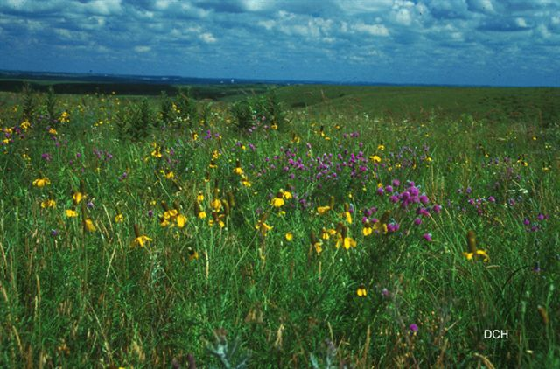
Iowa’s Tallgrass Prairies
Comprised 85% of natural landscape (IAON)
Home to variety of wildlife (including bison, elk, and wolves historically)
Kristen Callahan

Slide 3
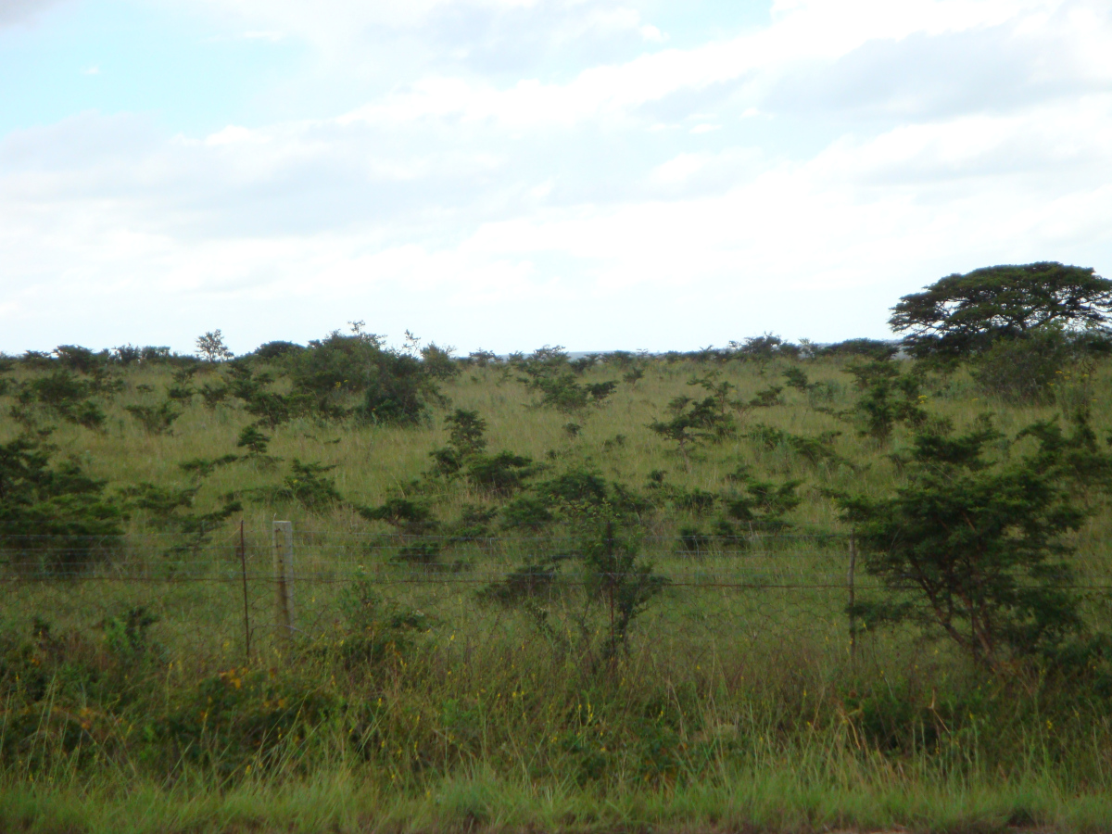
Woody Encroachment
Can slowly take over prairies (Ratajczak et al., 2011)
Historically controlled with bison and wildfires
Emma Jardine (2016)

Slide 4
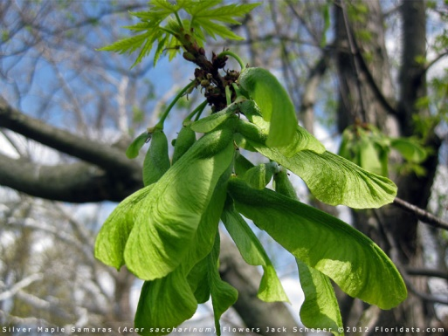
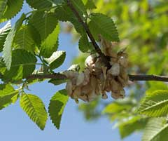
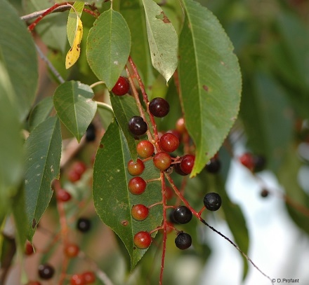
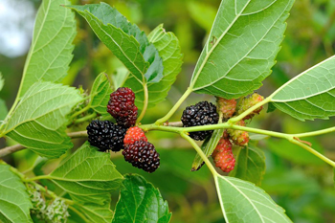
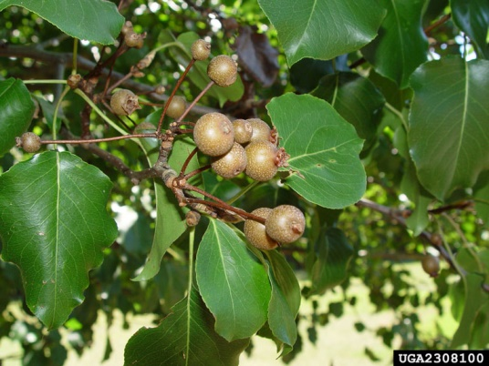
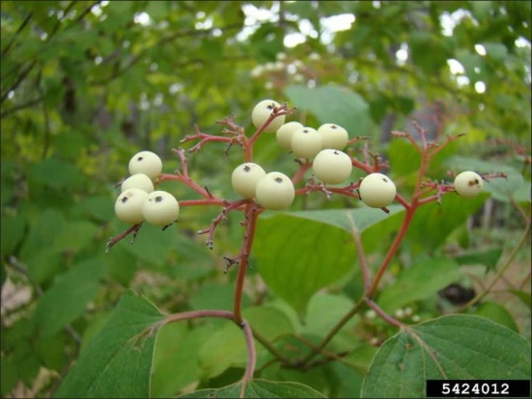
Seed Dispersal
Wind:
Silver
Maple
Siberian
Elm
Floridata
PFAF.org
Animal:
ohio.edu
Chuck Bargeron
Extension.iastatue.edu
Medicinalherbinfo.org
Black Cherry
White Mulberry
Callery Pear
Roughleaf Dogwood

Slide 5
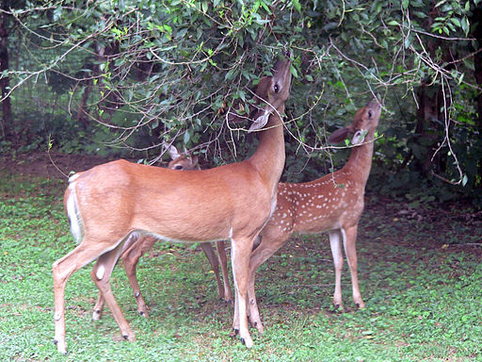
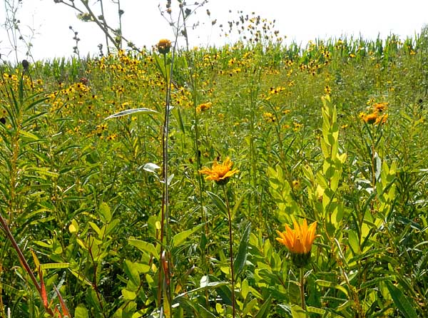
How do we combat encroachment?
Look at other factors that may control
  Herbivory
  Surrounding plant diversity
Todd Heft (2013)
Peoria Audubon Society

Slide 6
Hypotheses
Herbivory reduces establishment and growth of woody species.
Herbaceous plant diversity reduces establishment and growth of woody species.
Seed dispersal mode affects dispersal distance and spatial distribution of woody stems in the prairie.

Slide 7
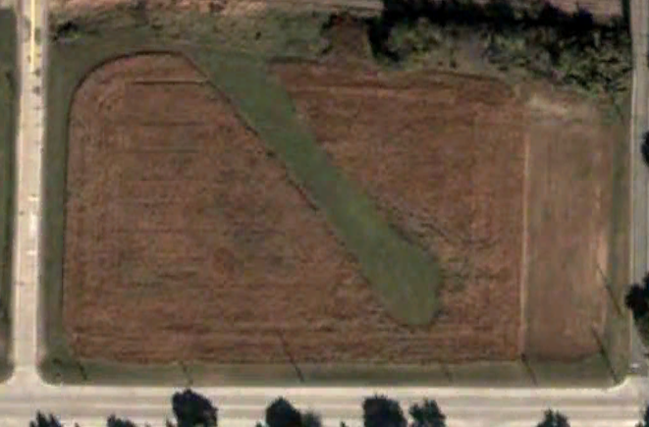
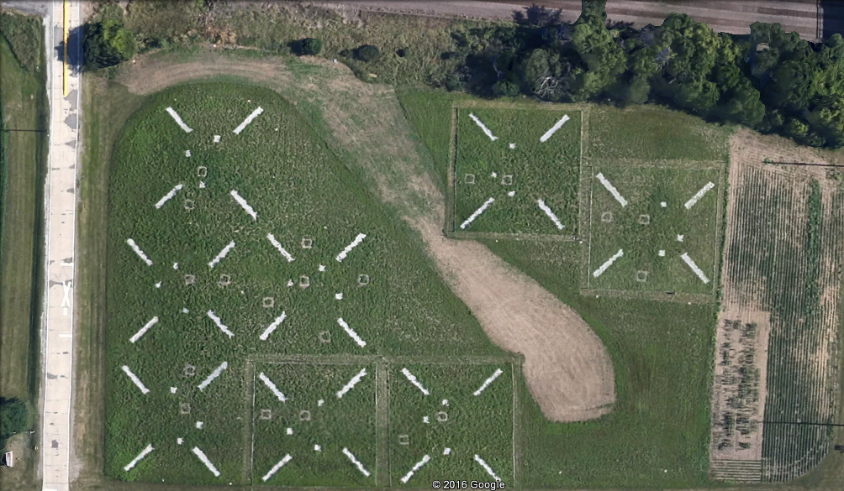
Oakridge Prairie

Slide 8
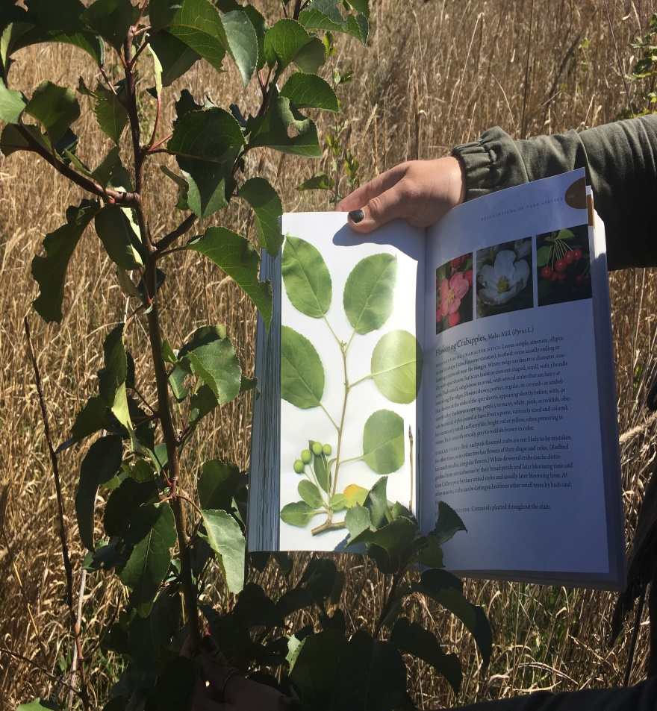
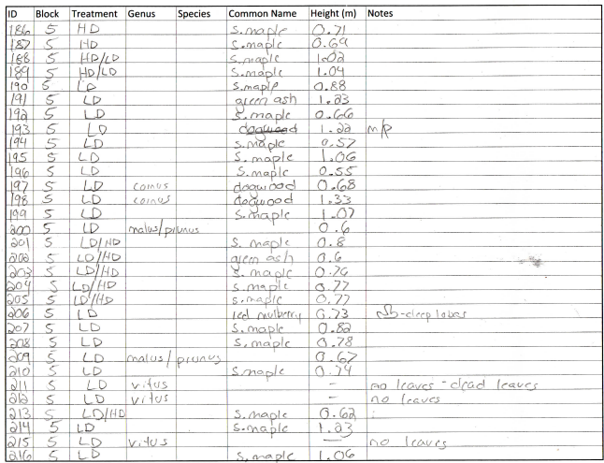
Methods
Collected data and GPS points in prairie and for surrounding conspecifics

Slide 9
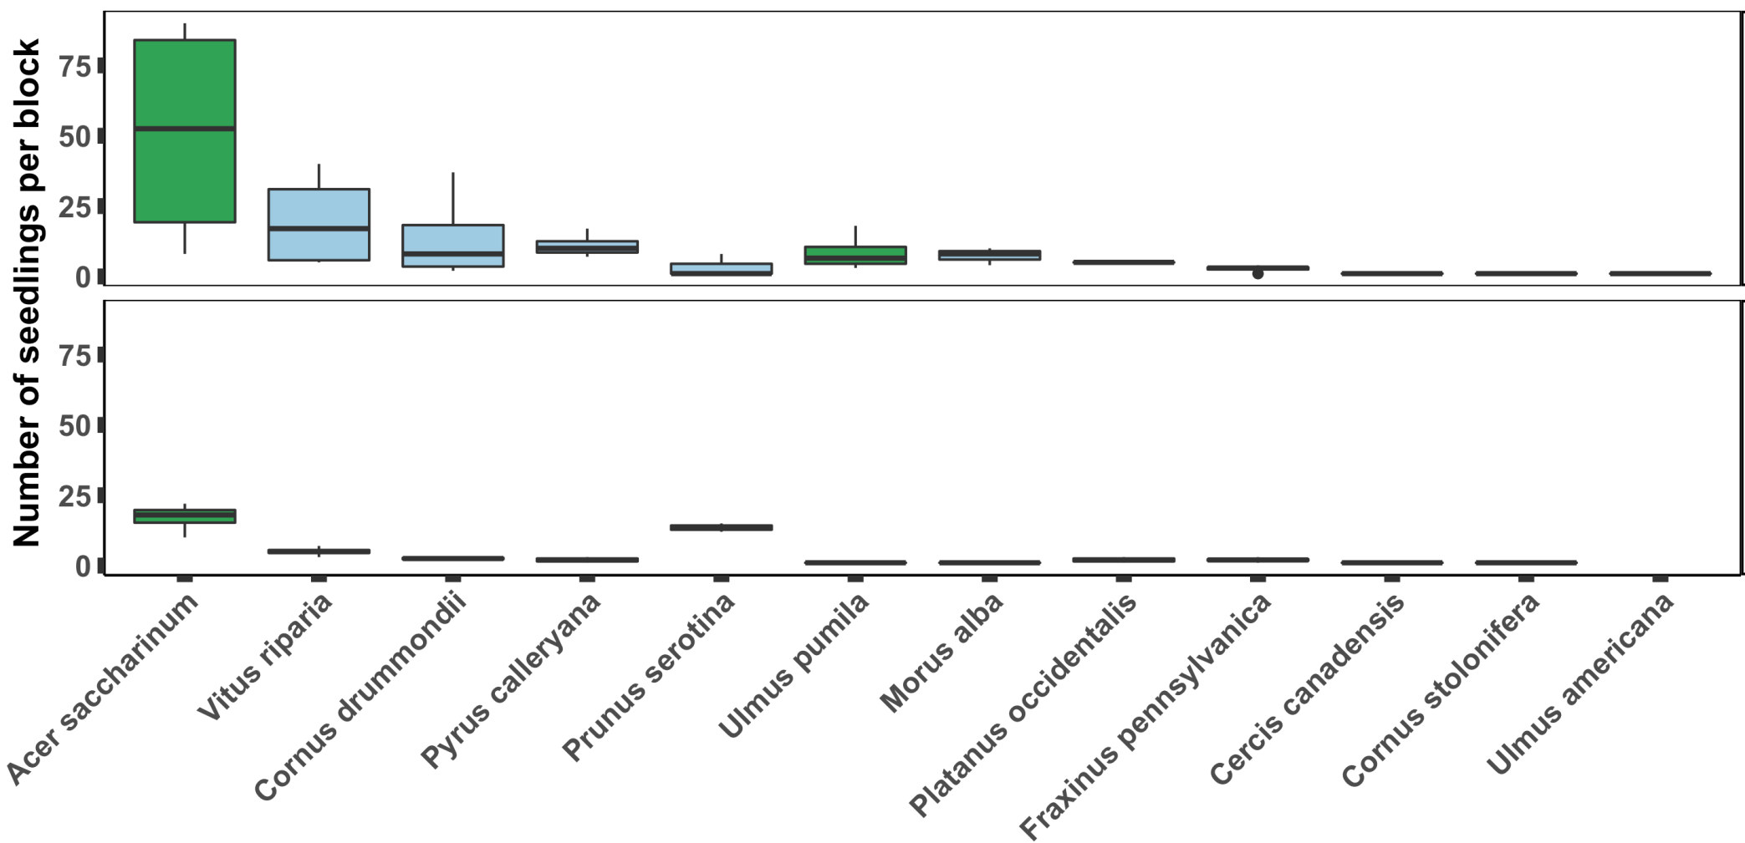


Abundance of Species by Herbivory Treatment
Exclosure
Open
Wind dispersed
Animal dispersed

Slide 10
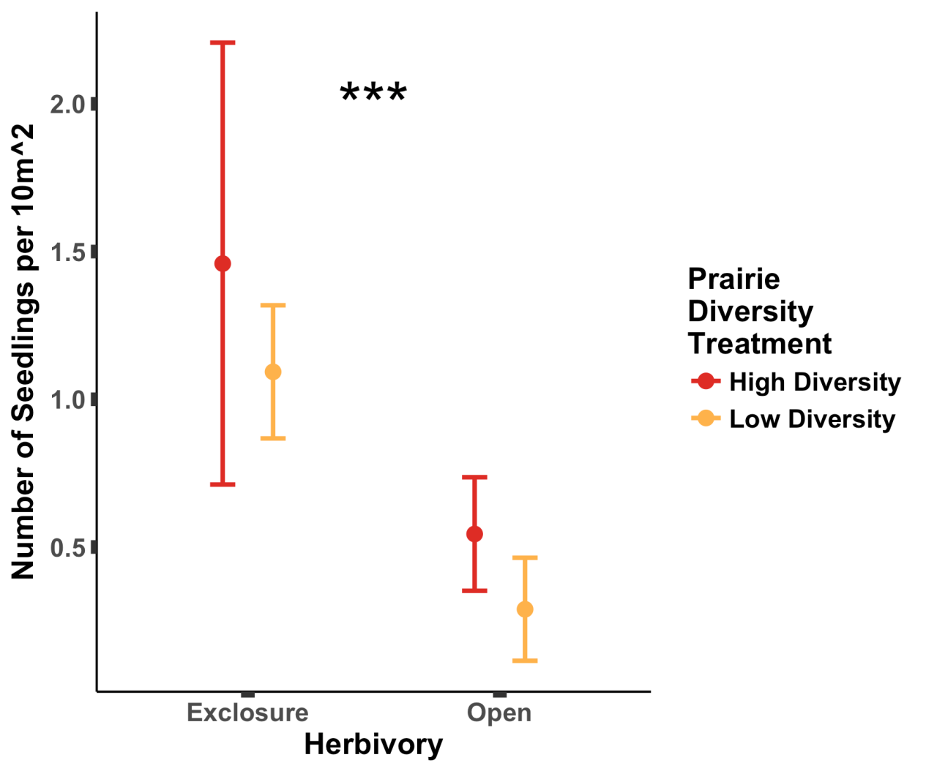
Treatment Affect on Overall Abundance
Number of Seedlings per 10m²

Slide 11
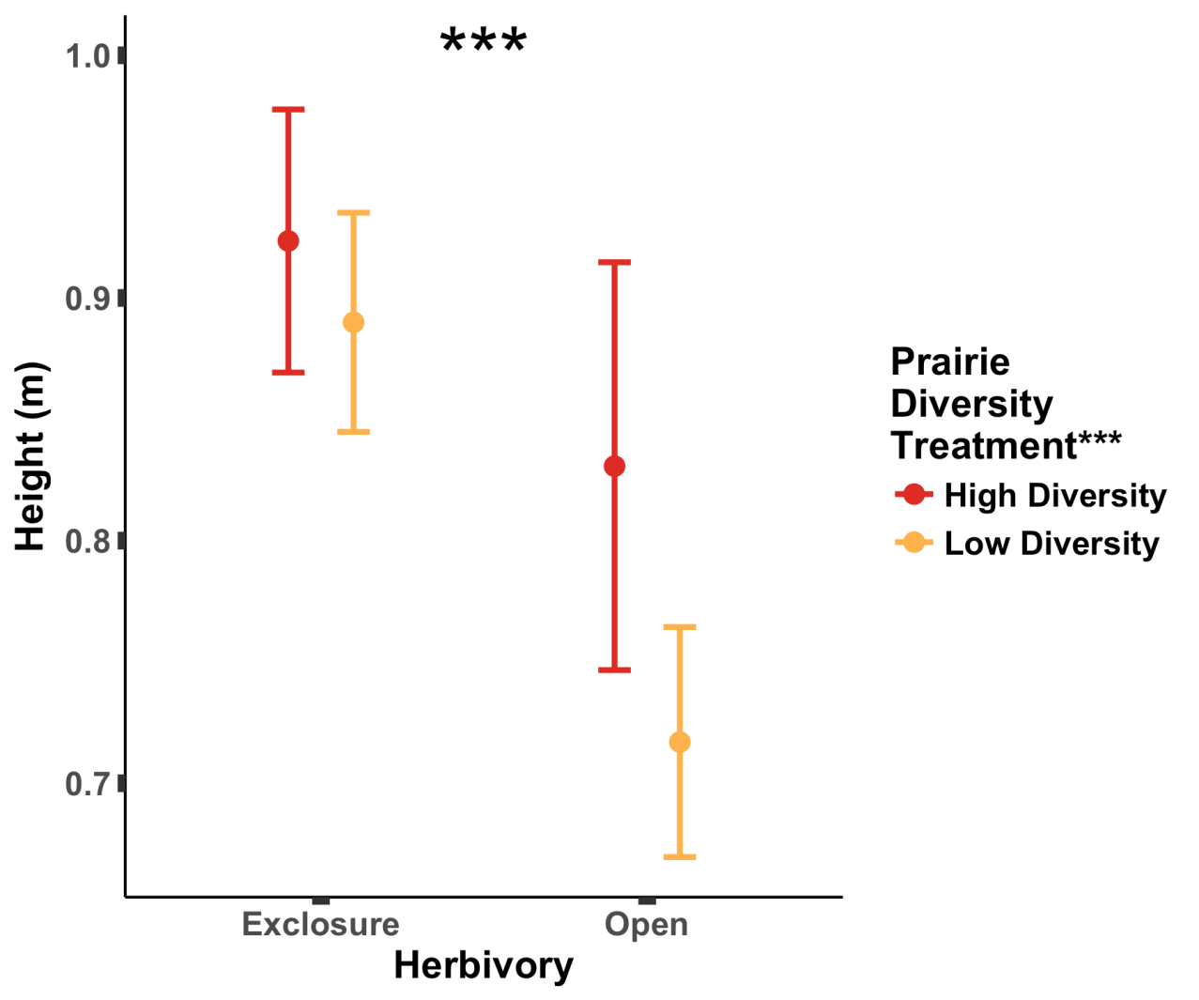
Treatment Affect on Overall Height
Height (m)

Slide 12
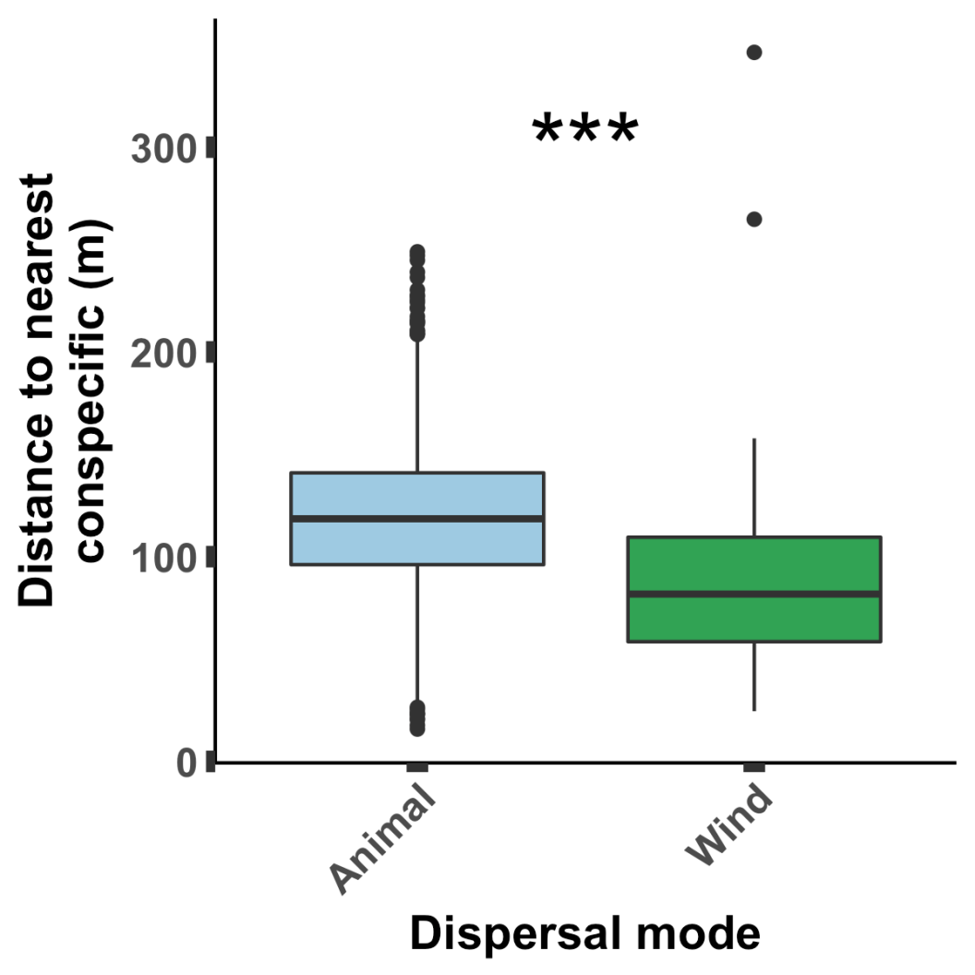
Effect of Dispersal Mode on Dispersal Distance
Distance to nearest conspecific (m)

Slide 13
Conclusions
Herbivory strongly limits woody encroachment.
Higher plant diversity may enhance encroachment.
Animals, likely birds, can enhance woody encroachment by dispersing seeds.

Slide 14
Acknowledgements
Thank you to Dr. Haldre Rogers, Brent Mortenson, Lauren Sullivan, Miranda Salsbery, Alex Karnish, Courtenay Ray, Ann Marie Gawel, Brittany Cavazos, and the Iowa Department of Transportation
.
Marshall McDaniel.
References
Ratajczak, Z., Nippert, J.B., Hartman, J.C., and Ocheltree, T.W. (2011). Positive feedbacks amplify rates of woody encroachment in mesic tallgrass prairie. Ecosphere, 2(11), 1-14. doi: 10.1890/ES11-00212.1
Iowa Association of Naturalists (2001). Iowa Prairies. Iowa’s Biological Communities Series.

Slide 15
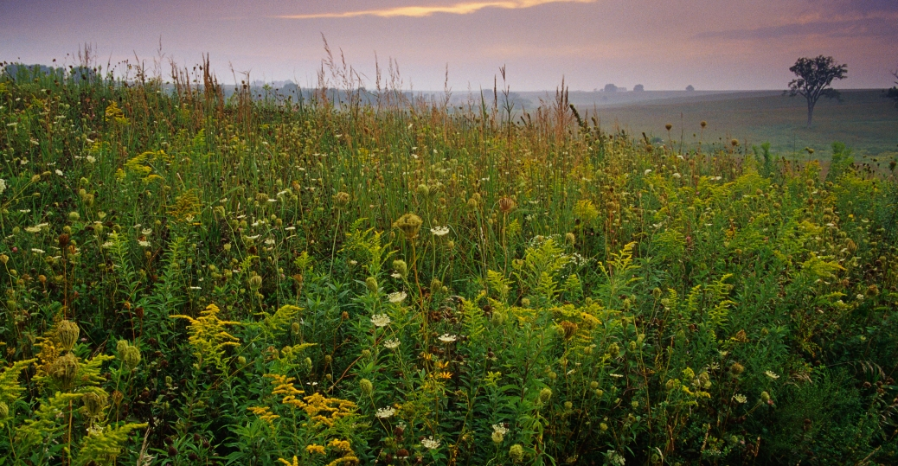
Questions?
History Channel

