Slide 1

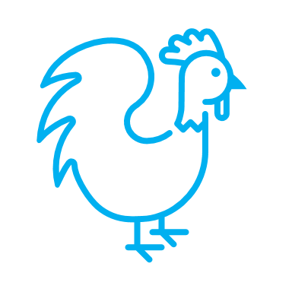


Prototype: "Pooper Picker Upper"
TSM 415 (section 1) By: Danielle (Abby) Espinosa-Gonzalez Bellolio, Corgan Davis, Morgan Ely, Benjamin Wozniak

Slide 2


Project Purpose
Design, manufacture and implement a prototype that improves:
      Cleanliness of chicken coop
      Ergonomic conditions of client by minimizing strain
      The process by making it quicker and more efficient.

Slide 3


Introduction
With the implementation of our prototype we seek to improve our clients tedious work conditions. Many farmers face the same problem with the help of our client and subject matter experts if this prototype proves to be a great success, we could help other small scale chicken farmers who may be facing similar difficulties using a shovel to clean.
This Photo by Unknown author is licensed under CC BY-SA.

Slide 4
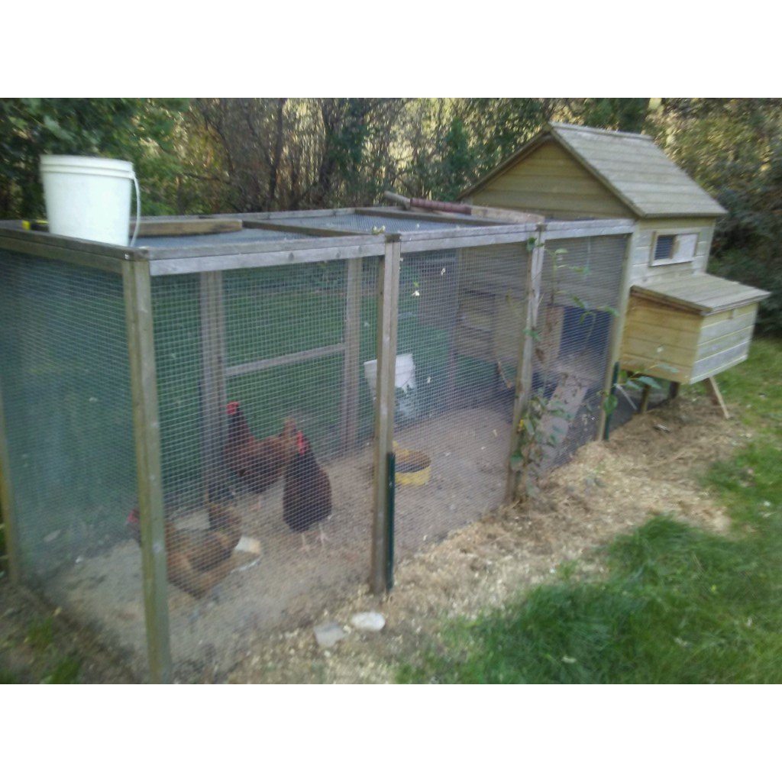
Opportunity
This machine will provide you with..
20% Reduction in cleaning time
Ergonomic improvement
Accessibility on small scale operations
Adjustability to relieve strain
Image above: Depicts problem area.

Slide 5

Solution
Our solution would be "the pooper picker-upper". This machine will alleviate the strains that come with cleaning the chicken coop as well as save you time.

Slide 6
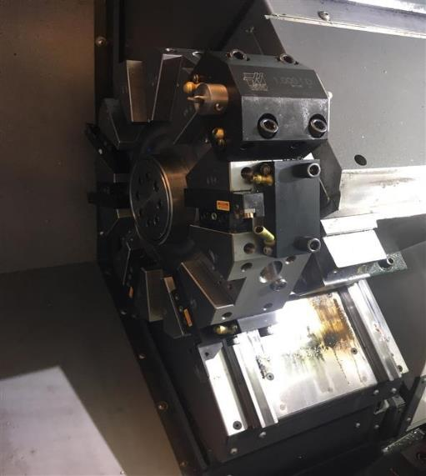
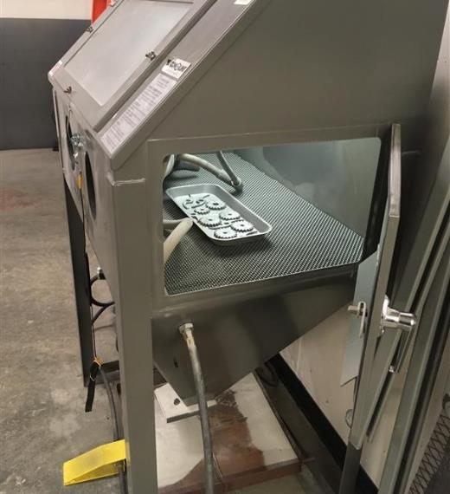
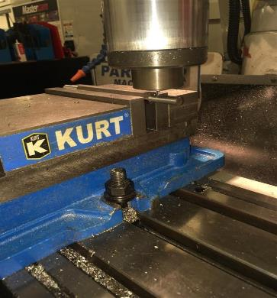
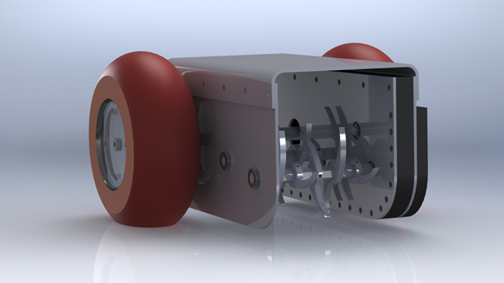
The Pooper Picker-Upper Design/Manufacturing

Slide 7
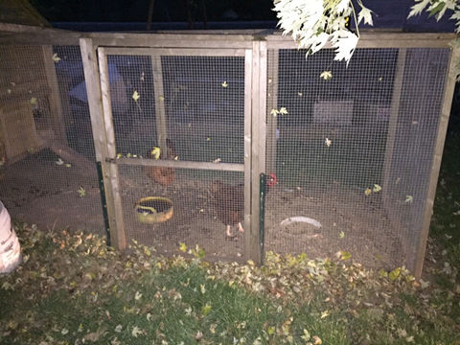
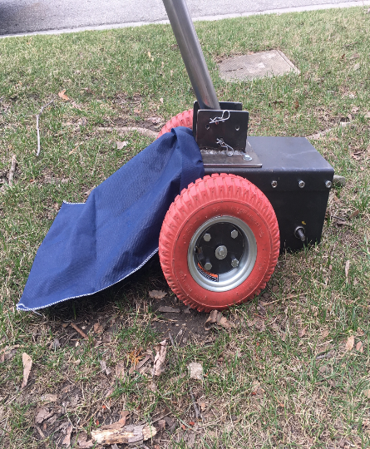
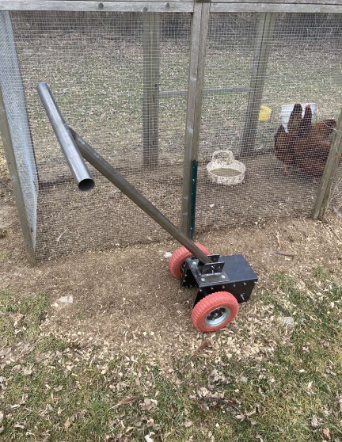
The Pooper Picker-Upper (Field Testing)

Slide 8
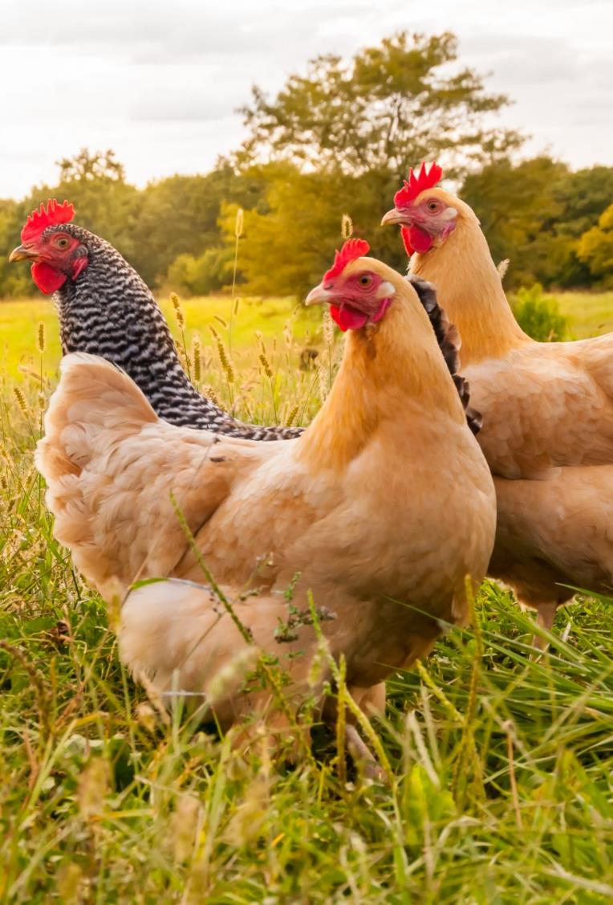
Project Benefits
A noticeable 33% decrease in time required to clean the coop.
A total average of 2 rating improvement on ergonomic survey.
Coop is visibly cleaner on photo log after prototype implementation.
Prototype proved to be efficient, durable and effective during field testing.

Slide 9
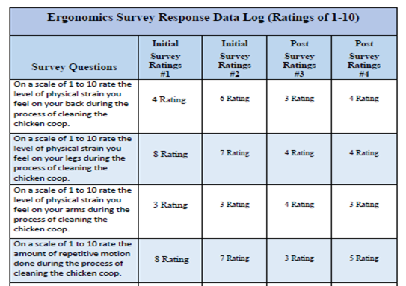
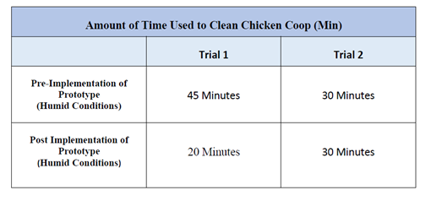
Evidence
(Image Above is the survey response data log used during field testing, which demonstrates notable ergonomic improvement by the user. )
(Second Image Above is the time log which demonstrates a notable time improvement by the user. )

Slide 10
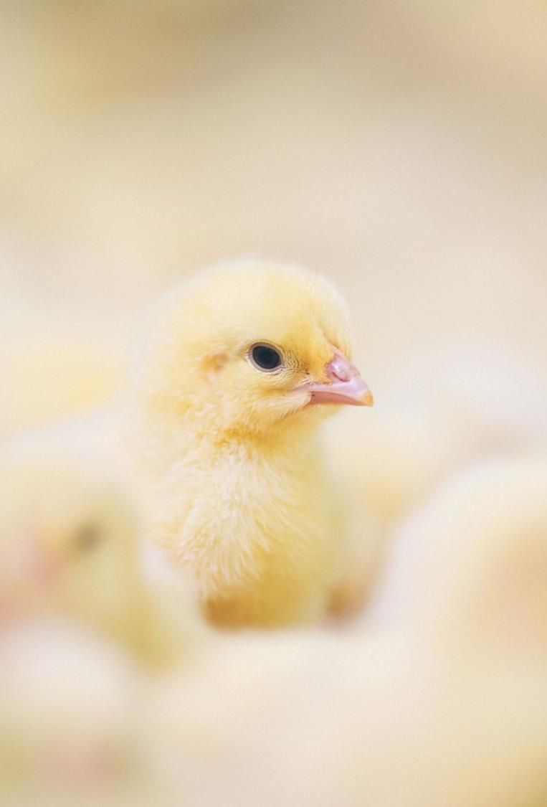
Action Steps
We proved that there was a 33% increase in time efficiency and an average 2- rating improvement per ergonomic survey question. We recommend that the client incorporate this prototype into his chicken coop cleaning routine in order to lessen his workload and improve his work conditions.

Slide 11
QUESTIONS

