Slide 1
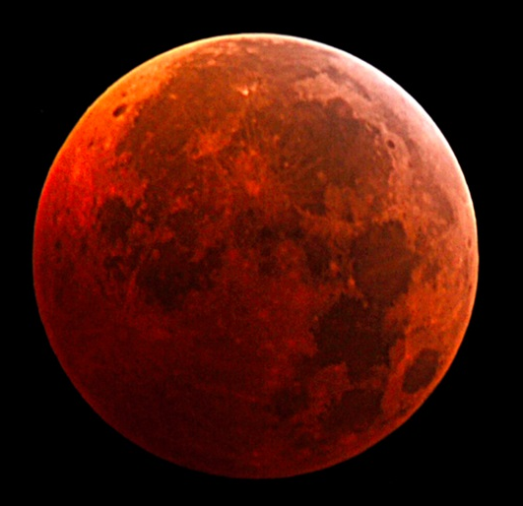
Growing Maize on Mars: Effects of Irradiation Induced Transposable Element Activity on Plant Survival and Development
Raegan Hoefler
Dr. Thomas Peterson
Iowa space grant consortium
Iowa State University
Research is supported by the NASA Iowa Space Grant under Award No. NNX16AL88H

Slide 2
Project Overview
Inspiration: The Martian
Hypothesis: Radiation will induce Transposable Element (TE) activity in maize
Significance: The results may indicate the feasibility of growing crops in space. Also, it may indicate the effects of increased radiation levels on Earth as the ozone layer depletes.
Prepare & sequence genomic DNA
Bioinformatic analysis
Determine
radiation
levels
Irradiate
Seedlings
Grow Seedlings
Research
Analyze for yield and kernel sector frequency
Grow out progeny
Notes:
We will discuss a little later how TE activity can actually affect plant growth. “Mobile” instead of moveable.

Slide 3
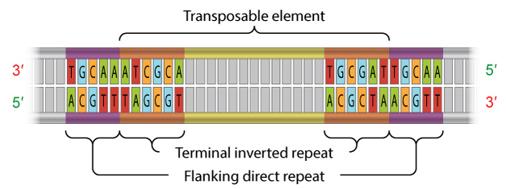

Transposable Elements (TEs)
Moveable elements in the genome
85% of maize genome
DNA Transposons
“cut and paste” mechanism
Why activated TEs can be problematic:
Structural Variation (SV)
Gene mutations
Chromosomal rearrangements
Gene relocations
http://www.nature.com/scitable/topicpage/transposons-the-jumping-genes-518
Notes:
**Most Tes are sleeping- can radiation wake these up?
**Potential outcome of activated Tes- can insert and mutate into genes and knockout genes
TIR = 9-40 basepairs
Sections of DNA that can move from one position to another
First discovered in maize, but have been found in many organisms
85% of maize genome is Tes
Could be deleterious if these got inserted into the wrong spots or took other DNA with them when they excise
Many ways these can rearrange: insertions, deletions, inversions…
Lead in to radiation- “Barbara McClintock proposed that stresses could activate these TE, and the stress in this case would be the radiation on Mars”
Talk about DNA TE and the mechanism by which they move

Slide 4
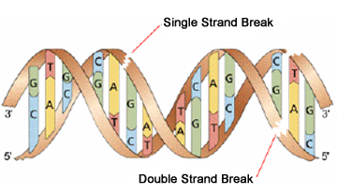
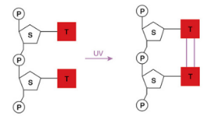
Radiation and DNA
Ionizing Radiation
Protons and X-rays
Induces double-stranded breaks in DNA
Lethal if not repaired
UV Radiation
Causes pyrimidine dimers
Dimers can interfere with replication and transcription
Notes:
Mars Science Laboratory’s Curiosity Rover
Measurements from August 7, 2012 to June 1, 2013
1 Martian year = 300 sol
1 sol = 24 hours and 39 minutes
Radiation environment is nothing like on Earth
Much harsher
Lack of magnetic field
Atmosphere width is less than 1% of Earth’s
Two types of ionizing radiation on Mars:
Galactic Cosmic Rays (GCRs)
Solar Energetic Particles (SEPs)
Very hard to re-create
How many days it takes to get 2 grays- not realistic, but wanted to get results
http://teachnuclear.ca/all-things-nuclear/radiation/biological-effects-of-radiation/effects-of-ionizing-radiation-on-dna/

Slide 5
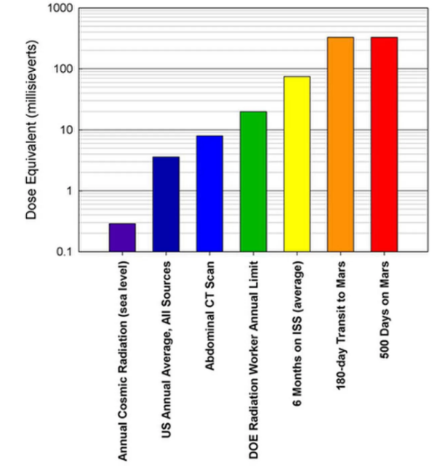
Radiation and My Project
Radiation on Mars | Equivalent on Earth | Radiation for our experiment | How it was Administered
GCR & SEPs* 0.530 mGy/day | None | X-rays 2 – 250 Gy | Linear Accelerator
UVB & UVC Daily fluence: 36.1 J/cm² | UVA & UVB Daily fluence: 3.9 J/cm² | UVC @ 254 nm 1500 µW/cm² 6.68 hours | Germicidal Lamp
* Galactic Cosmic Rays & Solar Energetic Particle; types of radiation events on Mars
Notes:
Human Equivalent Dose
1.6233 mSv
Lung CT Scan = 1.5 mSv
Exposure <16 min, do not exceed 1 J/cm²
50x more radiation on Mars
E
xposure <16 min, do not exceed 1 J/cm²
For UVA- If you received 1 J/cm2 every 16 minutes for a day, you would get 90 J/cm2.

Slide 6
Experiments and Results
Experiment | Dose | Results
A. | UV only: 36.1 J/cm² | Increased root growth
B. | UV: 36.1 J/cm² X-Ray: 50, 100, 150, 200, 250 Gy | 0% survival after 7 days for all doses
C. | UV: 36.1 J/cm² X-Ray: 25, 50, 75, 100, 150 Gy | 0% survival after 10 days for all doses
D. | UV: 36.1 J/cm² X-Ray: 2, 4, 6, 8, 10 Gy | Decrease in shoot growth for every increase in X-ray dosage 75% survival for dosage of 10 Gy, 100% survival for all other doses
E. | X-Ray only: 2, 4, 6, 8, 10 Gy | Decrease in shoot growth for plants which received doses 8 and 10 Gy 100% survival for all doses

Slide 7
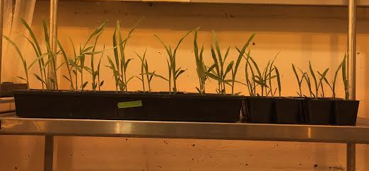

Average Shoot Height Each Day
*
Control 2 Gy 4Gy 6 Gy 8 Gy 10 Gy
* Significantly different from control at 0.05
Notes:
Average shoot height for plants each day

Slide 8
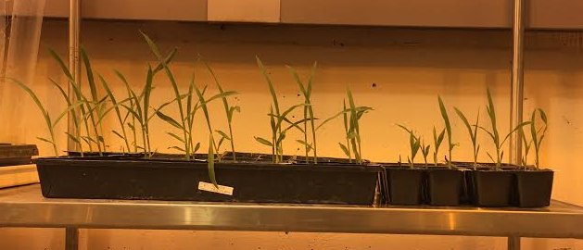
Average Shoot Height Each Day
^
Control 2 Gy 4Gy 6 Gy 8 Gy 10 Gy
* Significantly different from control at 0.05
^ Significantly different from UV + X-ray at 0.05

Slide 9
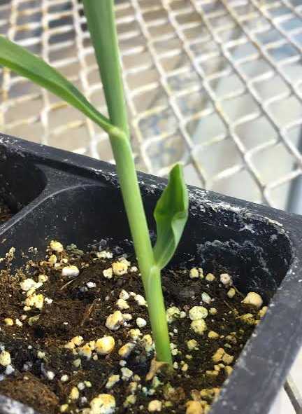
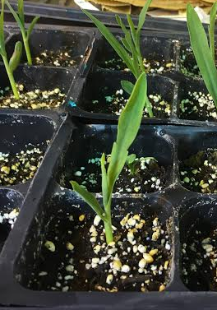
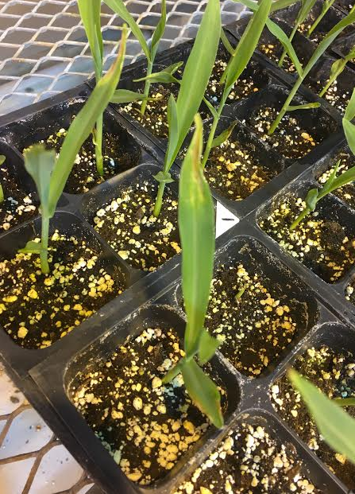
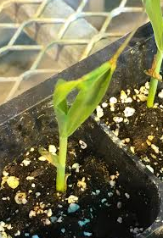
Effects of Radiation on Shoot Growth

Slide 10
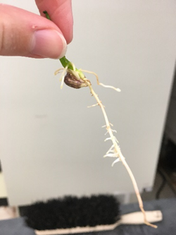
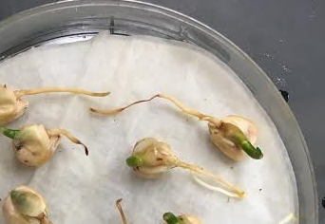
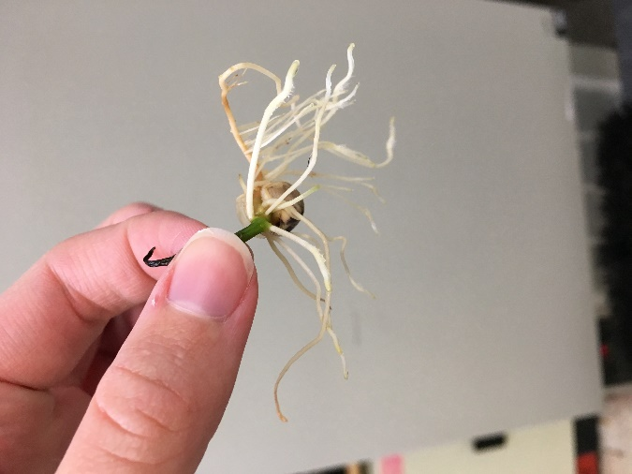
Effects of Radiation on Root Growth
UV only, Equivalent to 1 Martian Day
-4 days after IR

Slide 11
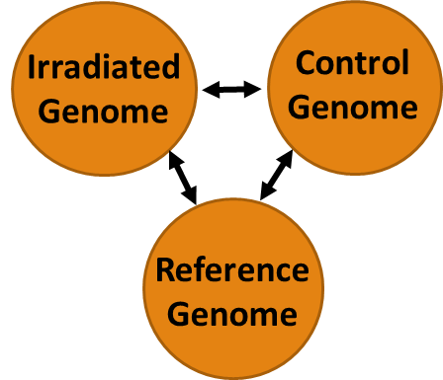
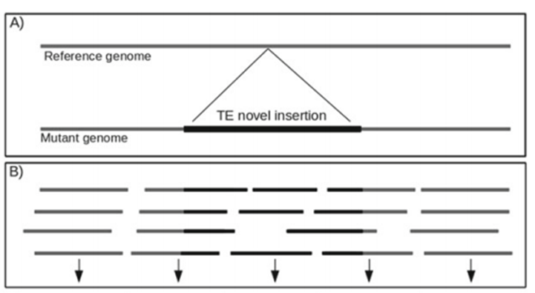
Detecting TEs using NGS
Maize Whole Genome Resequencing from BGI Americas
NGS- Next Generation Sequencing
2 samples: Control (non-irradiated) and Irradiated (36.1 J/cm2 UV and 2 Gy X-ray)
Genome size ~2500 Mb
Illumina X-ten Platform
Read Length: 150 PE
Coverage: 25x
Materials
Pipline – SearchTESV
Alignment tool- Bowtie
Reference Genome – b73
Sequencing Data – FASTQ files from BGI
TE Database- Maize Database
Notes:
2.5e+9

Slide 12


Acknowledgements
Iowa Space Grant Consortium
Iowa State University
Dr. Thomas Peterson, Principal Investigator
Terry Olson, Lab technician
Brian MacPhail, Medical Radiation Physicist
Weijia Su, PhD student
Sharu Paul Sharma, PhD student
Jeremy Schuster, Undergraduate student
Katherine Braught, Undergraduate student
Matthew Johnston, Undergraduate student

