Slide 1
”New” News:
The State of News Consumption and Helping Inform College Students
Keaton Mohr
Senior in Leadership Studies Program

Slide 2
Abstract
“This study looks into news consumption patterns of college students and how to adapt news dissemination practices to effectively reach out and inform college students. This research project will provide insight on how college students consume media and how they prefer to obtain news to be informed in the golden age of mobile technology. College students are turning away from traditional news platforms and turning to online and social media platforms (Pew Research Center, 2012). The findings will inform suggestions on how to tailor online news to fit the wants of college students, through a campus-wide survey at Iowa State University and analyzation of top news agencies using online platforms.”

Slide 3
Problem Defined
Shift from television news to online news, especially in ages 18-29 with a 27% increase (Pew Research Center, 2012)
College students have attributed their success to being able to access and use the internet (Pew Research Center, 2002)
News consumption patterns form during a student’s time in college (Barnhurst & Wartella, 1998)

Slide 4
Literature Review – News consumed
Younger generation is not switching to television news from newspapers, as previously predicted (Branhurst & Wartella, 1998; Pew Research Center, 2012)
1/3 of ages 18-29 watch television news, a 15% decline from 2006-2012 (Pew Research Center, 2012)
Most have used computers since 16-18, and many college students use laptops and smart phones for their education (Pew Research Center, 2002; Pearson, 2015)

Slide 5
Literature Review – Internet usage
College students skim the news periodically rather than daily and rely more on the Internet than traditional news outlets (Diddi & LaRose, 2006; Pew Research Center Research Center, 2002)
Students consume social media more than other age groups and internet usage was the top media consumed (Kromer, Schneider & Vorderer, 2016 )

Slide 6
Literature Review – Social media
College students consume news of interest to them or related to a past experience (Hider, Liu, Qayyum & Williamsom, 2014 )
Students have turned away from traditional news because of distrust in big businesses and turned to social media to share opinions (Hider, Liu, Qayyum & Williamsom, 2014; Loechner, 2009)

Slide 7
Literature Review – Uses & Gratifications
Assumes an audience actively uses mass media to satisfy their needs (University of Twente, 2017)
Students use social media to become connected but passively see news; news companies could be and are using this to their advantage (Brown, Rosengard & Tucker-McLaughlin, 2014)
Students are connecting more with local news through social media (Chen, Chock, Schweisberger, Wang, & Wolf, 2013)

Slide 8
Research Questions
What online platforms do they use to obtain news?
What online platforms do students trust and rely on?
How are news agencies using online platforms currently?

Slide 9
Methodology
First two questions
  Developed a survey of mostly quantitative questions, with some qualitative
  Questions about news consumption patterns and attitudes
Third question
  Analyzed current amenities news companies offered on top five social media platforms
    Facebook, Twitter, Instagram, Snapchat, Pinterest
  Analyzed followers and types of content

Slide 10
Data Collection
Qualtrics survey
  Sent to leadership studies students, fraternity brothers, coworkers, and additional friends
  Respondents all students
Social media websites
  Analyzed top four companies on top five social media platforms

Slide 11
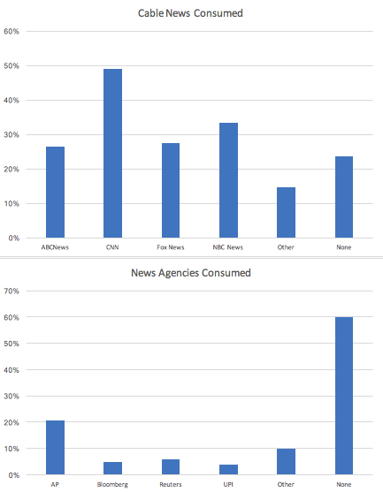
Consumption Data
CNN = most consumed cable news medium
AP = most consumed news agency medium
  More people do not consume news agency media

Slide 12
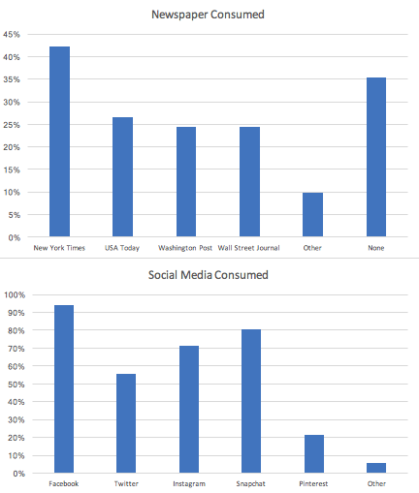
Consumption Data Cont.
New York Times = most consumed newspaper medium
Facebook = most accounts because…

Slide 13
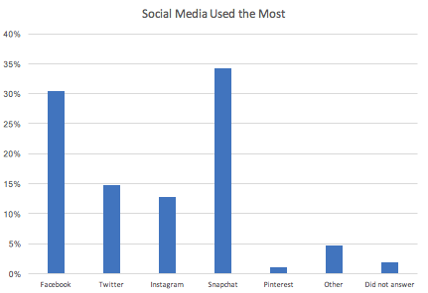

Slide 14
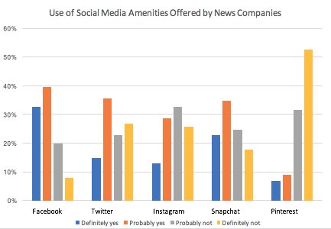

Slide 15
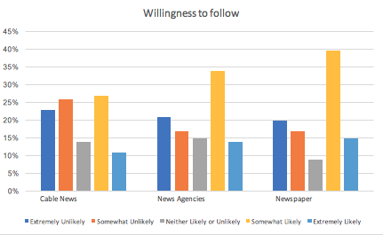

Slide 16
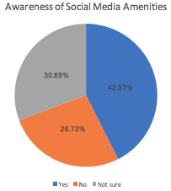
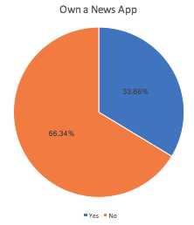
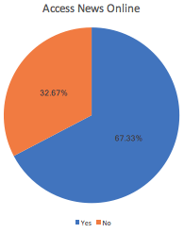

Slide 17
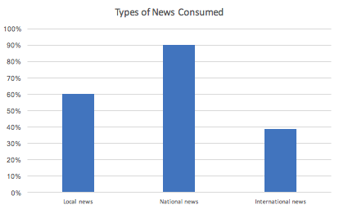
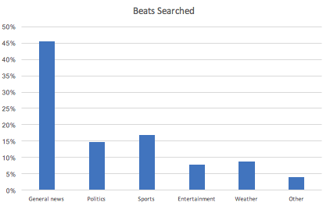
General news consumed the most
National news consumed the most

Slide 18
Facebook
Cable news
  CNN has the most page likes
  Uses more videos and live videos
News agencies
  Reuters has the most page likes
  Uses more articles tied to home website
Newspapers
  New York Times has most page likes
  Mirrors news agency content
Overall
  All cable news, Reuters and AP, and all newspapers but Wall Street Journal have multiple different side accounts that specialize in different beats
  All use pictures and videos but to varying degree

Slide 19
Twitter
Cable news
  CNN has most followers
  Use mostly videos and articles tied to the home website
News agencies
  Reuters has the most followers
  Mirrors content of cable news Twitter feeds
Newspapers
  New York Times has most followers
  Mirrors content of cable news and news agencies Twitter feeds
Overall
  All cable news, Reuters and AP, and all newspapers but Wall Street Journal have multiple different side accounts that specialize in different beats

Slide 20
Instagram
Cable news
  CNN has the most followers
  Pictures and videos with a short caption
    Fox News uses more words in the photos than the other companies
News agencies
  Reuters has the most followers
  More pictures with bigger captions and more hashtags
Newspapers
  New York Times has the most followers
  More photos about lifestyle and interests than general news
Overall
  All cable news, most news agencies and only one newspaper is a verified account.

Slide 21
Snapchat
Only two companies are on Snapchat
  CNN (Cable news)
  The Washington Post (Newspaper)
  Slide of pictures with captions explaining the news story
    Instrumental music in the background

Slide 22
Pinterest
ABC News, CNN, New York Times, The Washington Post, and Wall Street Journal have verified accounts. The other companies have unverified accounts.
Newspaper companies are more active
All companies utilize boards with pins that have certain topics
  Some are tied to articles on the home website, some are tied to articles to other websites

Slide 23
Conclusions
Students are consuming more cable news and newspapers than news agencies
More students are willing to engage with news on Facebook, Twitter, and Snapchat
More students are willing to follow newspapers on social media
More students engage with national news and access news online

Slide 24
Recommendations
Companies should become more active on Snapchat
Companies should be more focused on Facebook, Twitter, and Snapchat to reach out to the college generation
Pinterest is not the right place to engage students

Slide 25
Bibliography
Barnhurst, K. G. & Wartella, E. (1998). Young citizens, American TV newscasts and the collective memory. Critical Studies in Mass Communication, 15, 279–305.
Borkovich, D. & Breese-Vitelli, J. (2013). Mobile Technology Culture and Its Impact on College Students’ Local News Viewing Behavior. Issues in Information Systems, 406, 400-10.
Brown, T., Rosengard, D., & Tucker-McLaughlin, M. (2014). Students and Social News: How College Students Share News Through Social Media. Electronic News, 131, 120-137.
Chen, G., Chock, T., Schweisberger, V., Wang, Y., & Wolf, J. (2013). Social Media Features Attract College Students to News Websites. Newspaper Research Journal 34(4), 105, 96-108.
Communication Studies Theories. (2107). Uses and Gratifications Approach. University of Twente. Retrieved March 5, 2017 from https://www.utwente.nl/en/bms/communication-theories/sorted-by-cluster/Mass%20Media/Uses_and_Gratifications_Approach/
Diddi, A. & LaRose, R. (2006, June). Getting Hooked on News: Uses and Gratifications and the Formation of News Habits Among College Students in an Internet Environment. Journal of Broadcasting and Electronic Media 50(2), 205, 193-210.

Slide 26
Bibliography (Continued)
Duggan, M., Greenwood, S., & Perrin, A. (2016). Social Media Update 2016. Pew Research Center. Retrieve March 5, 2017 from http://www.pewinternet.org/2016/11/11/social-media-update-2016/
Gilliland, A., Jarvis, S., & Stroud, N. (2009, February). College Students, News Use, and Trust. Communication Research Papers 26(1), 37, 30-39.
Hider, P., Liu, Y., Qayyum, M., & Williamson, K. (2010, September). Investigating the News Seeking Patterns of Young Adults. Australian Academic and Research Libraries 41(3), 183-184, 178-191.
Kromer, N., Schneider, F., & Vorderer, P. (2016). Permanently online e Permanently connected: Explorations into university students’ use of social media and mobile smart devices. Computers in Human Behavior, 697-699, 694-703.
Loechner, J. (2009). Gender and Age Consumption Differs in Evolving Media Usage Patterns. Mediapost.com. Retrieved February 7, 2017 from http://www.mediapost.com/publications/article/115632/gender-and-age-consumption-differs-in-evolving-med.html

Slide 27
Bibliography (Continued 2)
Jones, S. et al. (2002, September 15). The internet Goes to College: How students are living in the future with today’s technology. Pew Internet and American Life. Retrieved February 6, 2017 from http://www.pewinternet.org/pdfs/PIP_College_Report.pdf.
Pew Research Center U.S. Politics and Policy. (2012, September 27). In Changing News Landscape, Even Television is Vulnerable: Trends in News Consumption: 1991-2012. Pew Research Center. Retrieved February 6, 2017 from http://www.people-press.org/2012/09/27/in-changing-news-landscape-even-television-is-vulnerable/.
Poll, H. (2015, June). Student Mobile Device Survey. National Report: College Students. Pearson Education. Retrieve February 7, 2017 from http://www.pearsoned.com/wp-content/uploads/2015-Pearson-Student-Mobile-Device-Survey-College.pdf.
Prybutok, V., Ryan, S., Wen, C., & Xu, C. (2012). It is not for fun: An examination of social network site usage. Faculty Research and Creative Activity, 11, Paper 7.
Yuan, E. (2011). News Consumption Across Multiple Media Platforms: A Repertoire Approach. Information, Communications and Society, 18, 998-1016.

